Slide 1
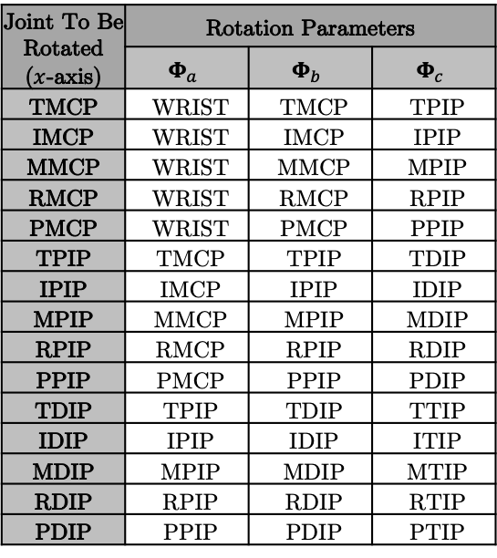
Joint To Be Rotated ($x$-axis) | Rotation Parameters
 | $$Φ_{a}$$ | $$Φ_{b}$$ | $$Φ_{c}$$
TMCP | WRIST | TMCP | TPIP
IMCP | WRIST | IMCP | IPIP
MMCP | WRIST | MMCP | MPIP
RMCP | WRIST | RMCP | RPIP
PMCP | WRIST | PMCP | PPIP
TPIP | TMCP | TPIP | TDIP
IPIP | IMCP | IPIP | IDIP
MPIP | MMCP | MPIP | MDIP
RPIP | RMCP | RPIP | RDIP
PPIP | PMCP | PPIP | PDIP
TDIP | TPIP | TDIP | TTIP
IDIP | IPIP | IDIP | ITIP
MDIP | MPIP | MDIP | MTIP
RDIP | RPIP | RDIP | RTIP
PDIP | PPIP | PDIP | PTIP

