Slide 1
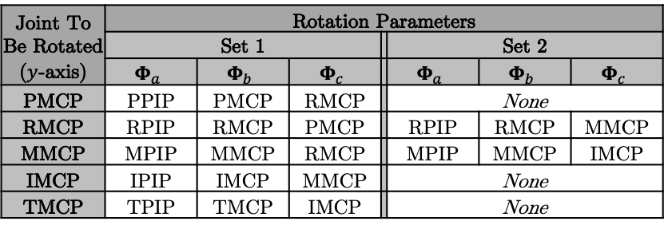
Joint To Be Rotated ($y$-axis) | Rotation Parameters
 | Set 1 |  |  |  | Set 2
 | $$Φ_{a}$$ | $$Φ_{b}$$ | $$Φ_{c}$$ |  | $$Φ_{a}$$ | $$Φ_{b}$$ | $$Φ_{c}$$
PMCP | PPIP | PMCP | RMCP |  | None
RMCP | RPIP | RMCP | PMCP |  | RPIP | RMCP | MMCP
MMCP | MPIP | MMCP | RMCP |  | MPIP | MMCP | IMCP
IMCP | IPIP | IMCP | MMCP |  | None
TMCP | TPIP | TMCP | IMCP |  | None

