Slide 1
Decoding a Game’s DNA
Evaluating Game Potential through Retention Metrics
Daniel Duhnev | August 2025

Slide 2
Introduction
Need to understand a Game’s DNA
Review of retention rate metric and why it matters
Determine which game has the most potential for success
Background
Objective
Goal
Notes:
Brief overview of the task
What is game DNA and why retention matters:
- What is Game DNA?
Game DNA is the unique pattern of how players engage with a game in the first few minutes. It shows the game’s ability to capture player interest early on.
- Why Retention Matters:
Retention tells us how many players come back after their first session. Higher retention means the game is enjoyable and keeps players engaged, which is key for its success.
Goal: Identify which game has the highest success potential

Slide 3
Methodology
Dataset: 40,000 unique users (10,000 per game)
Key Metrics:
Playtime: Minutes played in first session
Retention: If user returned (Yes/No)
Goal: Identify which of 4 games shows strongest success potential
Notes:
Description of the dataset (users, games, retention, playtime)
Key metrics used (retention rate, playtime)
Retention Rate – What percentage of players come back after their first session of playtime
Playtime – How many minutes did each player spent on the game during their first session
How retention is calculated

Slide 4
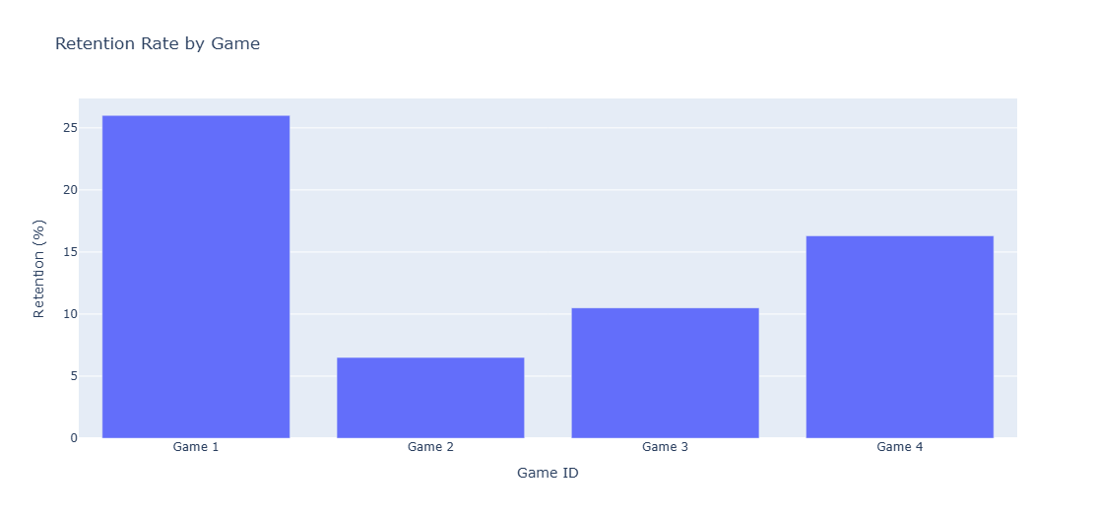
Retention Analysis by Game
Notes:
Bar chart showing average retention per game
Interpretation: Which game performs best and why retention is important

Slide 5
Retention Analysis by Game
Game 1 with highest retention rate of 26%
10% higher than second-place game
Over 1 in 4 players returned to Game 1
Shows strong engagement capturing players interest early

Slide 6
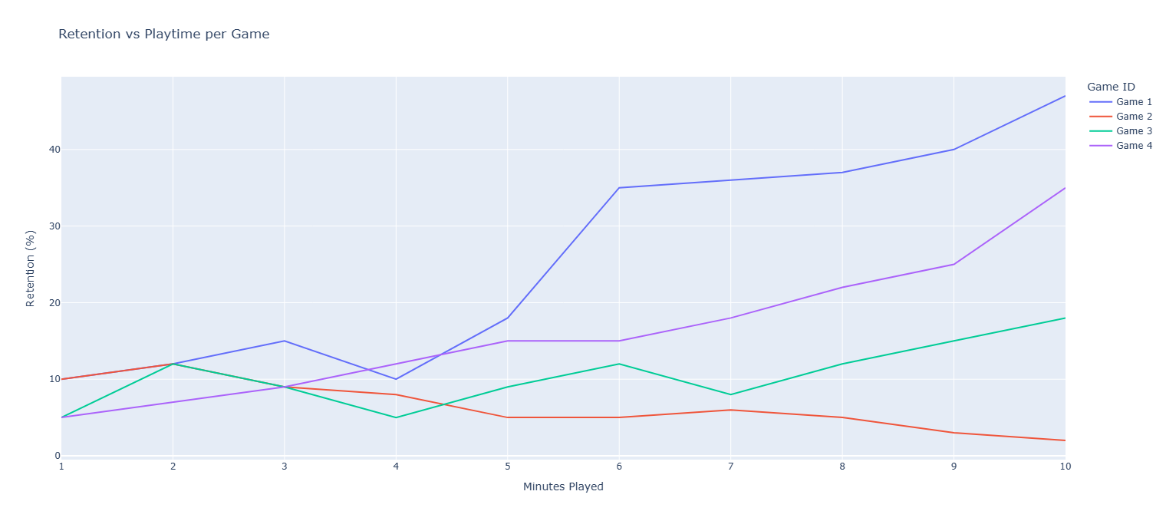
DNA Retention Curves
Notes:
Minute-by-minute retention curves per game
Explanation of what the curves reveal about player engagement and potential
Identify “strong DNA” vs “wormholes” (retention drops)

Slide 7
DNA Retention Curves
Game 1 again shows highest potential
Has the strongest DNA with the steepest retention curve
Can engage players well, especially from the 5th minute of gametime onwards

Slide 8
Discussion
Game 1 shows strongest retention and growth potential
It stands out with:
The highest overall retention rate at 26%
The steepest retention curve with retention increasing the most with playtime
Notes:
Summary of findings
Which game shows the highest potential based on DNA analysis
Intuition behind the results (why the leading game stands out)
Next steps or suggested focus areas for the team

Slide 9
Limitations
Small data sample
Limited context
10k installs per game
>40k installs for robust conclusions
No information on lifecycle
Important for determining ROI
Based on Aleksandr Enin’s Article “How do you evaluate a mobile game's profit potential?”
Notes:
Summary of findings
Which game shows the highest potential based on DNA analysis
Intuition behind the results (why the leading game stands out)

Slide 10
Conclusion and Next Steps
Game 1 clearest winner with highest potential for success
Shows strong DNA with best early engagement
More data collection and consideration of factors such as game lifecycle required before further investment

Slide 11
Thank you!
Daniel Duhnev | daniduhnev@gmail.com

