Slide 1

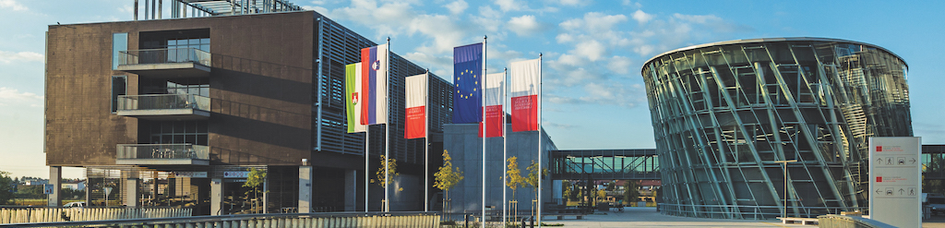


Master's Thesis Defense · 16 July 2026 · Universitat Pompeu Fabra
Non-invasive Detection of Pancreas Graft Rejection
Comparing Automated Texture Analysis with Clinical Ultrasound Biomarkers
Daniel Duhnev
EMAI 2024-2026 | Supervisor: Gemma Piella (UPF)
Notes:
Good morning. Thank you for being here. My name is Daniel Duhnev and this is my master's thesis for the EMAI programme, supervised by Gemma Piella. The title is 'Non-invasive Detection of Pancreas Graft Rejection'. In the next twenty minutes or so I will show how I tested whether radiomics texture features from ordinary grayscale ultrasound can detect pancreas transplant rejection, and compare that against the clinical ultrasound biomarkers used at Hospital Clinic Barcelona. I'll walk through the motivation, the methods, the results, and what I conclude. Take a breath, speak slowly, and remember: this is a clean, honest negative result with a working positive control - that is a strong scientific story.

Slide 2
Outline
• 1. Motivation — pancreas transplant rejection and why we need a non-invasive test
• 2. Data & Methods — dataset, preprocessing, radiomics, statistics, machine learning
• 3. Results — radiomics vs. rejection, and a clinical-biomarker positive control
• 4. Conclusions — what the negative result means, limitations, and future work
Notes:
Here is the roadmap. First I motivate the clinical problem - what pancreas rejection is and why biopsy is a problem. Then the data and the full analysis pipeline. Then the results, which are the heart of the talk, including an important positive control. And finally what it all means. I'll keep the methods tight so we have time on results and discussion, which is where your questions will probably focus.

Slide 3
Clinical Background: Pancreas Transplant Rejection
• Pancreas transplantation can restore normal blood-sugar control in type 1 diabetes
• Graft rejection is a common, serious complication that threatens the transplant
• Reference standard for diagnosis is percutaneous biopsy
– invasive, carries risk of complications
– sampling error, delayed results, costly
• Not performed routinely — clinicians need a non-invasive alternative
Notes:
Pancreas transplantation is a treatment for type 1 diabetes - a working graft can restore normal glucose control and free the patient from insulin. But the immune system can attack the graft: that's rejection, and it's a leading cause of graft loss. To confirm rejection today, the reference standard is a percutaneous needle biopsy. That's invasive - it carries a real risk of bleeding and other complications, it can miss the affected region because it samples only a small piece of tissue, results take time, and it's expensive. Because of these downsides biopsy is not done routinely. So there is a clear clinical need for a non-invasive way to monitor the graft. That need is the motivation for this whole thesis.

Slide 4
The Opportunity: Non-invasive Ultrasound
• Ultrasound is cheap, fast, bedside, and radiation-free
• Specialised US biomarkers already discriminate rejection (Bassaganyas et al., 2025):
– ARFI elastography — tissue stiffness
– DCE-US — contrast-enhanced perfusion
• But these need special acquisition protocols and manual measurement
• Research gap: can automated texture analysis of ordinary grayscale US do the same?
Notes:
Ultrasound is an attractive starting point: it's inexpensive, quick, done at the bedside, and uses no ionising radiation. And we know ultrasound CAN see rejection - recent work by Bassaganyas and colleagues at Hospital Clinic, published in 2025, showed that two specialised ultrasound biomarkers discriminate rejection in the late period after transplant: ARFI elastography, which measures tissue stiffness, and dynamic contrast-enhanced ultrasound, which measures perfusion. The catch is that both require special acquisition protocols, extra equipment or contrast agent, and manual measurement by an expert. That sets up my research gap: could we instead use radiomics - fully automated texture analysis - on the plain grayscale B-mode images that are captured in every routine scan? If that worked, it would be essentially free and scalable.

Slide 5
Research Question & Objectives
• Can radiomics texture features from grayscale ultrasound predict pancreas rejection?
• 1. Extract standardised radiomics features from the graft region
• 2. Test whether individual features discriminate rejection (statistics)
• 3. Build and evaluate machine-learning classifiers
• 4. Reproduce the clinical-biomarker analysis (ARFI / DCE-US) as a control
• 5. Compare automated radiomics against manual clinical biomarkers
Notes:
This is the central question of the thesis: can radiomics features from grayscale ultrasound predict rejection? I broke it into five concrete objectives. One - build a pipeline to extract standardised texture features from the graft. Two - test each feature individually with statistics. Three - go multivariate and build machine-learning classifiers. Four - and this is crucial - reproduce the known clinical-biomarker result on the same cohort, as a positive control to prove my pipeline works. Five - directly compare the automated radiomics against the manual clinical biomarkers. Keep these five in mind; my conclusions map straight back onto them.

Slide 6
Dataset
• 137 ultrasound studies from 55 patients (Hospital Clinic Barcelona)
• 39 studies with clinically diagnosed rejection (27 biopsy-confirmed)
• 98 studies with no rejection → class balance ~ 72 : 28
• Many patients have several studies over time (repeated measures)
– Naively pooling all 137 would violate independence and inflate significance
• Primary analysis uses one study per patient — an independent dataset of 55
Notes:
The data comes from Hospital Clinic Barcelona: 137 grayscale ultrasound studies from 55 transplant patients. Of those, 39 studies had clinically diagnosed rejection - and 27 of those 39 were confirmed by biopsy; the rest were clinical diagnoses, because as I said biopsy isn't routine. The remaining 98 studies had no rejection, so the classes are imbalanced, roughly 72 to 28. One important subtlety: many patients contributed several scans over time. If I just pooled all 137 studies as if they were independent, I'd be double-counting patients and that artificially inflates statistical significance - it's a repeated-measures problem. So my primary analysis takes just one study per patient, giving a clean independent dataset of 55. The full 137 is kept only as an exploratory supplement in the appendix. If a committee member asks 'why 55 and not 137', this is the answer - statistical independence.

Slide 7
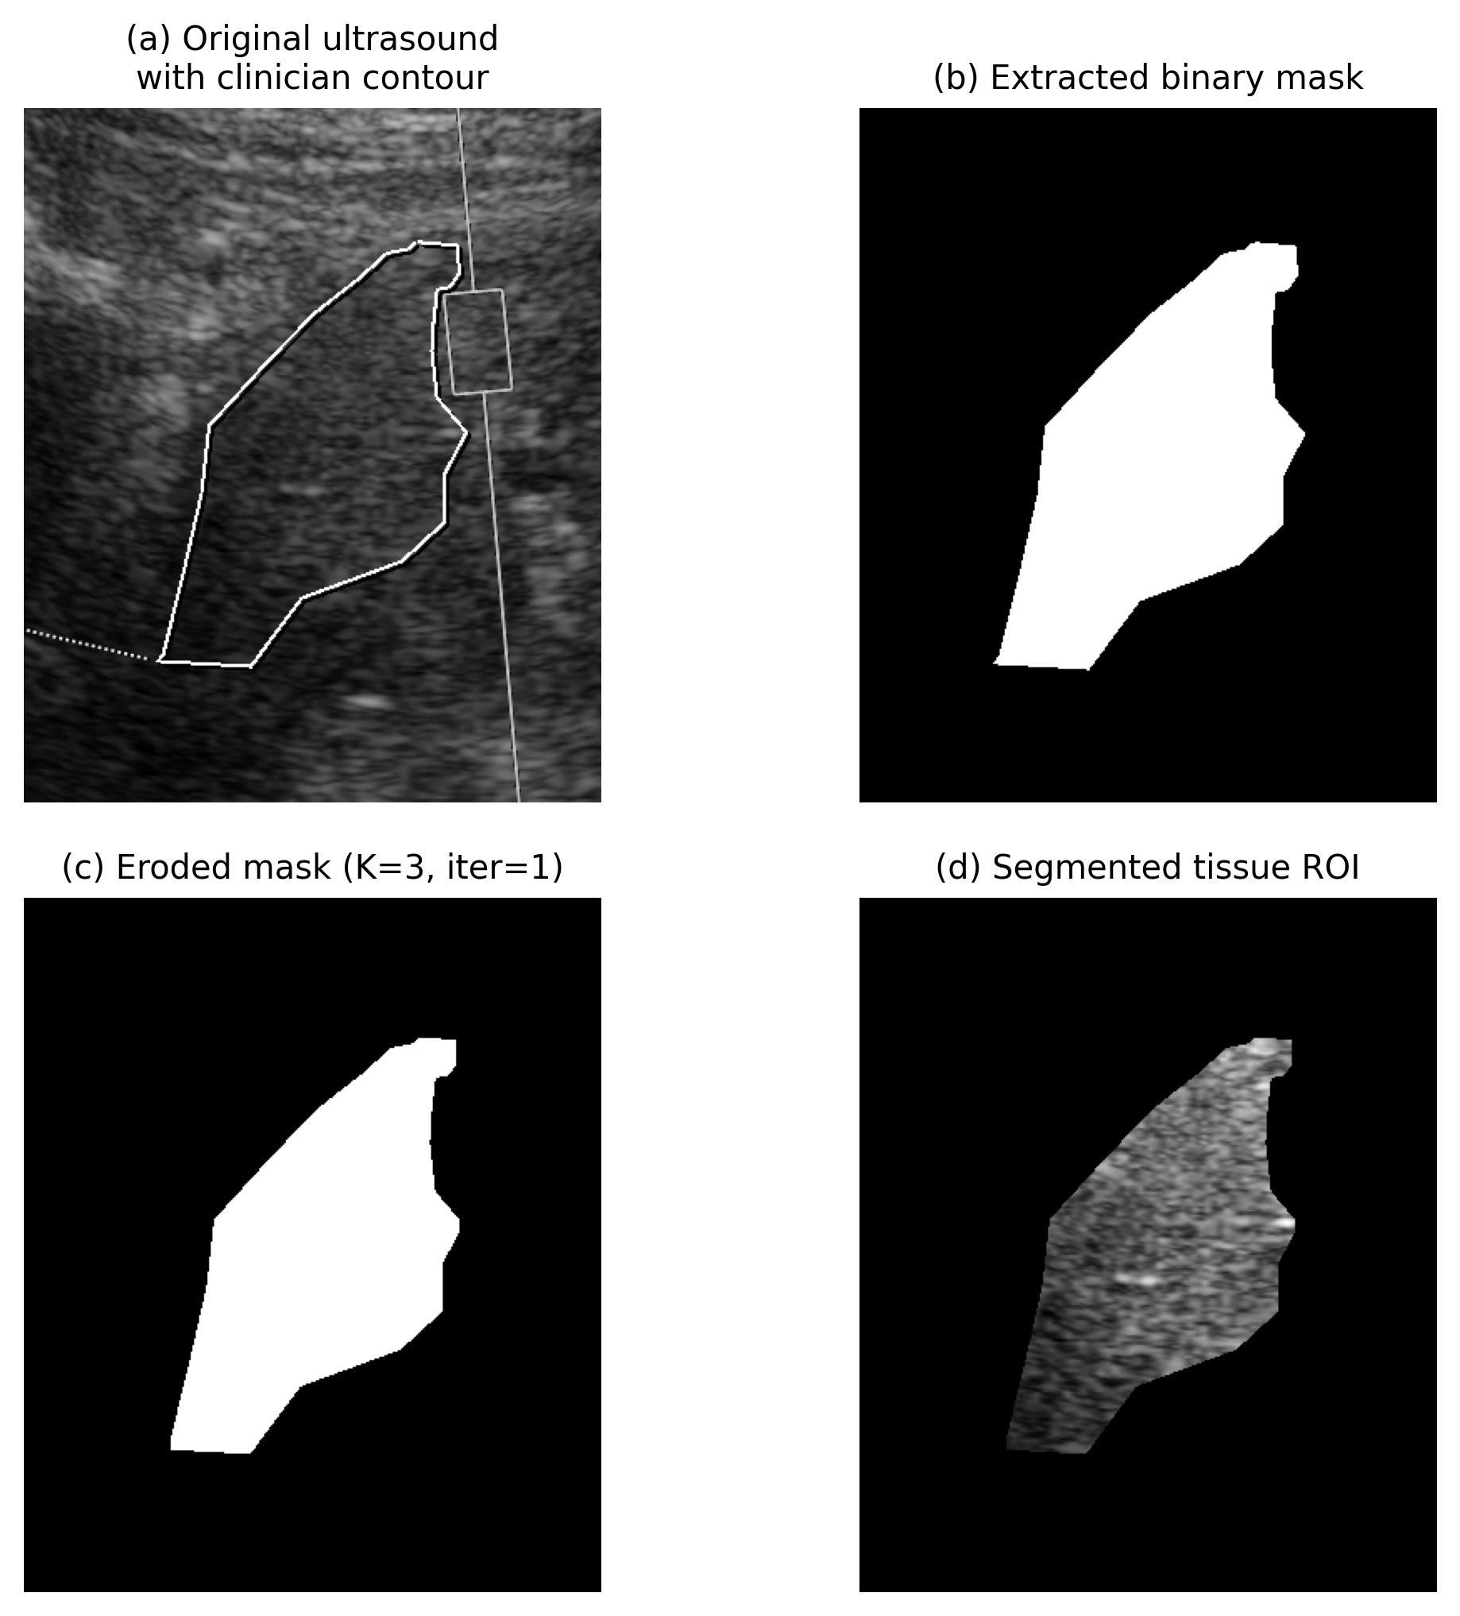
Preprocessing: Isolating the Graft
• Start from clinician-annotated grayscale US (contour drawn around graft)
• Remove the annotation contour, then erode the mask (kernel 3, 1 iter)
– erosion pulls the ROI away from the bright boundary
• Result: a clean graft-only region of interest for feature extraction
Preprocessing pipeline: annotation → contour removal → mask erosion → graft ROI
Notes:
Before extracting any features I had to isolate the graft tissue itself. The clinicians had drawn a contour around the pancreas graft on each image. I remove that drawn contour line - otherwise the bright annotation would contaminate the texture - and then I erode the mask inward by a small amount, a 3-by-3 kernel for one iteration. Eroding pulls the region of interest away from the bright edge of the graft so I'm measuring genuine internal tissue texture, not the boundary. The output, shown on the right, is a clean graft-only region that goes into feature extraction. I tested different erosion kernels and this was a reasonable, conservative choice.

Slide 8
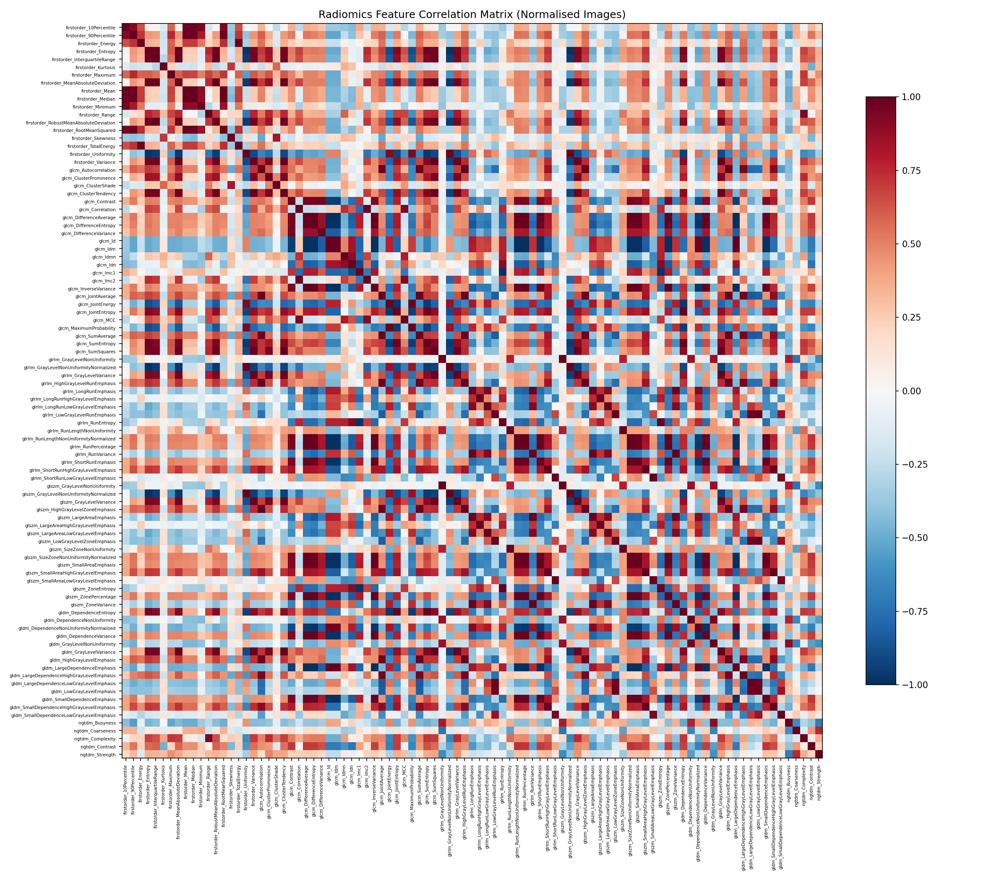
Radiomics Feature Extraction
• PyRadiomics — IBSI-compliant, reproducible extraction
• 93 features across 6 families:
– First-order intensity; GLCM, GLRLM, GLSZM, GLDM, NGTDM (texture)
• Per-image z-score normalisation to control for gain / depth differences
• Radiomics turns each graft image into a 93-number texture fingerprint
Feature correlation structure (many features are redundant)
Notes:
For the features I used PyRadiomics, a standard, IBSI-compliant library, so the extraction is reproducible and comparable with other studies. From each graft region it computes 93 features in six families: first-order intensity statistics, and five texture families - GLCM, GLRLM, GLSZM, GLDM and NGTDM - which capture spatial patterns like coarseness, homogeneity and contrast. Because ultrasound brightness depends on machine settings like gain and depth, I applied per-image z-score normalisation so I'm comparing texture, not scanner settings; this normalised pipeline is the canonical one in the thesis. The heatmap on the right shows the features are highly correlated - many are redundant - which matters for the machine learning step. In short, each image becomes a 93-number fingerprint of its texture.

Slide 9
Statistical Methodology
• Compare each feature between rejection vs. no-rejection groups
• Shapiro-Wilk normality test → choose the right test:
– Welch's t-test (normal) or Mann-Whitney U (non-normal)
• Benjamini-Hochberg FDR correction for 93 simultaneous tests
• Report effect sizes (rank-biserial / Cohen's d), not just p-values
Notes:
The first analysis is univariate: for each of the 93 features, does it differ between the rejection and no-rejection groups? For each feature I first run a Shapiro-Wilk test to check normality, and based on that I pick the appropriate test - Welch's t-test if it's roughly normal, Mann-Whitney U if not. Because I'm running 93 tests at once, some will look significant by chance, so I apply Benjamini-Hochberg false-discovery-rate correction. And I always report effect sizes, not just p-values, because with a modest sample a p-value alone can mislead. This is textbook, defensible methodology - and it's exactly the same pipeline I later apply to the clinical biomarkers as my control.

Slide 10
Machine-Learning Methodology
• Correlation filter (|r| > 0.9) reduces 93 → 27 features
• Pipeline: StandardScaler → SelectKBest (ANOVA-F) → classifier
• Four models: Logistic Regression, Random Forest, SVM, Naive Bayes
• Joint hyper-parameter + feature-count tuning via GridSearchCV
• Evaluated with stratified k-fold + LOOCV; bootstrap 95% CIs
Notes:
Individual features might miss a signal that only appears when features are combined, so next I built classifiers. First I remove redundancy: if two features correlate above 0.9 I drop one, which takes 93 down to 27. Then everything sits inside a scikit-learn pipeline - scaling, then SelectKBest with ANOVA F to pick the best k features, then the classifier - and crucially the whole pipeline is fit inside cross-validation so there's no information leakage from the test fold. I tried four classifiers: logistic regression, random forest, SVM and naive Bayes, and I jointly tuned both the hyper-parameters and the number of features k using grid search. I evaluated with stratified k-fold and leave-one-out cross-validation, and I put bootstrap 95% confidence intervals on the AUCs so we can see whether performance is really above chance. If asked about leakage: feature selection is inside the CV loop, so it's clean.

Slide 11
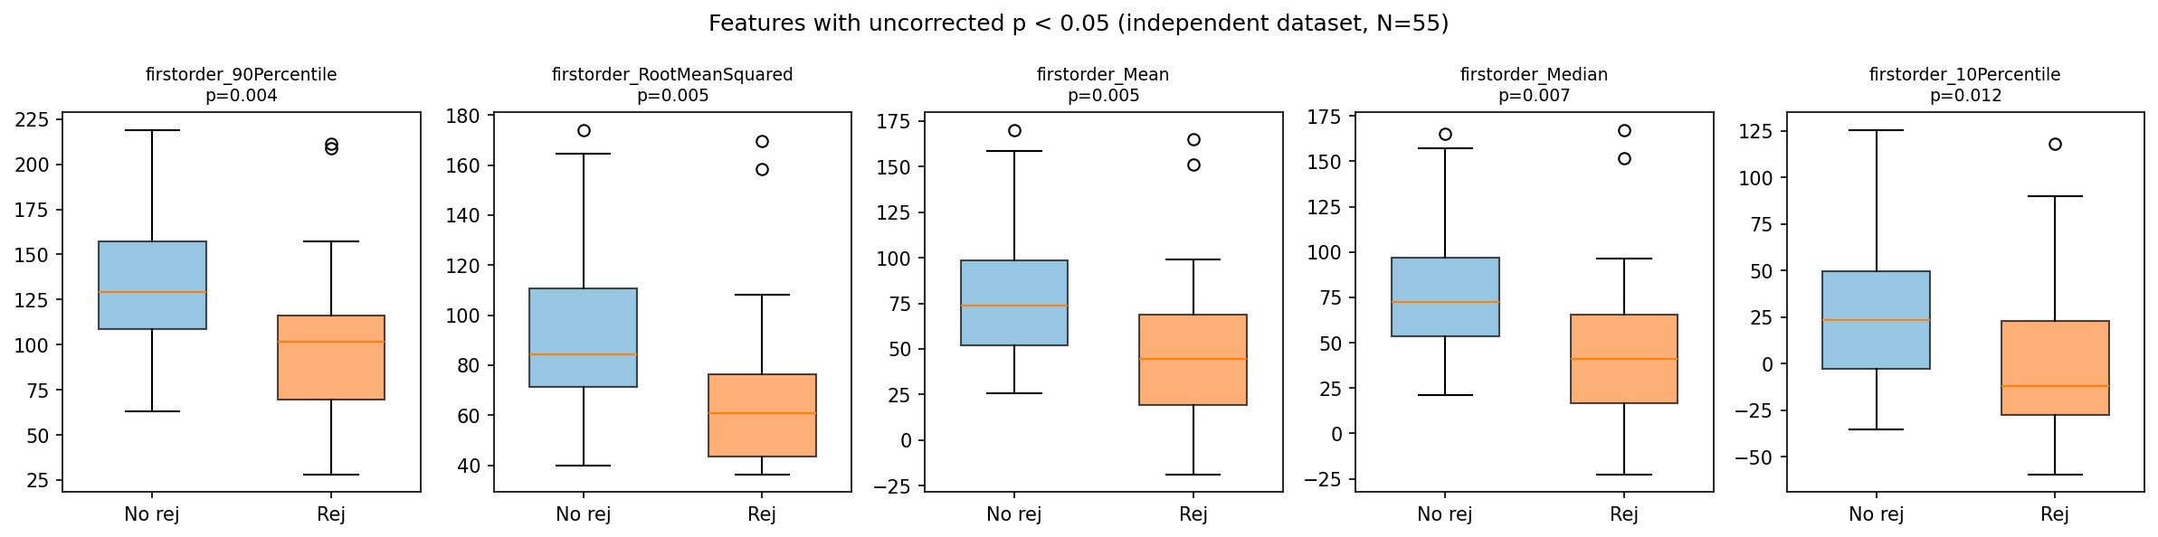
Result 1 — No Radiomics Feature Discriminates Rejection
• 0 of 93 features significant after FDR correction
• A few raw p-values dip below 0.05, but none survive correction; small effect sizes
• Distributions overlap heavily — holds on both independent (55) and full (137) datasets
Top features: rejection vs. no-rejection distributions overlap
Notes:
Here's the first main result, and it's a clean null. After false-discovery-rate correction, zero of the 93 radiomics features significantly discriminate rejection. A handful of raw p-values dip under 0.05 - which is exactly what you'd expect by chance out of 93 tests - but none of them survive correction. The effect sizes are small and, as you can see in the boxplots on the right, the rejection and no-rejection distributions sit right on top of each other. And this isn't a quirk of the smaller dataset: the same null holds whether I use the independent 55 or the full 137. So at the single-feature level, grayscale texture shows no signal for rejection.

Slide 12
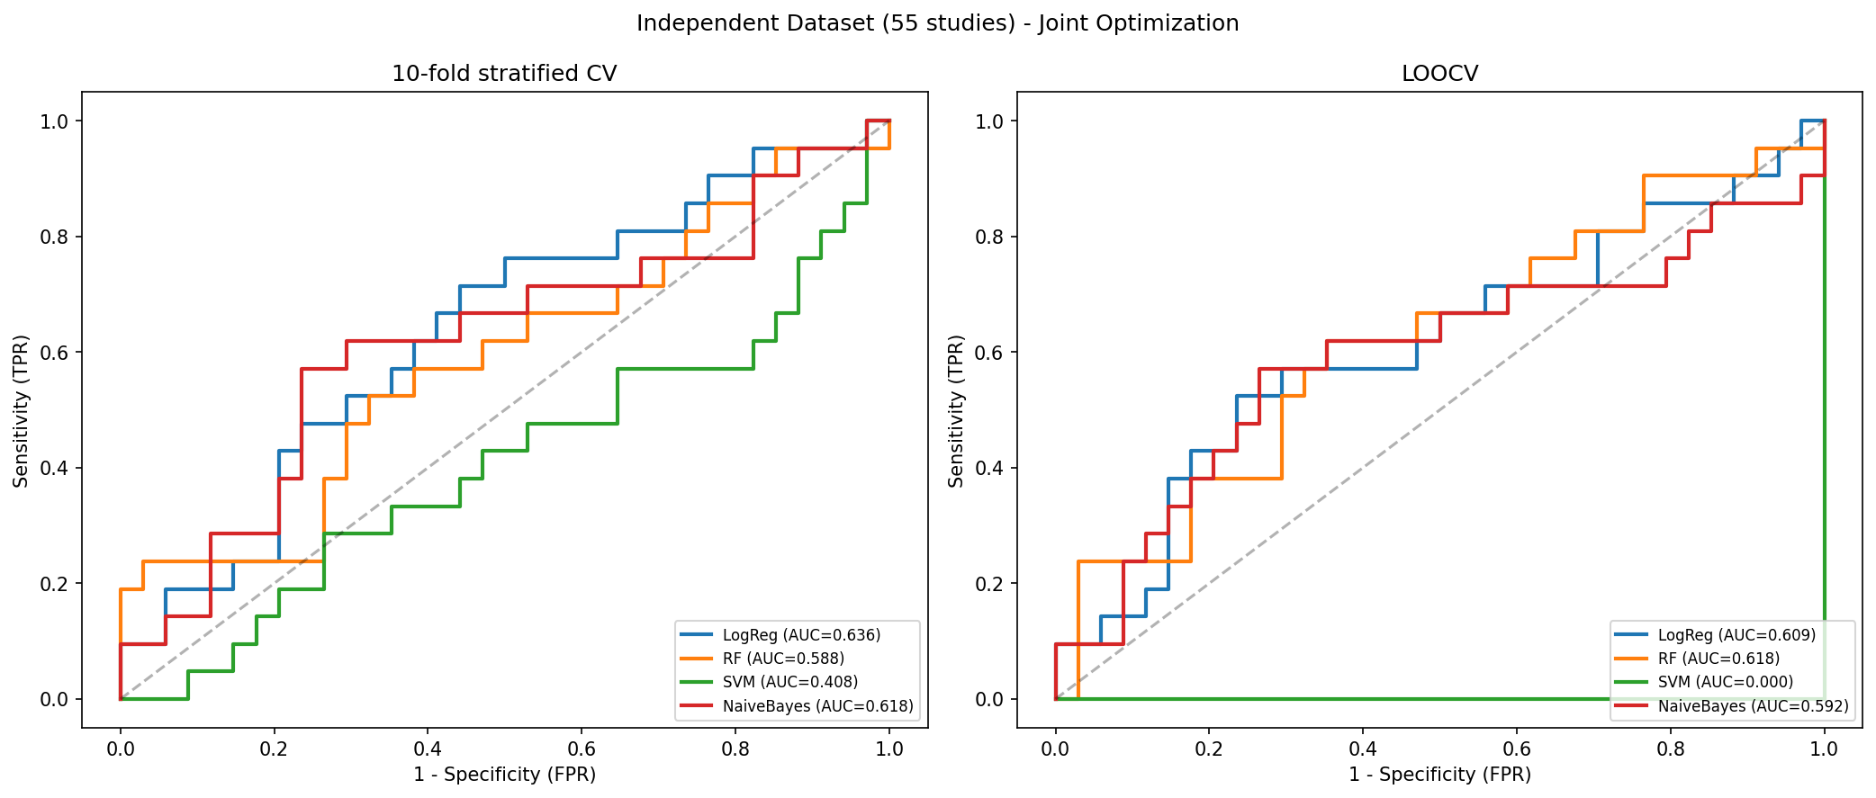
Result 2 — Classifiers Perform at Chance
• Best model (Logistic Regression): AUC 0.636, 95% CI [0.48, 0.78]
• The confidence interval crosses 0.5 — indistinguishable from chance
• Other models similar or worse (RF 0.59, NB 0.62, SVM 0.41)
• No multivariate combination of features recovers a signal
ROC — independent dataset; curves hug the diagonal
Notes:
Machine learning tells the same story. The best classifier was logistic regression, with a cross-validated AUC of 0.636. But look at the confidence interval: 0.48 to 0.78. It crosses 0.5, which means we cannot distinguish it from random guessing. The other models were similar or worse - random forest 0.59, naive Bayes 0.62, and SVM actually below chance at 0.41, which is a sign it just latched onto the majority class. On the ROC plot the curves hug the diagonal. So combining features multivariately does not rescue a signal that wasn't there univariately. At this point a natural worry is: maybe my whole pipeline is broken and would find nothing anywhere. The next slide addresses exactly that.

Slide 13
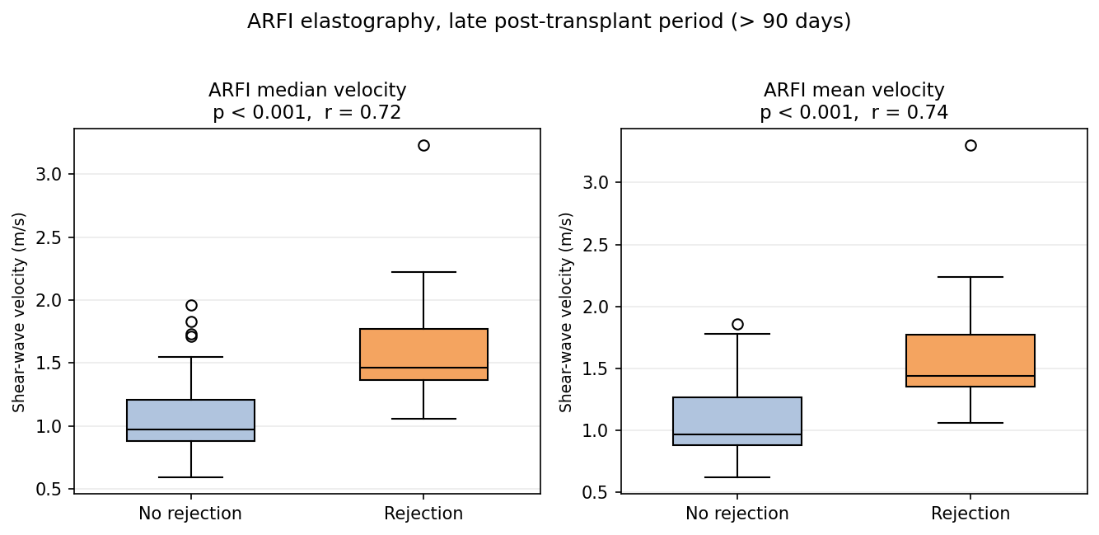
Result 3 — Positive Control: The Pipeline Works
• Same statistical pipeline applied to the clinical biomarkers
• ARFI elastography discriminates rejection (late period): p < 0.001, r = 0.72
• Matches Bassaganyas et al. (2025) to three decimal places
• → The radiomics null is real, not a broken pipeline
ARFI stiffness, late period (>90 days): rejection grafts are markedly stiffer (positive control)
Notes:
This is the slide that makes the whole thesis credible. I took the exact same statistical pipeline and pointed it at the clinical biomarkers recorded for the same patients. And it works: ARFI elastography, the stiffness measure, strongly discriminates rejection in the late post-transplant period - p less than 0.001 and a large effect size, r equals 0.72. In fact my numbers match the published Bassaganyas 2025 result to three decimal places, which validates that I've reproduced their analysis faithfully. The logic here is important: my pipeline CAN detect rejection when a real signal is present in the data. So the radiomics null is a genuine finding about grayscale texture, not a bug or an underpowered mistake. This is the positive control that separates a strong negative result from a weak one.

Slide 14
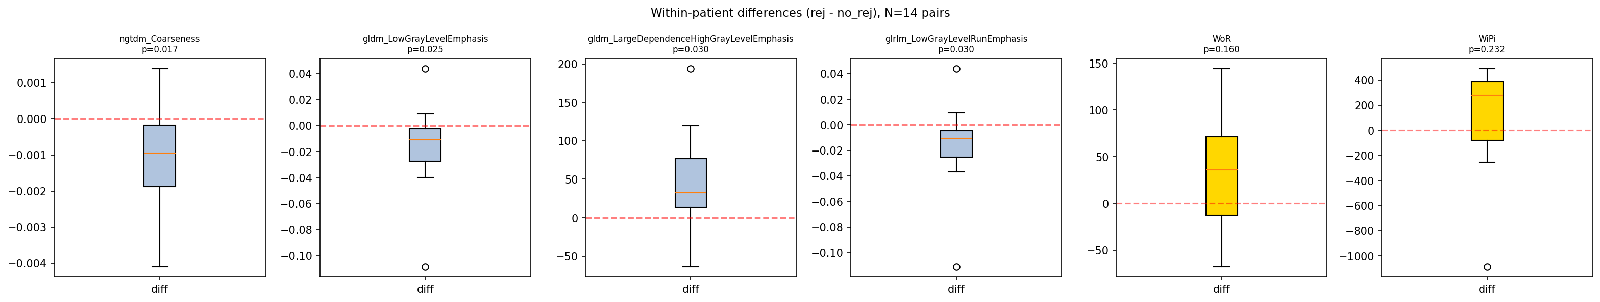
Why ARFI Works but Radiomics Doesn't
• Paired within-patient test: each patient's own rejection vs. non-rejection scans
• Paired ARFI change: p = 0.86 — no within-patient shift
• So ARFI reflects between-patient, late-period baseline stiffness
• A chronic difference — not a transient rejection change grayscale could catch
Within-patient paired differences centre on zero
Notes:
This is my favourite slide because it's a genuine insight, not just another null. If ARFI detects rejection so strongly, why can't texture pick up anything? I looked at the subset of patients who had both a rejection scan and a non-rejection scan, and compared each patient against themselves - a paired within-patient test. The paired ARFI change was p equals 0.86 - essentially zero within-patient difference. That means the strong ARFI signal is really a between-patient effect: patients who reject tend to have stiffer grafts in the late period as a baseline characteristic, rather than the stiffness jumping up transiently at the moment of rejection. That reframes the negative result. Grayscale texture is being asked to catch a transient, cross-sectional change that may simply not exist in a detectable form. I present this as hypothesis-generating - it's a smaller paired sample - but it's a coherent explanation.

Slide 15
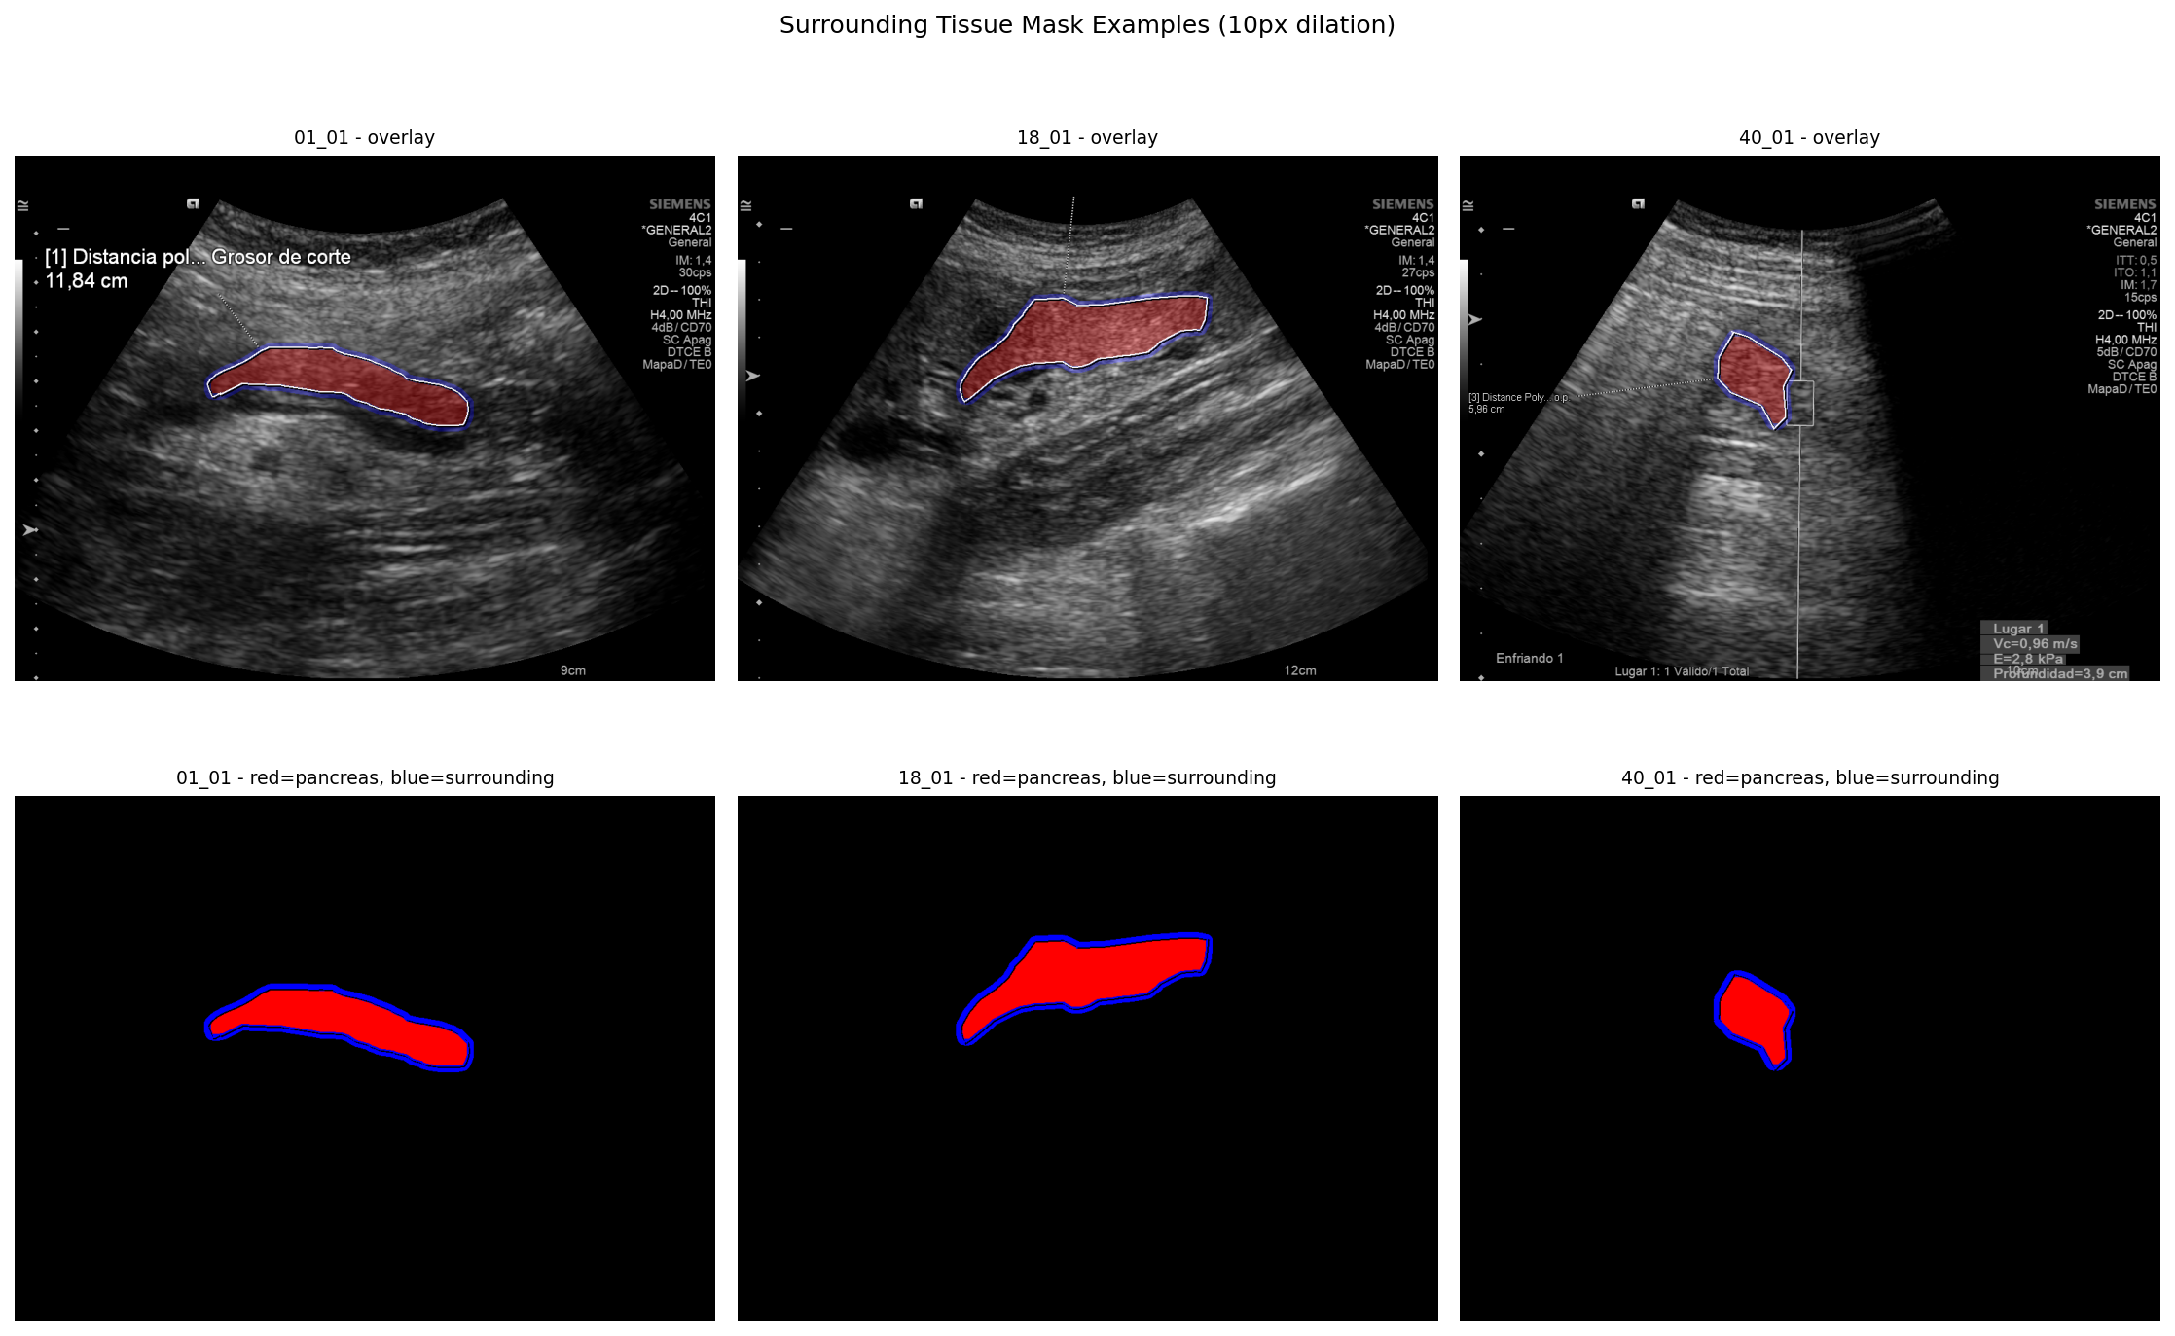
Robustness — The Null Holds Every Way I Tested It
• Paired within-patient radiomics analysis — no signal
• Alternative texture families (LBP, Gabor, Laws') — 153 features total — no signal
• Surrounding-tissue normalisation (graft vs. neighbouring tissue) — no signal
• Full dataset (137) exploratory analysis — no signal
• Consistent negative result → robust, not an artefact of one choice
Surrounding-tissue masks used for the normalisation check
Notes:
I didn't want the null to depend on any single modelling choice, so I attacked it from several directions. I re-ran the analysis paired within patients. I went beyond PyRadiomics and added three completely different texture families - Local Binary Patterns, Gabor filters, and Laws' texture energy - 153 features in total. I tried normalising the graft against its surrounding tissue, shown on the right, in case absolute intensity was washing out a relative difference. And I ran the full 137-study dataset as an exploratory check. Every one of these came back null. When a result is that stable across preprocessing, feature type, and dataset, you can be confident it's real and not an artefact of one arbitrary decision. That robustness is a big part of why I'm comfortable standing behind the conclusion.

Slide 16
Discussion — What the Negative Result Means
• Grayscale-US texture does not encode the tissue changes of rejection
• Rejection signal lives in stiffness (ARFI) and perfusion (DCE-US) —
– physical properties that B-mode brightness patterns do not capture
• A well-controlled negative result: validated pipeline + multiple robustness checks
• Clinically useful: rules out a cheap shortcut, keeps focus on the biomarkers that work
Notes:
So what does this mean? The interpretation is that the information distinguishing rejection lives in the physical tissue properties that specialised ultrasound measures - stiffness via ARFI and perfusion via contrast ultrasound - and those simply aren't encoded in the brightness texture patterns of a standard B-mode image. Radiomics can only work with what's in the pixels, and this particular signal isn't there. I want to frame this as a strength, not a disappointment. It's a well-controlled negative result: the pipeline is validated by the ARFI positive control, and the null survives every robustness check. That's scientifically valuable - a negative result with a working control is far more informative than a noisy positive one. And it's clinically useful: it tells the field not to chase a cheap grayscale-radiomics shortcut, and to keep investing in the biomarkers that actually work.

Slide 17
Limitations
• Modest sample size, single centre (Hospital Clinic Barcelona)
• 2D single-frame images — no volumetric / temporal texture
• Outcome label is clinical rejection (not all biopsy-confirmed)
• Class imbalance (~72 : 28) constrains classifier training
• Retrospective design; hand-drawn ROIs introduce some variability
Notes:
I want to be upfront about the limitations, because the committee will probe them. The sample is modest and from a single centre, so I can't claim this generalises everywhere. The images are 2D single frames, so I'm not capturing volumetric or temporal texture that a full cine-loop or 3D scan might contain. My outcome label is clinical rejection, and only 27 of the 39 rejection cases were biopsy-confirmed, so there's some label noise. The classes are imbalanced at roughly 72 to 28, which makes classifier training harder. And it's retrospective with hand-drawn regions, which adds variability. That said - and this is my key defence - none of these fully explains the null, because the positive control worked on the very same data with the very same limitations. So the limitations qualify the generality of the finding, but they don't undermine the core conclusion.

Slide 18
Conclusions
• Automated grayscale-US radiomics does not detect pancreas rejection
• No feature significant after correction; classifiers at chance (AUC ~0.64)
• Pipeline validated: reproduced ARFI result (p<0.001, r=0.72)
• The ARFI signal is between-patient baseline stiffness, not a transient change
• Clinical biomarkers remain necessary for non-invasive rejection monitoring
Notes:
To conclude, mapping back to my five objectives. I built the extraction pipeline and the statistical and machine-learning analyses. The answer to the central question is no: automated grayscale radiomics does not detect pancreas rejection - no feature survived correction and classifiers performed at chance, around 0.64 AUC with an interval crossing 0.5. Objective four, the control, succeeded and validated everything: I reproduced the ARFI result at p below 0.001 and r equal 0.72. And the comparison in objective five revealed that the ARFI signal is a between-patient baseline-stiffness effect. The bottom line for the clinic: the specialised biomarkers that measure stiffness and perfusion remain necessary - a texture shortcut on ordinary images won't replace them.

Slide 19
Future Work & Thank You
• Deep learning on raw images (features beyond hand-crafted texture)
• Multi-parametric models: combine B-mode + ARFI + DCE-US
• Larger, multi-centre, prospective cohorts with biopsy-confirmed labels
• Volumetric / temporal (3D or cine-loop) ultrasound
• Thank you — I'm happy to take your questions.
Notes:
Where could this go next? Deep learning on the raw images might find representations that hand-crafted texture features miss, though it needs more data. Multi-parametric models that fuse B-mode with ARFI and perfusion are probably the most promising clinical direction. Larger, multi-centre, prospective cohorts with biopsy-confirmed labels would settle generalisability and label noise. And moving to 3D or cine-loop ultrasound would add the volumetric and temporal texture I couldn't access here. That's the end of my talk. Thank you for your attention - and thank you to Gemma and to the clinical team at Hospital Clinic. I'm very happy to take your questions. [Reminder to self: breathe, and if you don't know an answer, it's fine to say you'd need to check - reason out loud from what you do know.]

Slide 20
Backup Slides
Supporting detail for questions
Notes:
Divider - these slides are only shown if a question calls for them.

Slide 21
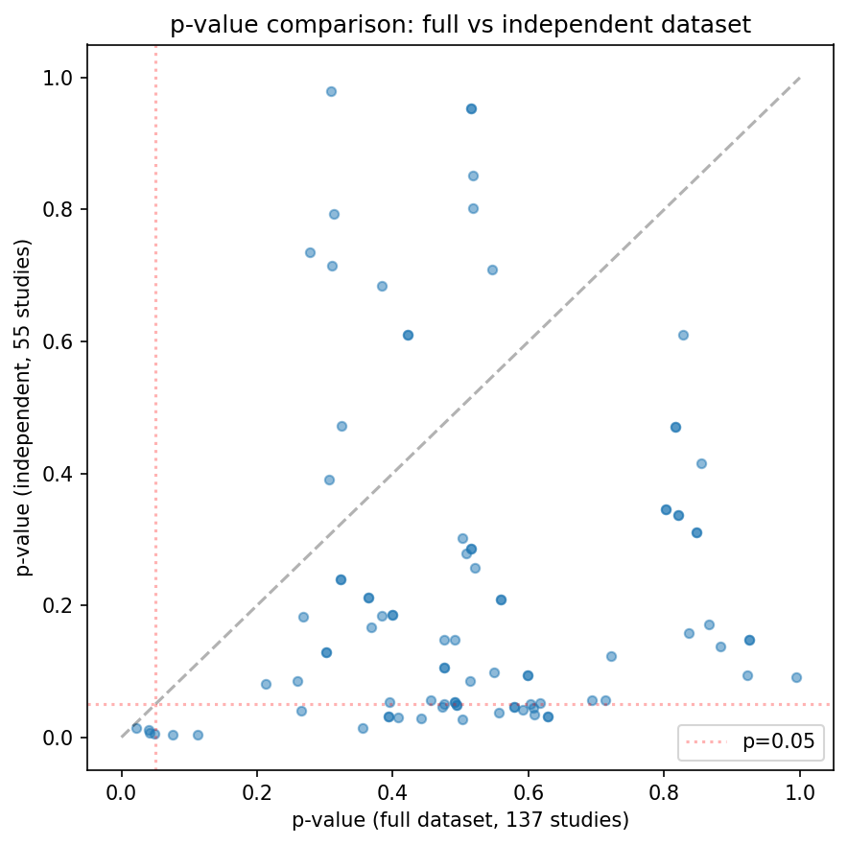
Backup — Statistical Detail
• Independent dataset: 55 studies, one per patient (no repeated measures)
• Shapiro-Wilk → Welch's t / Mann-Whitney U per feature
• Benjamini-Hochberg FDR across all 93 features; q < 0.05 threshold
• 0 features significant; smallest corrected q-values well above 0.05
• Full 93-feature table with p, q and effect sizes is in Appendix B of the thesis
Per-feature p-values: full vs. independent dataset
Notes:
Backup for detailed statistics questions. The independent dataset is 55 studies, one per patient. Per feature I chose the test by Shapiro-Wilk, then applied Benjamini-Hochberg across all 93 features. Nothing reached q below 0.05, and the plot compares per-feature p-values between the full and independent datasets - they tell the same null story. The complete table is in Appendix B if you want exact numbers for any feature.

Slide 22
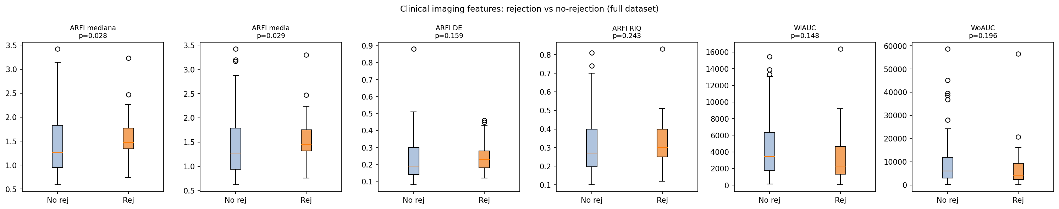
Backup — Clinical Biomarker Replication
• Reproduced Bassaganyas et al. (2025) on the same cohort
• ARFI elastography: p < 0.001, r = 0.72 (late period) — matches to 3 dp
• DCE-US perfusion parameters analysed with the same pipeline
• Confirms the analysis pipeline is correct and sensitive to real signal
ARFI stiffness by group (positive control)
Notes:
Backup on the replication. I reproduced the published clinical-biomarker analysis on the same patients, matching their ARFI result to three decimal places, p below 0.001 and r 0.72 in the late period. I ran the DCE-US perfusion parameters through the identical pipeline too. This is the evidence that my methods are sound and can detect a real signal when one exists.

Slide 23
Backup — ARFI Time-Stratification
• The ARFI rejection signal is time-dependent (90-day post-transplant cutoff):
• Full cohort (all periods): ARFI mediana / media only p ~ 0.03 (r = 0.26)
• Early period (≤ 90 days, n = 80): no significant feature
• Late period (> 90 days, n = 58): 8 features significant
– all 4 ARFI: mediana & media p < 0.001, r = 0.72 / 0.74
– median stiffness 0.97 → 1.46 m/s (no-rej → rejection)
– plus 4 DCE-US perfusion parameters (WiAUC, WoAUC, WiWoAUC, WiPi)
• Consistent with fibrosis in the chronic phase — and with the paired null (p = 0.86)
Notes:
Backup for the most likely deep question: 'isn't ARFI only significant in the late period?' Yes, and that's the point. On the whole cohort ARFI is only weakly significant, around p 0.03. In the first 90 days, nothing is significant - early post-operative variability drowns it out. But beyond 90 days, in the chronic phase, eight features become significant: all four ARFI stiffness measures, with median and mean velocity below p 0.001 and large effect sizes, plus four DCE-US perfusion parameters. Median stiffness goes from about 0.97 to 1.46 metres per second. This is the exact stratification and cutoff Bassaganyas used, and my numbers match. It fits the fibrosis interpretation, and it's consistent with the paired within-patient null - the signal is a chronic, between-patient baseline-stiffness difference, not a transient jump.

Slide 24
Backup — ML Configuration & Results
• Correlation pre-filter |r| > 0.9 → 27 features (drop higher-p of each pair)
• SelectKBest k grid tuned jointly with model hyper-parameters (GridSearchCV)
• LogReg AUC 0.636 [0.48,0.78] · RF 0.588 · NaiveBayes 0.618 · SVM 0.408
• Sensitivity/specificity trade-offs reflect class imbalance, not real signal
• Bootstrap 1000 resamples for every 95% confidence interval
ROC curves, all four tuned classifiers
Notes:
Backup for machine-learning questions. The correlation pre-filter drops one of each pair of features correlating above 0.9, keeping 27. The number of selected features k was tuned jointly with each model's hyper-parameters inside cross-validation. The four AUCs were 0.636 for logistic regression, 0.588 random forest, 0.618 naive Bayes, and 0.408 SVM. The extreme sensitivity or specificity values, like SVM predicting almost everything as one class, are symptoms of class imbalance rather than a real signal. Every confidence interval came from 1000 bootstrap resamples.

Slide 25
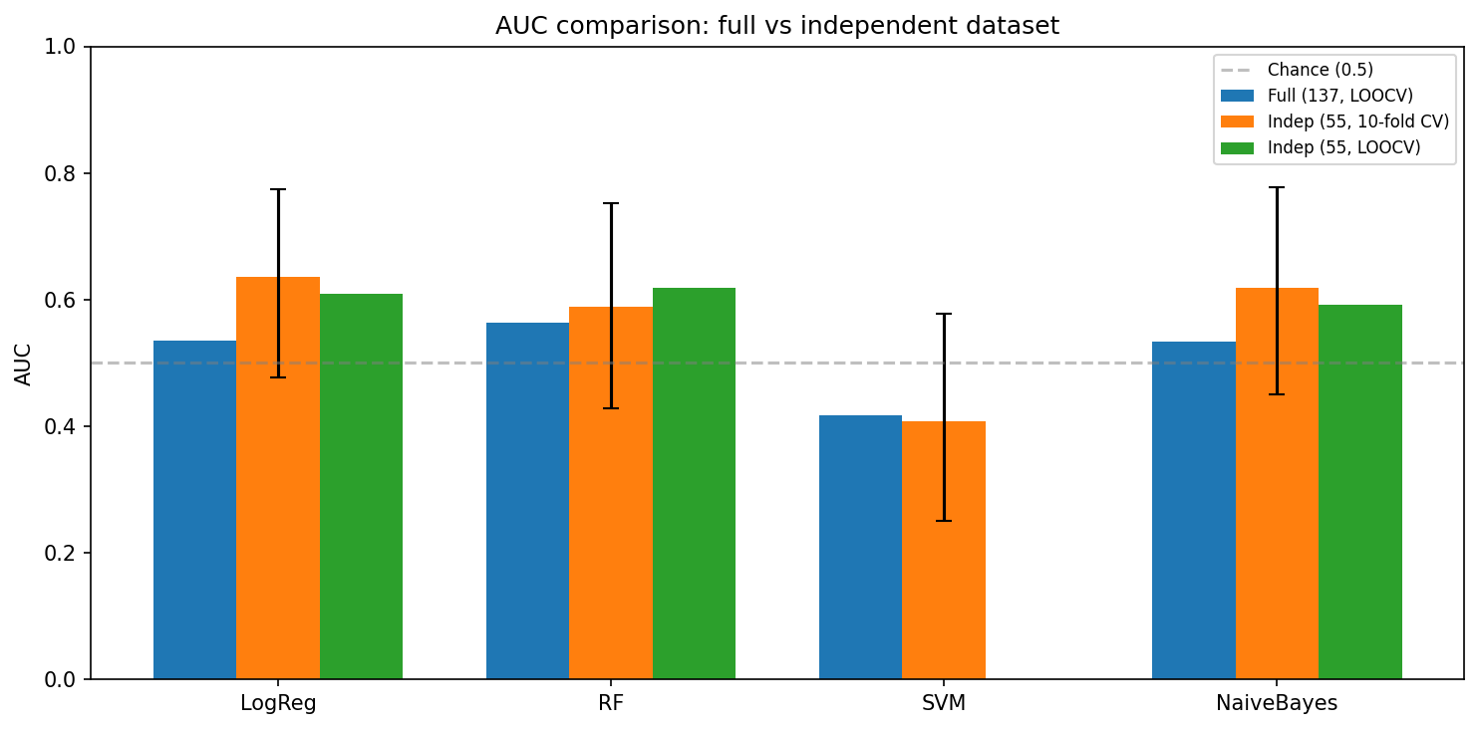
Backup — Full Dataset (137) Exploratory Analysis
• Full dataset = all 137 studies (repeated measures — not independent)
• Reported only as an exploratory supplement (Appendix A)
• Same conclusion: no feature significant after correction; ML at chance
• Reassures that the primary 55-study result is not just a small-sample fluke
Full vs. independent dataset — same null conclusion
Notes:
Backup on the full dataset. Using all 137 studies violates independence because patients repeat, so it's only exploratory, in Appendix A. I include it because it reaches the same null as the 55-study primary analysis, which reassures that the primary result isn't just a small-sample fluke - more data, same answer.

