Slide 1
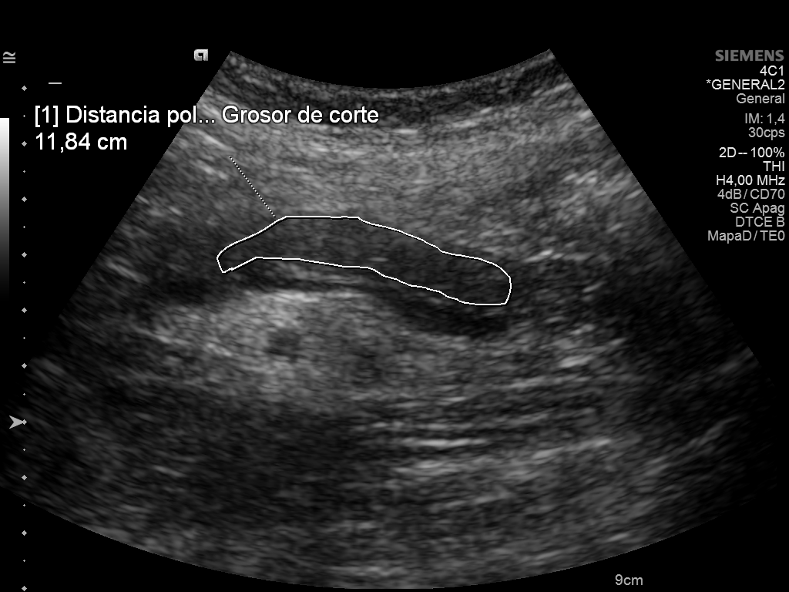
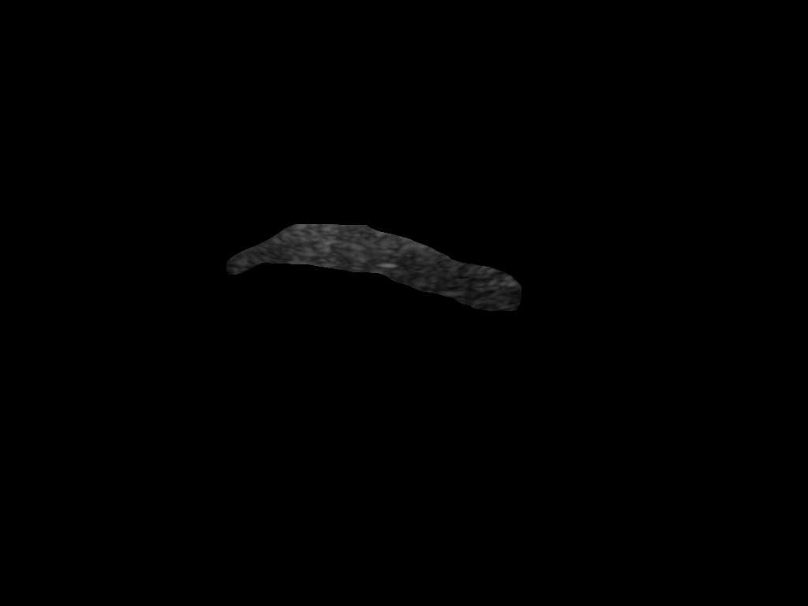
The Problem: Detecting Pancreas Transplant Rejection
1/3
Daniel Duhnev | EMAI 2024-2026 | Supervisor: Gemma Piella (UPF)
Pancreas transplantation treats severe Type 1 diabetes
Graft rejection: the immune system attacks the transplanted organ (~30% of cases)
Current diagnosis: biopsy (needle into the organ — invasive, risky)
Ultrasound is already used for routine monitoring — non-invasive, cheap, repeatable
Research question: Can we extract quantitative texture features ("radiomics") from ultrasound images and use machine learning to detect rejection automatically?
Raw ultrasound with contour
Preprocessing pipeline
Extracted pancreas ROI
EMAI Spring Event 2026 | Ljubljana | April 17, 2026

Slide 2
The Progress: What Works, What Doesn't
2/3
Daniel Duhnev | EMAI 2024-2026 | Supervisor: Gemma Piella (UPF)
RADIOMICS TEXTURE FEATURES
CLINICAL IMAGING BIOMARKERS (REPLICATION)
93 texture features extracted from 134 ultrasound studies (55 patients)
Features describe pixel patterns: intensity, contrast, homogeneity, etc.
Statistical testing: 0 out of 93 features significant (p < 0.05)
ML classification: AUC = 0.5 — equivalent to random guessing
Replicated analysis from Bassaganyas et al. (European Radiology, 2025)
ARFI elastography (measures tissue stiffness): p < 0.0001 in late period (>90 days)
DCE-US perfusion (blood flow): 3 features significant in late period
Replication accuracy: our p-values match published results to 3 decimal places
Ultrasound texture alone does NOT predict rejection
Targeted clinical biomarkers DO predict rejection
Pipeline: DICOM images → contour removal → mask erosion → PyRadiomics feature extraction → Shapiro-Wilk normality → Mann-Whitney U / Welch's t-test → Benjamini-Hochberg FDR correction → Logistic Regression + Random Forest with stratified 5-fold CV
Key insight: The negative radiomics result IS the finding. It demonstrates that generic texture analysis cannot capture what specialized measurements (stiffness, blood flow) can. The exact replication of published results confirms our pipeline is correct — the null result is real, not a bug.
EMAI Spring Event 2026 | Ljubljana | April 17, 2026

Slide 3
The Future: Next Steps & Timeline
3/3
Daniel Duhnev | EMAI 2024-2026 | Supervisor: Gemma Piella (UPF)
ONGOING EXPERIMENTS
THESIS TIMELINE
Paired analysis: 14 patients have both rejection & non-rejection studies — each patient as their own control (Wilcoxon signed-rank test)
ML improvements: training vs test metrics to diagnose overfitting, recursive feature elimination (RFE)
Alternative features: Local Binary Patterns, Gabor filters, Laws' texture energy — methods not in standard radiomics
Surrounding tissue: use tissue around the pancreas as reference to normalize for machine/scanner variability; test contrast between organ and surroundings
Apr 2026
New experiments (paired, alt. features, normalization)
May 2026
Results analysis + Introduction chapter
Jun 2026
First complete draft
Jul 2026
Final submission
Aug 2026
Defense
Broader impact: This work narrows the search space for non-invasive rejection monitoring. Targeted biomarkers (stiffness, perfusion) outperform generic texture — future research should focus on what to measure, not just how to analyze it.
EMAI Spring Event 2026 | Ljubljana | April 17, 2026

