Slide 1

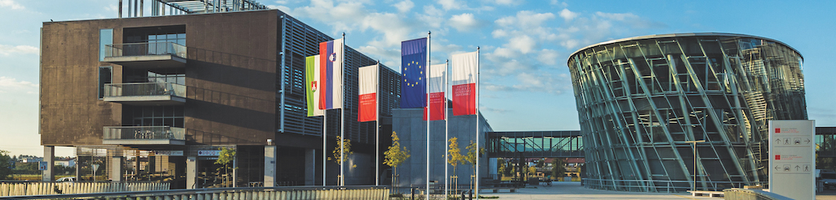


EMAI spring event (15 – 17 April 2026) @ University of Ljubljana
Non-invasive Detection of Pancreas Graft Rejection
Comparing Automated Texture Analysis with Clinical Ultrasound Biomarkers
Daniel Duhnev
EMAI 2024-2026 | Supervisor: Gemma Piella (UPF)
Notes:
Hello everyone,
My name is Daniel Duhnev, I'm a second year EMAI student working on my thesis at UPF under the supervision of Gemma Piella.
My project investigates whether we can detect pancreas transplant rejection non-invasively, using automated image analysis of ultrasound scans, and how that compares to clinical biomarkers that doctors already measure.

Slide 2
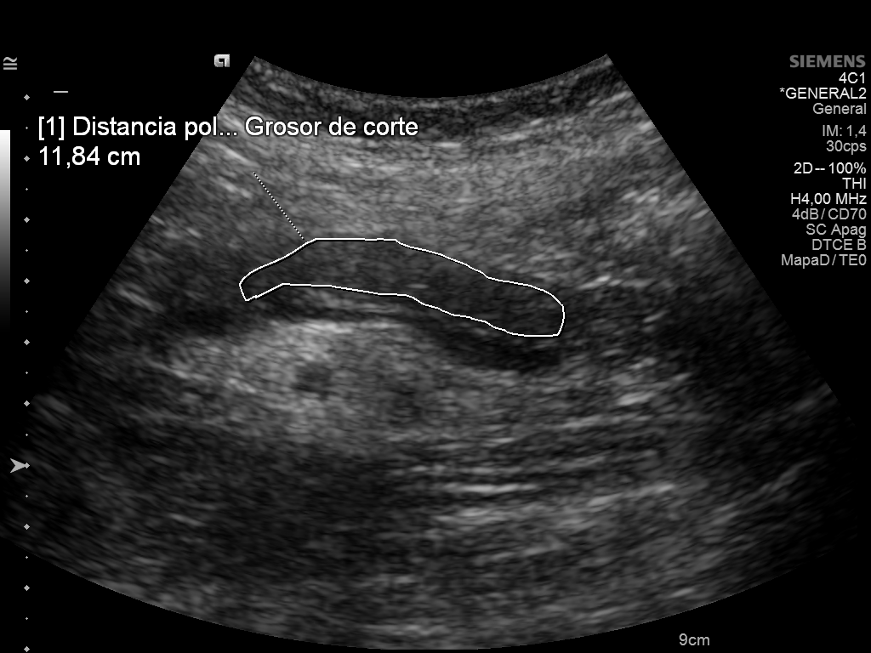
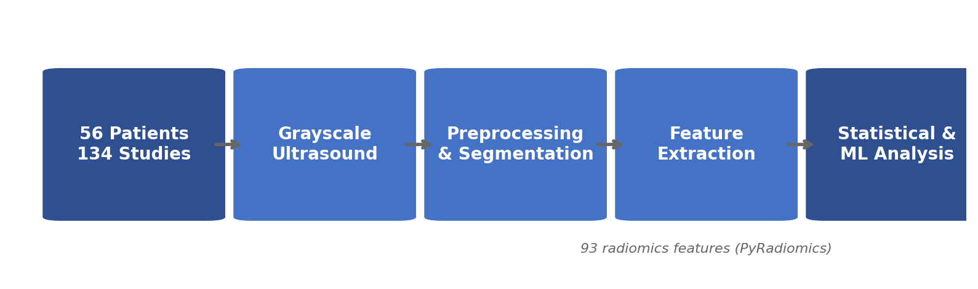
Problem Description
Raw ultrasound
Background
Pancreas transplantation treats type 1 diabetes.
Graft rejection affects ~30% of patients.
Current diagnosis relies on invasive biopsy involving risk of complications, delayed results, and high cost.
Opportunity
Use Ultrasound images instead - non-invasive, real-time, routine monitoring.
Research Question: Can automated image analysis detect rejection?
Goal
Compare automated texture features vs clinical biomarkers for rejection detection
Pipeline: DICOM images > contour removal > mask erosion > PyRadiomics (93 features) > Shapiro-Wilk > Mann-Whitney U / Welch's t-test > BH-FDR correction > LogReg + Random Forest (stratified 5-fold CV)
Notes:
BACKGROUND & CONTEXT So some context — pancreas transplantation is a treatment for type 1 diabetes, but around 30% of patients experience graft rejection, where the immune system attacks the transplanted organ. Currently the gold standard for diagnosing rejection is biopsy, which is invasive, carries risk of complications, takes time, and is expensive.
THE POTENTIAL OF ULTRASOUND Ultrasound is already used for routine monitoring of these patients — it's non-invasive, real-time, and widely available. As you can see here on the right, this is what a raw pancreas ultrasound looks like — the organ is outlined by the doctor during the exam.
THE CORE RESEARCH QUESTION
Can we extract quantitative features from these images automatically and use them to predict rejection without a biopsy?
METHODOLOGY & GOALS The goal of this thesis is to compare two approaches:
AUTOMATED TEXTURE ANALYSIS: Where we extract numerical features from the grayscale image using radiomics.
CLINICAL BIOMARKERS: Such as ARFI elastography and perfusion measurements that the doctors recorded manually during the same exams.
THE PIPELINE You can see the pipeline at the bottom — we go from raw DICOM images through:
Contour removal
Mask erosion (to clean the region of interest)
Extraction of 93 texture features
Statistical tests (with multiple testing correction)
Training machine learning classifiers

Slide 3
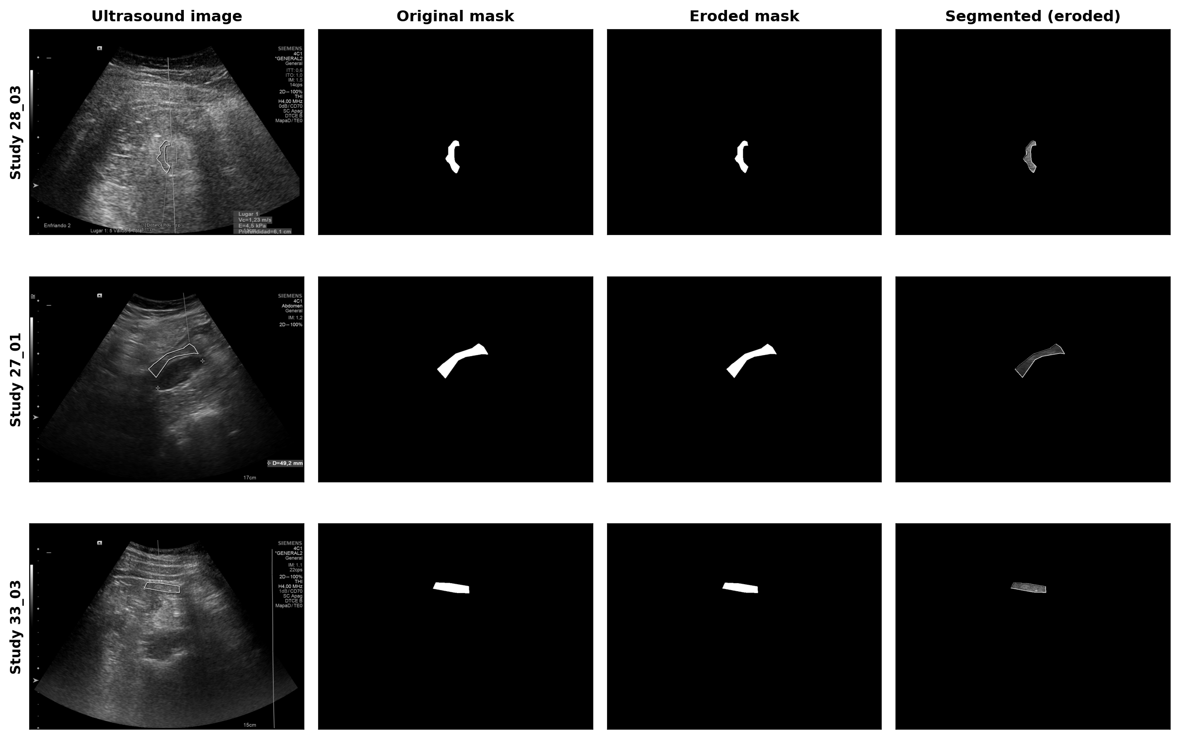
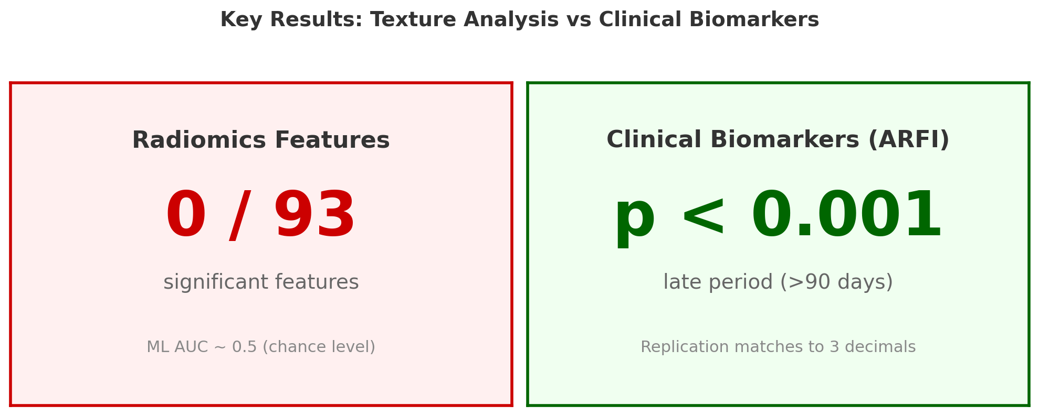
Progress: Methods & Results
Methodology
56 patients, 134 ultrasound studies (Hospital Clinic Barcelona)
Automated segmentation + mask erosion preprocessing
93 radiomics texture features extracted (PyRadiomics)
Statistical tests: Mann-Whitney U, Welch's t-test, FDR correction
ML: Logistic Regression + Random Forest (stratified 5-fold CV)
Key Finding
Radiomics texture features do NOT predict rejection
Some clinical biomarkers DO predict rejection
Replication of Bassaganyas et al. 2025 validated to 3 decimal places
Notes:
METHODS & DATASET For the study we had data from 56 patients at Hospital Clinic Barcelona, totalling 134 ultrasound studies — so some patients had multiple exams over time.
[LOOK AT TOP RIGHT FIGURE] As you can see in this figure on the top right, each image goes through preprocessing — we take the ultrasound, extract the organ mask, apply erosion to remove boundary artifacts, and get a clean region of interest.
FEATURE EXTRACTION From each ROI we extracted 93 radiomics texture features using PyRadiomics — these capture things like intensity distributions, spatial patterns, and texture heterogeneity.
STATISTICS & MACHINE LEARNING We then ran statistical tests — Shapiro-Wilk for normality, then either Welch's t-test or Mann-Whitney U depending on the distribution, with Benjamini-Hochberg correction for the 93 comparisons. We also trained logistic regression and random forest classifiers with stratified 5-fold cross-validation.
THE KEY FINDING: RADIOMICS [LOOK AT COMPARISON FIGURE] The key finding — and you can see this clearly in this comparison figure — is that zero out of 93 radiomics features were statistically significant. The machine learning models achieved AUC around 0.5, which is chance level.
Summary: Radiomics texture features from grayscale ultrasound do not predict rejection.
CLINICAL REPLICATION & VALIDATION However, we also replicated the clinical analysis from Bassaganyas et al. 2025, who used the same dataset.
Their ARFI elastography measurements — which capture tissue stiffness — showed strong significance, p less than 0.001 in the late post-transplant period.
Our replication matched their published p-values to three decimal places.
Conclusion: This validates that our pipeline is correct and the negative radiomics result is genuine, not a bug.

Slide 4
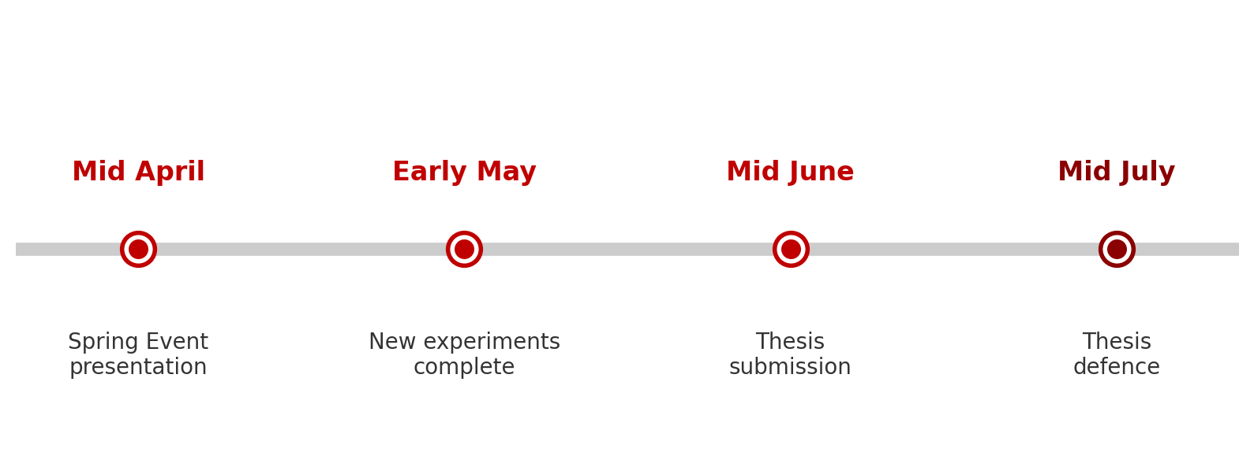
Further Work
Ongoing Challenges & Next Experiments
Improve ML pipeline: add training metrics, recursive feature elimination (RFE)
Paired analysis: analyse patients with both rejection and non-rejection outcomes (Wilcoxon signed-rank test)
Surrounding tissue analysis: Analyse tissue surrounding the pancreas for signs of rejection
Alternative texture features beyond PyRadiomics: LBP, Gabor filters, Laws' energy
Address repeated measures: 55 patients contribute 134 non-independent studies
Notes:
FURTHER WORK & EXPERIMENTS So looking ahead, I have several experiments planned to strengthen these findings before thesis submission.
ML PIPELINE IMPROVEMENTS: Adding training metrics so we can distinguish between "no signal" and overfitting, and applying recursive feature elimination to see if a smaller subset of features performs better.
PAIRED ANALYSIS: 14 of our 55 patients have both rejection and non-rejection studies, so we can use each patient as their own control with a Wilcoxon signed-rank test. This eliminates between-patient variability and is the most internally valid test we can run.
PERIPANCREATIC ANALYSIS: Analysing the tissue surrounding the pancreas — rejection causes inflammation that might extend beyond the organ boundary, and we want to test whether that carries any signal.
ALTERNATIVE TEXTURE FEATURES: Trying features beyond what PyRadiomics offers — things like Local Binary Patterns, Gabor filters, and Laws' texture energy, which capture different properties of the image.
STATISTICAL INDEPENDENCE: Properly addressing the repeated measures issue — our 134 studies come from only 55 patients, so they're not truly independent.
TIMELINE & CONCLUSION [LOOK AT THE TIMELINE FIGURE] As you can see in the timeline:
EARLY MAY: Experiments complete
MID JUNE: Thesis submission
MID JULY: Defense
Thank you.

