Slide 1
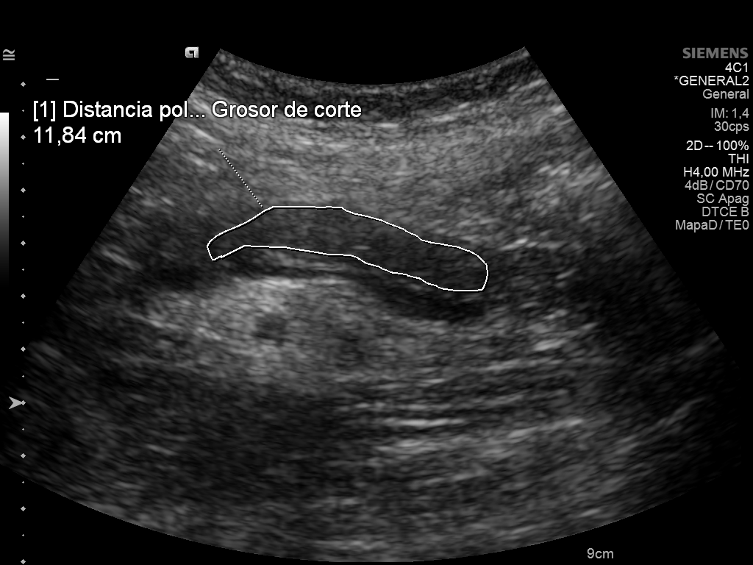
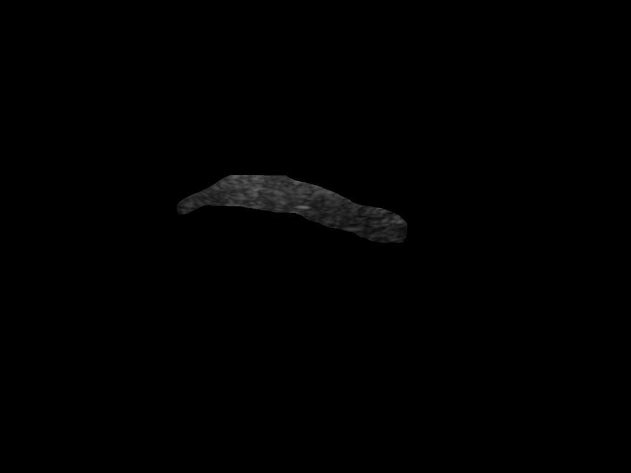
The Problem
Can Ultrasound Texture Predict Pancreas Transplant Rejection?
Pancreas transplantation treats severe Type 1 diabetes
Graft rejection (~30%): immune system attacks the transplanted organ
Current diagnosis: biopsy — invasive, carries complication risk
Ultrasound already used for monitoring — non-invasive, cheap, repeatable
Raw ultrasound
Research question: Can we extract quantitative texture features ("radiomics") from ultrasound and use ML to detect rejection?
Pipeline >>>
Extracted pancreas ROI
Daniel Duhnev | EMAI 2024-2026 | Supervisor: Gemma Piella | Spring Event, Ljubljana, April 17 2026

Slide 2
The Progress
RADIOMICS (texture features)
CLINICAL BIOMARKERS (replication)
93 features from 134 studies (55 patients)
Describe pixel patterns: intensity, contrast, homogeneity
Statistical tests: 0/93 significant (p < 0.05)
ML classifiers: AUC = 0.5 (random chance)
Replicated Bassaganyas et al. (Eur Radiology, 2025)
ARFI elastography (stiffness): p < 0.0001
DCE-US perfusion (blood flow): 3 features significant
Replication: p-values match to 3 decimal places
Texture alone does NOT predict rejection
Clinical biomarkers DO predict rejection
Key insight: The negative result IS the contribution. Generic texture analysis cannot capture what specialized measurements (stiffness, blood flow) can. The exact replication confirms our pipeline is correct — the null result is real, not a bug.
Pipeline: DICOM images > contour removal > mask erosion > PyRadiomics (93 features) > Shapiro-Wilk > Mann-Whitney U / Welch's t-test > BH-FDR correction > LogReg + Random Forest (stratified 5-fold CV)
Daniel Duhnev | EMAI 2024-2026 | Supervisor: Gemma Piella | Spring Event, Ljubljana, April 17 2026

Slide 3
The Future
ONGOING EXPERIMENTS
TIMELINE
Paired analysis: 14 patients with both outcomes — each as their own control (Wilcoxon signed-rank test)
ML improvements: training vs test metrics for overfitting diagnosis; recursive feature elimination (RFE)
Alternative features: Local Binary Patterns, Gabor filters, Laws' energy — beyond standard radiomics
Surrounding tissue: normalize for scanner variability; test contrast between pancreas and surrounding region
Apr 2026
New experiments
May 2026
Results + Introduction
Jun 2026
First complete draft
Jul 2026
Submission
Aug 2026
Defense
Broader impact: Targeted biomarkers outperform generic texture analysis. This narrows the search space for non-invasive rejection monitoring and guides where future research should focus.
Daniel Duhnev | EMAI 2024-2026 | Supervisor: Gemma Piella | Spring Event, Ljubljana, April 17 2026

