Slide 1

USING THE METAGPT FRAMEWORK TO AUTOMATE THE FUZZY FRONT END OF THE PRODUCT INNOVATION PROCESS

Slide 2
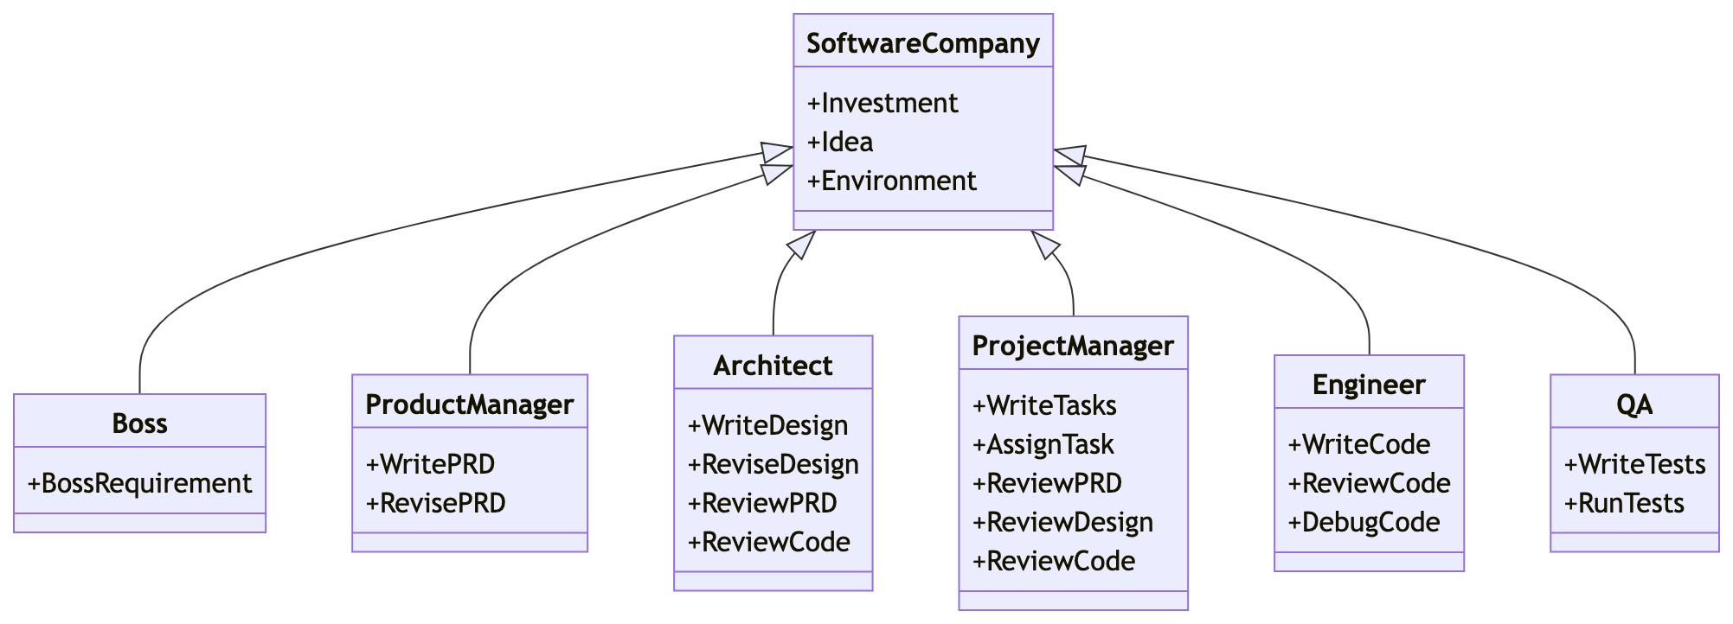
MetaGPT

Slide 3
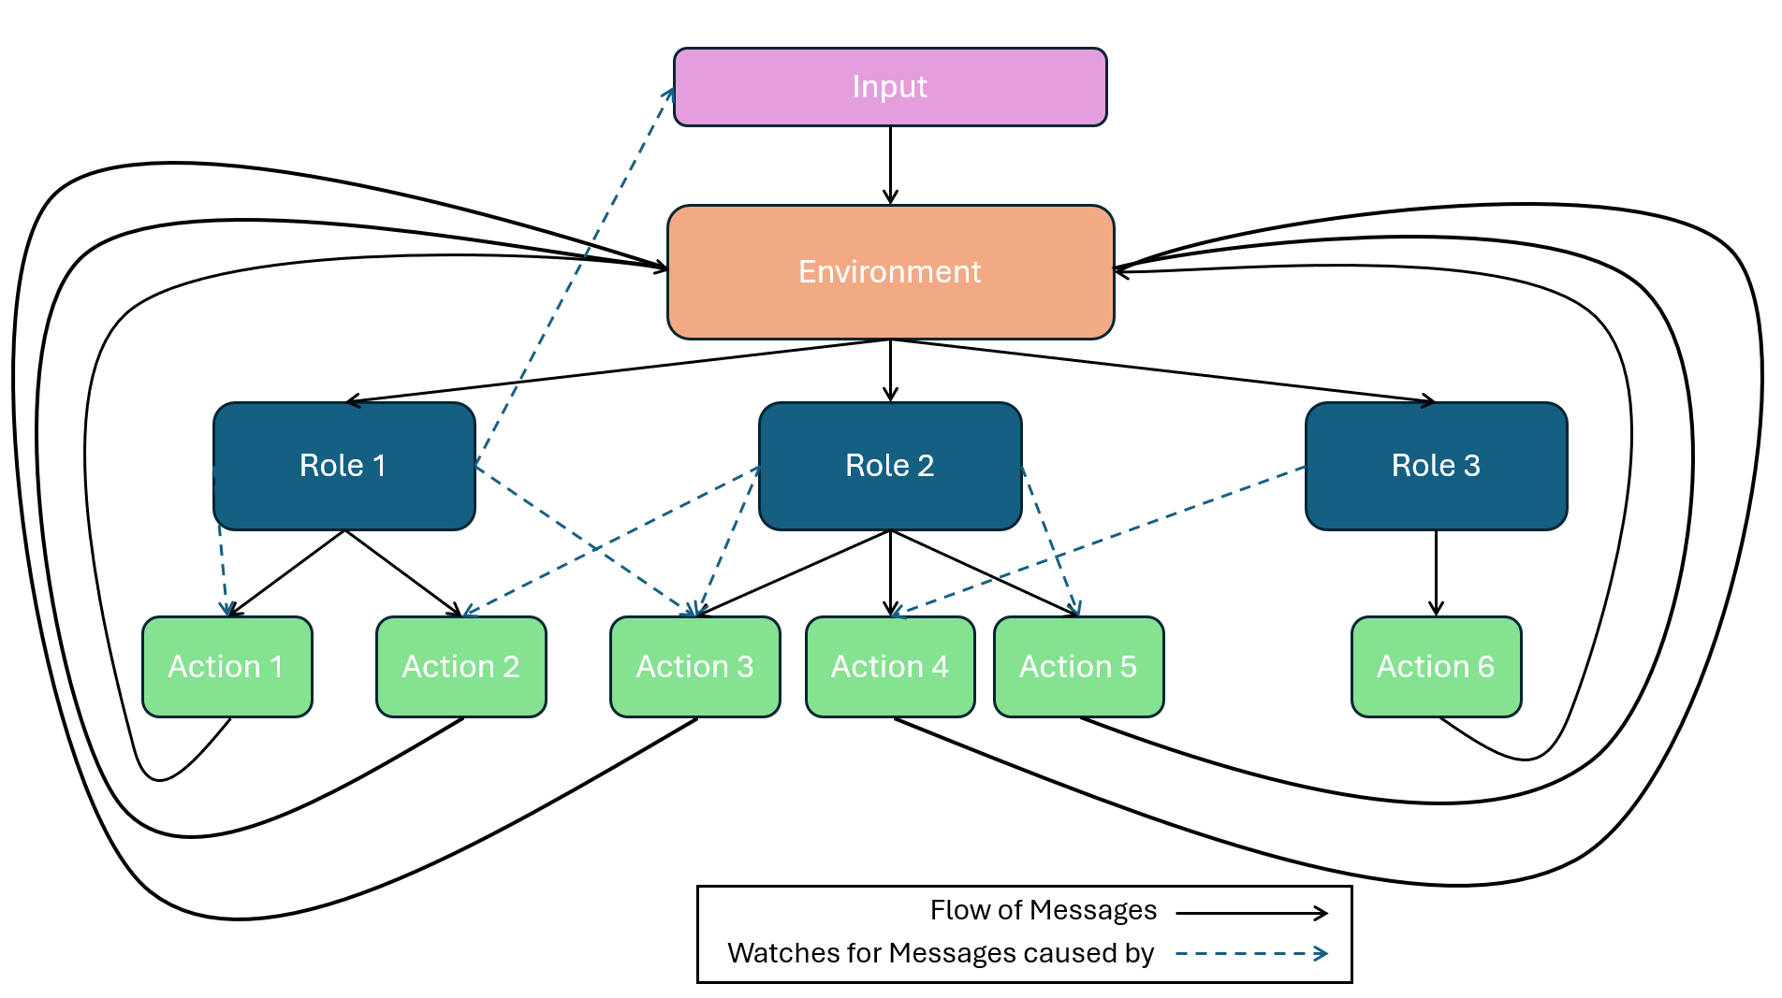

Slide 4
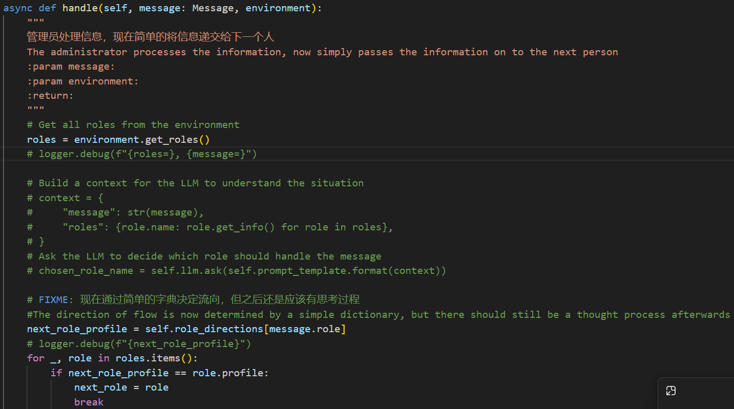
The Challenge of Codebase Familiarisation

Slide 5
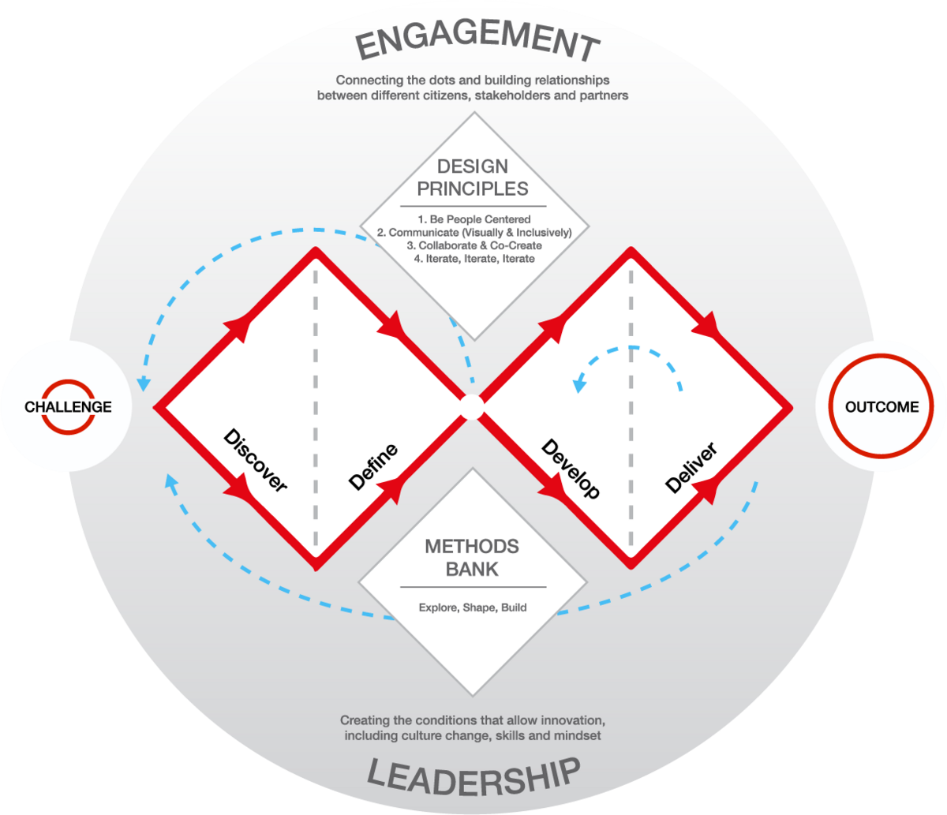
The Fuzzy Front-End
Framework for Innovation by the Design Council (UK)

Slide 6
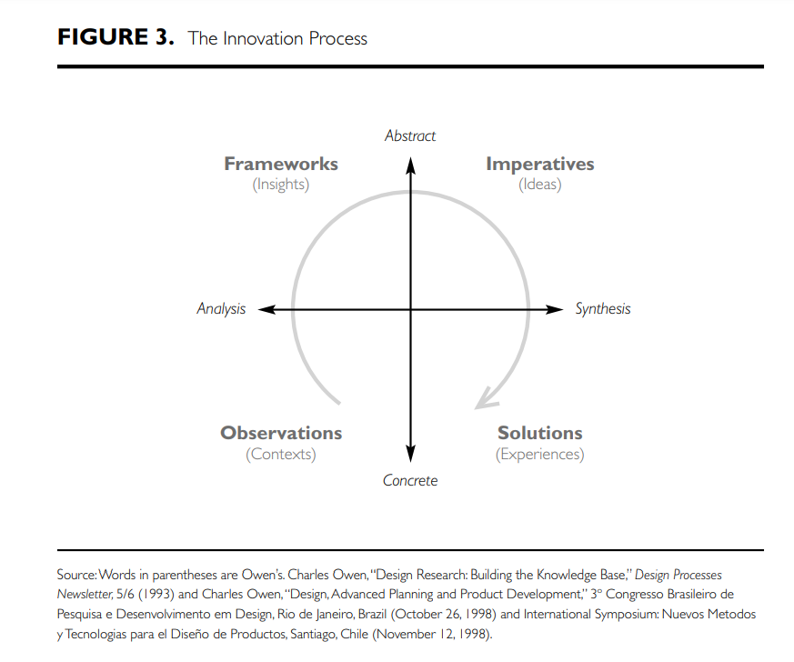
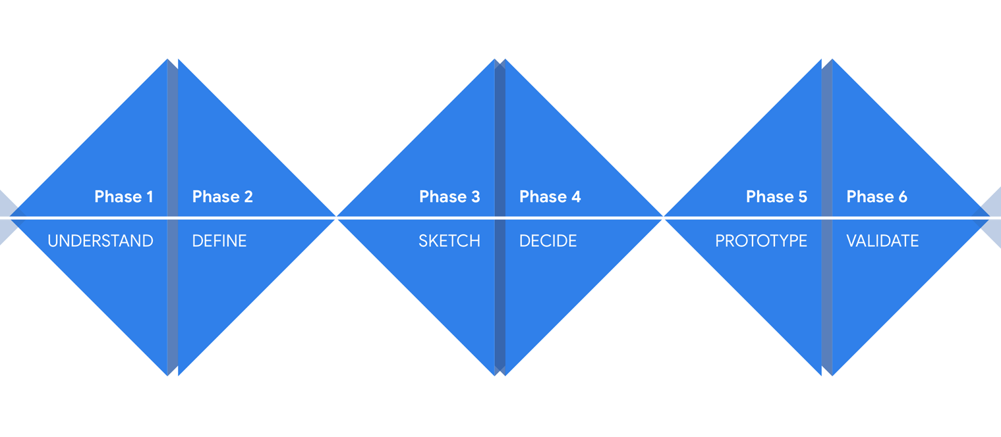
Review of Existing FFE Frameworks
Learning Model for Innovation Beckman and Barry (2007)
Google Design Sprint Kit

Slide 7
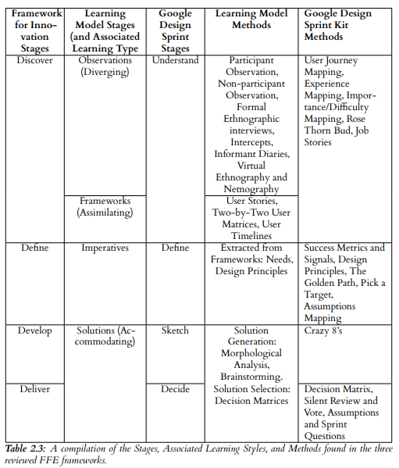

Slide 8
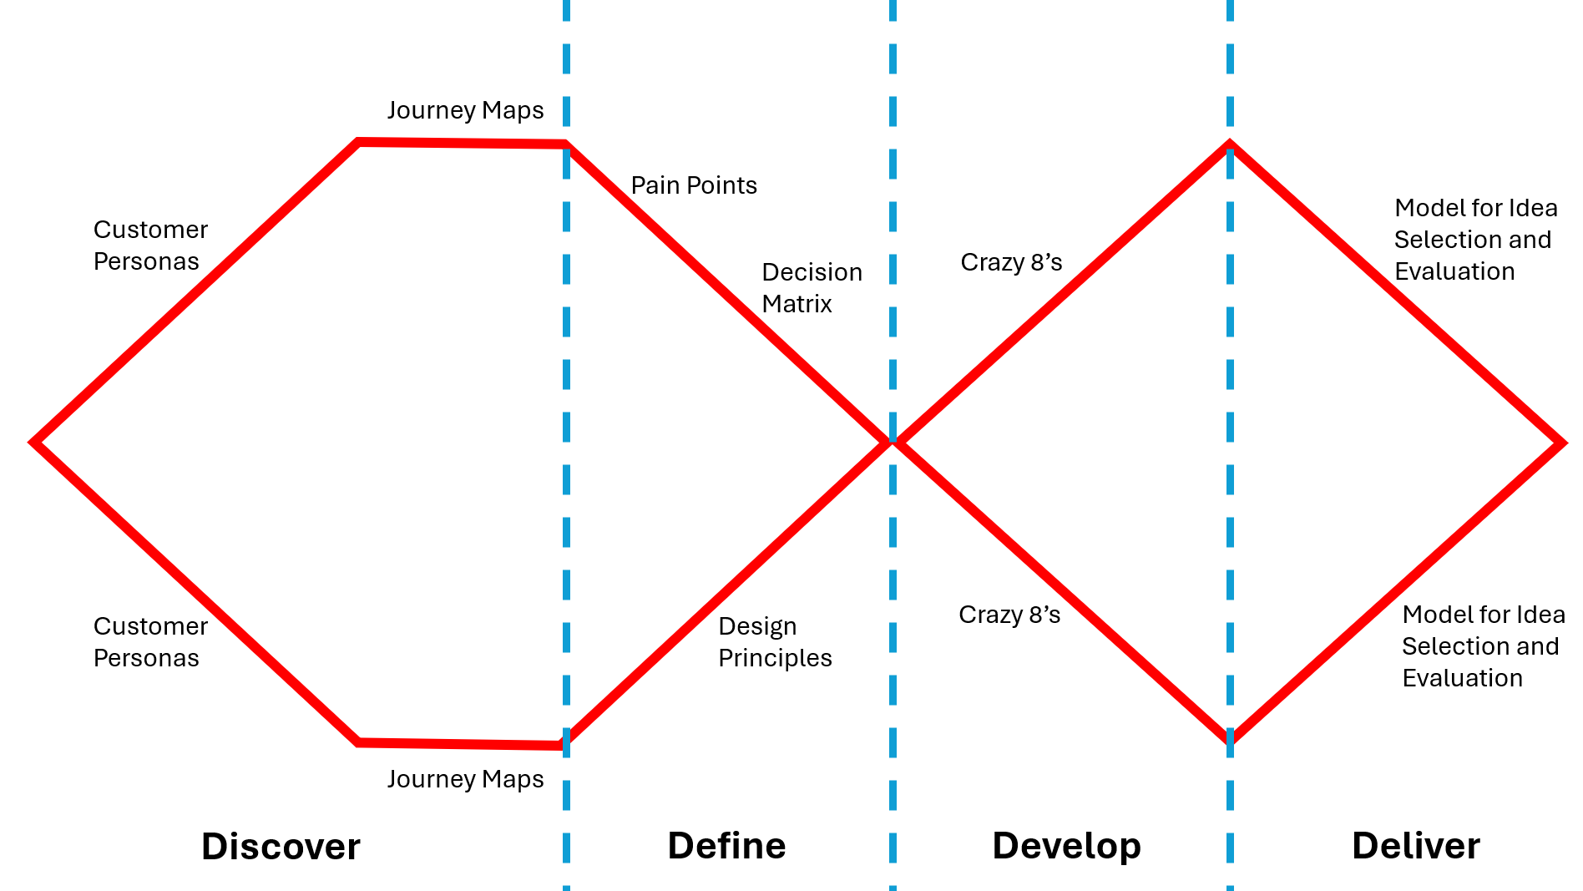
Designing a Standard Operating Procedure for the Fuzzy Front End

Slide 9
Evaluation
1) Two experts create Product Innovation Scenarios
2) Have human innovators, ChatGPT, and the MetaGPT based system generate innovation ideas
3) Have the experts blindy evaluate the ideas

Slide 10
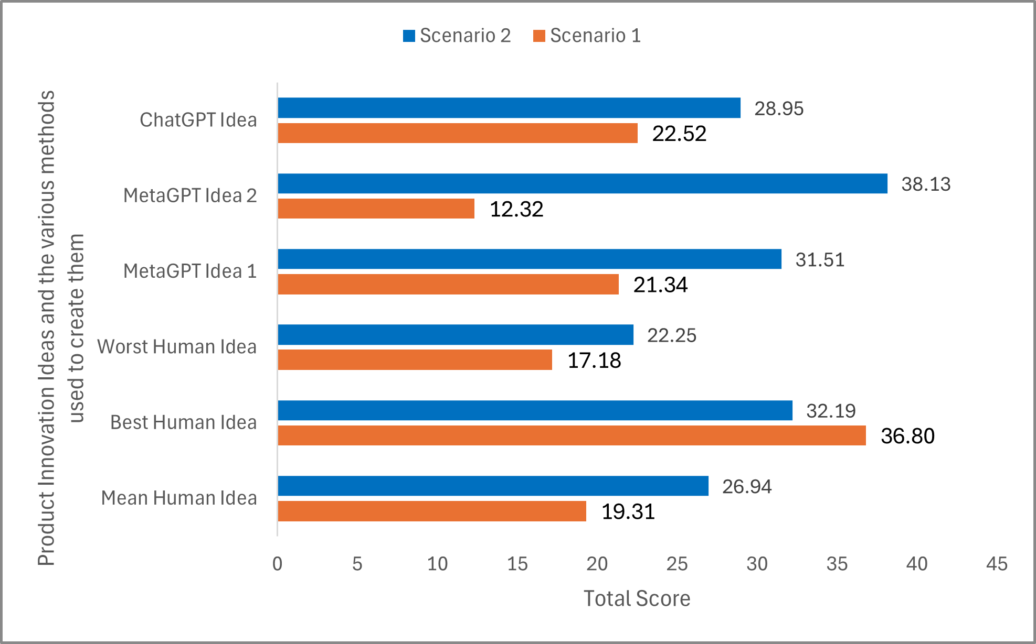
Results

Slide 11
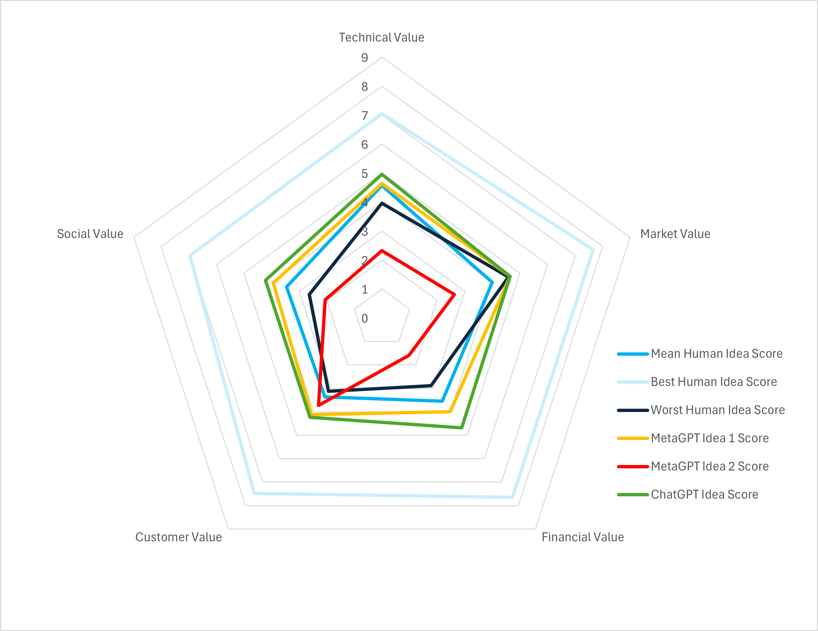
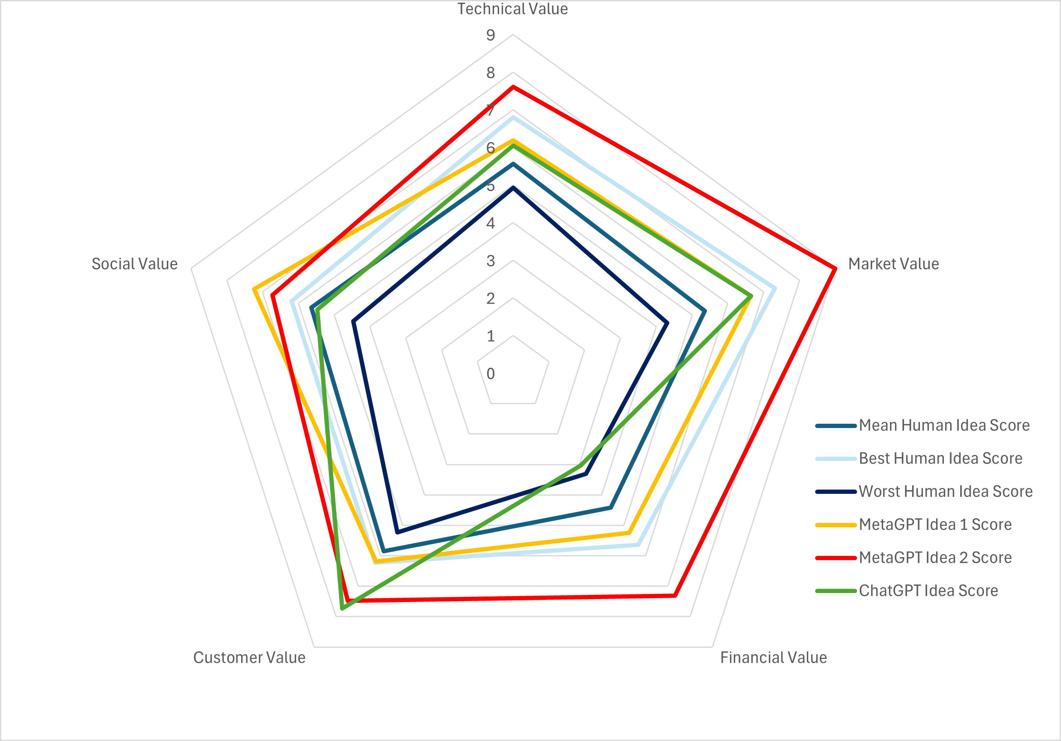
Scenario 1
Scenario 2

Slide 12

Thank you for listening!

