Slide 1
Flying Car
By Daniel Ha

Slide 2
Overview
History 1
History 2
Current Costs
Implementation
Pros 1
Pros 2
Cons
Summary
Reference

Slide 3
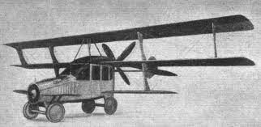
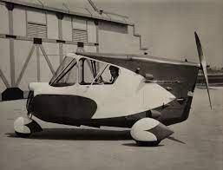
History
First Inventors:
Glenn Curtis - 1917
Waldo Waterman - 1937
Notes:
Curtiss Autoplane - In 1917, Glenn Curtiss, who could be called the father of the flying car, unveiled the first attempt at such a vehicle. His aluminum Autoplane sported three wings that spanned 40 feet (12.2 meters). The car's motor drove a four-bladed propeller at the rear of the car. The Autoplane never truly flew, but it did manage a few short hops.
Arrowbile - Developed by Waldo Waterman in 1937, the Arrowbile was a hybrid Studebaker-aircraft. Like the Autoplane, it too had a propeller attached to the rear of the vehicle. The three-wheeled car was powered by a typical 100-horsepower Studebaker engine. The wings detached for storage. A lack of funding killed the project.

Slide 4
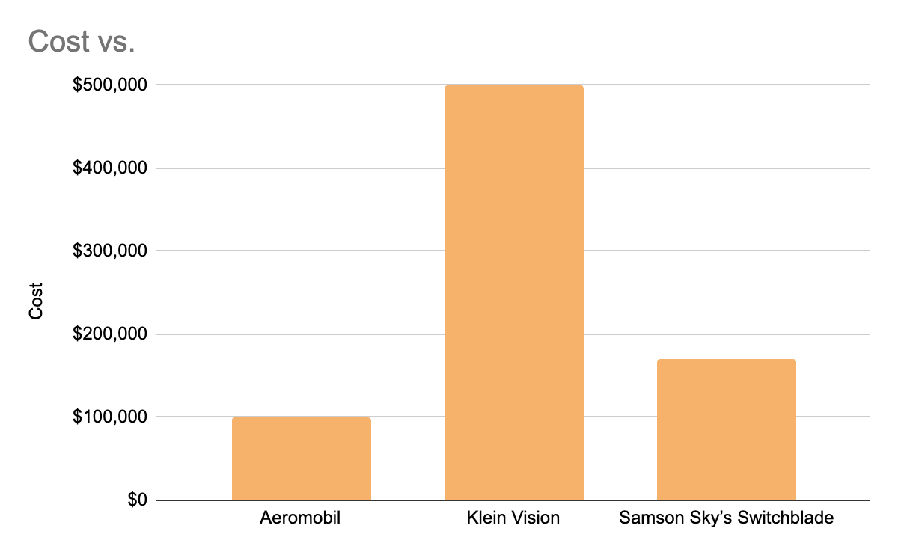
Current Costs
=

Slide 5
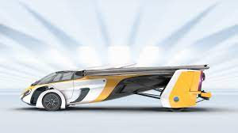
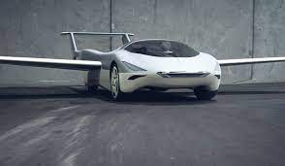
Implementation
There are many cars that are in testing, like the AeroMobil
And Klein’s Vision Car
Notes:
The evolution of the supercar is the AeroMobil. Inspired by the mythical winged horse Pegasus, the AeroMobil is the high-end vehicle species equally at home on the road or in the sky – the flying car.
The culmination of leading-edge automotive and aerospace design and engineering, advanced materials, luxury features, and impeccable styling, the AeroMobil does what no supercar or private jet can do.
It can seamlessly transform from car to aircraft – from driving to flying – in under three minutes.

Slide 6
Pros
Some of the Pros include:
Clear Roads (less cars on the ground)
Clear traffic jams (Cars distributed air and ground)
Lower gas emissions(over long distances)
Notes:
One of the biggest problems in most modern cities is traffic caused by road vehicles. Roads that were built a long time ago simply can’t cope with the huge number of cars, trucks and other vehicles that compete for space today. Staying on the theme of lower emissions and greater efficiency. Flying cars can take a much more direct route from point A to point B. This means less fuel is required and the journey times are much quicker as a result when compared to a journey on land. Journeys on land often involve many twists and turns, traffic signals and junctions, all of which reduce the efficiency of the journey and increase fuel consumption. Providing the manufacturers of these electric flying cars can make them effective around our cities in the future, it will free up the roads and the streets for pedestrians and cyclists.

Slide 7
Pros
Some more pros are:
Space for pedestrians and Cyclist (less space needed for cars)
Less need for roads (air travel becomes more used)
Fast (air quicker than ground)

Slide 8
Cons
The Cons include:
Expensive (since it is still at R&D)
Loud noises (loud engine)
Fatal accidents (risk of falling out of the air)
Notes:
As we have seen, flying cars require a significant amount of energy to get airborne. Depending on the technology used, this can come with much noise. A typical helicopter, for example, produces 100db in flight. Flying cars need to meet the technical standards of both aeroplanes and cars, therefore, being quite costly to build and maintain. They are also built on different structures and principles hence aerodynamic designing being very expensive.Flying cars could have mid-air collisions with other flying vehicles such as helicopters due to various reasons including poor visibility caused by weather changes or loss of control. In case of mechanical failures, an aircraft could fall from the sky or have an emergency landing which could result in property damage and deaths.

Slide 9
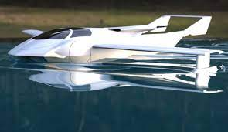
Summary
Overall I think that flying cars will benefit our society an is a good idea. The pros presented outweigh the cons and the cons are something that can be changed with time and research.

Slide 10
Reference
Advantages and disadvantages of flying cars - Rob Wreglesworth - 2023
What Are The Advantages And Disadvantages Of Flying Cars? The Pros And Cons - Virginia Mutero - 2023
How Flying Cars Will Work - Kevin Bonsor - no date
Aeromobil Site - Aeromobil - Recent
Klein Visions site - Klein Vision - Recent

