Slide 1
A Role-Aware Explainable AI Dashboard for Student At-Risk Classification in Learning Management Systems
Internal Thesis Defense
Master of Science in Computer Science
Daniel Larry
A00020528 | daniel.larry@aun.edu.ng
Supervisor: Dr. Zainab Shamsiya Usman
School of Information Technology and Computing, American University of Nigeria
Notes:
Good morning. My name is Daniel Larry, and I am presenting my MSc thesis, supervised by Dr. Zainab Shamsiya Usman. The thesis designs, builds and technically evaluates a dashboard that predicts which students are at risk of failing or withdrawing, explains each prediction with SHAP and LIME, and shows those explanations differently to instructors, academic advisors and administrators.

Slide 2
Presentation Outline
1
Background and problem statement
2
Aim, objectives and research questions
3
Research gap
4
Methodology: knowledge engineering
5
System design and implementation
6
Results: prediction and explainability
7
The role-aware dashboard
8
Contributions, limitations and conclusion
2
Notes:
This is the order of the talk. I start with the problem and what the study set out to do, then the method, the system I built, the results of the technical evaluation, the dashboard itself, and I close with the contributions, limitations and conclusions.

Slide 3
Background
LMSs such as Moodle, Canvas and Blackboard record rich data on how students engage
Learning analytics turns this data into insight, including early identification of at-risk students
Ensemble models already reach high accuracy on benchmarks such as OULAD
Less attention goes to what happens after a student is flagged
The practical problem
A score alone changes little.
A tutor told that a student has a 70% chance of failing needs to know why, whether the reason is actionable, and what a sensible next step would be.
3
Notes:
Learning Management Systems such as Moodle, Canvas and Blackboard record a great deal about how students engage. Learning analytics uses that data, and one of its most common uses is flagging students who may fail or withdraw. Ensemble models already do this accurately on benchmarks such as OULAD. What gets much less attention is the step after the flag: a score on its own does not tell a tutor why the student was flagged, or what to do about it. That gap is where this study sits.

Slide 4
Problem Statement
Risk scores without reasons
Most systems output a score with no account of the reasoning behind it.
1
One view for every role
Instructors, advisors and administrators decide different things, yet dashboards rarely differ by role.
2
XAI seldom built in, evaluation still generic
SHAP and LIME are mature but rarely integrated into working dashboards, and evaluation frameworks remain general.
3
Approach: treat it as a design and technical problem, structured with the CommonKADS knowledge engineering methodology.
4
Notes:
Three things make up the problem. First, most at-risk systems give a score with no reasoning behind it. Second, instructors, advisors and administrators make different decisions, yet dashboards usually give them all the same view. Third, SHAP and LIME are mature techniques, but they are rarely built into working learning analytics dashboards, and the ways XAI is evaluated in education are still generic. So I treat this as both a design problem and a technical problem, and I use CommonKADS to structure the design. One scope point up front: no practitioner data was collected, so usability and decision-making are not measured here.

Slide 5
Aim and Objectives
AIM
Investigate how a role-aware explainable AI dashboard can support at-risk student prediction in LMS environments, using OULAD as the empirical basis.
O1
Review
Predictive features, ML models and XAI techniques, plus the knowledge engineering and design principles for role-aware dashboards.
O2
Model and explain
Develop and evaluate an ensemble model on OULAD, with SHAP and LIME for global and instance-level explanations.
O3
Design and evaluate the dashboard
Implement role-specific views for instructors, advisors and administrators, and evaluate the prediction and explanation components.
5
Notes:
The aim is to investigate how a role-aware explainable AI dashboard can support at-risk prediction in an LMS, using OULAD as the empirical base. Three objectives follow from it: review the literature, build and evaluate the model with SHAP and LIME, and design and implement the role-aware dashboard and evaluate it technically.

Slide 6
Research Questions
RQ1
How can explainable AI techniques (specifically SHAP and LIME) be integrated into a knowledge engineering pipeline to improve transparency in student at-risk prediction models?
RQ2
What dashboard features and explanation structures, based on the CommonKADS Agent Model and the learning analytics dashboard literature, can be specified to support the different information needs of instructors, advisors, and administrators within an LMS?
RQ3
What do the predictive performance and explainability findings indicate about the technical potential of the proposed role-aware explainable dashboard to support practitioner interpretation and decision-making?
6
Notes:
These are the three research questions. RQ1 is about integrating SHAP and LIME into a knowledge engineering pipeline. RQ2 is about which dashboard features and explanation structures, grounded in the CommonKADS Agent Model and the dashboard literature, fit each role. RQ3 asks what the performance and explainability findings say about the dashboard's technical potential to support practitioners. I come back to each one in the conclusion.

Slide 7
Research Gap
Communication
Accurate models, but little attention to how predictions reach practitioners.
Role tailoring
The only role-specific XAI dashboard found (Afzaal et al.) targets students.
Multi-role dashboards
No dashboard found serving instructors, advisors and administrators from one model.
Knowledge engineering
Little work on SHAP and LIME output as knowledge delivered per role.
Evaluation
Frameworks remain generic across stakeholder groups.
This study: one shared prediction system, three role-specific explanation views, designed with CommonKADS and technically evaluated.
7
Notes:
The literature review points to five related gaps. Accurate ensemble models exist, but how their predictions reach practitioners gets little attention. XAI in education is rarely tailored to roles: the only role-specific XAI dashboard I found, Afzaal and colleagues, is for students. Dashboards usually serve one type of user, and I found no study serving all three staff roles from one shared model. Little work treats SHAP and LIME output as knowledge to be delivered, and evaluation frameworks are generic. This study brings these together.

Slide 8
Methodology: Knowledge Engineering
CommonKADS knowledge engineering methodology
Core problem: represent the knowledge the prediction system produces and deliver it to each role according to its needs
1
Knowledge acquisition and organisation analysis
2
Knowledge and system modelling
3
Artefact design and development
4
Technical evaluation
Iterative, with feedback between phases; knowledge acquired from published literature
Supporting: Design science (DSRM)
Structures the research steps around the built artefact
Supporting: TAM
Design lens for usefulness and ease of use; not tested empirically
8
Notes:
The methodology is knowledge engineering, using CommonKADS. I chose it because the central design problem is a knowledge problem: how to represent the knowledge the prediction system produces, the predictions and their SHAP and LIME explanations, and deliver it to instructors, advisors and administrators according to what each of them needs. The work ran in four iterative knowledge engineering phases: knowledge acquisition and organisation analysis, knowledge and system modelling, artefact design and development, and technical evaluation. Knowledge acquisition drew on published literature, not interviews, because no practitioners were involved. Design science, following Peffers and colleagues, structures the research steps around the artefact, and the Technology Acceptance Model is only a design lens, not tested.

Slide 9
CommonKADS Models in This Study
Organisation
Scores arrive without reasons, one view for all.
→ Serve three roles from one prediction system
Task
Assess risk, explain, assign role, deliver.
→ Layered architecture
Agent
Needs of each staff role, from the literature.
→ Individual, caseload and cohort views
Knowledge
Engagement, assessment and demographic features.
→ Feature dictionary with readable labels
Communication
Selective explanations phrased for the reader.
→ SHAP and LIME side by side, role-gated
Design
Maps all models onto the system.
→ Five layers with role-based access
9
Notes:
Each of the six CommonKADS models was applied to a concrete part of the design. The Organisation Model shows where at-risk information breaks down. The Task Model splits the work into risk assessment, explanation, role assignment and delivery. The Agent Model describes what each role needs; it is built from published evidence, not from interviews, so it is a well-sourced hypothesis. The Knowledge, Communication and Design Models give the feature dictionary, the way explanations are shown, and the five-layer architecture.

Slide 10
Dataset: OULAD
32,593
records
22
module presentations
52.8%
at risk
59
features
Withdrawn 10,156 + Fail 7,052
At risk: 17,208
Pass 12,361 + Distinction 3,024
Not at risk: 15,385
Engagement
VLE clicks, active days, clicks 7, 14 and 28 days before deadlines
Assessment
Submissions, mean and lowest score, lateness, banked results
Demographic and registration
Age band, IMD band, education, region, prior attempts, credits
10
Notes:
The data is the Open University Learning Analytics Dataset: 32,593 student-module-presentation records over 22 module presentations. The target is binary. Withdrawn and Fail become at risk, which gives 17,208 cases or 52.8 percent; Pass and Distinction become not at risk. So the classes are only mildly imbalanced. Note that withdrawals are 59 percent of the positive class, so the model is best read as mainly a withdrawal predictor. There are 24 input columns, 59 features after one-hot encoding, in three families.

Slide 11
System Architecture
Presentation
React: instructor, advisor and administrator views
LMS integration (tested)
Moodle 5.2
Native plugin; uses Moodle login, roles and enrolments
Interface / API
Flask, JWT login, role-based access control
Explainability
TreeSHAP global (cached), LIME local (on demand)
Canvas
Dashboard embedded via External URL module item
Prediction engine
XGBoost pipeline, versioned joblib artefact
Docker Compose
API, Moodle and Canvas in one local deployment
Data layer
pandas, deadline-anchored feature engineering
11
Notes:
The system has five layers, following the CommonKADS Design Model. The data layer builds deadline-anchored features with pandas. The prediction engine serves a versioned XGBoost pipeline. The explainability module caches global TreeSHAP values and runs LIME on demand. The Flask API handles JWT login and role-based access control, and the React front end gives the three role views. Everything runs under Docker Compose, and I tested two LMS integration paths: a native Moodle 5.2 plugin and a Canvas External URL embed, with all 22 module presentations loaded as courses.

Slide 12
Prototype Model Performance (XGBoost)
0.877
Accuracy
0.866
Precision
0.909
Recall
0.887
F1-score
0.962
ROC-AUC
Confusion matrix (threshold 0.5)
Evaluation protocol
GroupKFold, 4 folds by course presentation
Out-of-fold predictions for all 32,593 rows
300 trees, depth 5, no tuning or resampling
Retrospective: features span the full presentation
 | Predicted not at risk | Predicted at risk
Not at risk | 12,963 | 2,422
At risk | 1,574 | 15,634
15,634 of 17,208
at-risk students correctly flagged
12
Notes:
These are out-of-fold results for the prototype XGBoost model, using GroupKFold grouped by course presentation, so each prediction comes from a model that never saw that presentation. Accuracy is 0.877, precision 0.866, recall 0.909, F1 0.887 and ROC-AUC 0.962. Recall matters most here: of 17,208 at-risk students the model catches 15,634 and misses 1,574. The cost is 2,422 false positives, about 15.7 percent of the not-at-risk group, which a practitioner can review and set aside. These figures are retrospective, because features cover the whole presentation.

Slide 13
Comparing the Three Ensemble Models
Model | Accuracy | Precision | Recall | F1-score
XGBoost (prototype) | 0.877 | 0.866 | 0.909 | 0.887
Random Forest | 0.892 | 0.900 | 0.896 | 0.898
Gradient Boosting | 0.887 | 0.890 | 0.896 | 0.893
Shaded: best value in each column
Random Forest
Highest F1 (0.898), accuracy and precision
XGBoost: kept
Highest recall (0.909), the pre-set selection criterion: a missed at-risk student gets no support
F1 gap between best and worst model: 0.011
13
Notes:
All three models were run under the same pipeline and the same GroupKFold protocol. They sit in a narrow band. Random Forest has the highest F1, 0.898, and the highest accuracy and precision. XGBoost has the highest recall, 0.909. Because recall was set in advance as the selection criterion, since missing an at-risk student costs more than reviewing one who turns out fine, XGBoost stays in the prototype. The F1 gap between best and worst is only 0.011, and Random Forest is worth revisiting if priorities change.

Slide 14
Variability Across Course Presentations
2013
Precision above 0.95, recall 0.86 to 0.88
2014
Recall up to 0.963, precision 0.81 to 0.82
Range
Accuracy 0.846 to 0.916: generalise pooled figures with care
14
Notes:
Because each fold holds out a whole presentation, I can report results per presentation. Performance is not uniform. The 2013 presentations have very high precision, above 0.95, but lower recall. The 2014 presentations show the reverse, with recall up to 0.963 for 2014B but precision around 0.81. Accuracy ranges from 0.846 to 0.916. With only four groups I cannot pin down the cause, but it means the pooled figures should be generalised with care.

Slide 15
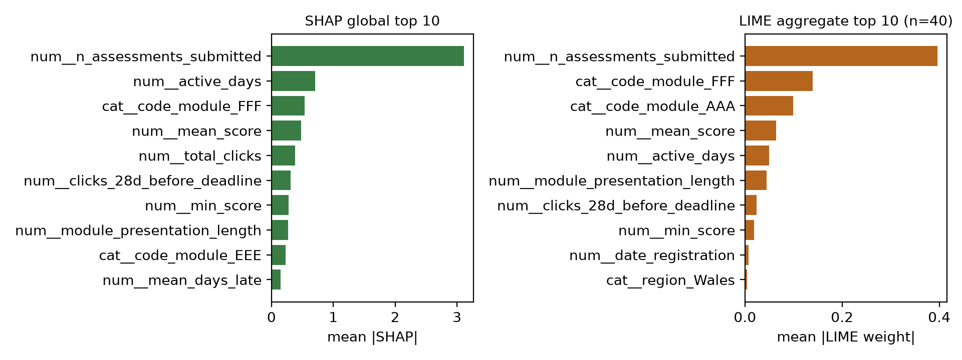
Explainability: SHAP and LIME
#1
Assessments submitted leads in both methods
6
further features shared in each top 10
0.635
mean top-5 overlap per student (SD 0.197)
Attributions describe how the model behaves, not what causes student outcomes.
15
Notes:
Global TreeSHAP was run on all 32,593 records, and LIME on a random sample of 40 students. Both methods put assessments submitted at the top, by a wide margin. They share six more features in their top ten. At the level of individual students, the average top-five overlap is 0.635, so on average just over three of the five leading features agree. Agreement is partial, which is why the dashboard shows both. These are attributions about the model's behaviour, not causes of student outcomes. For example, clicks in the 28 days before deadlines pushes towards at-risk, which is most likely collinearity with total clicks.

Slide 16
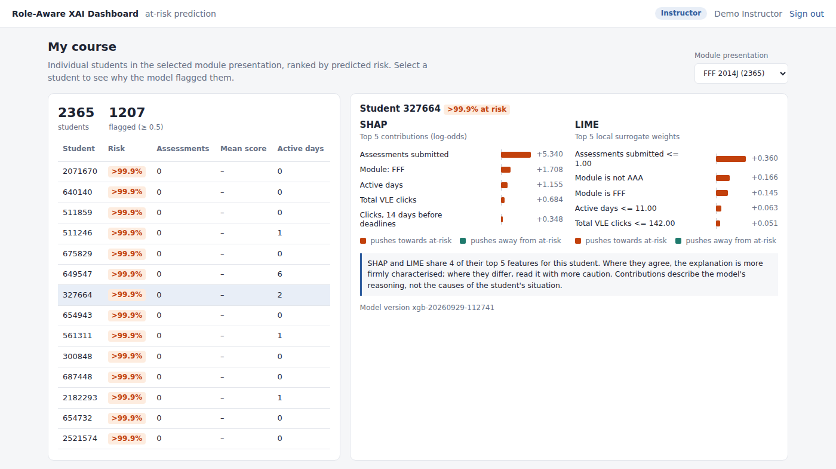
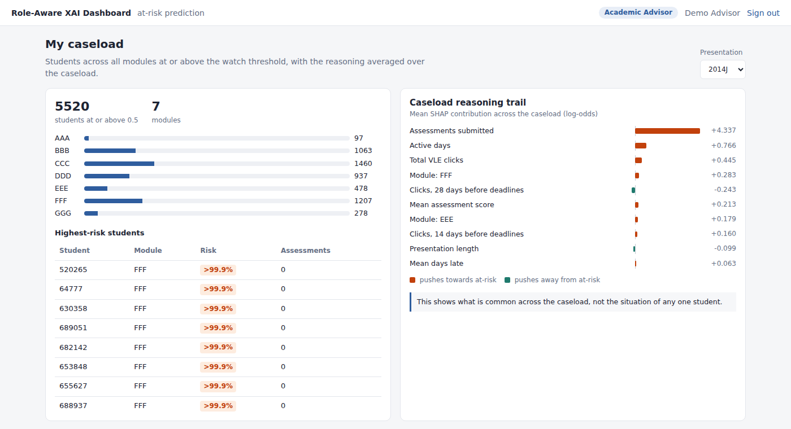
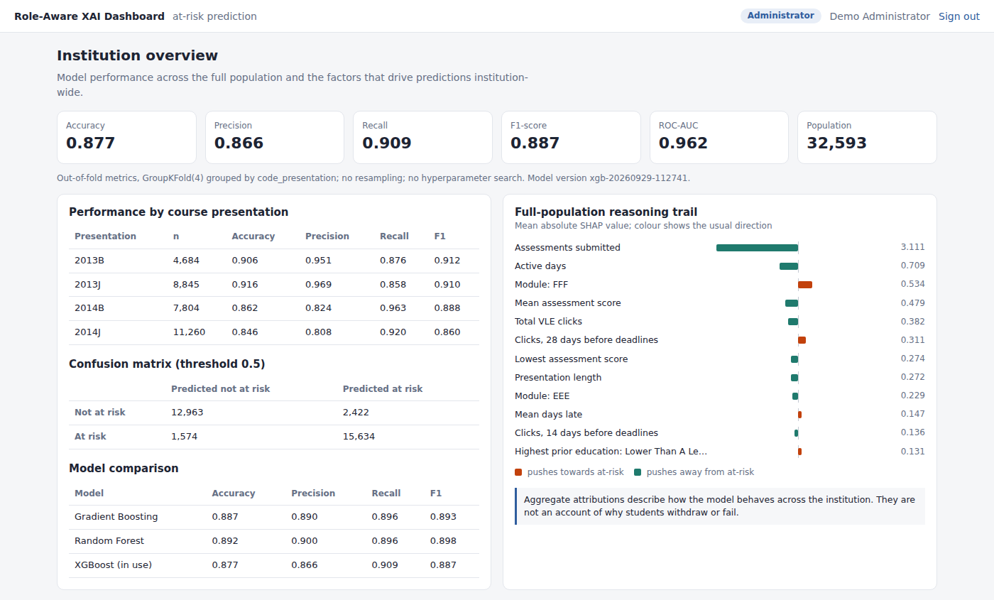
Role-Aware Dashboard: Three Views
Instructor
Advisor
Administrator
Individual
Caseload
Cohort
Decision
Acts within a running course
Shows
Per-student SHAP and LIME, side by side
Decision
Prioritises a caseload, plans 1:1 talks
Shows
Reasoning averaged over flagged students
Decision
Directs institutional resources
Shows
Model performance and population-wide drivers
Same prediction, different depth of explanation for each role
16
Notes:
This is the core design idea. Every role sees the same prediction, but at a different depth. The instructor works inside a running course and sees individual students with SHAP and LIME side by side. The advisor manages a caseload and sees reasoning averaged over students at or above the watch threshold. The administrator directs resources and sees institution-wide performance and the full-population reasoning trail. These views were derived from the Agent Model and the literature and have not yet been tested with users.

Slide 17
Instructor View in Detail
1
Students ranked by predicted risk in the selected course
2
SHAP and LIME top 5 side by side, with direction of effect
3
Agreement note: 4 of 5 top features shared for this student
17
Notes:
Here is the instructor view for module FFF, presentation 2014J. Students are ranked by predicted risk. Selecting one shows the top five SHAP contributions and the top five LIME weights next to each other, colour-coded by whether a feature pushes towards or away from at-risk. A note says how many features the two methods share for this student, here four of five, and reminds the reader that contributions describe the model's reasoning, not the student's situation. The same views also run inside Moodle as a plugin and inside Canvas.

Slide 18
Contributions
1
Prediction and explanation in one running system
The explanation layer serves the interface directly, not as an offline analysis.
2
Role-aware treatment of explanation
Distinct views derived from each role's responsibilities and questions.
3
CommonKADS applied to explainable learning analytics
Shows the design problem is largely a knowledge problem.
4
Evidence on SHAP and LIME agreement
Where the methods converge and differ, at global and local level.
18
Notes:
There are four contributions. First, a working system where prediction and explanation run together, with the explanation layer serving the interface directly, rather than explanation as an offline analysis. Second, role-aware explanation: distinct views derived from each role's responsibilities, with the reasoning documented. Third, a methodological one: applying CommonKADS shows that the design problem here is largely a knowledge problem. Fourth, evidence on where SHAP and LIME agree and differ, at global and local level.

Slide 19
Limitations and Future Work
Limitations
No practitioner data: trust, usability and decision quality untested
Retrospective features: no early-warning point evaluated
One dataset (OULAD) and context
Stability, fidelity, calibration and fairness checks not completed
Future work
Early-warning evaluation at weeks 2, 4, 6 and 8
Probability calibration (Platt, isotonic)
Subgroup fairness assessment
Practitioner study using TAM constructs
Other institutions and live data
19
Notes:
I want to be clear about the limits. No practitioner used the system, so trust, usability and decision quality are untested. Features cover the whole presentation, so this is retrospective classification, not early warning. The study uses one dataset. The planned stability, fidelity, calibration and fairness checks were not completed. The future work follows directly: the three first-tier priorities are early-warning evaluation, calibration and a fairness assessment, and then a practitioner study and other institutions' data.

Slide 20
Conclusion
RQ1
SHAP (global, cached) and LIME (local, on demand) integrated in a CommonKADS-designed pipeline; they agree on the main drivers and partly differ per student.
RQ2
Individual, caseload and cohort views derived from the Agent Model and implemented; not yet tested with users.
RQ3
Technical preconditions in place: recall 0.909, reasons traceable to recorded behaviour, cross-checked methods. Practitioner value is still to be shown.
A working, technically evaluated prototype and a foundation for practitioner validation.
20
Notes:
To close, the answers. RQ1: SHAP and LIME were integrated into a pipeline designed with CommonKADS, with global SHAP cached and LIME on demand; they agree on the main drivers and partly differ for individual students. RQ2: individual, caseload and cohort views were derived from the Agent Model and implemented; they are specified, not yet user-tested. RQ3: the technical preconditions are in place: high recall, reasons traceable to recorded behaviour, and cross-checked methods. Whether practitioners benefit is the next study. Thank you, I welcome your questions.

Slide 21
THANK YOU
Questions and comments are welcome
Notes:
Thank you. I am happy to take your questions.

