Slide 1
Executive Summary: Renewable Energy Mix for DAC Operations
Energy Mix Optimisation Pipeline

Slide 2
Why This Matters for DACMA
Electricity carbon intensity can materially reduce net CO2 removal performance.
This workflow identifies the lowest-GWP supply mix under local resource and land constraints.
Outputs are decision-ready: capacity targets, expected grid reliance, and net GWP impact.

Slide 3
Pipeline Overview
Ingest hourly NASA POWER weather data (solar irradiation, wind speed, temperature).
Convert weather into hourly PV and wind generation potential per MW installed.
Simulate hourly battery dispatch and residual grid imports to meet demand.
Grid-search PV/Wind capacities to minimize lifecycle GWP per kWh under land limits.
Publish data tables and figures for operational and strategic review.

Slide 4
Core Assumptions
PV: 15% conversion efficiency, temperature derating above 25 C, 0.07 kg CO2e/kWh.
Wind: standard power curve (3/12/25 m/s), 0.011 kg CO2e/kWh.
Land use factors: PV 0.02 km²/MW; Wind 0.26 km²/MW.
Battery: 120 MWh, 90 MW, 90% discharge efficiency, 20% minimum state of charge.
Grid: always available to close deficits at 0.6 kg CO2e/kWh.
Demand profile: hourly scaling to annual target with heat-driven uplift above 30 C.

Slide 5
Land Limitation: Why Wind Can Be Zero
Hard constraint in example case: total land available = 1,000 km² (largest PV farm is ~600 km²)
Land intensity: PV 0.02 km²/MW vs Wind 0.26 km²/MW (~13x larger for wind).
Capacity implied by land limit: PV up to 50,000 MW vs Wind up to 3,846 MW.
Optimisation objective minimizes gross GWP of delivered electricity while meeting demand hourly.
Site data signal: PV delivers ~24.7x more annual energy per km² than wind in current inputs.
Resulting behaviour: wind is often excluded because allocating scarce land to PV displaces more high-GWP grid energy.

Slide 6
Optimisation Logic and KPIs
Primary objective: minimise gross average GWP of delivered electricity (kg CO2e/kWh).
Net reporting: subtract configured annual atmospheric removal credit (default 5000 tCO2e/year).
Key outputs: optimal PV/Wind MW, source shares, annual emissions, net GWP, curtailment.
Sensitivity mode: evaluate how source shares and net GWP shift with demand level.

Slide 7
Current Results Snapshot
Demand sweep: 7,900 to 9,500 MWh/year (8 demand points).
Best net GWP in sweep: -0.333 kg CO2e/kWh at 7,900 MWh/year.
Grid share trend: 38.1% at low demand -> 47.9% at high demand.
At best net GWP point: PV 61.9%, Wind 0.0%, Grid 38.1%.

Slide 8
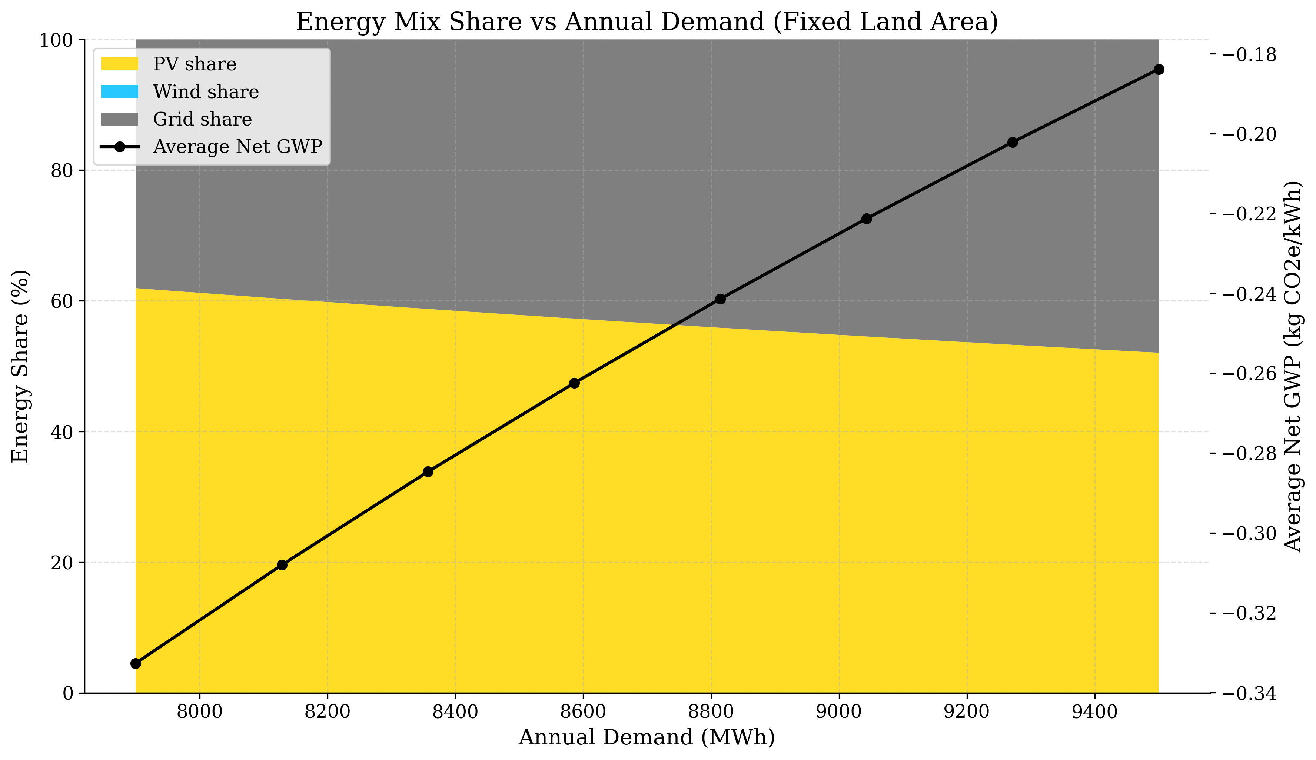
Demand Sensitivity: Energy Mix
Source share changes as annual demand increases.

Slide 9
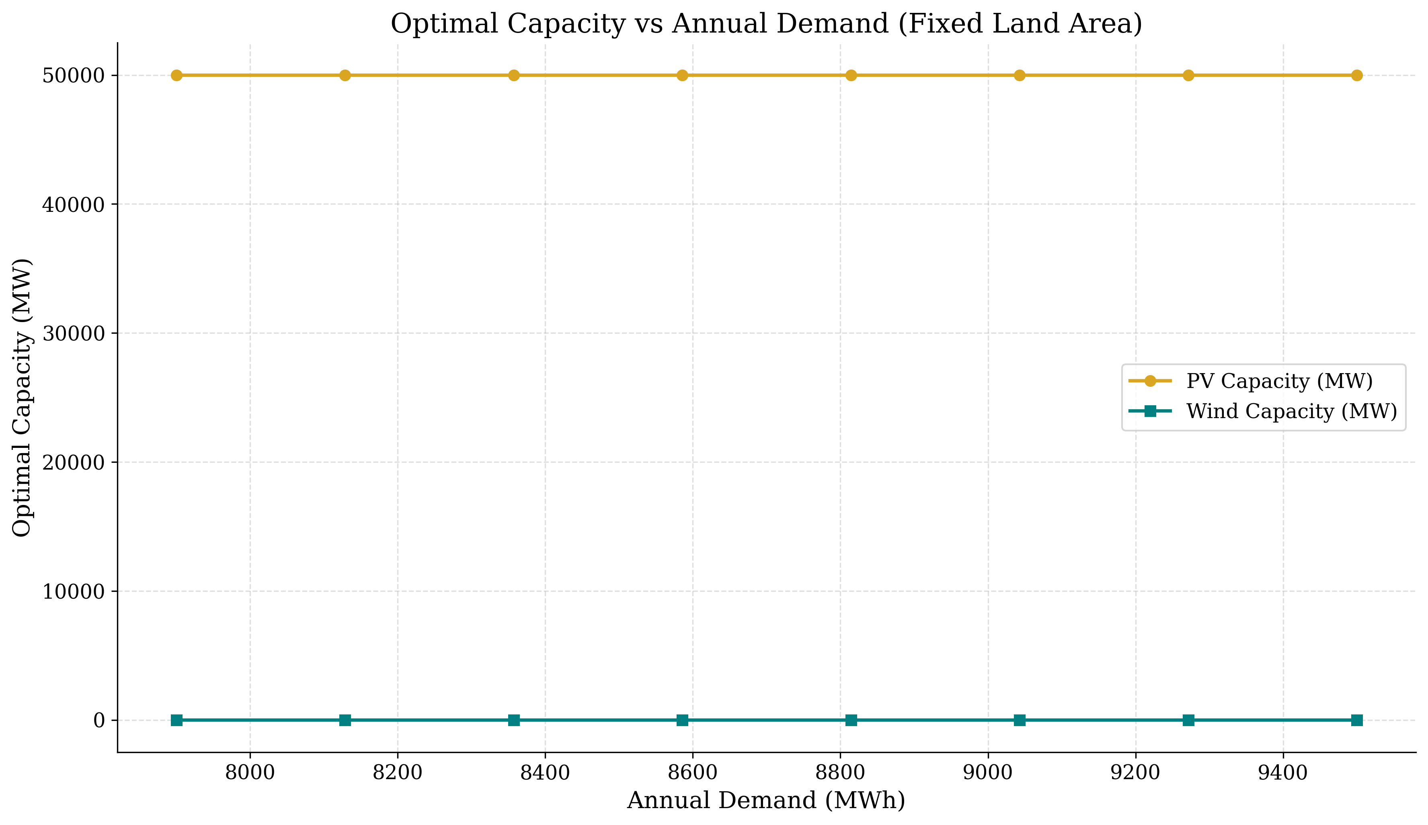
Demand Sensitivity: Capacity Requirements
Installed PV/Wind capacity and resulting net GWP across demand points.

Slide 10
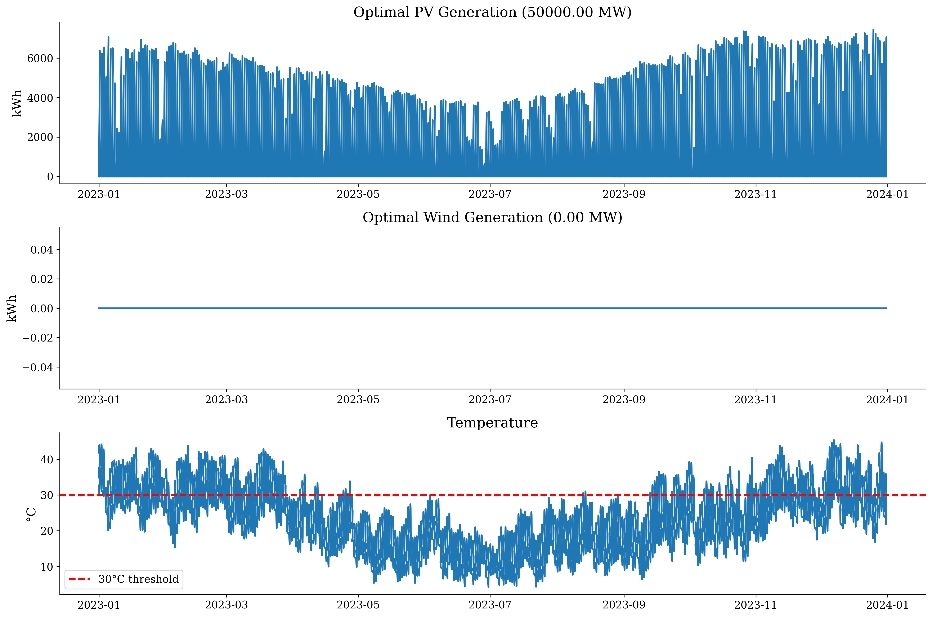
Operational Profile (Example Optimal System)
Hourly patterns for renewable generation, battery use, and demand coverage.

Slide 11
Business Value to a DAC Company
Improves confidence in net-removal claims by tying energy sourcing to emissions outcomes.
Supports land and infrastructure planning with transparent capacity-to-performance trade-offs.
Enables procurement strategy for PPAs and firming based on modeled grid dependence.
Provides a repeatable baseline for techno-economic and financing due diligence.

Slide 12
Recommended Next Steps
Co-optimise battery size (MWh/MW) with PV/Wind capacity to reduce grid reliance further.
Add dynamic grid emissions and electricity pricing to evaluate cost-carbon frontiers.
Run uncertainty ranges for weather years and component performance degradation.
Integrate this model with plant-level DAC operations for dispatch-aware optimization.

