Slide 1

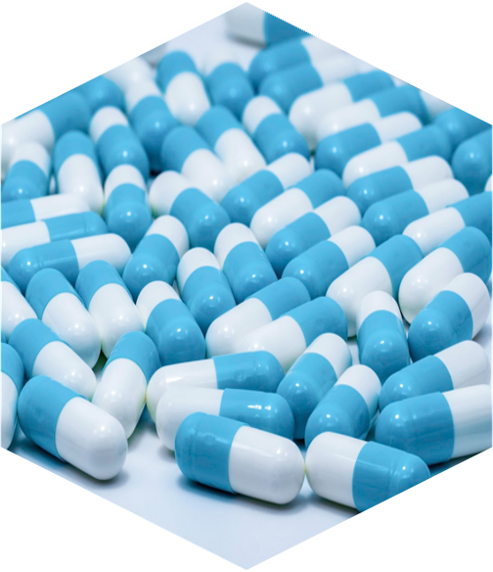




Organic dyes
Biopolymer synthesis
citronellal
chitin
Natural products
Medicinal chemistry
Organic chemistry
indigo
hyaluronic acid
Organic materials
Cosmetics
nylon 6,6
aspirin

Slide 2
Catalysis
energy
[Cat]
catalyst: substance that increases the rate of a chemical reaction without itself undergoing any permanent chemical change.
Notes:
In this context, the discovery of catalytic reactions is especially relevant. A catalyst accelerates a reaction without being consumed, meaning it can be used in substoichiometric amounts and therefore helps to minimize waste. Moreover, catalysts can open up unconventional reaction pathways by lowering activation barriers, enabling transformations that would otherwise be unfeasible, such as could be the case of palladium catalists in the amination of aryl bromides.

Slide 3
Typical “organometallic catalyst”
Catalyst contains both metal and organic ligands
Notes:
These organometallic catalysts which feature both a metal center and a organic ligand sphere have been particularly impactful

Slide 4
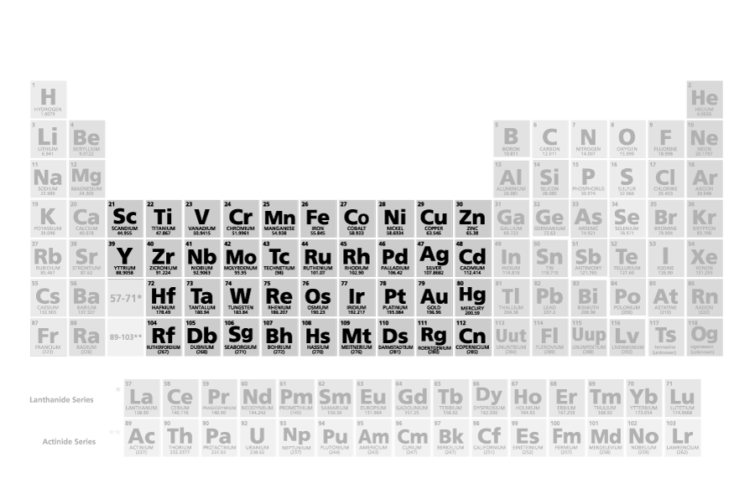
Typical “organometallic catalyst”
Catalyst contains both metal and organic ligands
organic ligands
Notes:
In great part because of the wide variety of transition metals available, each one exhibiting different properties, and the versatility provided by the broad arrange of ligands that can be used.

Slide 5
Organometallic reactions
Cross coupling
C-H functionalization
No pre-functionalized substrates
Notes:
In this context, in recent decades, many chemists have turned their attention to direct, one step metal-promoted C–H functionalization reactions because they allow a much more rapid increase in molecular complexity from native/non-functionalized precursors. This strategy involves the activation of a C–H bond with the transition metal catalyst to form an organometallic intermediate that can then be further functionalized.

Slide 6
Ligand-substrate supramolecular interactions
Supramolecular
recognition unit
Notes:
In recent years there has been also a significant progress in the design of bidentate neutral ligands that, equipped with supramolecular recognition sites, which interact with functional groups on the substrate and help position the iridium center for meta- or para-selective C–H activation.

Slide 7
Mechanism: Non-covalent interactions
Network of attractive interactions between the carbonyl group of the benzamide and the CF3-pyridine ring of ligand
SMD_{THF}/M06/6-311++G(2d,p)+SDD(Ir)//M06/6 31G(d) +LANL2DZ(Ir)
Notes:
A closer examination revealed an extensive network of attractive interactions between the amide carbonyl and the CF₃-substituted pyridine ring, stabilizing the transition state.

Slide 8
Mechanism: NBO analysis
πC=O ⇢ π*C-C
Outer-sphere substrate-ligand interactions
SMD_{THF}/M06/6-311++G(2d,p)+SDD(Ir)//M06/6 31G(d) +LANL2DZ(Ir)
Notes:
Natural Bond Orbital (NBO) analysis indicated that dispersion interactions between the amide carbonyl π-bonding orbital and the CF₃-pyridine π*-antibonding orbital led to a shorter distance between the carbonyl group and the pyridine ring that enhancesselectivity. The electron-withdrawing nature of CF₃ strengthened these interactions, driving the preference for ortho borylation.

Slide 9
Mechanism: isomerization step
IEFPCM_{THF}/M06/6-311++G(2d,p)+SDD(Ir)//M06/6 31G(d) +LANL2DZ(Ir)
Notes:
This ligand repositioning alters the complex topology, transitioning from one distorted pentagonal bipyramidal structure to another, where the alkyl and boron groups are better aligned for reductive elimination.

Slide 10
Mechanism: isomerization step
IEFPCM_{THF}/M06/6-311++G(2d,p)+SDD(Ir)//M06/6 31G(d) +LANL2DZ(Ir)
Notes:
Given this, we explored alternative mechanistic pathways that could better align with these findings. Our computational studies identified a more favorable pathway leading to the reductive elimination step, which involved an isomerization of the ligands after C–H activation.

Slide 11
General conclusions
favours ortho borylation
allows N-Me borylation
Notes:
So finally, as general conclusions I can say that the work of this PhD thesis has allowed us to discover two new types of chemo- and regioselective iridium-catalyzed borylation reactions, one for the ortho-borylation of aromatic amides and other for the N-methyl borylation of aliphatic amides.
Through experimental and computational mechanistic studies, we have identified the existence of unconventional dispersion non-covalent interactions between the substrate and the designed CF₃-containing bipyridine ligands as the key factor responsible for the controlled reactivity and exceptional selectivity of these reactions.

Slide 12
General conclusions
Notes:
So finally, as general conclusions I can say that the work of this PhD thesis has allowed us to discover two new types of chemo- and regioselective iridium-catalyzed borylation reactions, one for the ortho-borylation of aromatic amides and other for the N-methyl borylation of aliphatic amides.
Through experimental and computational mechanistic studies, we have identified the existence of unconventional dispersion non-covalent interactions between the substrate and the designed CF₃-containing bipyridine ligands as the key factor responsible for the controlled reactivity and exceptional selectivity of these reactions.

Slide 13
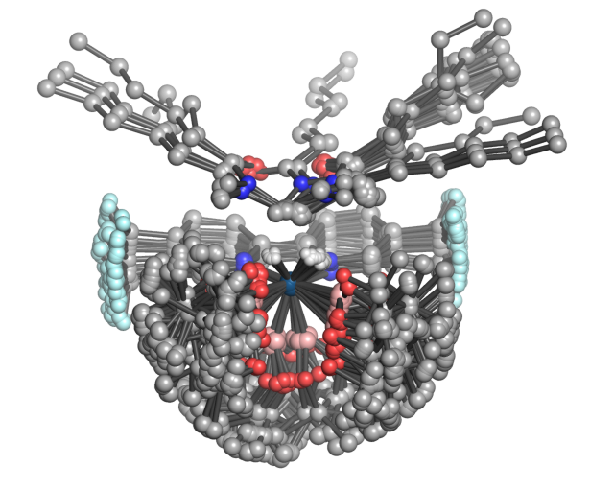

Slide 14
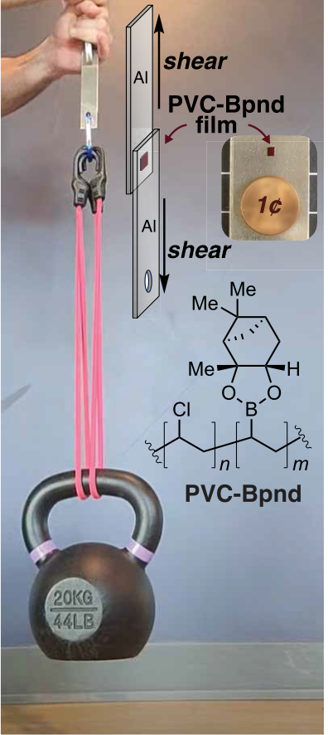
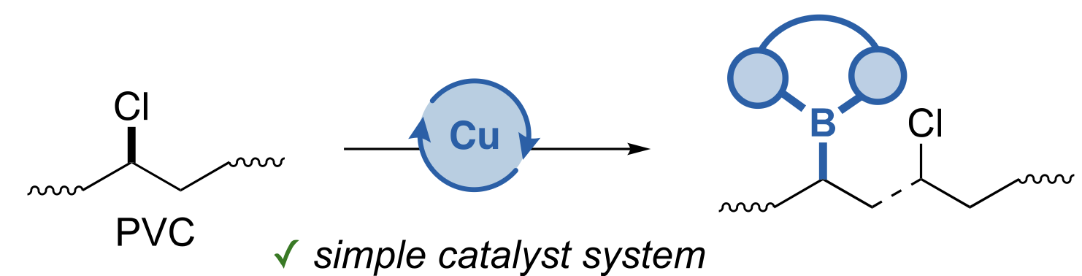

Slide 15

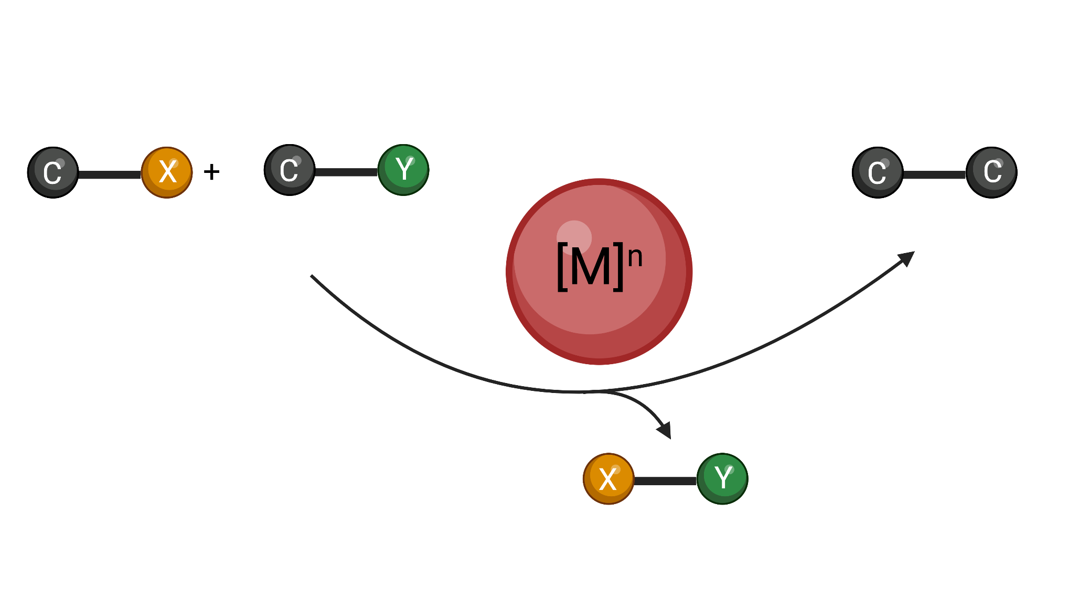
Notes:
Among the different bioorthogonal transformations based on Transition metal complexes, those involving the formation of C-C bond in biological media are very scarce

Slide 16
Notes:
Among the different bioorthogonal transformations based on Transition metal complexes, those involving the formation of C-C bond in biological media are very scarce

Slide 18
