Slide 1

Git: From zero to not crying
By Alfonso Banda

Slide 2

I’m Alfonso Banda
From Frontend as Lead Consultant
Centene

Slide 3

Agenda
What is Git?
States of a file
Basic Commands
Git Flow
Main branch
Pull Request
Git Rebase
Git Merge
Conflicts
Git Hosting providers

Slide 4
What is Git?
Created by Linus Torvalds in 2005
Distributed Version Control System
Helps you to fix your mess (if you make a mistake, there is almost always a way to fix it)
it’s involved in all the development and delivery process

Slide 5
Why is important and useful?
Cloud-based version control system that tracks changes in any set of files.
Used for coordinating work among programmers who are collaboratively.
Enterprise grade solution for development and production.

Slide 6
Download and Install Git
Git - Downloads (git-scm.com)
Open bash (windows) or terminal (mac) and type command git --version

Slide 7
States of a file
Untracked: File created but not tracked
Modified: File already tracked before, modified but not staged
Staged: File has been modified and is ready to be committed
Committed: Changes has been saved and tracked on git history.

Slide 8
Basic Commands
git init
git add
git commit
git pull
git push
git remote

Slide 9
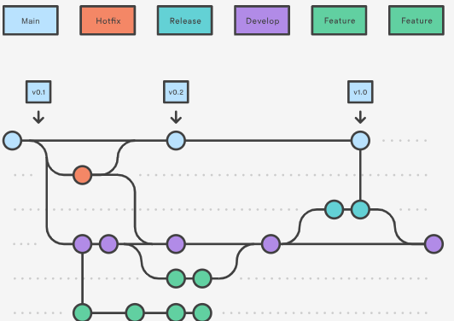
Git Flow
Git Flow atlassian

Slide 10
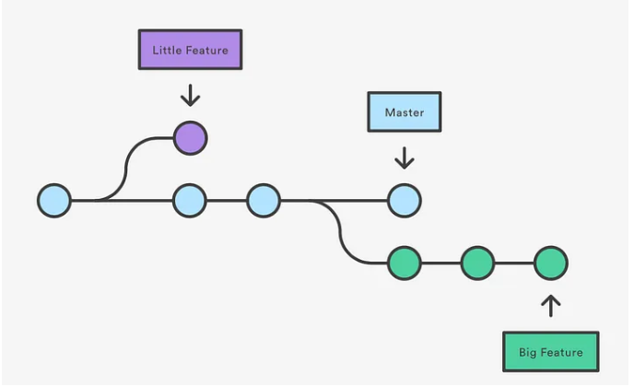
Main branch (Don’t touch it unless you know what are you doing)
by convention this branch is used for production deployments, should be stable and before any merging, all the changes should be properly tested and verified.

Slide 11

Pull Request
Tool used for verifying code changes before passing to a principal branch.
Example: Pokedex Pull Request

Slide 12
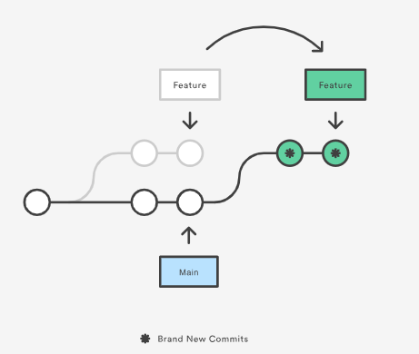
git rebase
Rebasing is the process of moving or combining a sequence of commits to a new base commit. Rebasing is most useful and easily visualized in the context of a feature branching workflow.

Slide 13
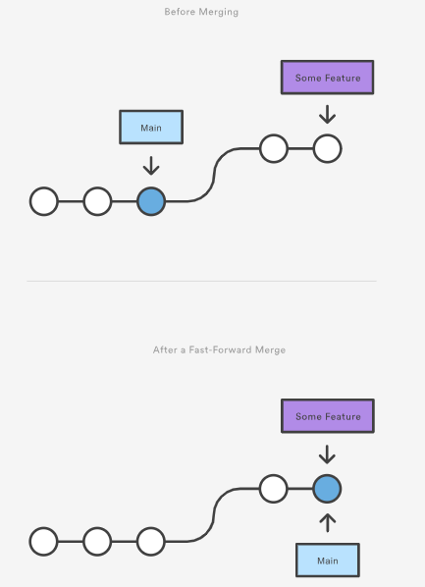
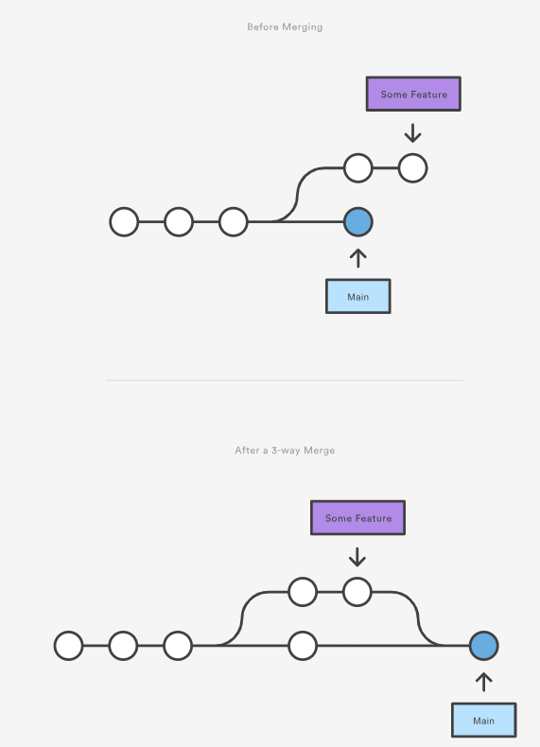
Git Merge: Key aspects
Git merging combines sequences of commits into one unified history of commits.
There are two main ways Git will merge: Fast Forward and Three way
Git can automatically merge commits unless there are changes that conflict in both commit sequences.

Slide 14
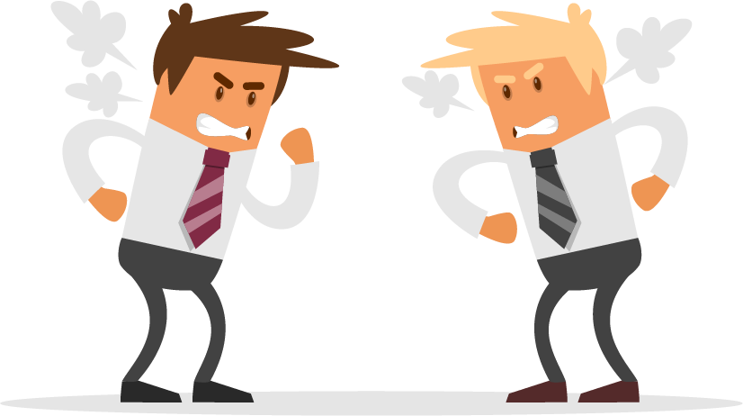
Conflicts: “Anything that can go wrong will go wrong.”
“Conflicts generally arise when two people have changed the same lines in a file, or if one developer deleted a file while another developer was modifying it”

Slide 15





Git: Hosting Providers

Slide 16
Github
Git is a command-line tool, but the center around which all things involving Git revolve is the hub.
1.- Create account GitHub.
2.- Create repository for class.
3.- Create first folder
4.- Download and Install github desktop. GitHub Desktop | Simple collaboration from your desktop
5.- clone repository from github (remote) to your computer (local)
*GitHub limits the size of files allowed in repositories to less than 50 MiB.

Slide 17
Support and references
https://education.github.com/git-cheat-sheet-education.pdf
https://www.atlassian.com/git/glossary#commands

Slide 18

Thank you!

Slide 19
Don’t forget to submit your IC points!!!

Slide 20
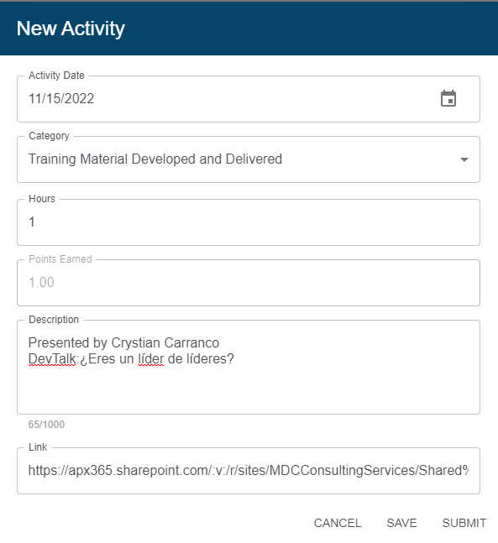
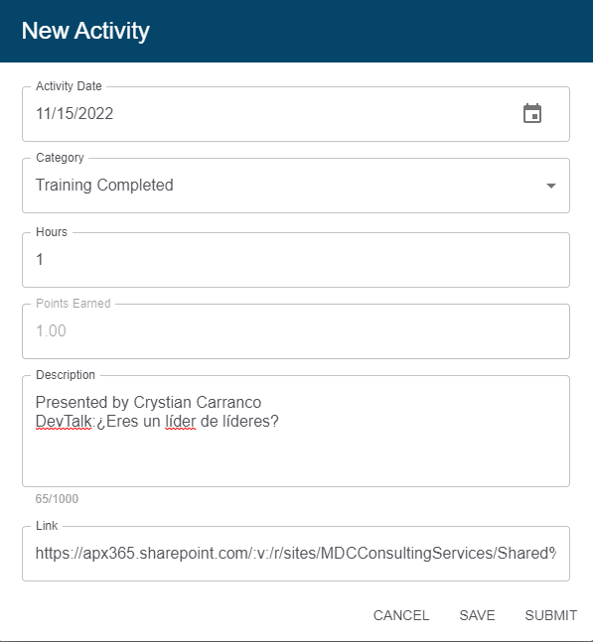
Presenter Audience

