Slide 1
WorkshopLM
OPENAI BUILD WEEK · WORK & PRODUCTIVITY
A source-grounded production workspace for serious teams
Project overview · Build Week 2026

Slide 2
Notebook-style research,
but built to finish the work
WORKSHOPLM
PROJECT BRIEF

Slide 3
Teams do not need another place to collect notes
The gap
Meetings, PDFs, links, and voice capture accumulate faster than teams can turn them into aligned, polished deliverables.
The opportunity
Preserve the source trail, shape thinking spatially, approve the brief, then generate a coherent set of finished assets.

Slide 4
One workflow turns raw thinking into controlled production
CAPTURE
SHAPE
DELIVER
Talk, paste, or connect bounded source material.
Keep provenance from the first segment.
Cluster and edit evidence on the Map.
Approve exactly one brief.
Apply the locked style.
Approve the storyboard, then render.

Slide 5
Three product choices make WorkshopLM meaningfully different
GROUNDING
Every claim retains a source and locator.
CONSISTENCY
DESIGN.md locks visual intent across outputs.
CONTROL
Brief and storyboard are the only approval gates.

Slide 6
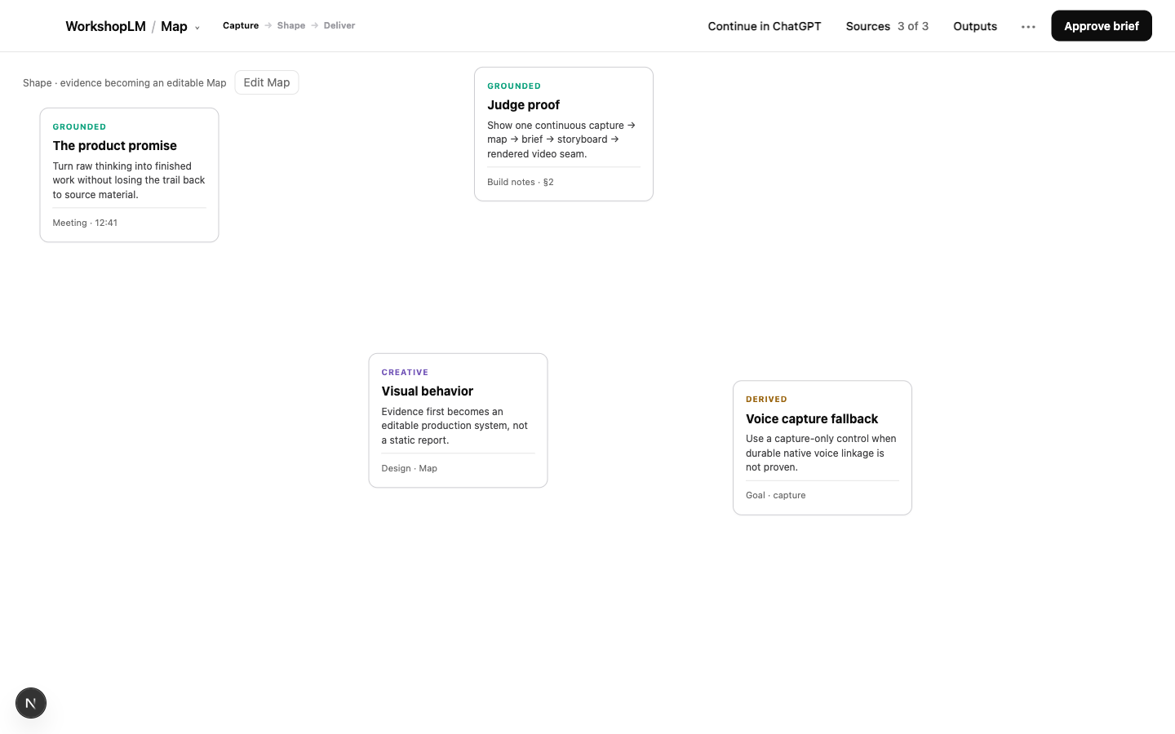
The Map makes grounding visible
Evidence becomes an editable spatial model—not a chat summary.
Claims carry grounded, derived, creative, or unverified states.
The Map becomes the brief only after approval.

Slide 7
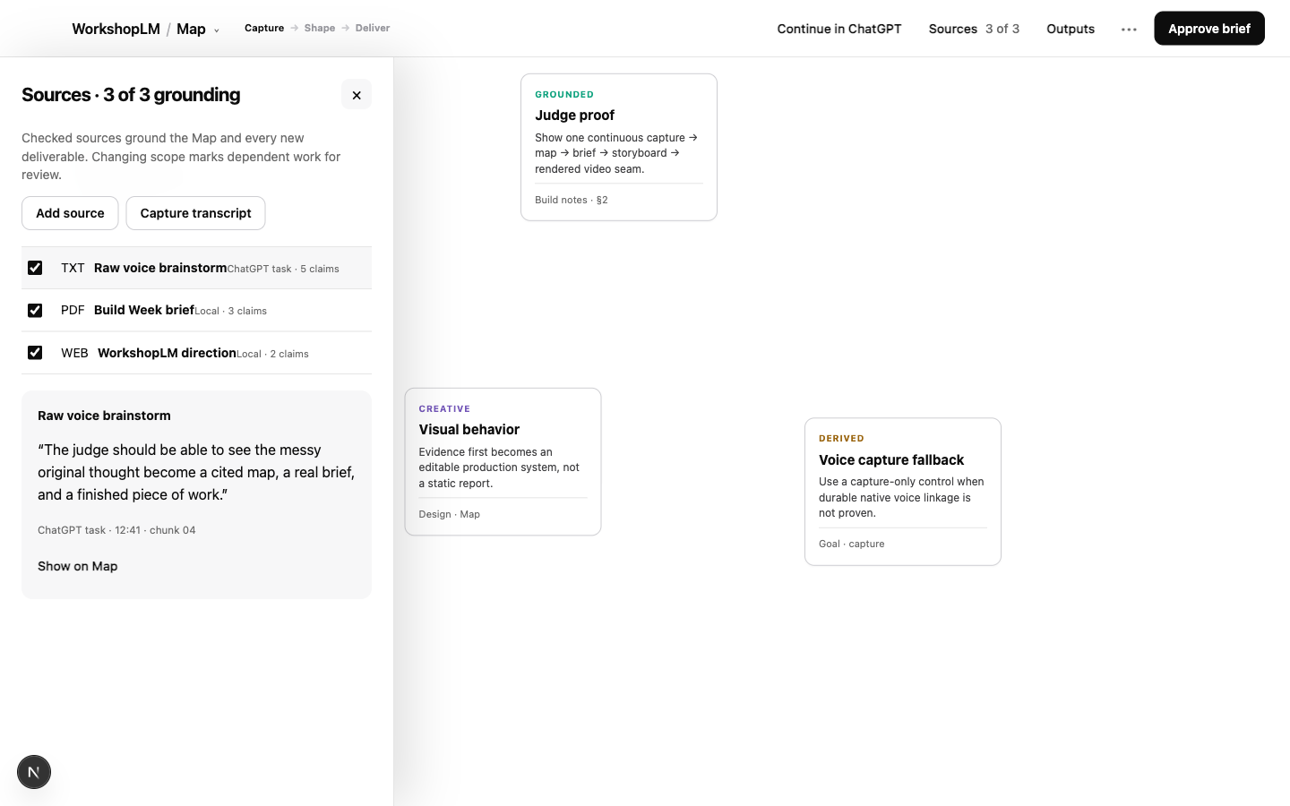
Sources stay one gesture away
Local files, pasted text, public URLs, and captured transcript segments are normalized into bounded evidence.
Source details preserve the exact locator and a path back to the Map.

Slide 8
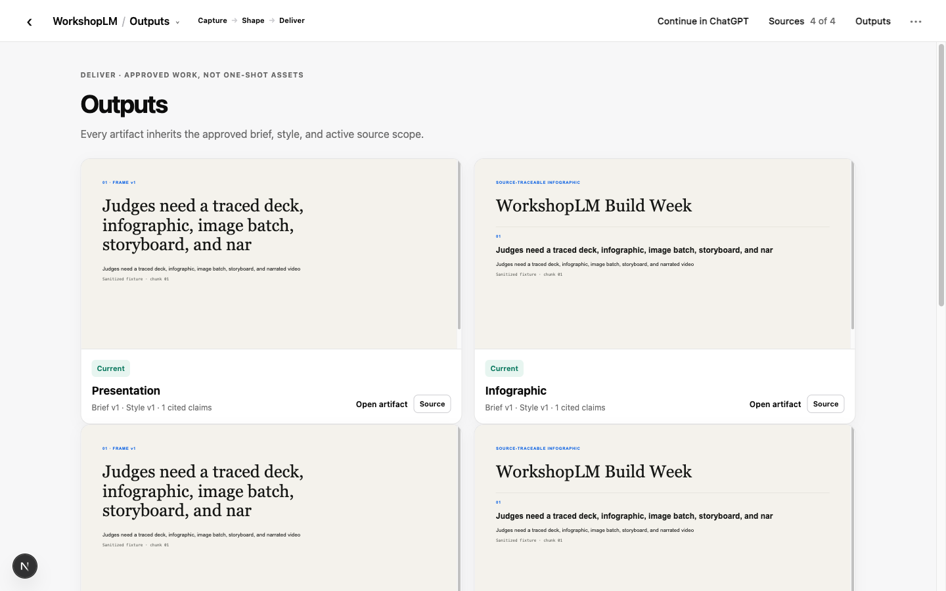
Finished outputs look—and behave—like real artifacts
Decks, infographics, image sets, storyboards, and video open as genuine visual previews.
Quiet badges show source count, brief/style version, and current or stale state without turning the gallery into a dashboard.

Slide 9
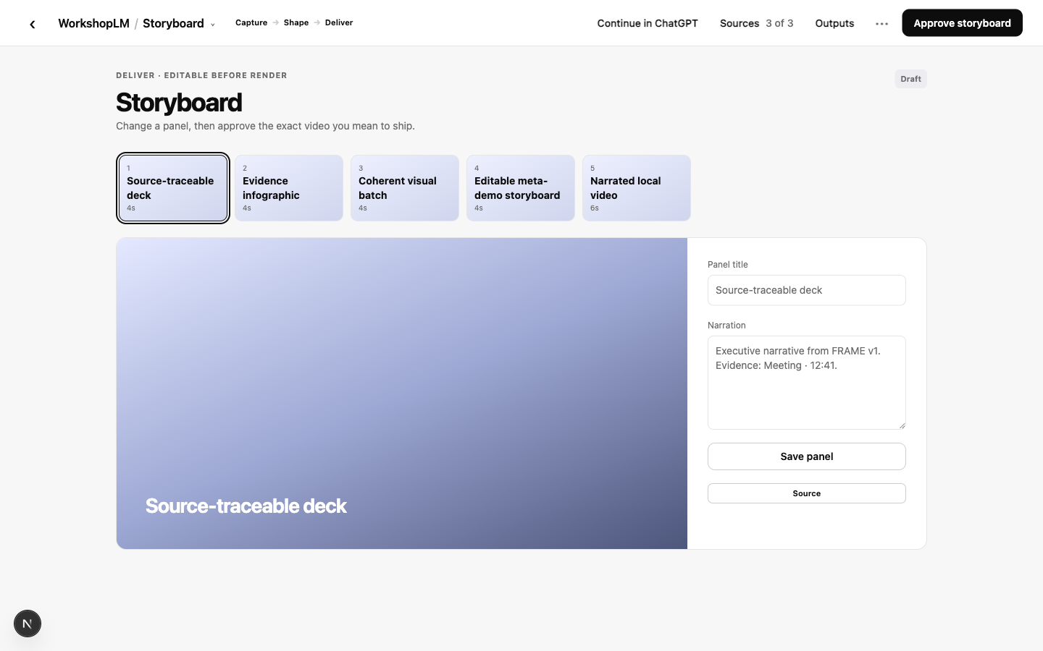
Storyboard approval protects the expensive render
Panels stay editable before video generation.
Teams can change title, narration, duration, and sequence before approving the final render.

Slide 10
The demo architecture is local by design
CHATGPT / CODEX
Conversation, connected context, and the app doorway.
WORKSHOPLM UI
A strong visual workspace in the in-app browser.
LOCAL ENGINE
SQLite, deterministic retrieval, artifact storage, jobs, and HyperFrames.

Slide 11
The deterministic floor is already real
The local product builds, typechecks, lints, and runs the capture → Map → brief → style → storyboard → video seam. These are fixture-mode engineering results—not live-provider proof.
PASS
6 / 6
5
Recorded fixture
Acceptance gates
Storyboard panels

Slide 12
The remaining gap is provider evidence, not product plumbing
The build is honest about its boundary: a strong, runnable production system with deterministic substitutes where provider calls have not yet been authorized.
VERIFIED NOW
Local sources, citations, Map edits, stale propagation, approvals, queue recovery, artifact rendering, plugin install.
NOT PROVED YET
Paid GPT-5.6 generation, a real gpt-image-2 coherent batch, final TTS narration, native host persistence.
Build + typecheck + lint
Recorded seam passes
UI verified in-app
Spend authorization
Spike A host decision
Final recording proof

Slide 13
The submission proves the product by using the product
RAW INPUT
Capture a dated, messy founder brainstorm as source material.
FINISHED PACKAGE
Generate the deck, visuals, storyboard, video, README, and Devpost copy from one approved brief.
THE REVEAL
Show the polished submission first—then reveal the unedited source that created it.
1
2
3

Slide 14
WorkshopLM should be one focused ChatGPT App—not a mini operating system
HOST RESPONSIBILITY
ChatGPT handles conversation, connected apps, search, and model interaction. WorkshopLM opens as the visual workspace for shaping and production.
WORKSHOPLM RESPONSIBILITY
Own the Map, source/claim graph, approvals, DESIGN.md, output coherence, and artifact trace. Keep direct app-to-app orchestration out of the promise until proven.

Slide 15
The plugin ecosystem is a capability map, not a dependency list
Presentations
Editable decks + QA
HyperFrames
Local video rendering
Figma / Canva
Design handoff lessons
Record & Replay
Demo capture evidence
OpenAI Developers
API, models, Apps SDK
Browser
Real in-app QA
Granola / Zoom
Meeting evidence
Google Drive / Slack
Team knowledge

Slide 16
Four plugins should materially shape the hackathon build
OpenAI Developers
Use now for model routing, Realtime, image generation, Apps SDK, and claim-safe API choices.
Browser + HyperFrames
Use Browser for the judge-visible local UI; use HyperFrames locally for the approved-storyboard video seam.
Presentations
Use now as a real WorkshopLM output path: editable deck, rendered previews, overflow checks, and provenance.

Slide 17
Five plugin families are valuable references—not new runtime seams
Granola / Zoom / Drive / Slack
Learn source discovery, permission-aware retrieval, citations, and bounded handoff. Use one sanitized connector in the demo, not four.
Remotion / ChatCut / Sites
Keep one video fallback, one optional finishing tool, and Sites as a stretch output. Avoid parallel pipelines before the demo is locked.
Figma / Product Design / Canva
Learn progressive disclosure, brand systems, editable handoff, and review loops. Keep WorkshopLM’s flagship visual experience native.

Slide 18
Plugin adoption needs four hard guardrails
Research conclusion
The unified Apps model validates WorkshopLM’s direction: one conversational host, one focused interactive app, MCP-backed tools, and connected knowledge. Sources: help.openai.com Apps SDK + Apps in ChatGPT; developers.openai.com/codex/use-cases.
Judge reliability
No connector, login, network call, or paid credit may be required to understand the video.
Host boundary
Do not claim private ChatGPT integration or direct app-to-app orchestration until live proof exists.
One seam
Every plugin must strengthen capture → Map → brief → outputs → storyboard → video.
Provenance
Imported context must become a local source with exact locators and evidence states.

Slide 19
The next 48 hours should convert proof into a film
TODAY
Authorize provider spend; run GPT-5.6, image, and TTS evidence. Close Spike A. Record the founder brainstorm.
NEXT
Deduplicate output cards, finish the real image preview, and rehearse the simplified UI. Repair only recording-visible friction.
THEN
Record the first full video early. Iterate the submission package from captured proof—not promises.
JUL 14
JUL 15
JUL 16

Slide 20
Five founder actions unlock the winning version
Everything else remains delegated to the build loop.
Recommended ceiling: $25 for routing benchmark, coherent image batch, and narration proof. No spend occurs without explicit approval.
Authorize a bounded OpenAI spend ceiling.
Close Spike A: provide a disposable task ID or declare capture fallback final.
Record a dated founder brainstorm and preserve the original file.
Run /feedback from the primary Codex task and record the Session ID.
Protect July 16 for the first complete video recording.

Slide 21
A seam-free demo beats
another week of features
RECOMMENDATION
WORKSHOPLM

