Slide 1
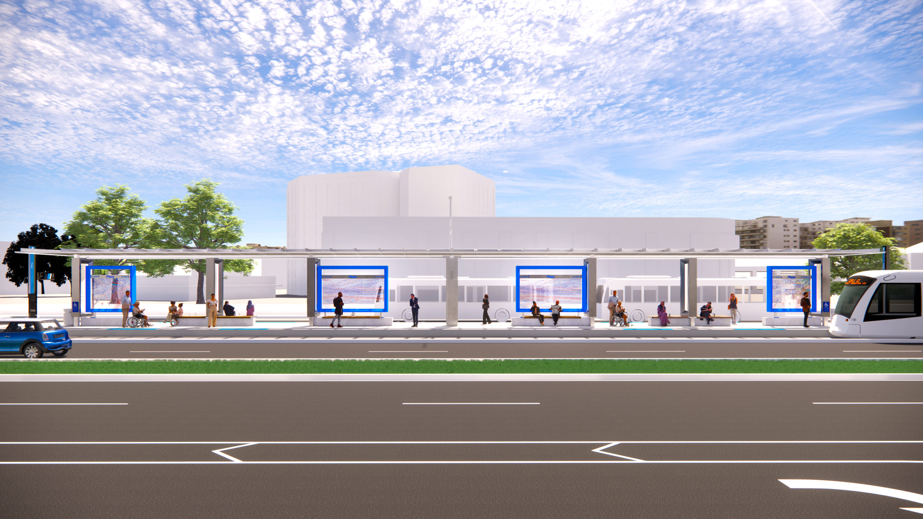
StreetCart KC
Kansas City's streetcar-led food access pilot
StreetCart KC converts Kansas City's fare-free streetcar corridor into a gamified food access backbone, using sports-team volunteer tournaments to move grocery boxes from transit hubs into the city's worst food deserts for $20-35 per delivered box.
Oracle-led city proposal
Muse inside the pitch
Thin live demo linked
11-slide deck • live site • worklog evidence
46,400
3M lbs
1,000 lbs
Residents hit by store closures
Federal supply shortfall
Produce rescue window
Four grocery closures in 2024-2025 landed inside USDA food-desert ZIPs.
Harvesters reports a 3 million-pound quarterly gap after the TEFAP cut.
Emergency tomatoes and peppers must be routed through cold-chain partners inside 48 hours.
Team Codex KC • Oracle Track • 60-day pilot plan

Slide 2
StreetCart KC
Team Codex KC • Oracle Track
Kansas City's food access problem is visible in three numbers
Lead with the facts that make the StreetCart response feel necessary, not decorative.
46,400
3M lbs
1,000 lbs
Residents hit by store closures
Federal supply shortfall
Produce rescue window
Four grocery closures in 2024-2025 landed inside USDA food-desert ZIPs.
Harvesters reports a 3 million-pound quarterly gap after the TEFAP cut.
Emergency tomatoes and peppers must be routed through cold-chain partners inside 48 hours.
Who this proposal is for
City food-access lead who needs a visible 60-day win and a renewal case
Pantry and nonprofit partners who need one operating picture instead of fragmented phone trees
Residents in priority ZIPs who need bilingual instructions and predictable pickup windows
Volunteer teams who need a reason to show up more than once
Priority ZIP proof anchors
64130
18.2% food insecurity • 38% no vehicle • zero pantry hits in sampled API query
66101
24.1% food insecurity • 62.8% Hispanic • partner-fed expansion case beyond the corridor
Source set: challenge brief, harvest, pantries, demographics, supply alerts.
Use only the three numbers judges will remember. Save the rest for backup.

Slide 3
StreetCart KC
Team Codex KC • Oracle Track
StreetCart KC fixes the access layer in one visible operating loop
The streetcar is the public spine. Partners and feeder hubs do the neighborhood fulfillment.
Challenge data
Pilot priorities
Streetcar hubs
Resident instructions
Verified completions
harvest + pantries + alerts + demographics
ZIP ranking and weekly hub schedule
Recurring civic-facing pickup windows
Bilingual SMS and partner-assisted intake
Pickup, delivery, and verification ledger
Public proof loop
Households served • verified points
Phase 2 expansion uses KC's free bus network to extend reach beyond the corridor.
Borrowed operating pattern: Baltimore pickup points, Atlanta transit visibility, Philadelphia coordination layer.
This slide should explain the whole company in one pass.

Slide 4
StreetCart KC
Team Codex KC • Oracle Track
Start narrow: four hubs, five ZIPs, one 60-day pilot
Streetcar-facing hubs create the public story. Partner feeders extend access where the corridor alone cannot.
River Market Hub
Union Station Hub
Streetcar spine
Streetcar spine
Tue / Thu · 8:00 AM - 11:00 AM
Tue / Thu · 4:00 PM - 6:00 PM
Harvesters + After the Harvest KC
Bishop Sullivan Center + Harvesters
Serves 64127, 64130
Serves 64130, 64132
Westport Hub
Cross-Lines Connector Hub
Streetcar spine
Partner bridge
Wed / Fri · 11:00 AM - 2:00 PM
Wed / Fri · 11:00 AM - 2:00 PM
Guadalupe Centers + KC Community Gardens
Cross-Lines + El Centro
Serves 64127, 64128, 64132
Serves 66101, 66105
Pilot ZIPs
66101 • 64127 • 66105 • 64130 • 64128 • 64132
Exact streetcar stop names can change. The logic is fixed: civic spine plus feeder reach.

Slide 5
StreetCart KC
Team Codex KC • Oracle Track
$500K contract: use the first 60 days to prove renewal
The brief says $500K revenue, $150K operating costs, and 60 days to prove it works. This budget spends like a pilot, not a capital project.
$150K
$120K
$150K
Pilot operations (60 days)
Tech build
Direct 60-day pilot opex
30% of contract • Staff, food top-ups, cold-chain supplies, vans, insurance, gas cards, and contingency.
24% of contract • Dispatch and gamification platform, kiosk integration, routing, dashboard, and QA.
Field staffing and partner hub support
Food handling, cold-chain support, and produce triage
Bilingual SMS and resident outreach
Volunteer operations and event execution
$100K
$80K
Marketing + branding
Streetcar wrap + renewal
20% of contract • Campaign creative, co-branding, launch events, PR, and bilingual outreach.
16% of contract • Winning-team wrap, maintenance, and a seed runway into Season 2.
$50K
This is the spend that proves the pilot works.
Evaluation
10% of contract • Third-party evaluator, survey design, and the final report.
The direct pilot opex callout is the number to say out loud when judges ask about feasibility.

Slide 6
StreetCart KC
Team Codex KC • Oracle Track
What the city gets back in 60 days
Score StreetCart on completed access, not app vanity metrics.
3,000-5,000
5,000-7,500
150K-250K
>70%
Unique households served
Total deliveries completed
Pounds distributed
Priority ZIP share
Households reached across the six highest-priority ZIPs during the 60-day pilot.
Verified boxes moved through hubs, routes, and selective delivery assists.
Combined donated and purchased food moved through partner-led operations.
Delivery volume held in 64127, 64128, 64130, 64132, 66101, and 66105.
Renewal triggers
Why this is more fundable than another store bet
3,000-5,000 households served with more than 70% of volume in the six worst ZIPs
Fully loaded delivered-box cost held below $35 with a 3:1 to 5:1 donated-food leverage ratio
Volunteer retention above 40% for repeat drivers and route claimers
Community vote cleared in 66101 and 66105 inside 14 days
Uses existing assets and partners instead of new capital build-out
Creates a visible city proof loop with public accountability
Works as a thin operating layer judges can imagine renewing quickly
Say 'renewal case' at least once. That is the city-buying lens.

Slide 7
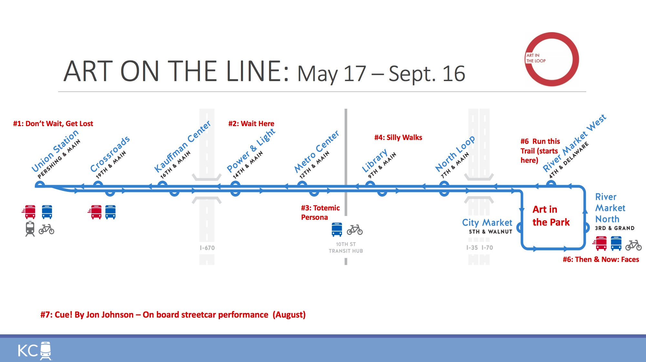
StreetCart KC
Team Codex KC • Oracle Track
Muse proof lives inside the pitch, not beside it
Civic structure leads. Sports energy makes people remember it.
Station scoreboard mock
Winning wrap prize
Resident-facing proof
WEEK 3 LEADERBOARD
Su proxima recogida de StreetCart KC
Chiefs Kingdom
1248
CHIEFS KINGDOM
Miercoles · 11:00 AM a 2:00 PM · Cross-Lines Connector Hub. Lleve una bolsa reutilizable. No se requiere identificacion. El Centro tendra apoyo en espanol en el sitio.
Royals Respond
1176
Sporting KC
1032
Renewal-phase reward that turns volunteer pride into a public civic signal.
Si no puede llegar, responda AYUDA para solicitar entrega prioritaria.
KC Current
984
Every Muse artifact must still point back to households served.

Slide 8
StreetCart KC
Team Codex KC • Oracle Track
What judges can touch in under two minutes
The live site is a thin proof: operator dashboard, resident instructions, and public leaderboard.
KPI
ZIP
Hub
StreetCart KC
Critical
66101
River
Miércoles · 11:00 AM - 2:00 PM
Chiefs Kingdom
1248
Critical
64127
Union
Cross-Lines Connector Hub
Royals Respond
1176
Critical
66105
Westport
No ID needed • reply AYUDA for delivery
Sporting KC
1032
Operator dashboard
Resident instruction view
Public leaderboard
priority ZIPs • next hub • KPI cards
English / Español
verified points only
Shows the pilot schedule, partner assignment, ZIP priority ranking, and the one curveball-ready operating lever.
Shows one example household getting a clear pickup message with a fallback for selective delivery.
Shows the tournament without losing the core metric: verified completions in priority ZIPs.
If the site raises more questions than confidence, cut features until these three views are clean.

Slide 9
StreetCart KC
Team Codex KC • Oracle Track
AI mastery is visible because the process is visible
Do not just claim AI use. Show how it changed the concept, the data choices, and the artifacts.
What AI actually did
Artifacts judges can inspect
Eight challenge endpoints were reduced to one operating fact base: alerts, demographics, harvest routes, closures, pantries, transit, scoreboards, and budget.
Curveballs were absorbed into the same model instead of being bolted on as side memos or appendix slides.
Oracle, Muse, and Architect now all read from one data spine, which keeps the deck, dashboard, and static site consistent under deadline pressure.
This deck and its source script
The live site showing the same pilot data
The data strategy memo
The timestamped worklog
Worklog moments
10:47 AM — cut low-signal APIs and lock the core data inputs
10:51 AM — streetcar beats bus as the brief's right answer, with bus kept as phase-two reach
10:55 AM — start a live reasoning log to prove iteration instead of reconstructing it later
AI mastery score target: show intentional direction, not accidental generation.
Reference docs: streetcart-kc-spine.md, data-strategy.md, 2026-03-28-worklog.md

Slide 10
StreetCart KC
Team Codex KC • Oracle Track
The hard questions already have answers
Reserve one slide for direct objections so the curveball lands as proof of discipline, not improvisation.
This is branding, not operations
The streetcar cannot carry food
The package leads with households served, ZIP targeting, partner staffing, and verified completions before it shows the bracket.
Phase one never depends on cargo on trains. The streetcar is the city-facing spine while partners and feeder hubs handle fulfillment.
Why not just use buses?
Why is this better than pantry outreach today?
Buses expand reach in phase two, but the streetcar is the most visible Kansas City-specific organizing line for a 60-day proof.
It gives the city one public operating layer for schedules, resident guidance, volunteer turnout, and proof instead of fragmented referrals.
Slides 9-11 should feel like judge defense: evidence, objections, then the curveball.
Keep the rebuttals operational. Avoid defensive copy.

Slide 11
StreetCart KC
Team Codex KC • Oracle Track
Curveball response
StreetCart KC handles the vote requirement and the 48-hour produce surge without changing the streetcar-backed, partner-led model.
Two curveballs. Same operating spine.
Voto y Verdura in 66101 + 66105
1,000 lbs in a 48-hour perishables window
66101 + 66105 • 14 days
1000 lbs • 48 hours
Spanish-first, trust-based outreach runs through El Centro Academy, Cross-Lines, tiendas, laundromats, and produce pop-ups instead of downtown civic channels.
Cold storage, not demand, is the binding constraint, so produce is routed to four partner sites that can hold or move perishables immediately.
Trusted anchors
Operating moves
Route
Lbs
Cold chain
El Centro Academy pickup line
Cross-Lines distribution windows
Minnesota Avenue bus stop pop-ups
Days 1-3: collect support at trusted anchor sites
Days 4-10: run produce giveaways with support forms in every bag
Days 11-13: send bilingual two-person canvass teams into the densest blocks
Cross-Lines
400
Walk-in cooler
Guadalupe Centers
200
Small fridge
Della Lamb
150
Small fridge
Spanish first • bilingual hotline • community canvassers
KCK Unidos
Harvesters
250
Industrial
Dispatch flow
Day 0: pick up, weigh, bag, and drop to cold-chain partners • Day 1: run same-day pop-up and partner distributions where cooler space exists • Day 2: clear the remaining inventory through scheduled partner routes
A decentralized partner network responds inside hours because the model relies on staging hubs, trusted agencies, and volunteers, not a single expensive building.
14 days
48 hours
$8K internal reallocation
~$190 emergency move
Keep the curveball on one slide. Use the detailed playbook for speaker-note overflow.

