Slide 1
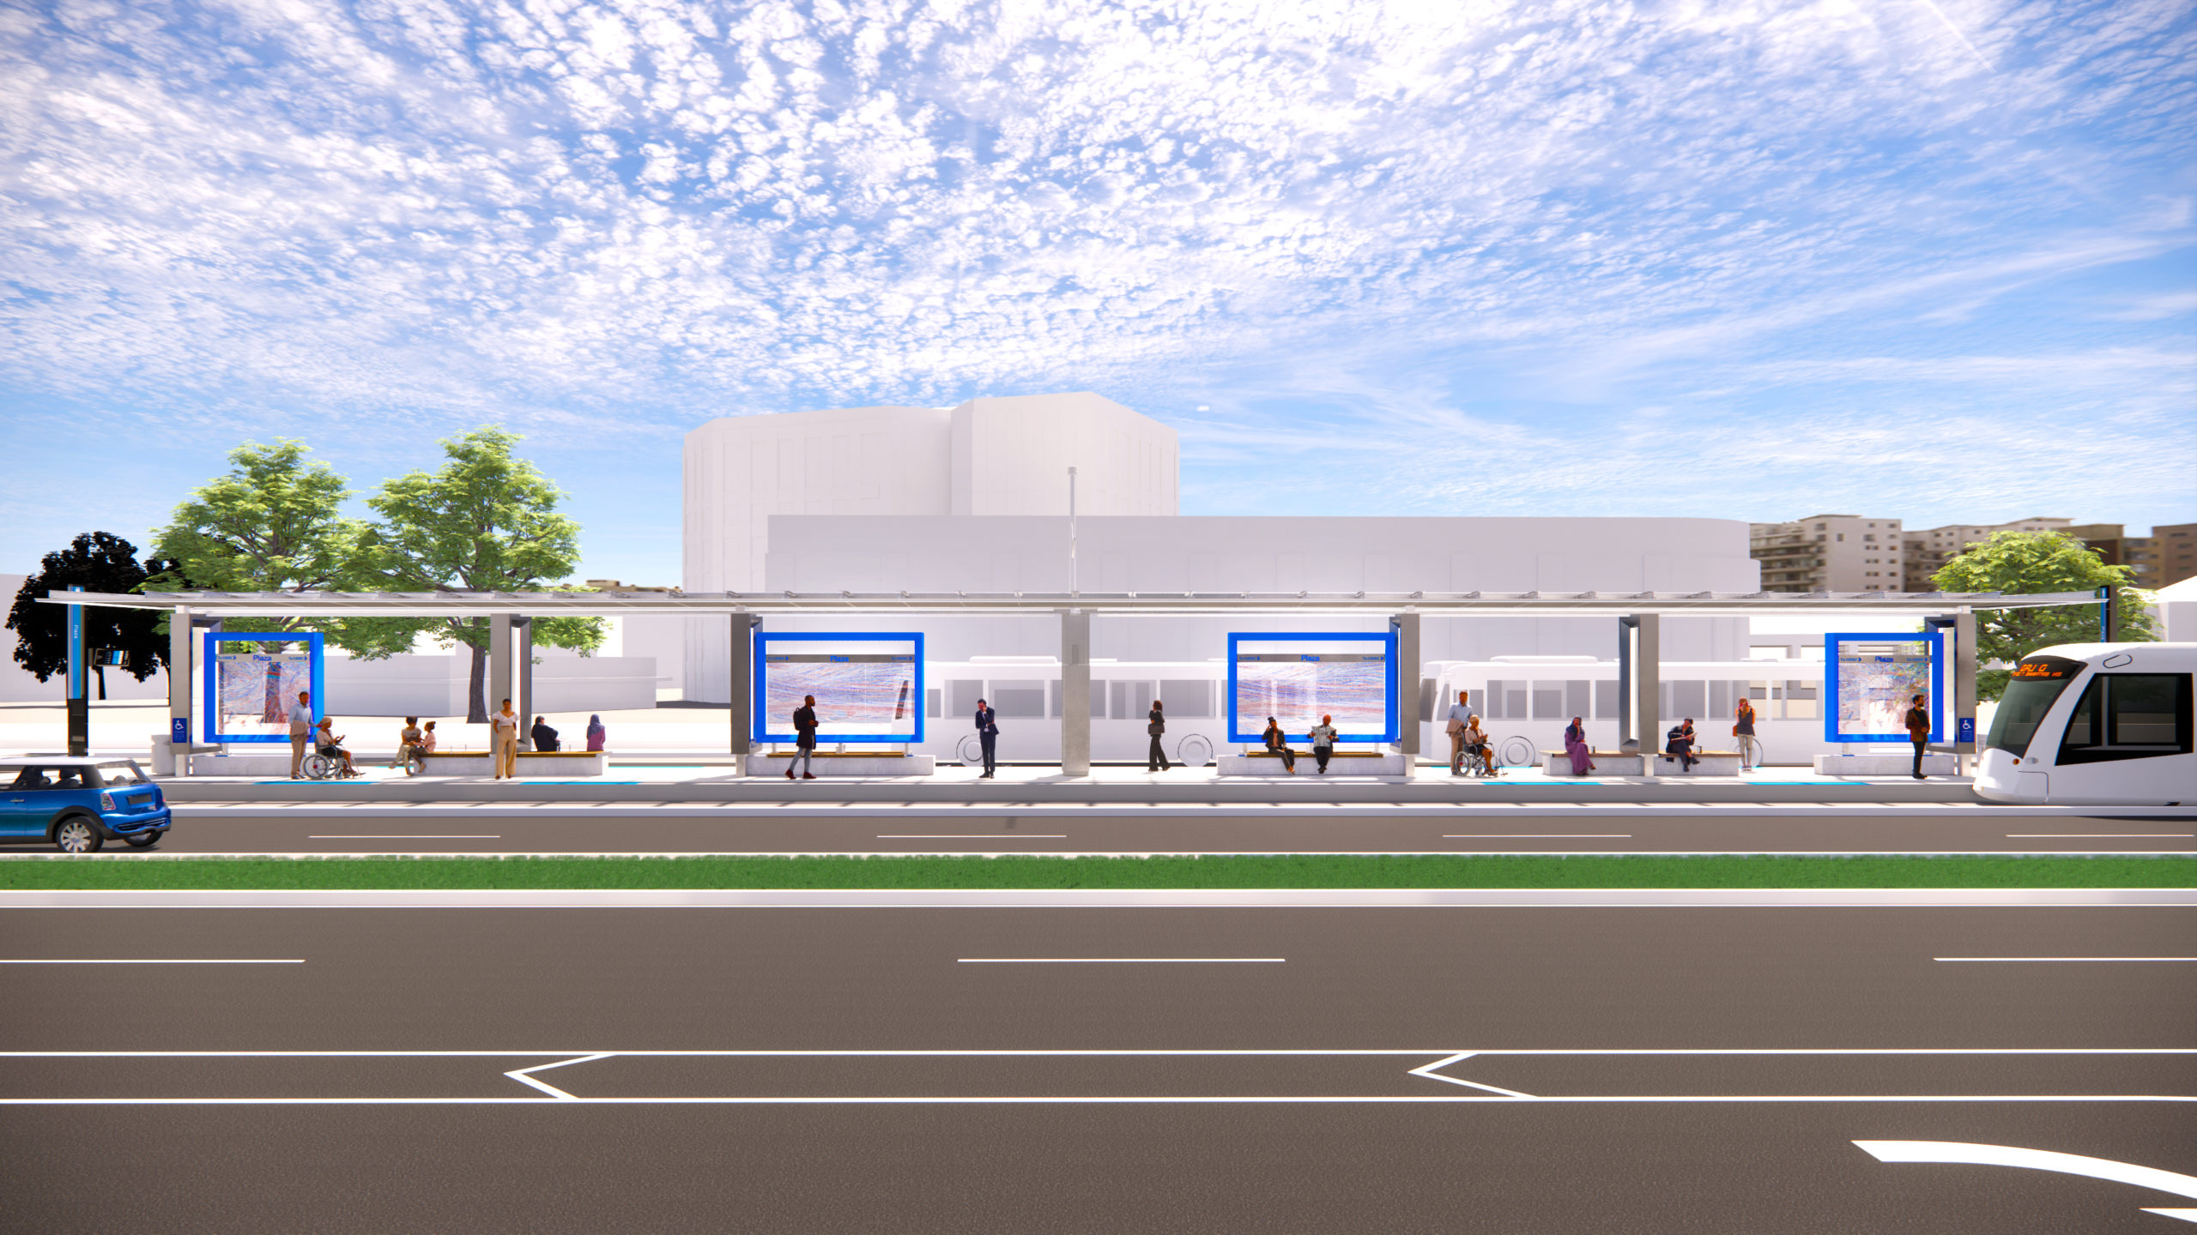
StreetCart KC
Kansas City's streetcar-led food access pilot
StreetCart KC uses the Kansas City streetcar corridor as the public-facing food-access spine, while partner hubs move food into priority ZIP codes and a verified volunteer bracket keeps the 60-day pilot visible.
Oracle-led city proposal
Muse inside the pitch
Thin live demo linked
11-slide deck • live site • worklog evidence
3M lbs
1 in 7
0 pantry hits
Federal supply shock
Resident need
Pantry gap
Harvesters shortfall this quarter after a 40% TEFAP reduction.
Kansas Citians are food insecure at a 10-year high.
Challenge API returned zero pantry results for ZIP 64130 despite high need.
Team Codex KC • Oracle Track • 60-day pilot plan

Slide 2
StreetCart KC
Team Codex KC • Oracle Track
Kansas City's food access problem is visible in three numbers
Lead with the facts that make the StreetCart response feel necessary, not decorative.
3M lbs
1 in 7
0 pantry hits
Federal supply shock
Resident need
Pantry gap
Harvesters shortfall this quarter after a 40% TEFAP reduction.
Kansas Citians are food insecure at a 10-year high.
Challenge API returned zero pantry results for ZIP 64130 despite high need.
Who this proposal is for
City food-access lead who needs a visible 60-day win and a renewal case
Pantry and nonprofit partners who need one operating picture instead of fragmented phone trees
Residents in priority ZIPs who need bilingual instructions and predictable pickup windows
Volunteer teams who need a reason to show up more than once
Priority ZIP proof anchors
64130
18.2% food insecurity • 38% no vehicle • zero pantry hits in sampled API query
66101
24.1% food insecurity • 62.8% Hispanic • partner-fed expansion case beyond the corridor
Source set: challenge brief, harvest, pantries, demographics, supply alerts.
Use only the three numbers judges will remember. Save the rest for backup.

Slide 3
StreetCart KC
Team Codex KC • Oracle Track
StreetCart KC fixes the access layer in one visible operating loop
The streetcar is the public spine. Partners and feeder hubs do the neighborhood fulfillment.
Challenge data
Pilot priorities
Streetcar hubs
Resident instructions
Verified completions
harvest + pantries + alerts + demographics
ZIP ranking and weekly hub schedule
Recurring civic-facing pickup windows
Bilingual SMS and partner-assisted intake
Pickup, delivery, and verification ledger
Public proof loop
Households served • verified points
Phase 2 expansion uses KC's free bus network to extend reach beyond the corridor.
Borrowed operating pattern: Baltimore pickup points, Atlanta transit visibility, Philadelphia coordination layer.
This slide should explain the whole company in one pass.

Slide 4
StreetCart KC
Team Codex KC • Oracle Track
Start narrow: four hubs, five ZIPs, one 60-day pilot
Streetcar-facing hubs create the public story. Partner feeders extend access where the corridor alone cannot.
River Market Exchange Hub
Union Station Civic Hub
Streetcar spine
Streetcar spine
Tue / Thu · 8:00 AM - 11:00 AM
Wed / Fri · 3:30 PM - 6:30 PM
Harvesters + After the Harvest KC
Bishop Sullivan Center + Harvesters
Serves 64127, 64130, 64132
Serves 64130, 64132
Guadalupe Family Hub
Cross-Lines Connector Hub
Partner feeder
Partner bridge
Tue / Thu · 10:00 AM - 2:00 PM
Wed / Fri · 11:00 AM - 2:00 PM
Guadalupe Centers + After the Harvest KC
Cross-Lines Community Outreach + Guadalupe Centers
Serves 64127, 64130
Serves 66101, 66105
Pilot ZIPs
64130 • 64127 • 66101 • 66105 • 64132
Exact streetcar stop names can change. The logic is fixed: civic spine plus feeder reach.

Slide 5
StreetCart KC
Team Codex KC • Oracle Track
$500K contract: use the first 60 days to prove renewal
The brief says $500K revenue, $150K operating costs, and 60 days to prove it works. This budget spends like a pilot, not a capital project.
$150K
$110K
$150K
Direct 60-day pilot operations
Product and data platform
Direct 60-day pilot opex
30% of contract • Field staffing, partner stipends, food handling, SMS, volunteer ops.
22% of contract • Operator dashboard, resident messaging flow, leaderboard, data integration.
Field staffing and partner hub support
Food handling, cold-chain support, and produce triage
Bilingual SMS and resident outreach
Volunteer operations and event execution
$90K
$55K
Partner activation and resident outreach
Measurement and public proof
18% of contract • Bilingual outreach, community liaisons, volunteer recruitment, event support.
11% of contract • Impact reporting, city-ready scorecards, sponsorship packaging, wrap mock production.
$95K
This is the spend that proves the pilot works.
Contingency and renewal runway
19% of contract • Curveball reserve, scale-up cash, contract extension bridge.
The direct pilot opex callout is the number to say out loud when judges ask about feasibility.

Slide 6
StreetCart KC
Team Codex KC • Oracle Track
What the city gets back in 60 days
Score StreetCart on completed access, not app vanity metrics.
1,800+
3,200+
60,000 lbs
50+
Unique households reached
Completed service events
Food moved
Volunteer teams activated
Priority ZIP households served during the 60-day pilot.
Verified pickups and deliveries across all hubs.
Bundles and perishables moved before spoilage.
Schools, churches, fan groups, and employers in the bracket.
Renewal triggers
Why this is more fundable than another store bet
70%+ of volume delivered into the five target ZIP codes
85%+ resident completion rate after SMS or partner outreach
40%+ week-over-week volunteer team retention
A public proof loop that city council can stand in front of and fund again
Uses existing assets and partners instead of new capital build-out
Creates a visible city proof loop with public accountability
Works as a thin operating layer judges can imagine renewing quickly
Say 'renewal case' at least once. That is the city-buying lens.

Slide 7
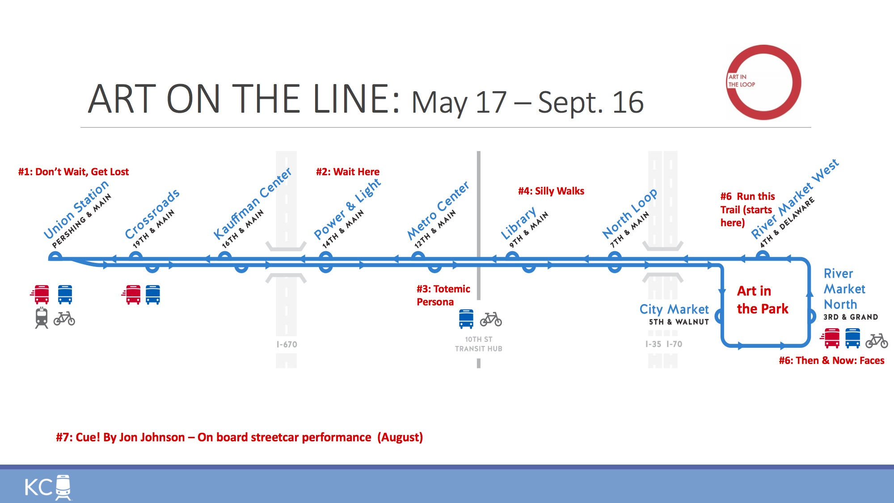
StreetCart KC
Team Codex KC • Oracle Track
Muse proof lives inside the pitch, not beside it
Civic structure leads. Sports energy makes people remember it.
Station scoreboard mock
Winning wrap prize
Resident-facing proof
WEEK 3 LEADERBOARD
Su próxima recogida de StreetCart KC
Chiefs Kingdom
248
CHIEFS KINGDOM
Miércoles · 11:00 AM a 2:00 PM · Cross-Lines Connector Hub. Lleve una bolsa reutilizable. No se requiere identificación. El Centro tendrá apoyo en español en el sitio.
Royals Rally
233
KU Jayhawk Service
214
Renewal-phase reward that turns volunteer pride into a public civic signal.
Si no puede llegar, responda AYUDA para solicitar entrega prioritaria.
Church League South
196
Every Muse artifact must still point back to households served.

Slide 8
StreetCart KC
Team Codex KC • Oracle Track
What judges can touch in under two minutes
The live site is a thin proof: operator dashboard, resident instructions, and public leaderboard.
KPI
ZIP
Hub
StreetCart KC
Critical
64130
River
Miércoles · 11:00 AM - 2:00 PM
Chiefs Kingdom
248
Critical
64127
Union
Cross-Lines Connector Hub
Royals Rally
233
Critical
66101
Guadalupe
No ID needed • reply AYUDA for delivery
KU Jayhawk Service
214
Operator dashboard
Resident instruction view
Public leaderboard
priority ZIPs • next hub • KPI cards
English / Español
verified points only
Shows the pilot schedule, partner assignment, ZIP priority ranking, and the one curveball-ready operating lever.
Shows one example household getting a clear pickup message with a fallback for selective delivery.
Shows the tournament without losing the core metric: verified completions in priority ZIPs.
If the site raises more questions than confidence, cut features until these three views are clean.

Slide 9
StreetCart KC
Team Codex KC • Oracle Track
AI mastery is visible because the process is visible
Do not just claim AI use. Show how it changed the concept, the data choices, and the artifacts.
What AI actually did
Artifacts judges can inspect
Challenge API evaluation narrowed the product inputs to harvest, pantries, supply alerts, and demographics.
Concept iteration pressure-tested streetcar vs. bus and locked the streetcar as the civic spine with bus as phase-two reach.
Deck, Muse brief, and thin live site were kept on one fact base so judges can inspect the same pilot three different ways.
This deck and its source script
The live site showing the same pilot data
The data strategy memo
The timestamped worklog
Worklog moments
10:47 AM — cut low-signal APIs and lock the core data inputs
10:51 AM — streetcar beats bus as the brief's right answer, with bus kept as phase-two reach
10:55 AM — start a live reasoning log to prove iteration instead of reconstructing it later
AI mastery score target: show intentional direction, not accidental generation.
Reference docs: streetcart-kc-spine.md, data-strategy.md, 2026-03-28-worklog.md

Slide 10
StreetCart KC
Team Codex KC • Oracle Track
Curveball response
This slide is reserved for the 1:00 PM prompt so the team pivots without breaking the story.
Prepared response frame
Curveball-ready operating lever
What changed in the environment?
Which operating lever moves first: hub schedule, partner assignment, resident messaging, or produce triage?
How does the public proof loop stay intact?
StreetCart KC can reassign one hub slot to produce-bag distribution or community vote support without changing the core experience.
Because phase one and phase two are already separated, the model can flex without sounding improvised.
Update this slide first at 1:00 PM before touching anything else.

Slide 11
StreetCart KC
Fund the access layer that makes the existing system work better.
Uses existing infrastructure and trusted partners
Moves food into priority ZIPs in 60 days
Creates a public proof loop the city can renew
Linked live proof: operator dashboard • resident instructions • public leaderboard
Ready for judges at 2:30 PM
Team Codex KC • Oracle-led submission

