Slide 1
2020 Rx emissions (FVS) vs 2020 WF emissions (FlamStat + FVS)
Background colors – LandFire 2020 FBFM40
Red pixels – Rx emissions > WF emissions

Slide 2
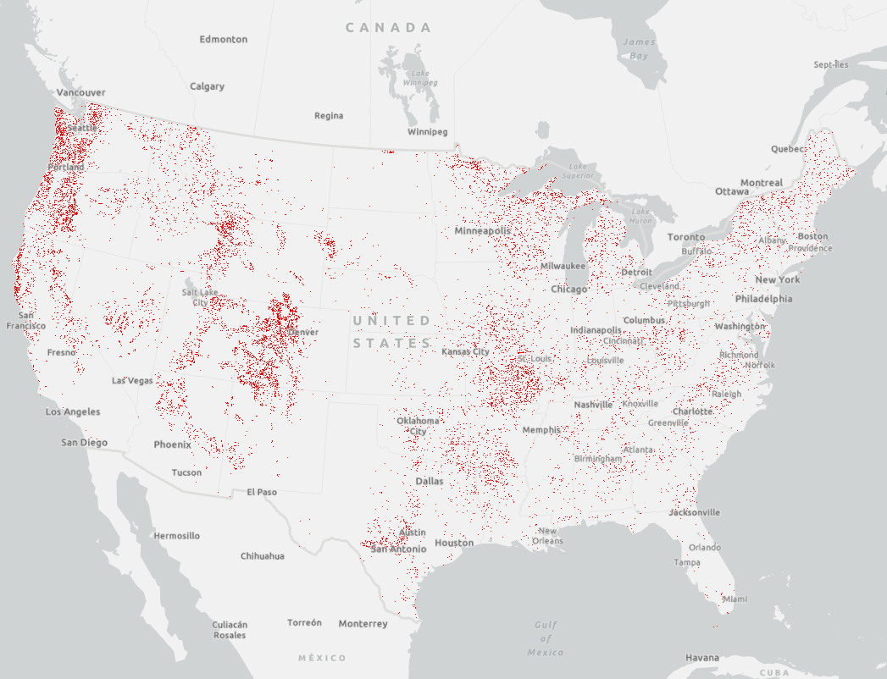

Slide 3
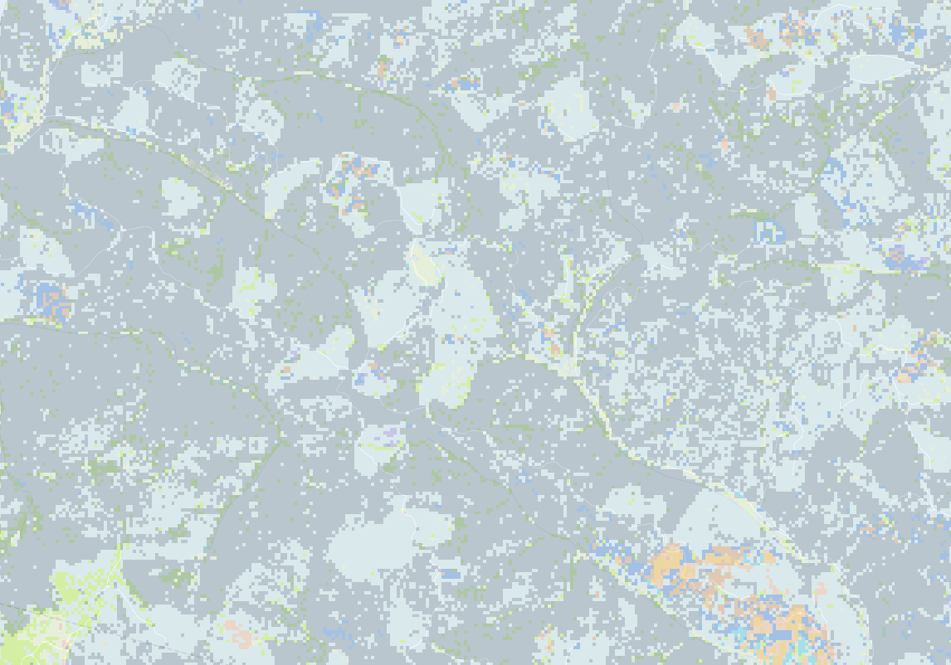
Umpqua NF, OR

Slide 4
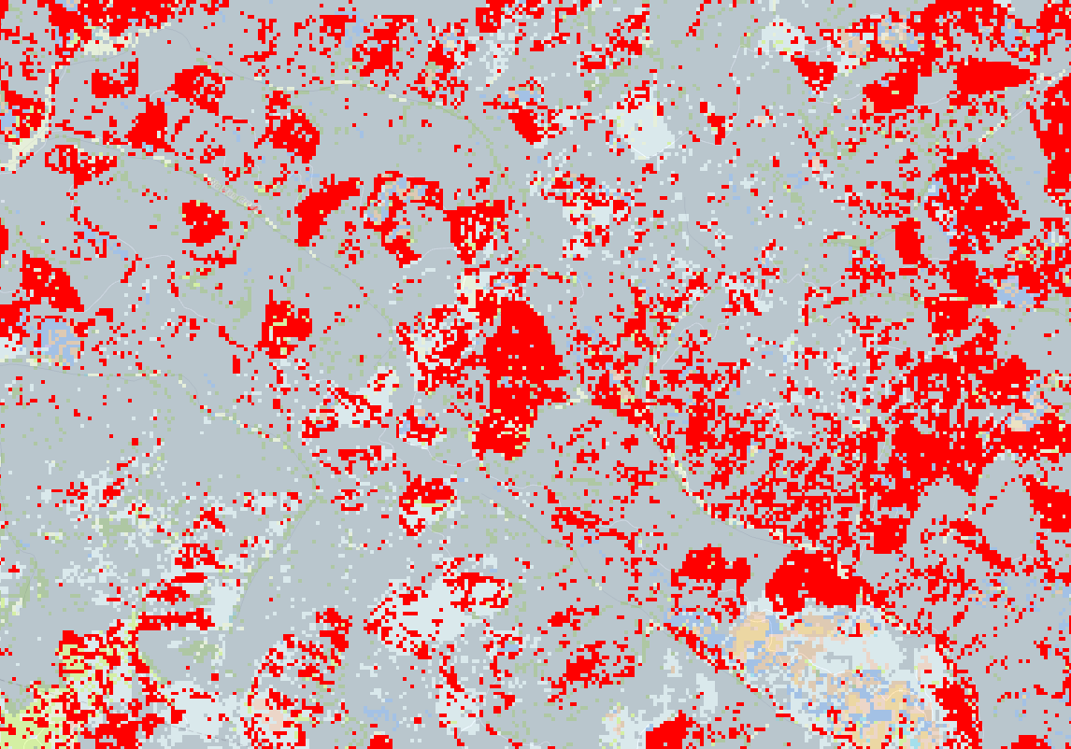
Umpqua NF, OR

Slide 5
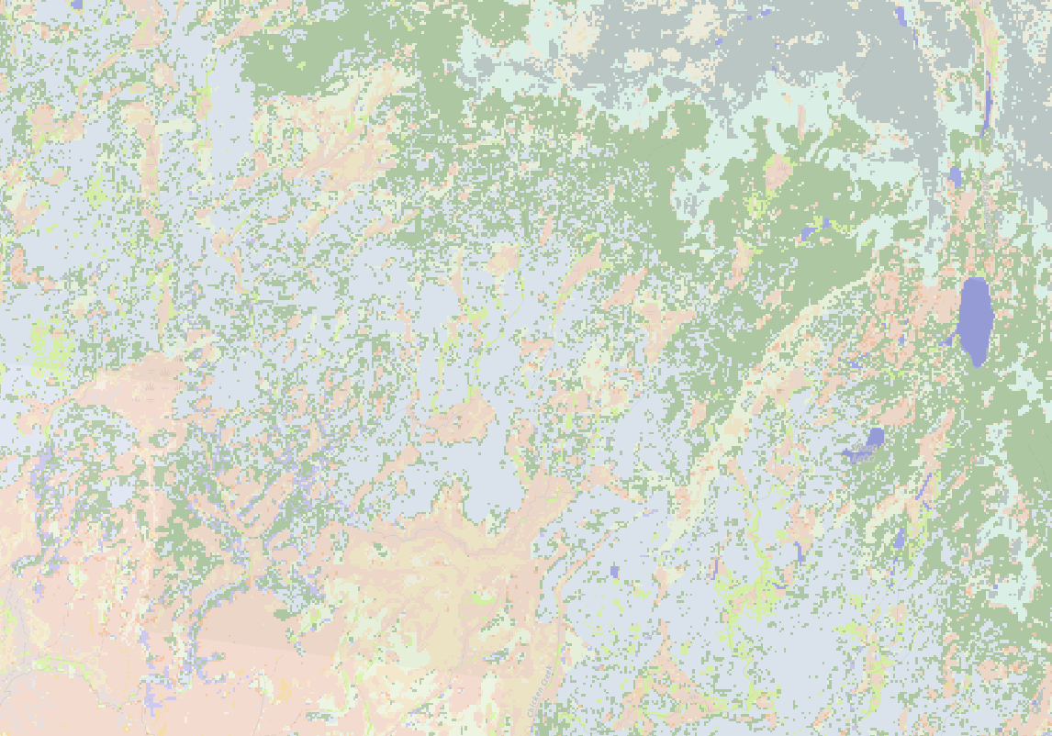
S. Wind Rivers, WY

Slide 6
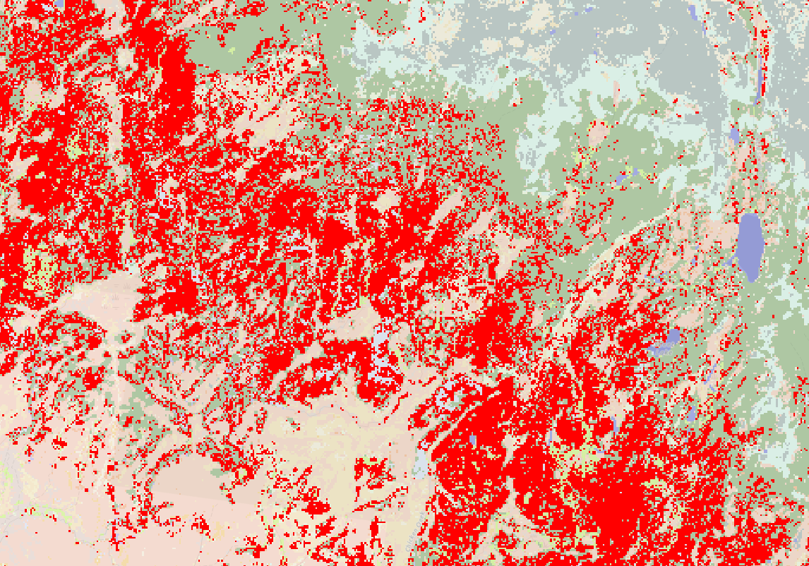
S. Wind Rivers, WY

Slide 7
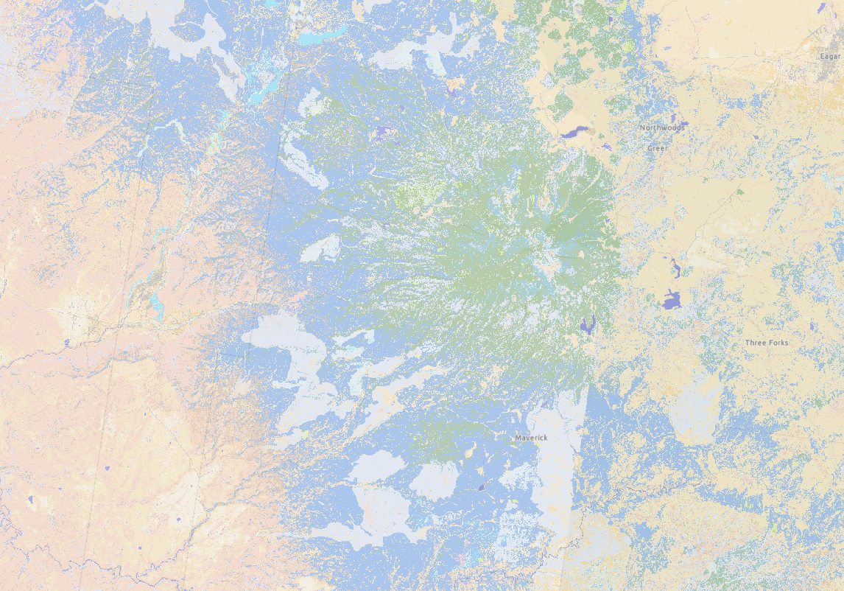
Apache-Sitgreaves NF, AZ

Slide 8
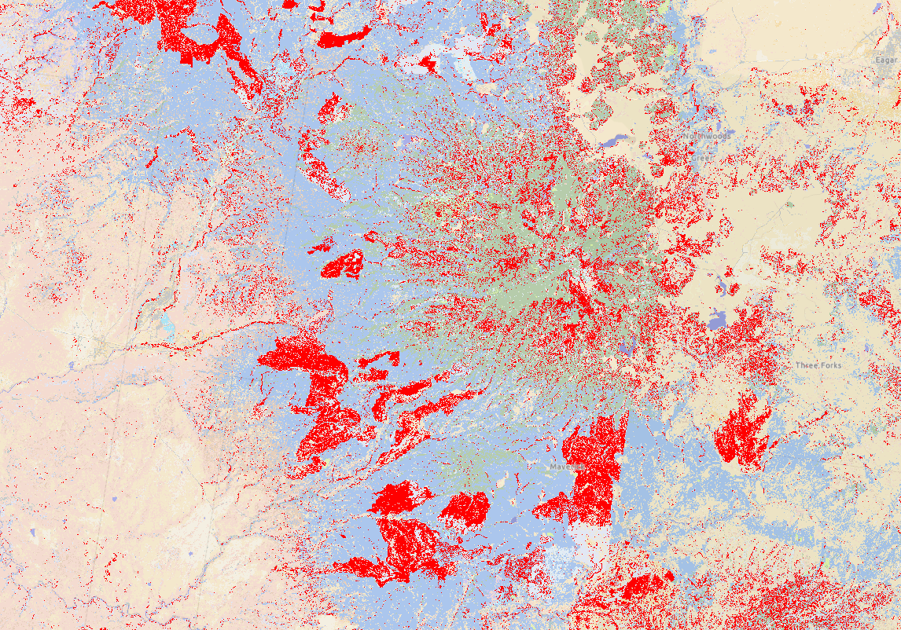
Apache-Sitgreaves NF, AZ

Slide 9
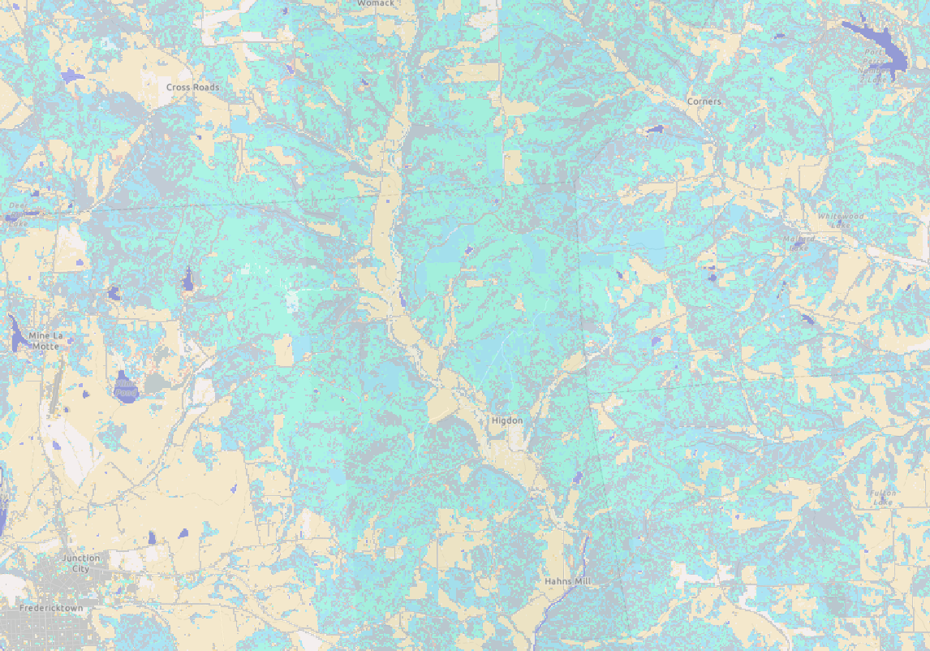
Fredericktown, MO

Slide 10
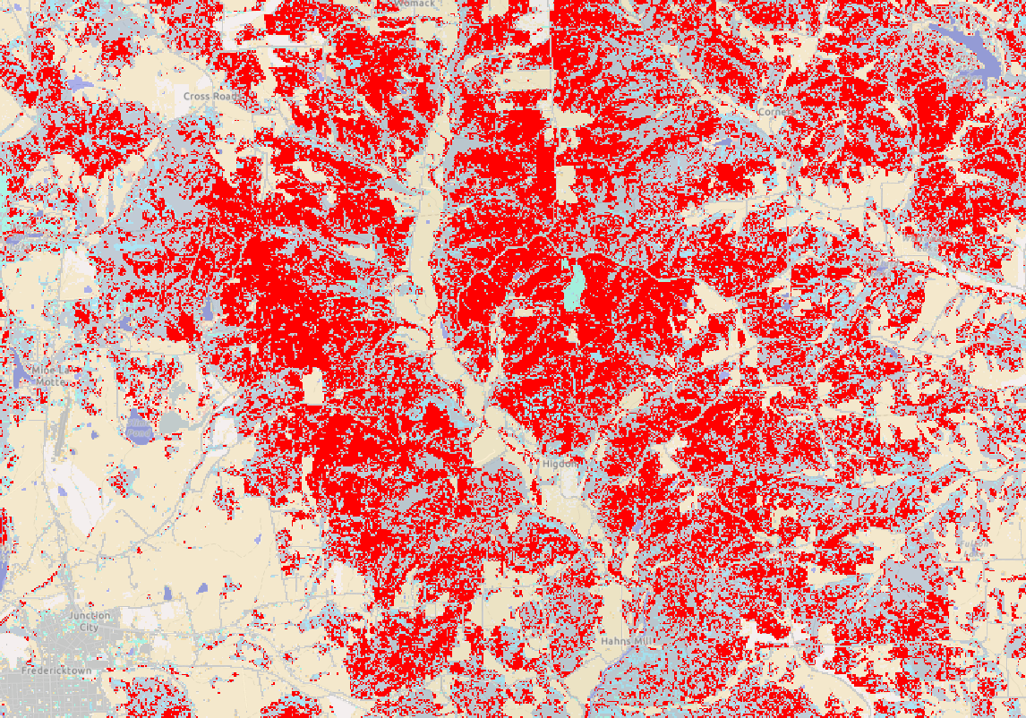
Fredericktown, MO

Slide 11
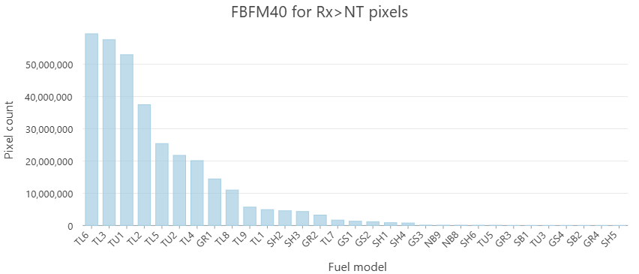

Slide 12
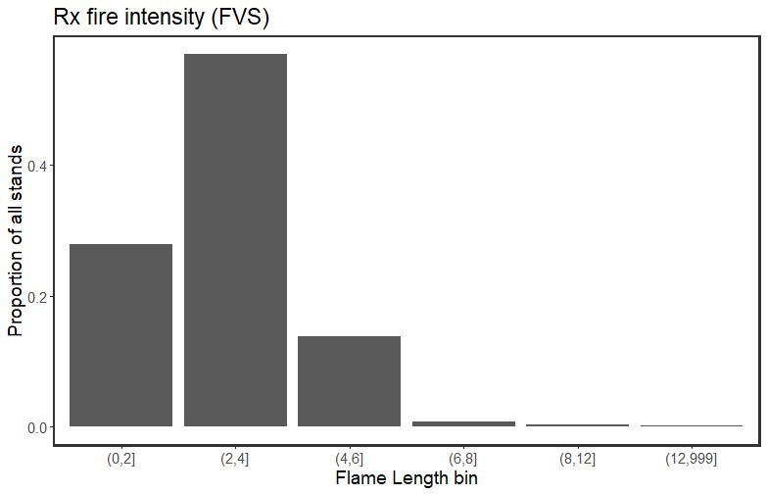
Are the mismatched pixels associated with way high FL?
Break out by FBFM40 and Rx-NT comp
Also break out by forest type and FRG

Slide 13
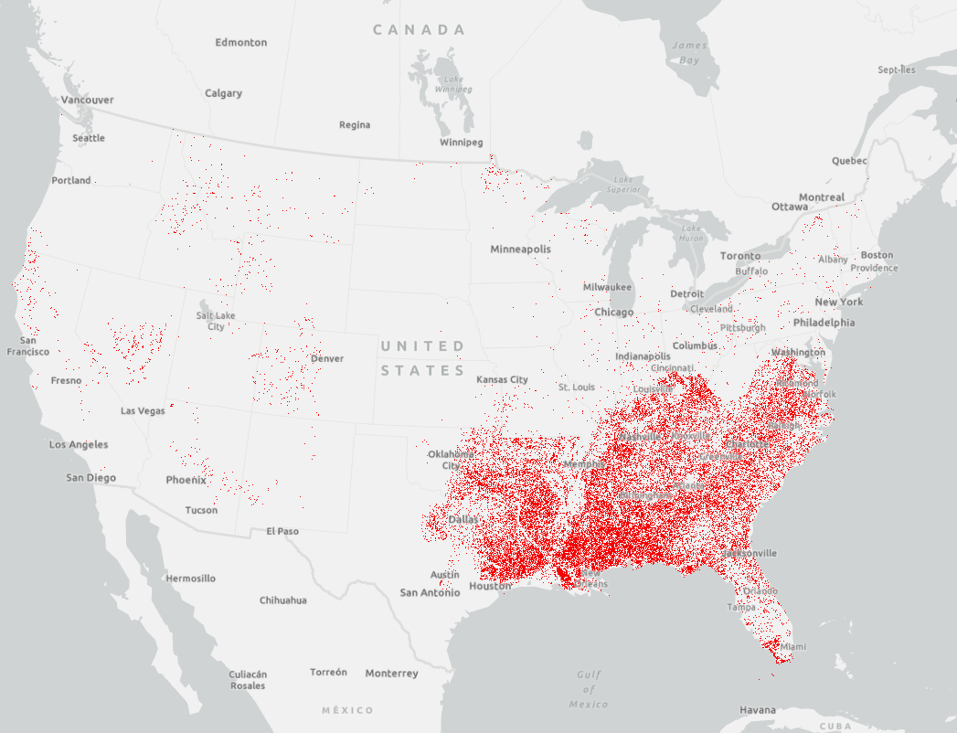
2021 NT emissions compared to 2020 Rx emissions
→ indicates that there’s something going on with the FVS-grow step, esp. in southern variant

