Slide 1

Efficient non-linear analysis of large data sets
Daniel Perry, Shireen Elhabian, Ross Whitaker

Slide 2
The Plan
Introduce Kernel PCA
Difficulty at scale – Nystrom method
Lasso Dictionary Selection
Note: Submitted to ICML (anonymous review)
Feedback welcome

Slide 3
Kernel PCA
Review PCA
Linear dimension reduction
Kernel PCA
Non-linear dimension reduction
Kernel trick
Relationship to other kernel methods
SVM
Etc.

Slide 4
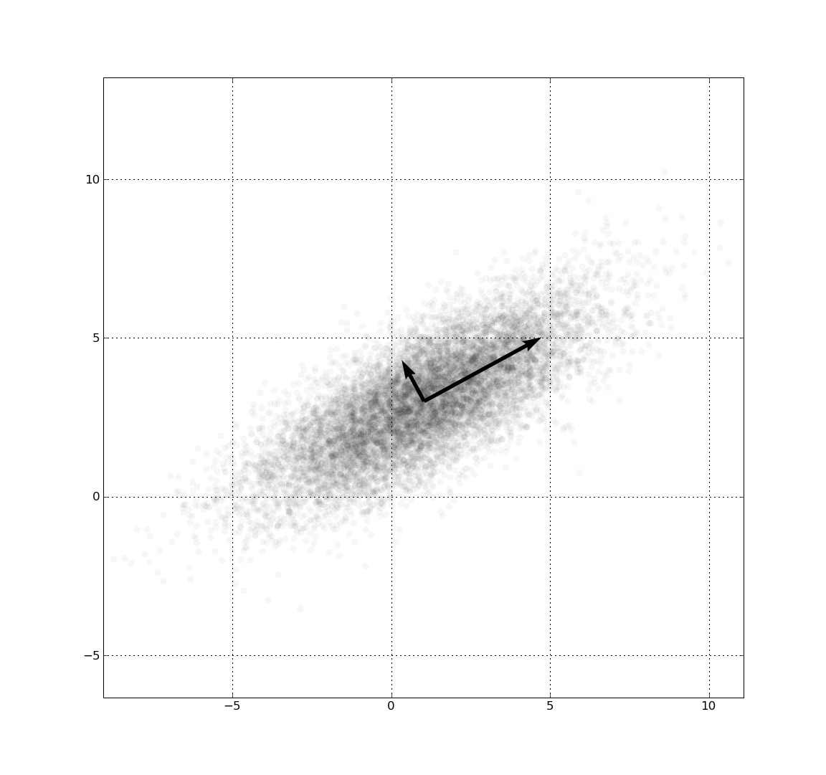
Principal Component Analysis (PCA)
Image: wikipedia
Find a new basis where the first direction preserves the most variance,
Second basis, second most, etc.

Slide 5




PCA: review
Centered data matrix
Compute covariance

Slide 6



PCA: review
Eigen Decomposition
Select p dominant eigen vectors

Slide 7

PCA: review
Project data into p-subspace
Optimal p-dimensional subspace in the sense of preserving the variance of data in r-dimensional space

Slide 8
PCA: Alternative Computation
Alternative computation (important later)
Normally use covariance
Eigen decomposition is O(r³)
(note: theoretically can do it in O(r^{2.3}))
Gramian matrix can also be used
Eigen decomposition is O(n³)
Useful when r > n (high dimensional data)
Aside: PCA can also be done using SVD of X
SVD is O(nr²) or O(rn²)

Slide 9

PCA: Gramian computation
Centered data matrix
Compute Gramian

Slide 10

PCA: Gramian Computation
Eigen decomposition
Recover PC Vectors

Slide 11
PCA: Gramian computation
Important things to notice
Only require Gramian (inner products)
Decomposition of n x n matrix
Not dependent on dimension d
This is important if d > n

Slide 12
PCA: Why?
Understanding data
Eg, look at how data changes along first principal component
Dimension reduction
Visualization
Pre-process data (ie for clustering, etc)

Slide 13
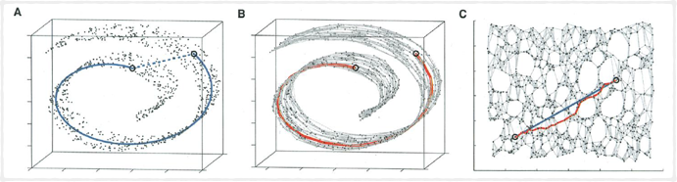
PCA: assumptions
Image: Tannenbaum, et al. “A global geometric framework for nonlinear dimension reduction”, Science 2000
PCA assumes the data can be described “accurately” by a linear space
Is the data better described by a non-linear subspace?

Slide 14
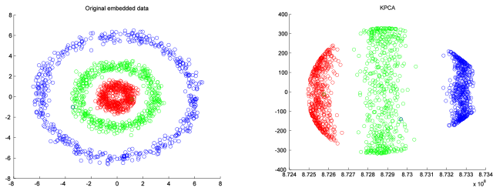
PCA: assumptions
PCA assumes the data can be described “accurately” by a linear space
Is the data better described by a non-linear subspace?

Slide 15
PCA: non-linear alternatives
Manifold Learning
Isomap
Locally Linear Embedding (LLD)
Etc
Principal Geodesic Analysis (PGA)
Kernel PCA
Etc

Slide 16
PCA: non-linear alternatives
Manifold Learning
Isomap
Locally Linear Embedding (LLD)
Etc
Principal Geodesic Analysis (PGA)
Kernel PCA
Etc

Slide 17
Kernel PCA: general formulation
General formulation of Kernel PCA is attractive for non-linear analysis
[Bengio, et al. 2004] showed that Isomap, LLE, and other manifold learning can be formulated as Kernel PCA
[Snape and Zafeiriou 2014] showed that PGA can be formulated as Kernel PCA
More generally, can perform Kernel PCA using any Mercer kernel (discussed later)
Note: more efficient to compute Isomap, PGA, etc directly, than in kPCA form

Slide 18
Kernel PCA: Introduction
Instead of PCA on the elements of X, PCA on a (non-linear) transformation,
can be potentially infinite in length
non-linear analysis we are doing depends on choice of
Isomap
LLE
PGA
Polynomial, etc.

Slide 19
Kernel PCA: Introduction
Kernel PCA as intuitive progression from PCA:
PCA on (non-linear) features
Non-linear PCA
PCA on BIG (non-linear) features
Kernel trick
Kernel PCA

Slide 20
PCA on (non-linear) features
Instead of PCA on X
Run PCA on a (non-linear) transformation of X
Example: quadratic expansion
Feature matrix, each column:
Covariance:
Proceed with PCA as usually on

Slide 21
PCA on BIG features
Now imagine an arbitrarily large polynomial (or other) expansion:
Covariance :
Gramian:
If q > n, use Gramian computation of PCA!

Slide 22
Kernel Trick
For Gramian computation
Expand each
compute inner products
Expensive!
Image you can define a “kernel” function such that
Costs less than expanding and computing dot product
Mercer’s theorem (roughly) says
Any symmetric semi-positive matrix is the Gramian matrix of inner products for some feature space

Slide 23
Kernel Trick
Using the kernel trick we can handle cases where
We know
But we don’t know
We can’t recover
Because we can’t compute directly
But we can compute projections,

Slide 24
Kernel PCA
[Scholkopf, 1997] introduced Kernel PCA
Compute Gramian
Eigen decomposition

Slide 25
Kernel PCA
Project onto p-dimensional subspace

Slide 26
Kernel Examples
Gaussian kernel:
Polynomial kernel:
Sigmoid kernel

Slide 27
General Kernel Methods
Today I’ll be focusing on Kernel PCA (kPCA)
Methods can be used on any other method using the kernel trick
Support Vector Machines (SVM)
Gaussian Processes (GP)
Etc
Because discussion is on efficient approximation of Gramian (Kernel) matrix

Slide 28
Kernel PCA on large data sets
Problems at scale (n is large)
Nystrom method
Previous work in dictionary selection

Slide 29
Kernel PCA: the ugly
Kernel PCA (and other kernel methods) are difficult when n is large
Kernel PCA uses the Gramian
n x n matrix
What if n is BIG?
O(n³) decomposition become infeasible

Slide 30
Kernel PCA on large data sets
Nystrom method
[Williams and Seeger, 2001]
[Drineas and Mahoney, 2005]
Maintain a subset of the data as a “dictionary”
(Current work)
Online Kernel PCA
[Kim et al. 2005]
[Kimura et al. 2005]
Maintain a rank-k approximation to Gramian
Compute pre-image of bases as “dictionary”
(Potential future work)
Random projection Approximations
[Rahimi and Recht, 2007]
[Lopez-Paz, et al. 2014]
Use random projection approximation to Gramian
(Currently working on this with Jeff Phillips and Mina Ghashami)

Slide 31


Nystrom method
[Williams and Seegers 2001] introduced to Kernel SVM
Use a smaller subset of the data, a “dictionary” to approximate the Gramian

Slide 32
Nystrom method
This is equivalent to projecting n data onto space spanned by D with basis,

Slide 33
Kernel PCA: Nystrom Method
Projected data points live in R^{d} – O(nd²)
Run PCA on projected data – O(d³)
O(nd²) + O(d³) instead of O(n³)
Good when d << n

Slide 34
Dictionary selection
How to select the dictionary ?
Uniform random
[Drineas and Mahoney 2005]
Greedy-random methods
[Smola, et al. 2001]
[Ouimet, et al. 2005]
Sparse Kernel PCA
[Tipping 2001]

Slide 35
Uniform Random Dictionary
Select a uniform random subset
Without replacement
With replacement
[Williams and Seegers, 2001]
Uniform random dictionary
[Drineas and Mahoney, 2005]
Analyzed within more general framework of matrix sketching
Importance sampling based on norm of data points
For stationary kernels (Gaussian) norm is 1,

Slide 36
Greedy Random
Greedily select points randomly (should) improve projection error
[Smola, et al. 2001] “Sparse Greedy Matrix”
Select a uniform random subset, R
From R select point z that improves projection error of R onto current dictionary D
Add z to D
Repeat until convergence
[Ouimet, et al. 2005] “Greedy Spectral Embedding”
D = first point
Consider every point, z, in X
If projection error of z onto current D is large
Add z to D

Slide 37
Sparse Kernel PCA
[Tipping 2001] introduced Sparse Kernel PCA
Based on Probabilistic PCA [Tipping and Bishop 1999]
Model the covariance in feature space as,
σ - controls sparsity (large value => more sparse)
W - diagonal weight matrix, weight corresponds to each data point
Compute model using expectation-maximization (EM)
Large σ “soaks up” ambient variance leaving only the most impactful data points with non-zero weight
Elements with non-zero weights are dictionary

Slide 38
Dictionary selection - problems
[Tipping 2001] – takes advantage of the Kernel PCA subspace
Papers using this approach have to subdivide problem because of speed (EM convergence)
Non-intuitive interaction between sparsity and σ parameter
[Smola, et al. 2001], [Ouimet, et al. 2005] – doesn’t use kernel PCA subspace to select dictionary (greedy)
Greedy nature leads to larger dictionaries
Build dictionary first, then compute kernel PCA

Slide 39
Proposed approach: Lasso Dictionary Selection
New sparse kernel PCA
Based on sparse PCA by [Zou, et al. 2006]
Uses L1 regularization to induce sparsity
Make use of kernel PCA subspace for dictionary selection (optimal instead of greedy)
Intuitive parameterization (size of dictionary)
Fixed number of iterations (size of dictionary)
Propose using a two-stage dictionary selection
First rough pass (using random or greedy methods)
Second careful pass selecting dictionary based on kernel PCA subspace

Slide 40
Sparse PCA
Proposed by [Zou, et al. 2006]
Motivation
running PCA on high dimensional data (analysis of genes)
Sparse PCA means less data points needed for analysis
Run PCA, then make the loadings sparse
Formulation as L1 regularized optimization problem,
Elastic-net problem
Solved using Least Angles Regression (LARS)
Each principal vector independently

Slide 41
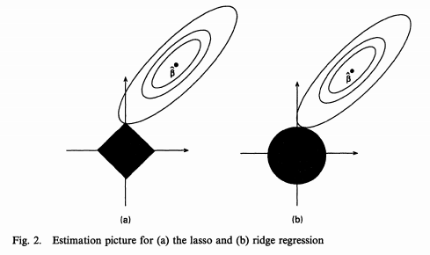
L1 regularization inducing sparsity
[image from quora.com]

Slide 42
Kernel Sparse PCA
We modified [Zou, et al. 2006] to use the kernel trick,
Run kernel PCA
Make each of the loadings sparse,
In kernel case r = n, so LARS solution to elastic net becomes the same as Lasso solution
Make loadings sparse for each PCA vector independently

Slide 43
Kernel Sparse PCA: problems
Sparse solution is found for each loading vector independently
Zero-loadings in each vector may not match up!
Suppose orange components only have one loading vector with non-zero weight?

Slide 44
Kernel Sparse PCA: problems
This results in a sub-optimal dictionary
Can we modify the optimization to consider all loading vectors at once?

Slide 45
Kernel Sparse PCA: problems
This results in a sub-optimal dictionary
Can we modify the optimization to consider all loading vectors at once?
W^{i} is the i^{th} row of W

Slide 46
Lasso Dictionary Selection
Input:
G (Gramian),
U,S (eigen decomp of G)
Find optimum using LARS:
Output:
D – non-zero entries of W

Slide 47
Two-step approach
Find a subset of size m << n that preserves statistics of full data set
Small enough to perform kernel PCA
Large enough to captures statistics of full dat aset
Run Lasso dictionary selection
Optimal dictionary of size d for subset of size m
Use dictionary D to approximate full Gramian

Slide 48
Comparison
Data sets:
UCI data sets using Gaussian kernel
σ chosen according to average inter-point distance
For fairness chose the same first stage subset for each method
Compare projection error of resulting dictionaries

Slide 49
Synthetic Gaussian (varying SNR)
SNR 0.1
SNR 1.0
SNR 10.0

Slide 50
UCI Cloud data set

Slide 51
UCI Forest cover type

Slide 52
UCI Solar flare

