Slide 1
Bullet Time Effect with Local Perception Filters
(danny perry)

Slide 2
Contents
Introduction to Perception Filters (most of the paper)
Use of Perception Filters with bullet time effect

Slide 3
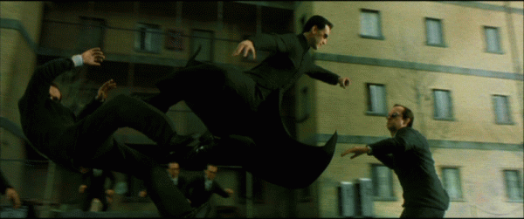
Bullet Time Effect
Introduced in The Matrix

Slide 4
Bullet Time Effect
Introduced in The Matrix
Now used in computer games:
  Max Payne, Jedi Knight II, Matrix games, etc.
Any others to mention?

Slide 5
Bullet Time Effect
Trivial in single player - “just slow down rendering”
Not many multiplayer games do it: why?

Slide 6
Bullet Time Effect
Trivial in single player - “just slow down rendering”
Not many multiplayer games do it: why?
  If slow down whole game, bad for other players
  Instead, some speed up the player
This paper presents an alternate method: change perception of the different players

Slide 7
Perception Filters
“a method used to hide communication delays in networked virtual environments” (introduced by Sharkey, et al.)
Essentially: speed up and slow down speed of passive entities when they are near local and remote players

Slide 8
Perception Filters
Verbage:
  Local players = “local players” = p
  Remote players = “remote players” = r
  Passive entities = “entities” = e
Perception Filters approach:
  Local players rendered using up-to-date information
  Remote players rendered using d seconds old information (with d second delay)
  (This is different from dead reckoning, we are not predicting)
  Entities are rendered at the time of the player they are closest to.

Slide 9
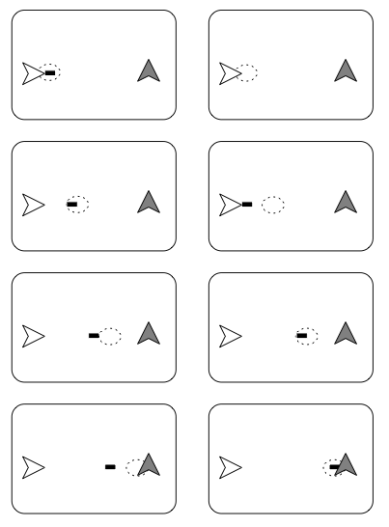
Perception Filters

Slide 10
Perception Filters
(java demo)

Slide 11


Perception Filters
How its done:
  d(i,j) is delay, delta(i,j) is distance

Slide 12
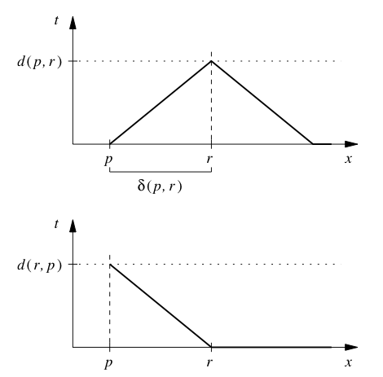
From p: slower uphill, faster down (top graph)
From r: faster at top (bottom graph)

Slide 13
Perception Filters
Problem: when e reaches r, p’s view of e is not there yet, but e will speed up anyway in p’s view.
Solution ?

Slide 14

Perception Filters
Problem: when e reaches r, p’s view of e is not there yet, but e will speed up anyway in p’s view.
Solution:
  Introduce a shadow r’ that “buffers” p’s view of the speedup

Slide 15
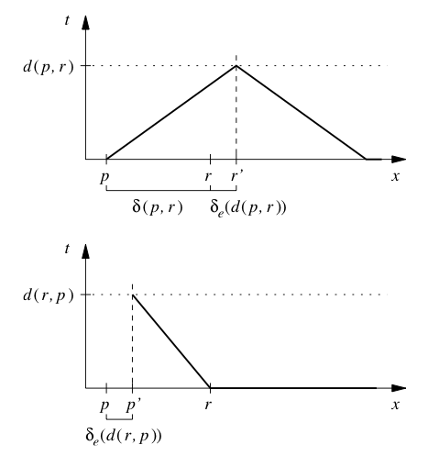
Top: won’t speed up until r’
Bottom: starts showing e at p’

Slide 16
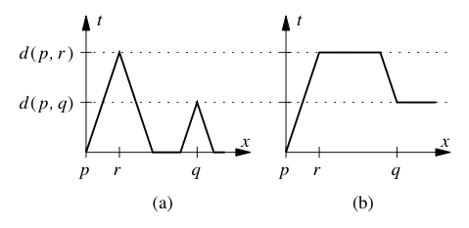
With multiple players 2 approaches:
  A. Minimize e’s not at local time (closest to local time)
  B. Minimize delay changes (more smooth)

Slide 17
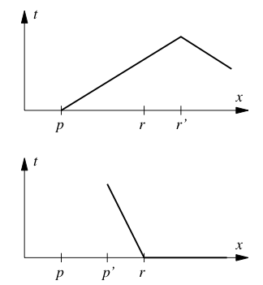
Problems
  When they reach “critical proximity” - get too close - no longer works. (graph: still okay)

Slide 18
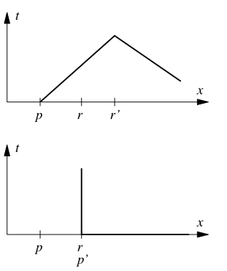
Problems
  When they reach “critical proximity” - get too close - no longer works(graph: at critical proximity)

Slide 19
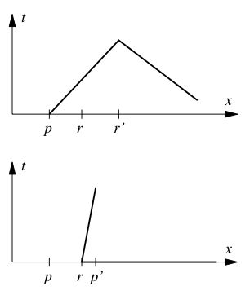
Problems
  When they reach “critical proximity” - get too close - no longer works (graph: past)

Slide 20
Perception Filters
Other Limitations ?

Slide 21
Perception Filters
Other Limitations ?
  A local player CANNOT DIRECTLY INTERACT with a remote player
  Computational requirements
  Jitter can mess things up easily (won’t look smooth)
  Assumption that we know exact delays

Slide 22
Bullet Time
Use the same machinery: when a player is using bullet time it is similar to a large delay.
In Bullet Time mode, entities close to player slow down.

