Slide 1
Cheat-Proof Playout for Centralized and Distributed Online Games
By
Nathaniel Baughman and Brian Levine
(danny perry)

Slide 2
Game System -
Assumptions
Grant Cheaters:
  Read, insert, modify, and block network messages
  Game software is readable by user - including game state and cryptographic keys
  Which means security by obscurity won’t work.

Slide 3
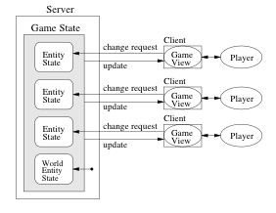
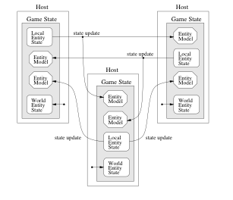
Game System -
Centralized or Distributed

Slide 4
Common Synchronization Techniques Detrimental
Example 1: Dead Reckoning
  Potential for cheating - “suppress-correct cheat”
Example 2: Stop-and-wait Simulations
  Potential for cheating - “lookahead cheat”

Slide 5
Dead Reckoning- suppress-correct cheat
Assume n steps in game simulation allowed to be dead-reckoned before connection is lost
What if we drop n-1 packets?
Then we have an up to date view of the world, but everyone else has an old view of us
Anyone remember their proposed cheat?

Slide 6
Dead Reckoning- suppress-correct cheat
Cheat Scenario:
Player S chases player A
Player S drops n-1 updates
Meanwhile A uses dead reckoning to guess, but never REALLY knows where S is.
S sends fabricated nth update that places S right behind A

Slide 7
Dead Reckoning- suppress-correct cheat
As long as S sends a plausible update every nth step, A cannot differentiate cheating from sluggish link
“We can conclude that fair play is indistinguishable from cheating when dead reckoning is used.” (p. 4)

Slide 8
Stop-and-wait Simulations - lookahead cheat
Stop-and-wait simulations like AoE
Eliminates possibility of “suppress-correct cheat” because there is no dead reckoning
However stop-and-wait simulations allow for another kind of cheat
Anyone remember this proposed cheat?

Slide 9
Stop-and-wait Simulations - lookahead cheat
Wait for everyone to send their updates, then send your update after taking into account their information
Scenario: B makes a lethal shot at A
A has a cheating agent that sends the decision to raise shields in time (because it looked-ahead)

Slide 10
Solution Version 1.0:
Lockstep Protocol
Prevents suppress-correct and lookahead cheats
Anyone remember what the basic idea was?

Slide 11
Solution Version 1.0:
Lockstep Protocol
Basic Idea:
Turn into 2-step process:
  First, send hash of your decision
  Second, once everyone has sent the hash, send the decisions
  If hash(decisions) == hash_sent then good, else CHEATER!
We’ve prevented the proposed cheats, but any Problems?

Slide 12
Solution Version 1.0:
Lockstep Protocol
Main problem is that we’ve just doubled the communication, and synchronization time since EVERYONE has to send the hash, before EVERYONE sends their decisions.
This will slow us down - we’re already battling time for reasonable user experience.
Solution: Asynchronous version of Lockstep called “AS”.

Slide 13
AS -
Asynchronous Synchronization
Basic idea is to restrict interaction of each player to an “aura” or SOI - sphere of influence
If our player can’t be interacting with another player, then don’t bother synchronizing game play with them
If we can interact (SOIs intersect) then lockstep with them

Slide 14
AS -
Basic Algorithm Outline
Compute local host’s current state
Send hash of it out
Process hashes sent by remote hosts
Foreach remote_host
  Accept state of remote hosts (up to current time)
  Compute potential influence (SOI’s) intersections
  IF no intersection of SOIs
    THEN local host is not waiting for remote_host
  ELSE IF hash(remote_host) accepted
    THEN local host is not waiting for remote_host
  ELSE local host is waiting for remote_host
IF not waiting for any remote_host send local state

Slide 15
AS
Prevents cheating same way lockstep does
Prevents suppress-correct cheat because no dead reckoning
Prevents lookahead cheat because we get hashes before we get real state (we don’t send our state, until we’ve received hashes from everyone else)

Slide 16
AS -
Secret Possessions
Can’t really give knowledge of a “secret possession” to opposing players (assumption that they can see any information sent them)
Instead we give them a “promise” - basically a hash or encrypted form of the real thing (if encrypted, the key is not known to opposing players)
Player then signs the promise and gives it back - to prevent repudiation that the secret was promised.

Slide 17
AS -
Secret Possessions
Now, a player can have the promise and competing players won’t know he has the secret possession (I guess everyone has a “promise” field or something)
The game can be played
Afterward, the promise can be verified against the “secret possession” to detect cheating (prevents opponents from cheating, only checks for local player cheating - not preventing it)

Slide 18
AS -
MMO’s
AS like algorithm can be used for MMO’s
One cheating problem with MMO’s is sending position information, or other information, to everyone - “it might affect player strategy” - this would alert of ambushes or the like.
We assume the world is divided into regions
How do we tell if a player is in the same region without exposing my region (which may warn of an ambush)?
Proposed algorithm can do this.

Slide 19
AS -
MMO’s - Hidden Positions
Player A generates rand Ra and sends B h(Ra)
Player B generates rand Rb and sends A h(Rb)
Both compute R = Ra XOR Rb (? which means they exchange Ra and Rb as well right ?)
A computes z = Ek(x+R), sends z to B
B computers w = Ek’(y+R), sends w to A
A computes w’ = Ek(w), sends w’ to B
B computes z’ = Ek’(z), sends z’ to A
A & B have z’ & w’, if z’==w’ then x==y (same region)
(because z’=Ek’(Ek(x+R)), w’=Ek(Ek’(y+R)) only difference can be from x and y)

Slide 20
AS -
Performance Comparison
The reason we switched to AS was mostly due to performance
Performance comparison used Xpilot game and 10,18,30, and 37 players
Comparison was to see any improvement in frame rendering using AS over lockstep
Results showed that AS always kept the ms between frames lower overall

Slide 21
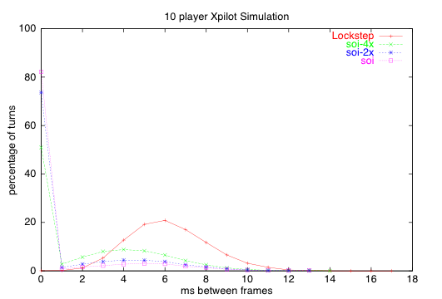
AS -
Performance Comparison

Slide 22
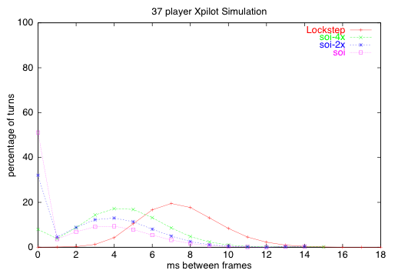
AS -
Performance Comparison

Slide 23
Conclusions
AS helps prevent two proposed cheats
AS performs better than standard lock-step algorithm
However, “it is clear dead reckoning will perform better…”(p.8)

Slide 24
Conclusions
I appreciated their approach to make the game design resilient to hackers
(traditionally just hack back at the hackers)
But, they only really addressed a couple of possible cheats - it would have been nice to see more considered
They claim it will scale for MMO’s
Comments?

