Slide 1


Music Generation with LSTMs
Beamlak Hailemariam & Daniel Suissa

Slide 2
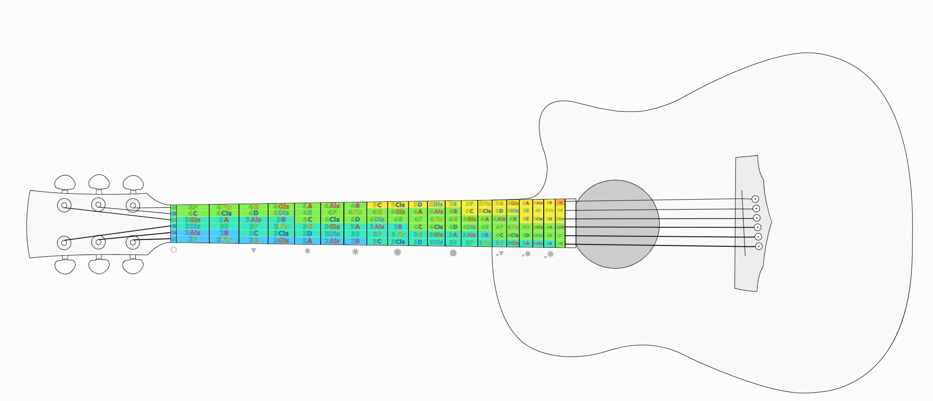

Data and Representation
An instrument playing is modeled as a sequence of states.
Each note can be on or off
Time tick: vector of size 72, representing on/off notes
Midi NoteOn/NoteOff Event
$$\left[\begin{matrix}1 \\ 0 \\ 1 \\ … \\ 1\end{matrix}\right]$$

Slide 3
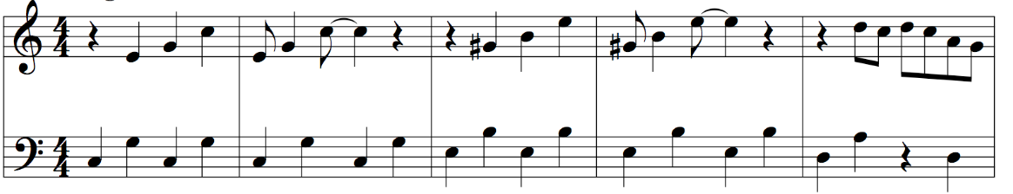
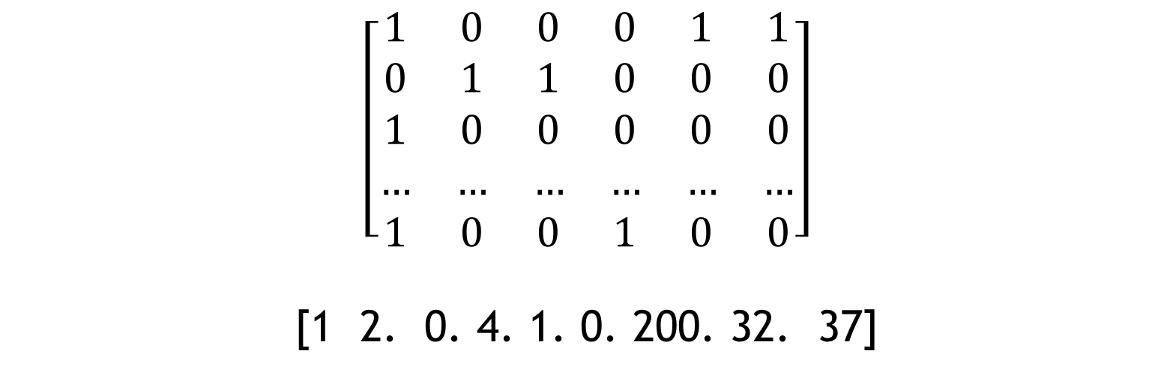
Time Sequencing
32 columns per bar
Sample: 100 columns (~3 bars)
20,000 samples
200 Rock Songs
Only guitar tracks
636 configurations
$$\left[\begin{matrix}1 & 0 & 0 & 0 & 1 & 1 \\ 0 & 1 & 1 & 0 & 0 & 0 \\ 1 & 0 & 0 & 0 & 0 & 0 \\ … & … & … & … & … & … \\ 1 & 0 & 0 & 1 & 0 & 0\end{matrix}\right]$$
[1 2. 0. 4. 1. 0. 200. 32. 37]

Slide 4
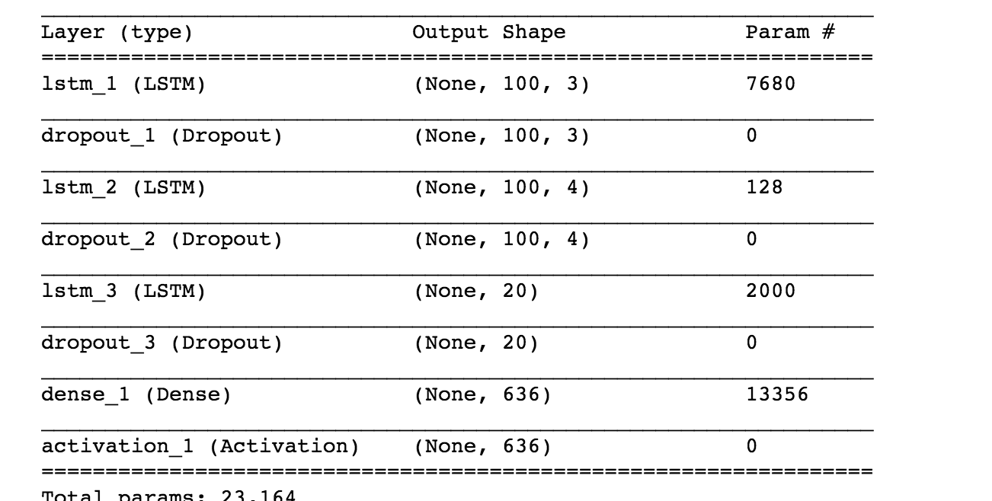
Model
LSTM: Long Short term memory units
Good at encoding long sequences in an internal state
Input shape: 100 x 636
Last layers is a dense layer producing probabilities for each note configuration
Loss reached: 1.11

Slide 5
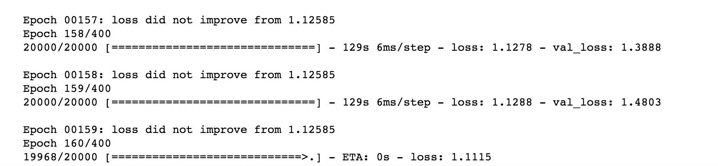
Model

Slide 6
Rock n’ Roll

