Slide 1
Blacktown Chinese Christian Church
Welcome to Our English Service 23.02.2025
English Service 9:45 – 11:00 am
Worship Songs: Passage: Speaker: Topic: Response Song: Announcements and Closing Prayer Benediction
Job 1:6-22 Xavier Lakshmanan Job: Following God with Commitment TBA

Slide 2
BCCC english service

Slide 3

Please keep all phones on silent

Slide 4

Bible reading

Slide 5
Job 1:6-22
⁶ One day the angels came to present themselves before the Lord, and Satan also came with them. ⁷ The Lord said to Satan, “Where have you come from?”
Satan answered the Lord, “From roaming throughout the earth, going back and forth on it.”

Slide 6
Job 1:6-22
⁸ Then the Lord said to Satan, “Have you considered my servant Job? There is no one on earth like him; he is blameless and upright, a man who fears God and shuns evil.”
⁹ “Does Job fear God for nothing?” Satan replied.

Slide 7
Job 1:6-22
¹⁰ “Have you not put a hedge around him and his household and everything he has? You have blessed the work of his hands, so that his flocks and herds are spread throughout the land. ¹¹ But now stretch out your hand and strike everything he has, and he will surely curse you to your face.”

Slide 8
Job 1:6-22
¹² The Lord said to Satan, “Very well, then, everything he has is in your power, but on the man himself do not lay a finger.”
Then Satan went out from the presence of the Lord.
¹³ One day when Job’s sons and daughters were feasting and drinking wine at the oldest brother’s house,

Slide 9
Job 1:6-22
¹⁴ a messenger came to Job and said, “The oxen were plowing and the donkeys were grazing nearby, ¹⁵ and the Sabeans attacked and made off with them. They put the servants to the sword, and I am the only one who has escaped to tell you!”

Slide 10
Job 1:6-22
¹⁶ While he was still speaking, another messenger came and said, “The fire of God fell from the heavens and burned up the sheep and the servants, and I am the only one who has escaped to tell you!”
¹⁷ While he was still speaking, another messenger came and said, “The Chaldeans formed three raiding parties and swept down on your camels and made off with them. They put the servants to the sword, and I am the only one who has escaped to tell you!”

Slide 11
Job 1:6-22
¹⁸ While he was still speaking, yet another messenger came and said, “Your sons and daughters were feasting and drinking wine at the oldest brother’s house, ¹⁹ when suddenly a mighty wind swept in from the desert and struck the four corners of the house. It collapsed on them and they are dead, and I am the only one who has escaped to tell you!”

Slide 12
Job 1:6-22
²⁰ At this, Job got up and tore his robe and shaved his head. Then he fell to the ground in worship ²¹ and said:
“Naked I came from my mother’s womb,
and naked I will depart.
The Lord gave and the Lord has taken away;
may the name of the Lord be praised.”

Slide 13
Job 1:6-22
²² In all this, Job did not sin by charging God with wrongdoing.

Slide 14
Announcements

Slide 15





Account name: Blacktown Chinese Christian Church
Account number: 4216 50263
Offering
BSB: 112 - 879
Please put in "offering" as the reference
The offering box is available at the back of the hall

Slide 16
Prayer points

Slide 17
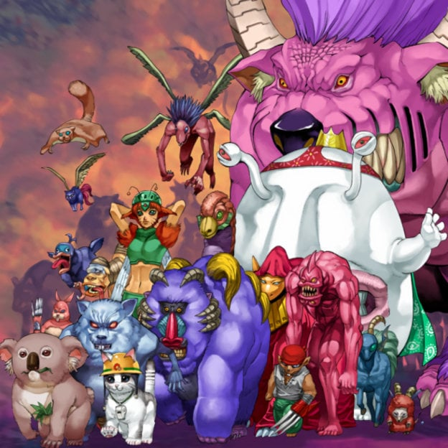
Mingle time!

