Slide 1
Register
Processing Unit
GPU
GPU
GPU
SM1
SM2
SMn
Warp Schedulers
Warp Schedulers
Warp Schedulers
SM1
SM1
SM1
Warps
Warps
Warps
Shared Memory
Cache
Shared Memory
Cache
Shared Memory
Cache
Global Memory – GDDR5 / Constant Memory
Host Memory

Slide 2
Data To architecture
Number Of SM → cuda Device Properties
Number of TOTAL Global/Shared/Register memory → cuda Deviece Properties
Number Of Warp Shedulers → CC (Compute Capability (WIKI for actual architecture)
Size of Warps = 32 for all (number of concurrent Threads per Scheduler)
Performance: #SMs * #Wscheduler * Wsize * Freq * #OpPerCycle
Example: 5*4*32*1518000000 * 2 = 1.9TFLOPS
(Achtung: GFLOPs Specs sind mit add+mul kombobefehl gerechnet (Faktor 2 Grösser als normale single float operation)

Slide 3
Quadro P1000
SMs: 4 (GL107 5)
Clock: 1518.5MHz
Max Threas/SM: 2048
Max Threads/Block: 1024
Max Blocks/SM: 32
Max Warps/SM: 64
CC: 6.1
Global/Shared/Register:
4GB/GPU, 65k/Block, 512kB/Th
Warp Shedulers pro SM = Th/Wsize: 4 (Cuncurrent Th pro SM: 128)
Cuncurrent Kernels: 1
Performance: 774.7 GFLOPS

Slide 4
Quadro K420
SMs: 1
Clock: 875.5MHz
Max Threas/SM: 2048
Max Threads/Block: 1024
Max Blocks/SM: 16
Max Warps/SM: 64
CC: 3.0
Global/Shared/Register:
1GB/GPU, 48k/Block, 512kB/Th
Warp Shedulers pro SM = Th/Wsize: 6 (Cuncurrent Th pro SM: 192)
Cuncurrent Kernels: 1
Performance: 168.1 GFLOPS

Slide 5
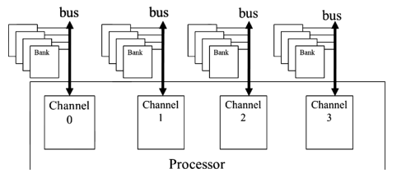
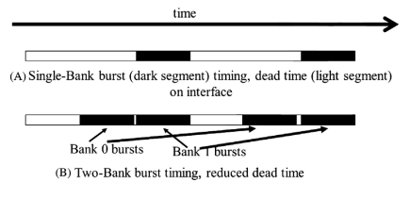
Global Memory - GDDR5
Channels = Concurrent Memory Controlers
Blocks (search Data)
p103ff

Slide 6
Quadro P1000
# Channels: 2
# Banks: 32
Speichertakt: 1253MHz (GP107GL: 1752MHz)
BW: 80.19 (FP107GL: 112.128GB/s)
Interface: 128bit → 2 channels
Example: 128bit / 8bit/byte * 1.253MHz * 2 transaction/clk * 2 channels
= 112.128GB/s
https://www.techpowerup.com/gpu-specs/quadro-p1000.c2932
https://de.wikipedia.org/wiki/Nvidia_Quadro

Slide 7
Performance Analysis
swAlloc: 13.481ms.
swH2D: 0.406638ms.
swKernel: 11.8767ms.
swD2H: 0.254802ms.
swFree: 0.25258ms.
Allocation takes time!! (and kernel)

Slide 8
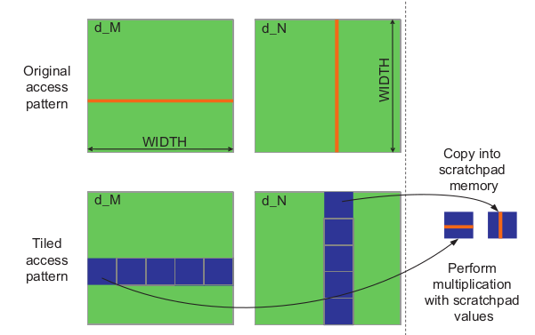
Corner tuning
Chapter 5 p110

