Slide 1
Overfitting
Jiaying Gong
Ph.D. candidate in Machine Learning Lab
Department of Computer Science

Slide 2
Objectives
Broad knowledge of overfitting.
Get a general understanding of different techniques to prevent overfitting.
Mathematically understanding of PCA and L1 Regularization.

Slide 3
Overfitting
If we have too many features (i.e. complex model), the learned hypothesis may fit the training set very well but fail to generalize to new examples (predict results on new examples).
The long training time of the model or its architectural complexity may cause the model to overfit. If the model trains for too long on the training data or is too complex, it learns the noise or irrelevant information within the dataset.

Slide 4

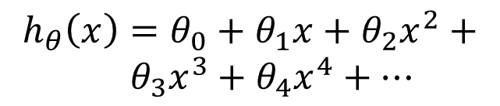

Example: Linear regression
Price ($) in 1000’s
Price ($) in 1000’s
Price ($) in 1000’s
Size in feet^2
Size in feet^2
Size in feet^2
$$h_{θ}\left(x\right)=θ_{0}+θ_{1}x$$
$$h_{θ}\left(x\right)=θ_{0}+θ_{1}x+θ_{2}x^{2}$$
$$h_{θ}\left(x\right)=θ_{0}+θ_{1}x+θ_{2}x^{2}+ \\ { θ}_{3}x^{3}+θ_{4}x^{4}+⋯$$
Underfitting
Just right
Overfitting

Slide 5
Overfitting vs Underfitting
Underfitting occurs when we have a high bias in our data, i.e., we are oversimplifying the problem, and as a result, the model does not work correctly in the training data.
Overfitting occurs when the model has a high variance, i.e., the model performs well on the training data but does not perform accurately in the evaluation set. The model memorizes the data patterns in the training dataset but fails to generalize to unseen examples.

Slide 6
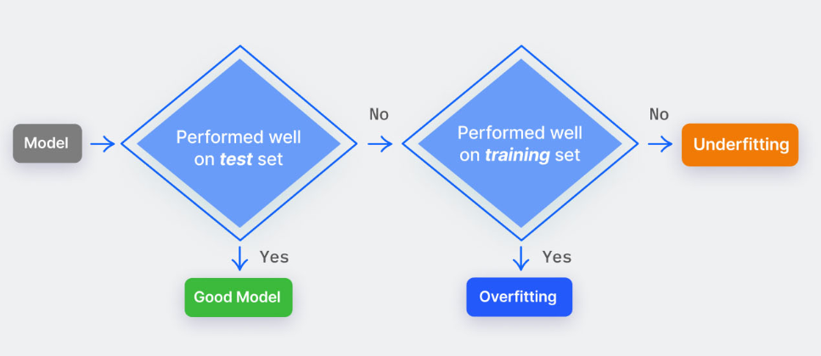
Overfitting vs Underfitting

Slide 7
How to prevent overfitting?

Slide 8
How to avoid overfitting?
Input Data
Train with more data (clean data)
Data augmentation
Feature Engineering – (too many features):
Feature Extraction (Dimension Reduction)
Feature Selection
Model – (architectural complexity):
Regularization
Dropout Layers
Training Stage – (long training time):
Cross-Validation
Early Stopping

Slide 9
How to avoid overfitting?
Input Data
Train with more data (clean data)
Data augmentation
Feature Engineering:
Feature Extraction (Dimension Reduction)
Feature Selection
Model:
Regularization
Dropout Layers
Training Stage:
Cross-Validation
Early Stopping

Slide 10
What are data augmentation techniques?

Slide 11
Data Augmentation
Computer Vision (CV):
Image mirroring, scaling, rotation, flipping, zooming, etc.
GAN models (i.e. CycleGAN)
Natural Language Processing (NLP):
Back translation
GPT-2 for generation
Time-series Prediction:
Jitter, inject noise, shifting, scaling, etc.

Slide 12
Data Augmentation
Computer Vision (CV):
Image mirroring, scaling, rotation, flipping, zooming, etc.
GAN models (i.e. CycleGAN)
Natural Language Processing (NLP):
Back translation
GPT-2 for generation
Time-series Prediction:
Jitter, inject noise, shifting, scaling, etc.

Slide 13
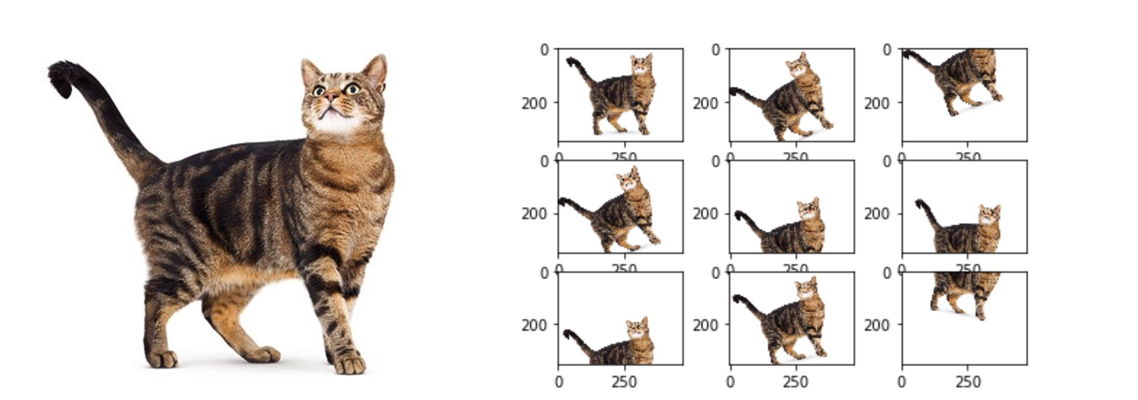
Data Augmentation - CV
Original Data
Augmented Data

Slide 14
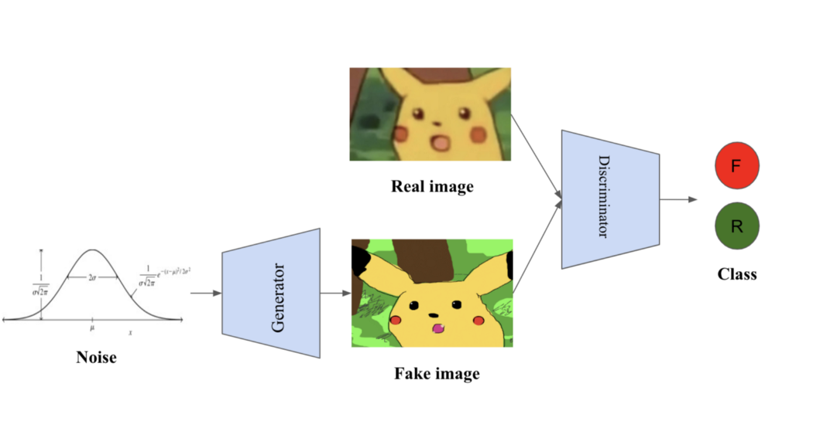
Data Augmentation - CV
Original Data
Augmented Data

Slide 15
Data Augmentation
Computer Vision (CV):
Image mirroring, scaling, rotation, flipping, zooming, etc.
GAN models (i.e. CycleGAN)
Natural Language Processing (NLP):
Back translation
GPT-2 for generation
Time-series Prediction:
Jitter, inject noise, shifting, scaling, etc.

Slide 16

Data Augmentation - NLP
Word Substitution

Slide 17
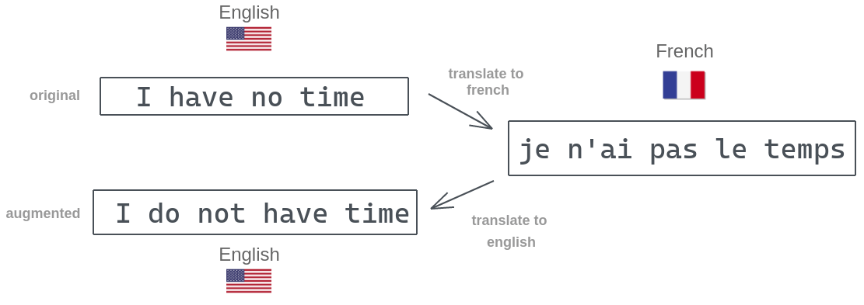
Data Augmentation - NLP
Back Translation

Slide 18
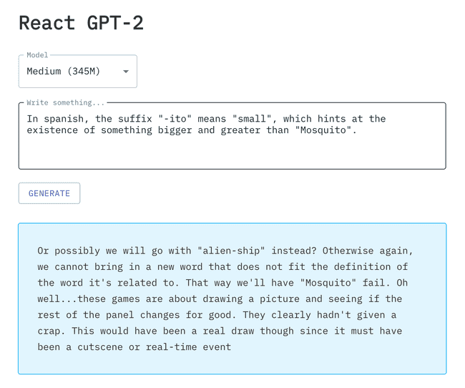
Data Augmentation - NLP

Slide 19
Data Augmentation
Computer Vision (CV):
Image mirroring, scaling, rotation, flipping, zooming, etc.
GAN models (i.e. CycleGAN)
Natural Language Processing (NLP):
Back translation
GPT-2 for generation
Time-series Prediction:
Jitter, inject noise, shifting, scaling, etc.

Slide 20
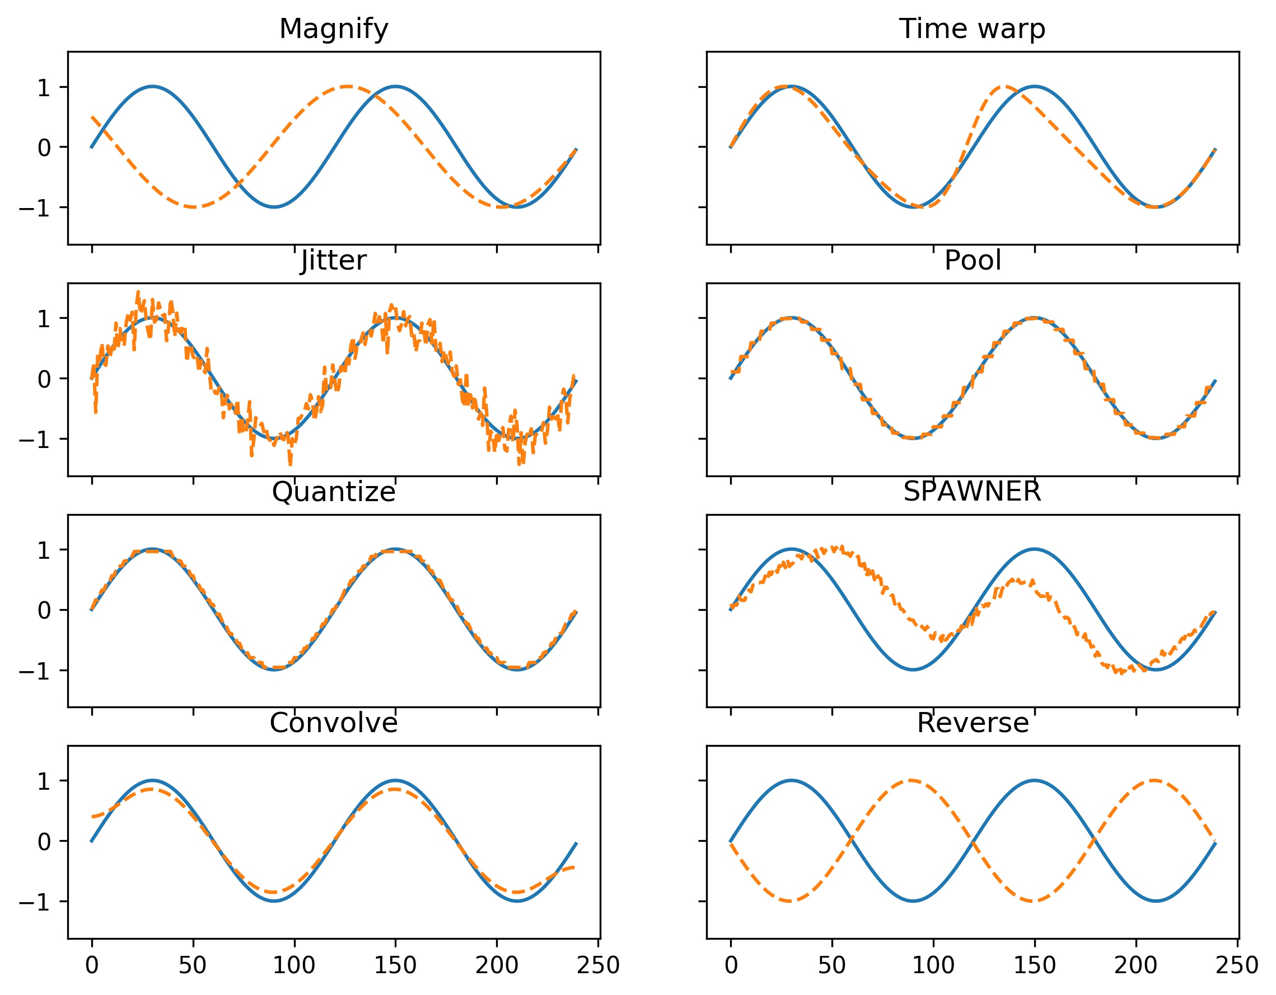
Data Augmentation – Time-series

Slide 21
How to avoid overfitting?
Input Data
Train with more data (clean data)
Data augmentation
Feature Engineering:
Feature Extraction (Dimension Reduction)
Feature Selection
Model:
Regularization
Dropout Layers
Training Stage:
Cross-Validation
Early Stopping

Slide 22
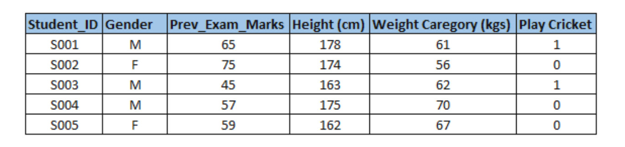
What are features?
Features
Labels

Slide 23
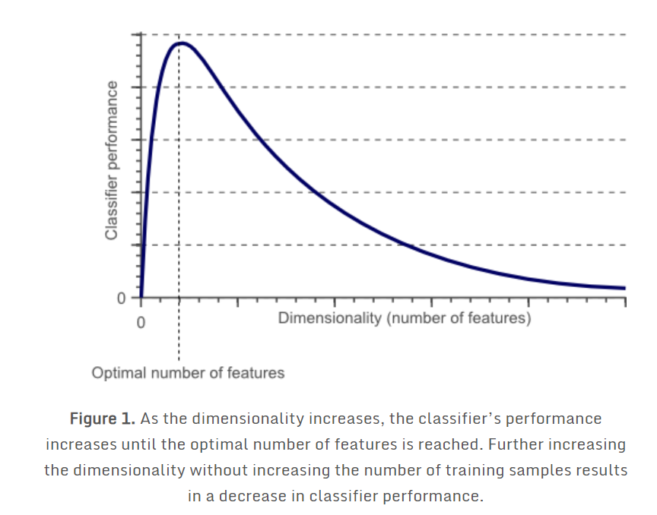
Curse of Dimensionality
If 0.5*red + 0.3*green + 0.2*blue > 0.6 : return cat; else return dog;

Slide 24
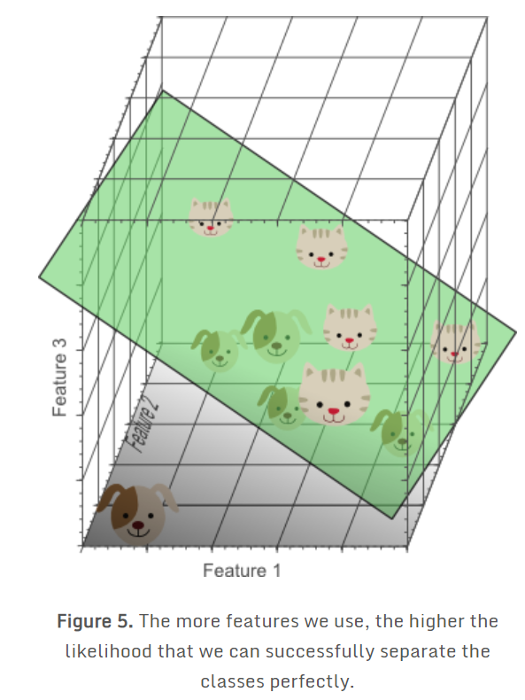
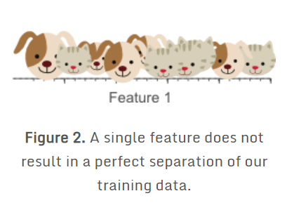
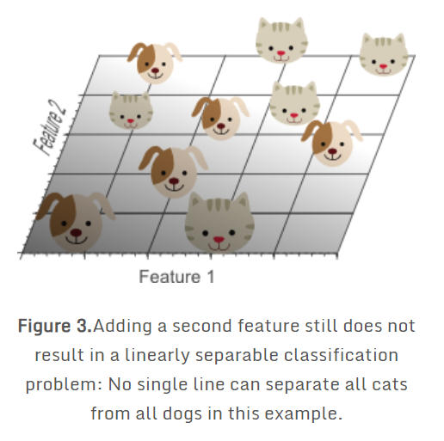
Curse of Dimensionality

Slide 25
Curse of Dimensionality
Problem: The density of the training samples decreased exponentially when we increased the dimensionality of the problem.

Slide 26
Curse of Dimensionality
In the 1D case (figure 2), 10 training instances covered the complete 1D feature space, the width of which was 5 unit intervals. Therefore, in the 1D case, the sample density was 10/5=2 samples/interval. In the 2D case however (figure 3), we still had 10 training instances at our disposal, which now cover a 2D feature space with an area of 5×5=25 unit squares. Therefore, in the 2D case, the sample density was 10/25 = 0.4 samples/interval. Finally, in the 3D case, the 10 samples had to cover a feature space volume of 5x5x5=125 unit cubes. Therefore, in the 3D case, the sample density was 10/125 = 0.08 samples/interval.

Slide 27
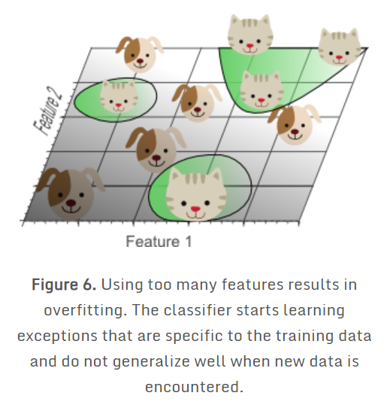
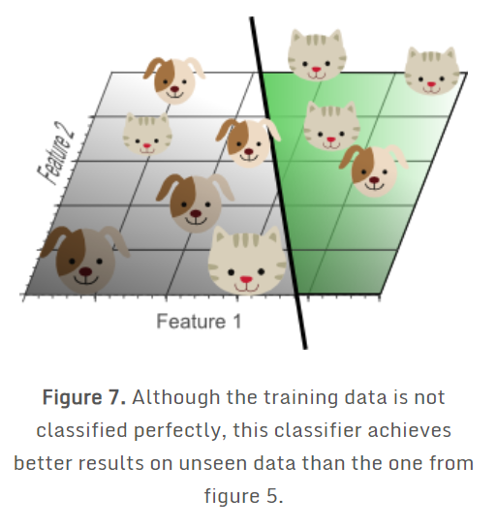
Curse of Dimensionality

Slide 28
Dimension Reduction
Dimensionality reduction is a method of converting the high dimensional variables into lower dimensional variables without changing the specific information of the variables.
Dimensionality Reduction is used to reduce the feature space with consideration by a set of principal features.

Slide 29
Dimension Reduction - PCA
Principal component analysis (PCA) is a technique that transforms high-dimensions data into lower-dimensions while retaining as much information as possible.

Slide 30
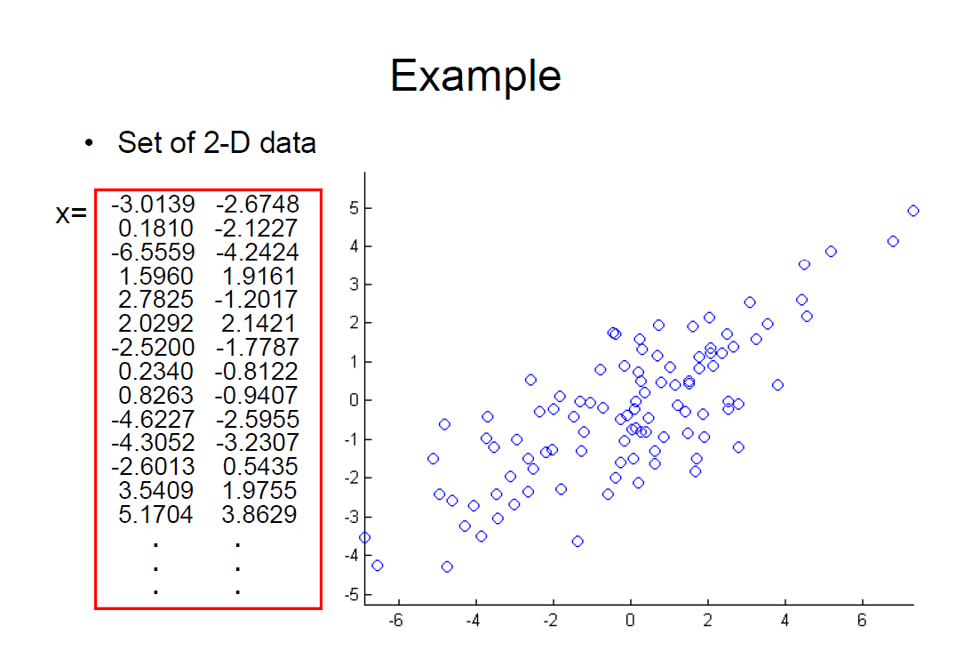

Slide 31
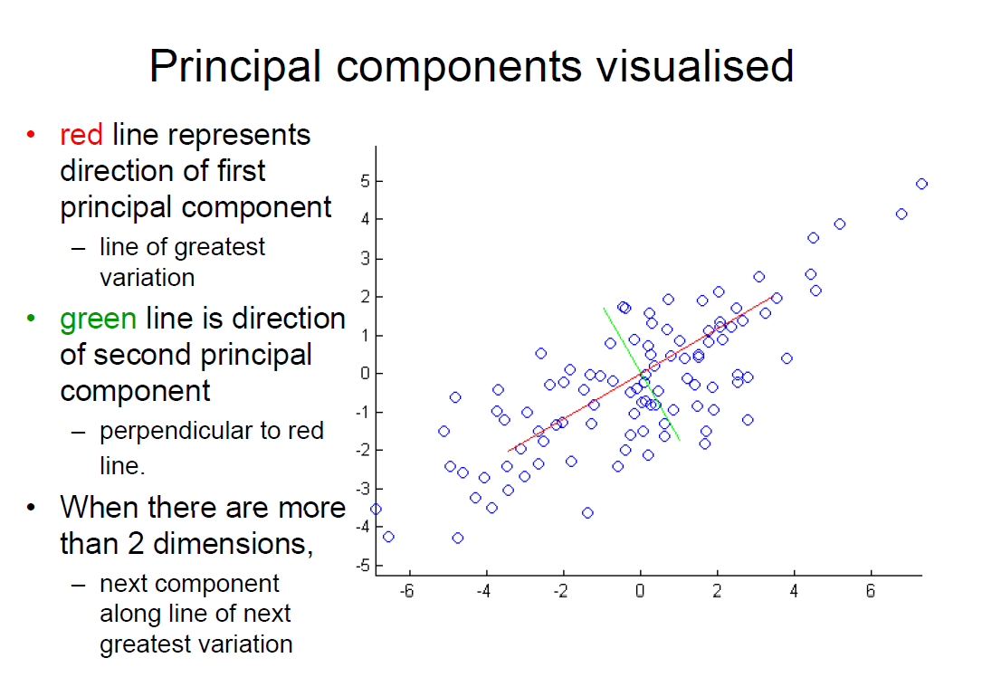

Slide 32
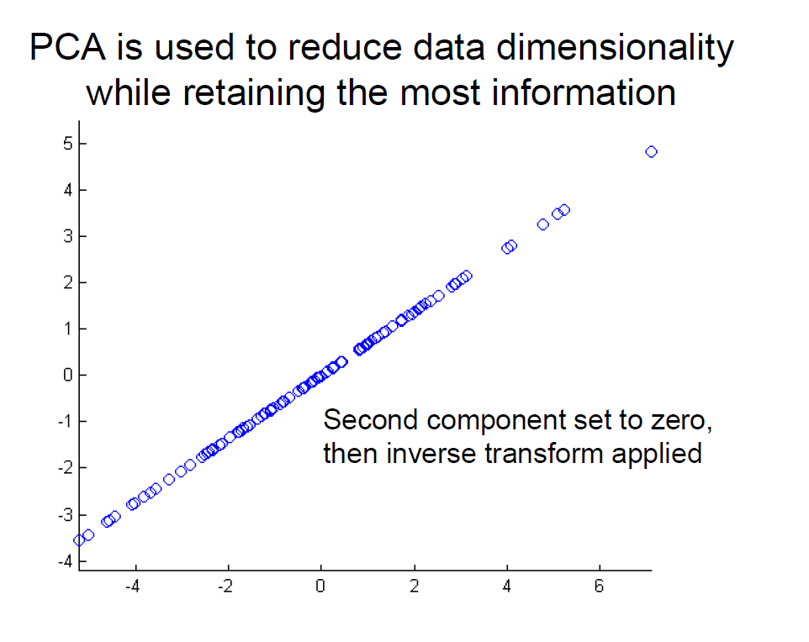

Slide 33
Understand PCA mathematically
Step 1: Calculate the covariance matrix for the features in the dataset.
Step 2: Calculate the eigenvalues and eigenvectors for the covariance matrix.
Step 3: Sort eigenvalues and their corresponding eigenvectors.
Step 4: Pick k eigenvalues and form a matrix of eigenvectors.
Step 5: Transform the original matrix.

Slide 34

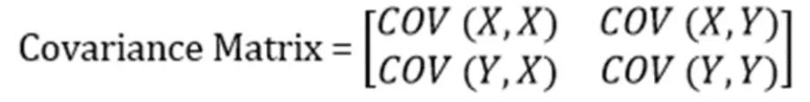
PCA
Step 1: Calculate the covariance matrix for the whole dataset

Slide 35
PCA
Step 2: Calculate eigenvalues and eigen vectors.
Let A be the covariance matrix, ν a vector and λ a scalar that satisfies Aν = λν, then λ is called eigenvalue associated with eigenvector ν of A.
Aν = λν -> (A-λE) ν=0
Because ν is a non-zero vector, | A-λE |=0

Slide 36
PCA
Step 3: Sort eigenvalues and their corresponding eigenvectors.
Step 4: Pick k eigenvalues and form a matrix of eigenvectors.
Step 5: Transform the original matrix.

Slide 37
Exercise for PCA
 | f1 | f2
D1 | -1 | -2
D2 | -1 | 0
D3 | 0 | 0
D4 | 2 | 1
D5 | 0 | 1
Find the eigenvalue and the transformed matrix
Question: What’s the meaning if eigenvalues are similar?

Slide 38
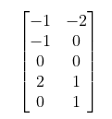









Solution

Slide 39
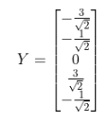


Solution

Slide 40
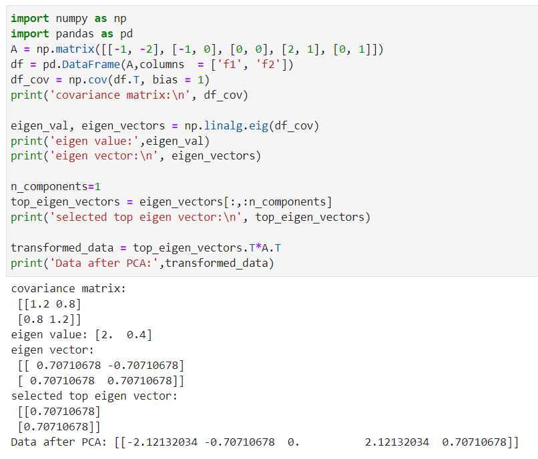
Result

Slide 41
How to avoid overfitting?
Input Data
Train with more data (clean data)
Data augmentation
Feature Engineering:
Feature Extraction (Dimension Reduction)
Feature Selection
Model:
Regularization
Dropout Layers
Ensemble
Training Stage:
Cross-Validation
Early Stopping

Slide 42
Feature Selection
Aim:
Simplify the Models
Shorten Training Time
Avoid the Curse of Dimensionality
Enhance Generalization by Reducing Overfitting
There is no fixed rule that defines how many features should be used in a classification problem.
In fact, this depends on the amount of training data available, the complexity of the decision boundaries, and the type of classifier used.

Slide 43
FEATURE SELECTION METHOD
Filter
Removing features with low variance
Univariate feature selection
Chi2 (Y Discrete)
Pearson Correlation (Y Continuous)
Mutual Information (Y Discrete) and Maximal Information Coefficient (Y Continuous)
Distance Correlation
Model Based Ranking
Wrapper
Recursive Feature Elimination
Embedded
Feature selection using SelectFromModel
L1-based Feature Selection
Randomized Sparse Models
Tree-based Feature Selection
Feature selection as part of a pipeline

Slide 44

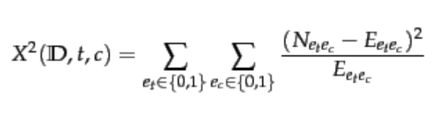
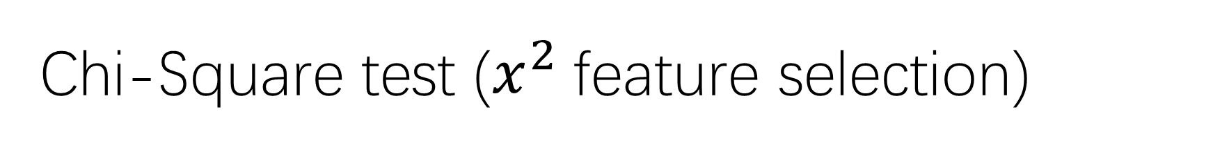
Chi-Square test ($x^{2}$feature selection)
In statistics, the test is applied to test the independence of two events, where two events A and B are defined to be independent if . In feature selection, the two events are occurrence of the term and occurrence of the class.

Slide 45
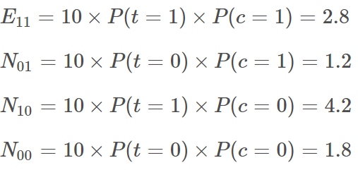

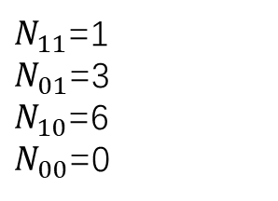
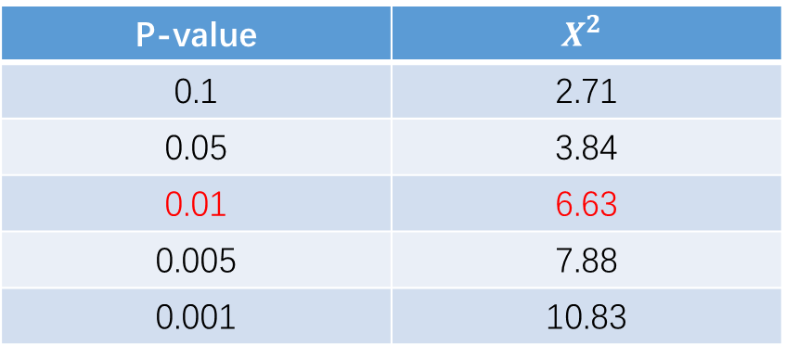
EXAMPLE
 | GENE1 | GENE2 | GENE3 | GENE4
Disease | 0.73 | 0.24 | 0.21 | 0.54
No Disease | 0.71 | 0.26 | 0.87 | 0.55
Sample No. | GENE3 | Disease
1 | 1 | 0
2 | 1 | 0
3 | 1 | 1
4 | 1 | 0
5 | 1 | 0
6 | 0 | 1
7 | 1 | 0
8 | 0 | 1
9 | 1 | 0
10 | 0 | 1
$N_{11}$=1
$N_{01}$=3
$N_{10}$=6
$N_{00}$=0
P-value | $$X^{2}$$
0.1 | 2.71
0.05 | 3.84
0.01 | 6.63
0.005 | 7.88
0.001 | 10.83

Slide 46
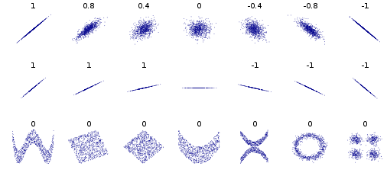
Pearson Correlation
A Pearson correlation is a number between -1 and 1 that indicates the extent to which two variables are linearly related.

Slide 47


Pearson Correlation

Slide 48
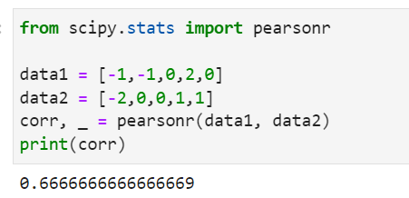
Answer:

Slide 49

Mutual Information and Maximal Information Coefficient
Mutual Information of two random variables is a measure of the mutual dependence between the two variables. More specifically, it quantifies the amount of information obtained about one random variable through observing the other random variable.

Slide 50
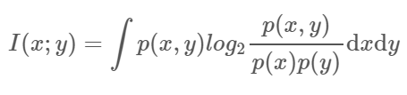
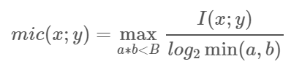
Mutual Information and Maximal Information Coefficient
Maximal information coefficient is a measure of the strength of the linear or non-linear association between two variables X and Y.

Slide 51
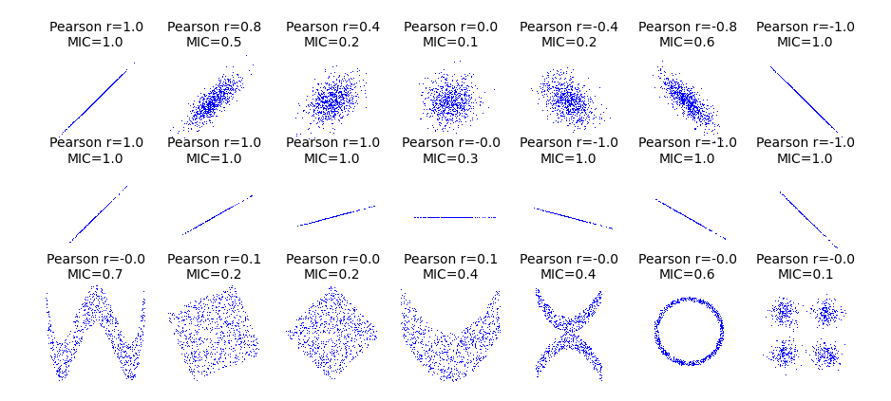
Mutual Information and Maximal Information Coefficient

Slide 52
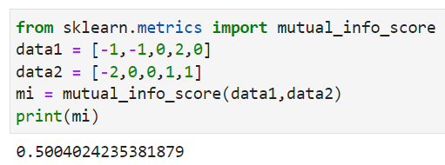
Mutual Information

Slide 53

Distance Correlation
Distance correlation is a measure of dependence between two paired random vectors of arbitrary dimension. The population distance correlation coefficient is zero if and only if the random vectors are independent. Thus, distance correlation measures both linear and nonlinear association between two random variables or random vectors.

Slide 54
Model Based Ranking
Build prediction model based on each individual feature and its corresponding response variable.
Python sklearn:
RandonForestRegressor
Example:
[('0.620', 'LSTAT'), ('0.591', 'RM'), ('0.467', 'NOX'), ('0.342', 'INDUS'), ('0.305', 'TAX'), ('0.240', 'PTRATIO'), ('0.206', 'CRIM'), ('0.187', 'RAD'), ('0.184', 'ZN'), ('0.135', 'B'), ('0.082', 'DIS'), ('0.020', 'CHAS'), ('0.002', 'AGE')]

Slide 55
FEATURE SELECTION METHOD
Filter
Removing features with low variance
Univariate feature selection
Chi2 (Y Discrete)
Pearson Correlation (Y Continuous)
Mutual Information (Y Discrete) and Maximal Information Coefficient (Y Continuous)
Distance Correlation
Model Based Ranking
Wrapper
Recursive Feature Elimination
Embedded
Feature selection using SelectFromModel
L1-based Feature Selection
Randomized Sparse Models
Tree-based Feature Selection
Feature selection as part of a pipeline

Slide 56
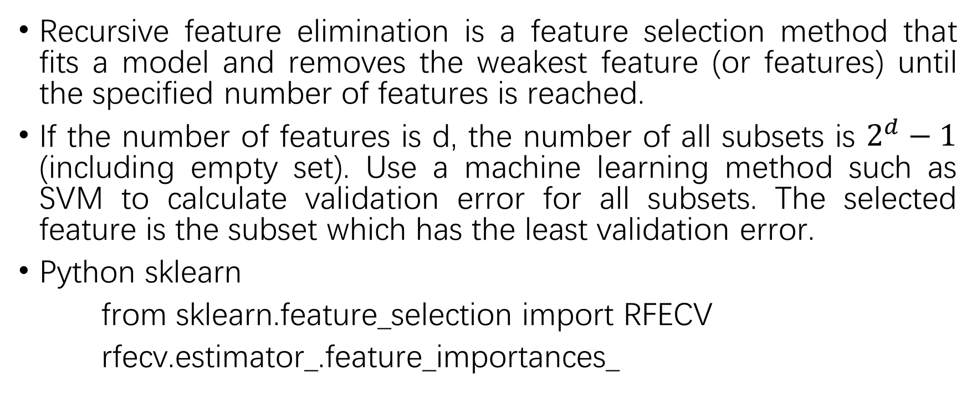
Recursive Feature Elimination
Recursive feature elimination is a feature selection method that fits a model and removes the weakest feature (or features) until the specified number of features is reached.
If the number of features is d, the number of all subsets is $2^{d}−1$ (including empty set). Use a machine learning method such as SVM to calculate validation error for all subsets. The selected feature is the subset which has the least validation error.
Python sklearn
from sklearn.feature_selection import RFECV
rfecv.estimator_.feature_importances_

Slide 57
FEATURE SELECTION METHOD
Filter
Removing features with low variance
Univariate feature selection
Chi2 (Y Discrete)
Pearson Correlation (Y Continuous)
Mutual Information (Y Discrete) and Maximal Information Coefficient (Y Continuous)
Distance Correlation
Model Based Ranking
Wrapper
Recursive Feature Elimination
Embedded
Feature selection using SelectFromModel (python sklearn)
L1 Regularization
Randomized Sparse Models
Tree-based Feature Selection
Feature selection as part of a pipeline

Slide 58
How to avoid overfitting?
Input Data
Train with more data (clean data)
Data augmentation
Feature Engineering:
Feature Extraction (Dimension Reduction)
Feature Selection
Model:
Regularization
Dropout Layers
Training Stage:
Cross-Validation
Early Stopping

Slide 59

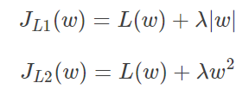


Regularization
Regularization applies a "penalty" to the input parameters with the larger coefficients, which subsequently limits the model's variance.
If there is one attribute $w$, loss function is $L(w)$
Question: Which regularization can do feature selection? L1 or L2? Why?

Slide 60
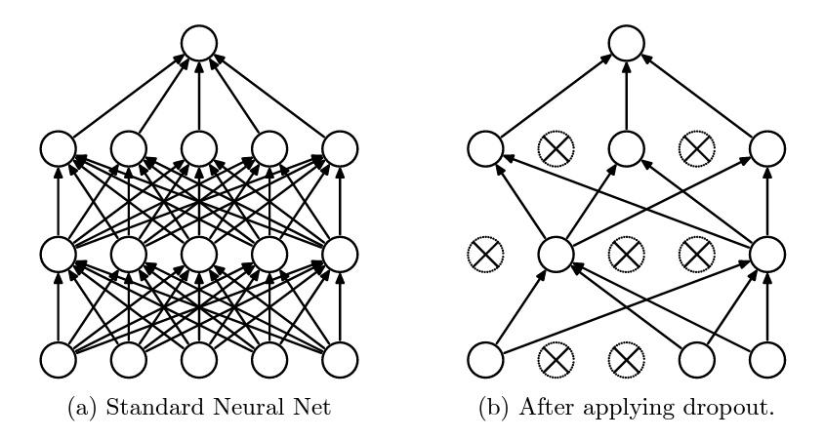
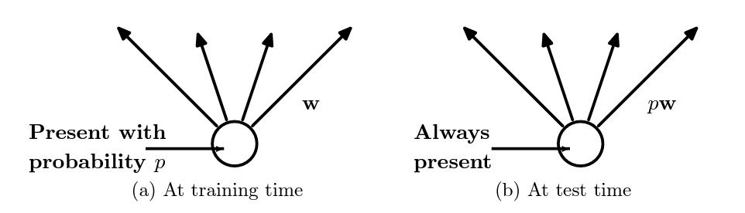
Dropout
Dropout: A Simple Way to Prevent Neural Networks from Overfitting
Journal of Machine Learning Research 2014

Slide 61
How to avoid overfitting?
Input Data
Train with more data (clean data)
Data augmentation
Feature Engineering:
Feature Extraction (Dimension Reduction)
Feature Selection
Model:
Regularization
Dropout Layers
Training Stage:
Cross-Validation
Early Stopping

Slide 62
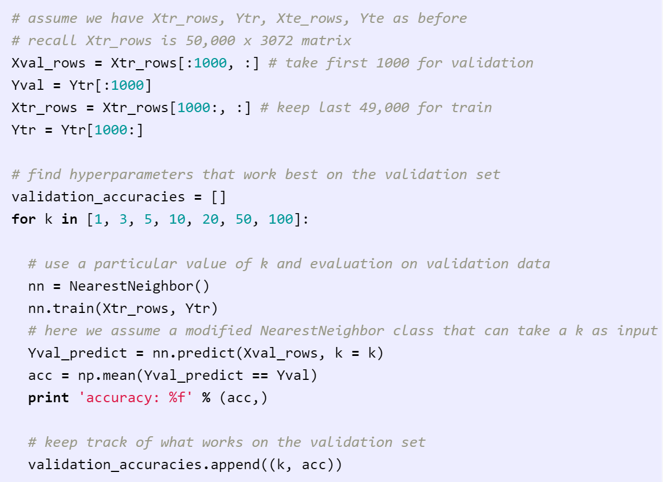
Validation set
Splitting training set: A fake test set to tune hyper-parameters

Slide 63
CROSS-VALIDATION
A technique for evaluating ML models by training several ML models on subsets of the available input data and evaluating them on the complementary subset of the data.

Slide 64
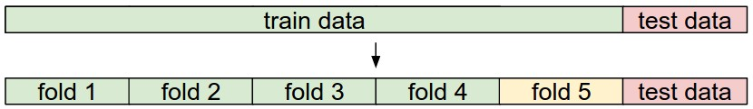
Cross-validation
5-fold cross-validation -> split the training data into 5 equal folds
4 of them for training and 1 for validation

Slide 65
Early Stopping: Always do this
Train Val
Loss
Accuracy
Stop training here
Iteration
Iteration
Stop training the model when accuracy on the validation set decreases Or train for a long time, but always keep track of the model snapshot that worked best on val
Lecture 7 -
Fei-Fei Li & Justin Johnson & Serena Yeung Lecture 7 - April 24, 2018

Slide 66
Conclusion
Input Data
Train with more data (clean data)
Data augmentation
Feature Engineering:
Feature Extraction (Dimension Reduction)
Feature Selection
Model:
Regularization
Dropout Layers
Training Stage:
Cross-Validation
Early Stopping

