Slide 1
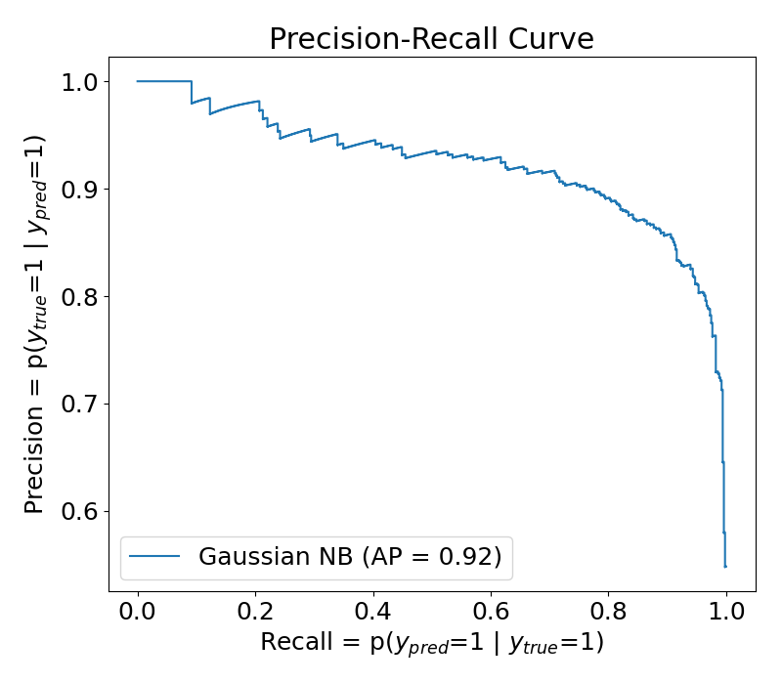
As decision threshold increases, precision remains the same or increases

