Slide 1
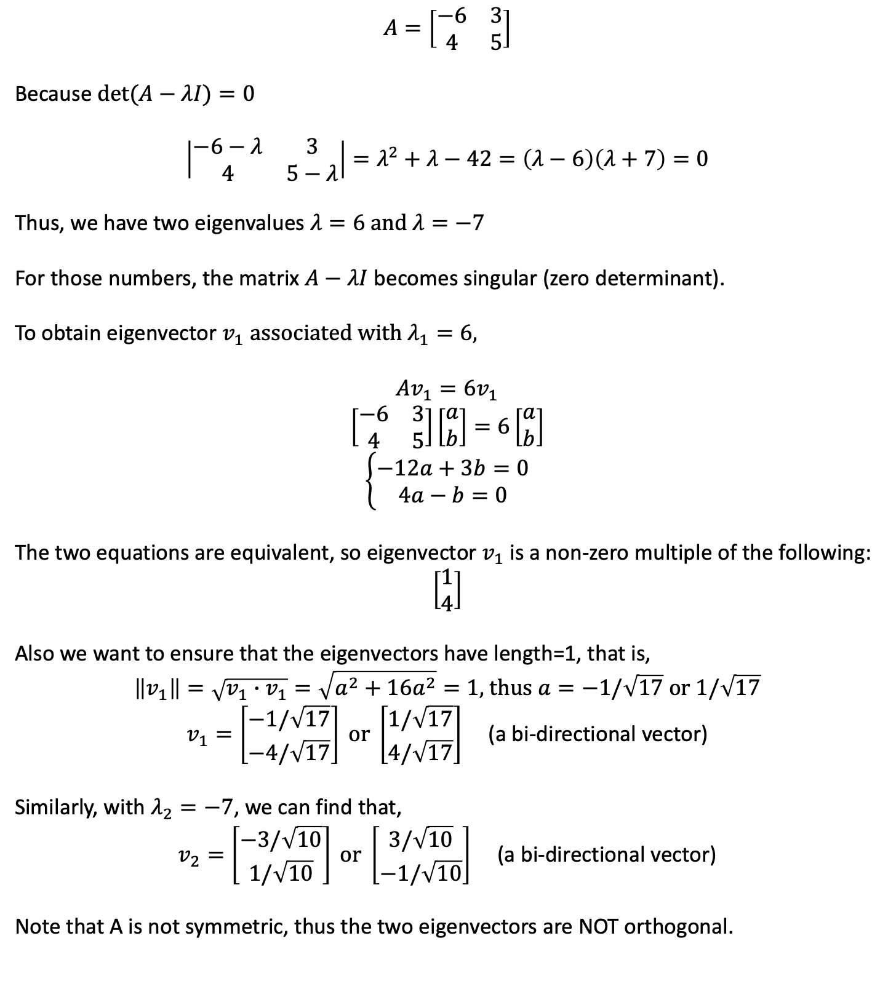
$$A=\left[\begin{matrix}−6 & 3 \\ 4 & 5\end{matrix}\right]$$
Because $det⁡(A−λI)=0$
$$\left|\begin{matrix}−6−λ & 3 \\ 4 & 5−λ\end{matrix}\right|=λ^{2}+λ−42=\left(λ−6\right)\left(λ+7\right)=0$$
Thus, we have two eigenvalues $λ=6 \text{and} λ=−7$
For those numbers, the matrix $A−λI$ becomes singular (zero determinant).
To obtain eigenvector $v_{1} associated with λ_{1}=6,$
$$Av_{1}=\text{6}v_{1}$$
$$\left[\begin{matrix}−6 & 3 \\ 4 & 5\end{matrix}\right]\left[\begin{matrix}a \\ b\end{matrix}\right]=6\left[\begin{matrix}a \\ b\end{matrix}\right]$$
$$\left\{\begin{aligned}−12a+3b=0 \\ 4a−b=0\end{aligned}\right.$$
The two equations are equivalent, so eigenvector $v_{1}$ is a non-zero multiple of the following:
$$\left[\begin{matrix}1 \\ 4\end{matrix}\right]$$
Also we want to ensure that the eigenvectors have length=1, that is,
$$\left\|v_{1}\right\|=\sqrt{v_{1}∙v_{1}}=\sqrt{a^{2}+16a^{2}}=1\text{, }\text{thus} a=−1/\sqrt{17} \text{or}\text{ 1/}\sqrt{17}$$
$v_{1}=\left[\begin{matrix}−1/\sqrt{17} \\ −4/\sqrt{17}\end{matrix}\right] \text{or} \left[\begin{matrix}1/\sqrt{17} \\ 4/\sqrt{17}\end{matrix}\right]$ (a bi-directional vector)
Similarly, with $λ_{2}=−7$, we can find that,
$v_{2}=\left[\begin{matrix}−3/\sqrt{10} \\ 1/\sqrt{10}\end{matrix}\right] \text{or} \left[\begin{matrix}3/\sqrt{10} \\ −1/\sqrt{10}\end{matrix}\right]$ (a bi-directional vector)
Note that A is not symmetric, thus the two eigenvectors are NOT orthogonal.
Notes:
Daniel Yang, Ph.D @ 2020

