Slide 1
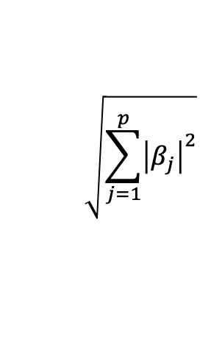
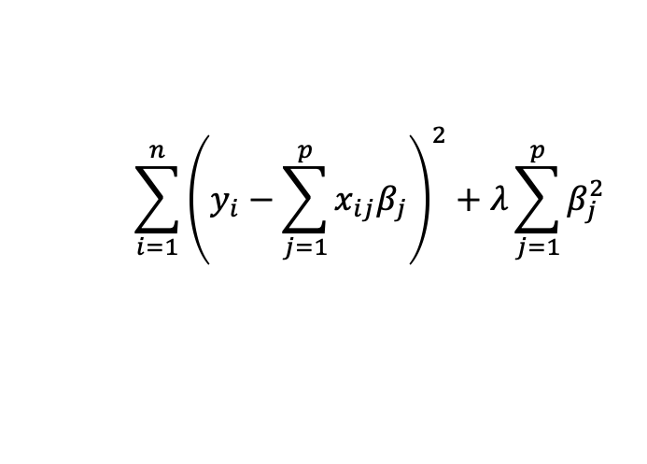
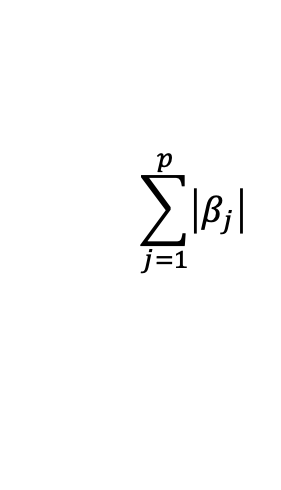
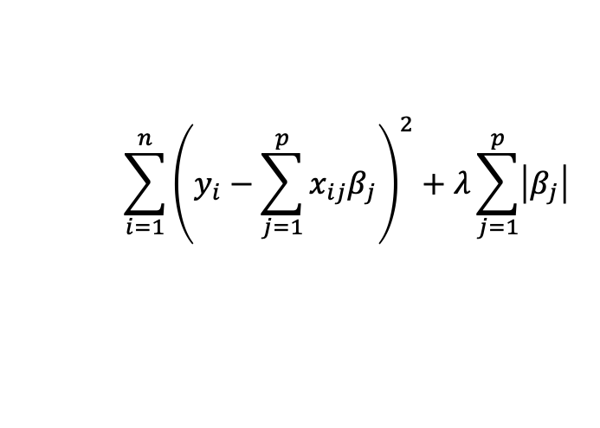
L2 norm:
$$\sum_{i=1}^{n}{{\left(y_{i}−\sum_{j=1}^{p}{x_{ij}β_{j}}\right)}^{2}+λ\sum_{j=1}^{p}{β_{j}^{2}}}$$
$$\sqrt{\sum_{j=1}^{p}{{\left|β_{j}\right|}^{2}}}$$
Cost Function for Ridge Regression
L1 norm:
$$\sum_{i=1}^{n}{{\left(y_{i}−\sum_{j=1}^{p}{x_{ij}β_{j}}\right)}^{2}+λ\sum_{j=1}^{p}{\left|β_{j}\right|}}$$
$$\sum_{j=1}^{p}{\left|β_{j}\right|}$$
Cost Function for Lasso Regression

