Slide 1


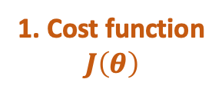



6. Cost/ loss/ error
1. Cost function
$$J\left(θ\right)$$
2. Initial $θ$
5. $α$
$2. θ=θ−α$ $\frac{∂J\left(θ\right)}{∂θ}$
4. $\frac{∂J\left(θ\right)}{∂θ}$
3. Gradient (=slope)
Global cost minimum
$$θ$$
Notes:
Daniel Yang @ 2020

