Slide 1
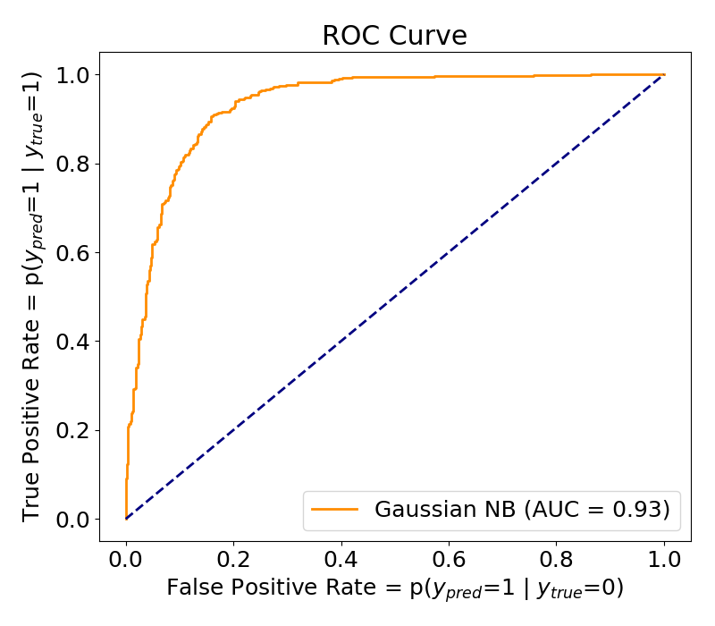
As decision threshold increases, recall remains the same or decreases

