Slide 1
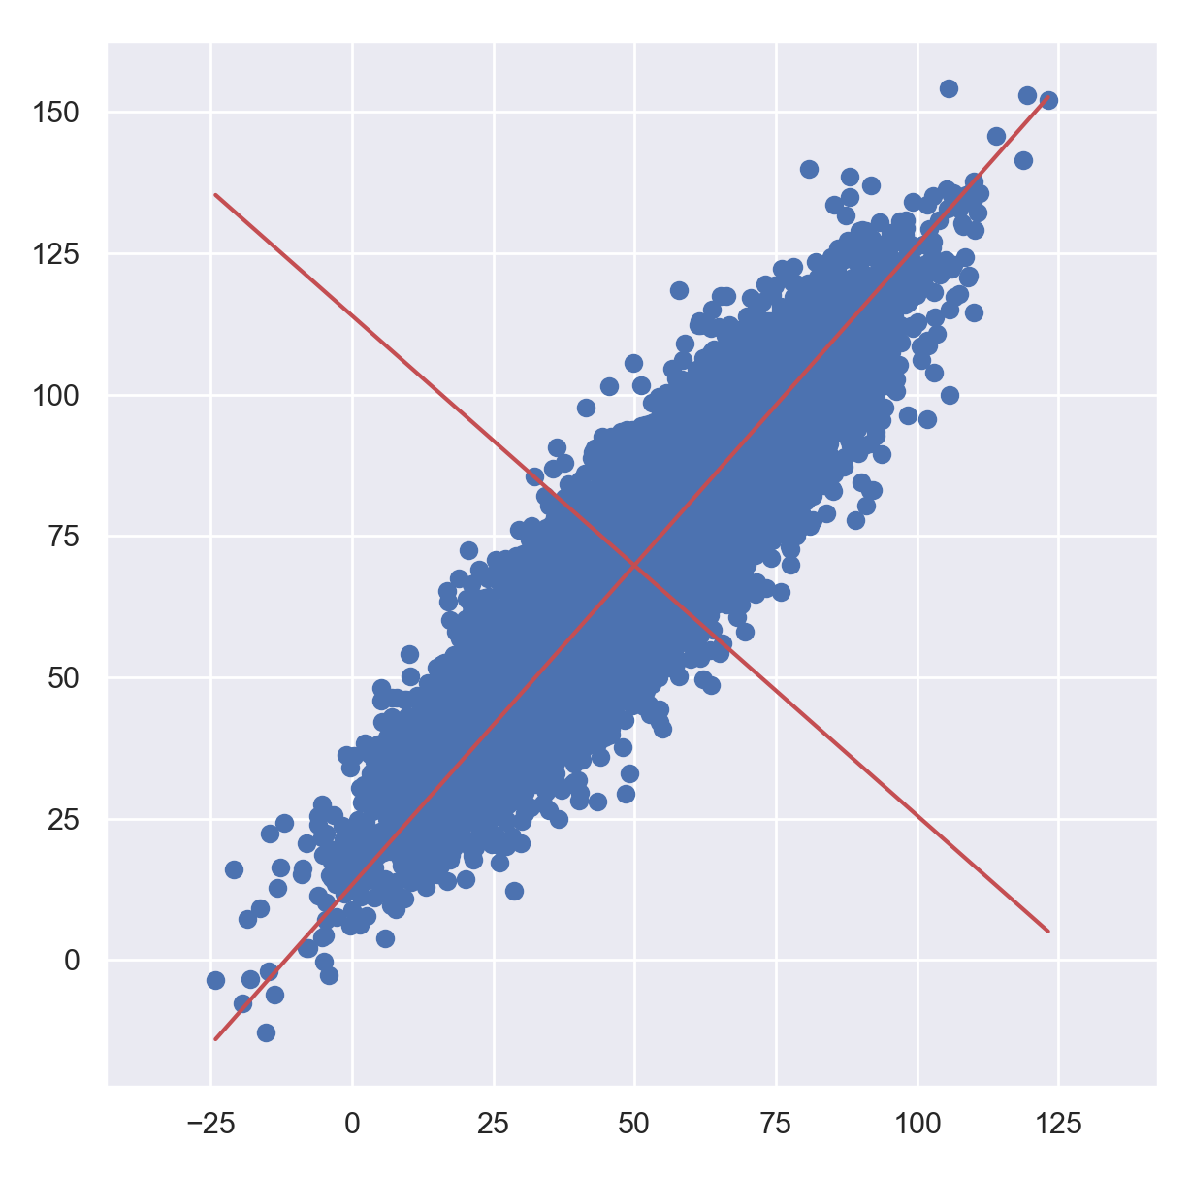
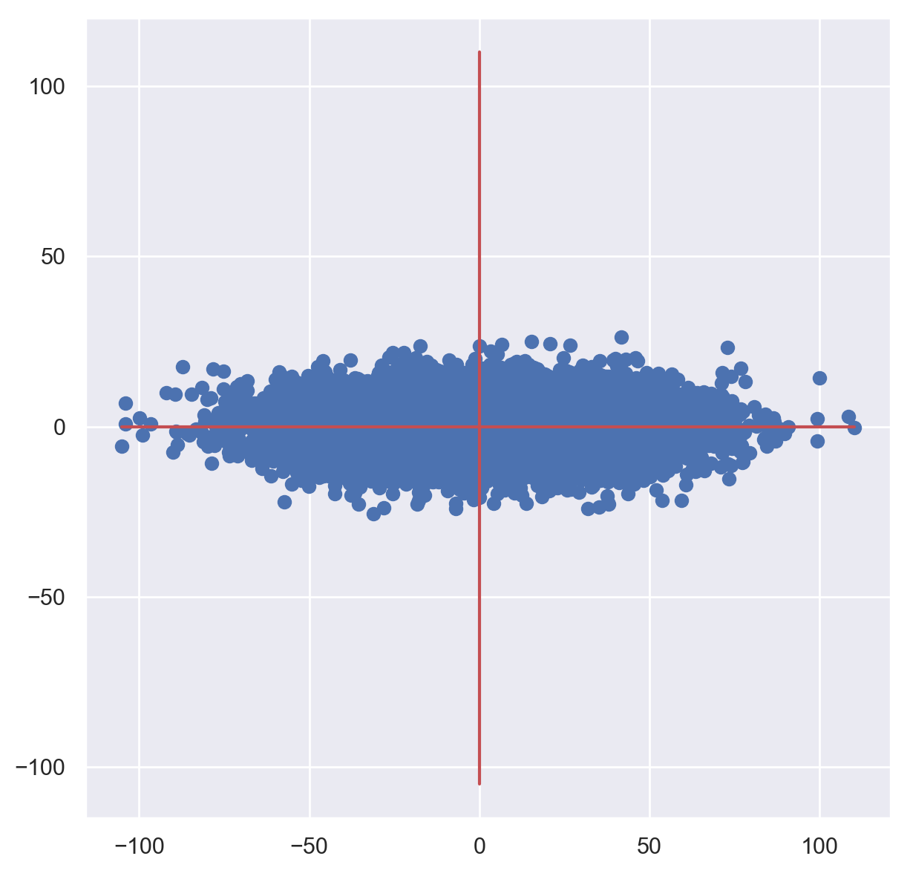
PC2
PC1
PC2
Projected
Original variable 2
PC1
Original variable 1

