Slide 1





$$y_{actual}=1$$
$$y_{actual}=0$$
$$y_{actual}=1$$
$$y_{actual}=0$$
$$y_{pred}=1$$
The set of all samples = 1
The set of all samples = 1
Notes:
Daniel Yang @ 2020

Slide 2

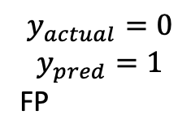

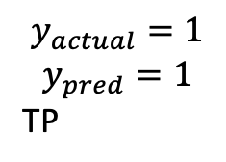
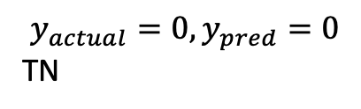
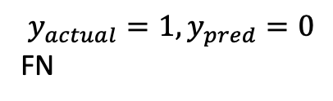
$$y_{actual}=1$$
$$y_{actual}=0$$
$$y_{actual}=1, y_{pred}=0$$
FN
$$y_{actual}=0, y_{pred}=0$$
TN
The set of all samples = 1
$$y_{actual}=1$$
$$y_{pred}=1$$
TP
$$y_{actual}=0$$
$$y_{pred}=1$$
FP

Slide 3



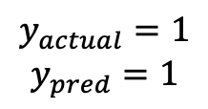
$$y_{actual}=0, y_{pred}=0$$
$$y_{actual}=1$$
$$y_{pred}=1$$
Accuracy =
$$y_{actual}=1$$
$$y_{actual}=0$$
it is sensitive to unbalanced class

Slide 4
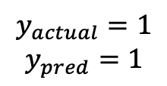


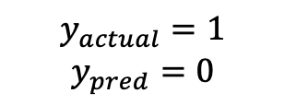
$$y_{actual}=1$$
$$y_{pred}=1$$
F₁ score =
$$y_{actual}=1$$
$$y_{pred}=0$$
$$y_{actual}=0$$
$$y_{pred}=1$$
+
$$y_{actual}=1$$
$$y_{pred}=1$$
+
2

Slide 5
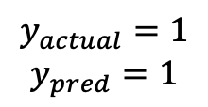
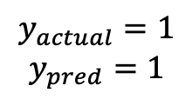
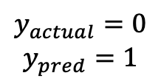
$$y_{actual}=1$$
$$y_{pred}=1$$
Precision =
$$y_{actual}=1$$
$$y_{pred}=1$$
$$y_{actual}=0$$
$$y_{pred}=1$$
it is sensitive to unbalanced class, as it is conditional upon the estimate of y_{pred}=1, which may be changed by the baseline p(y_{actual}=1)

Slide 6
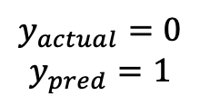
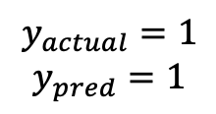
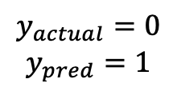
$$y_{actual}=0$$
$$y_{pred}=1$$
FDR =
$$y_{actual}=1$$
$$y_{pred}=1$$
$$y_{actual}=0$$
$$y_{pred}=1$$
it is sensitive to unbalanced class, as it is conditional upon the estimate of y_{pred}=1, which may be changed by the baseline p(y_{actual}=1)

Slide 7
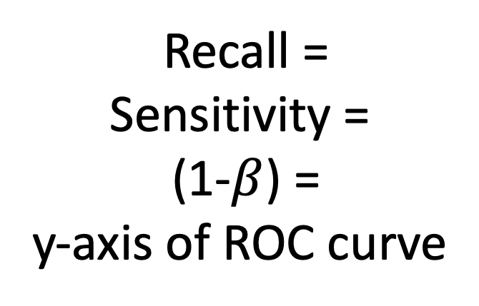
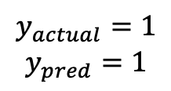

$$y_{actual}=1$$
$$y_{pred}=1$$
Recall = Sensitivity = (1-$β$) = y-axis of ROC curve
$$y_{actual}=1, y_{pred}=0$$
$$y_{actual}=1$$
$$y_{pred}=1$$
it is independent of p(y_{actual}=1), and insensitive to unbalanced class

Slide 8

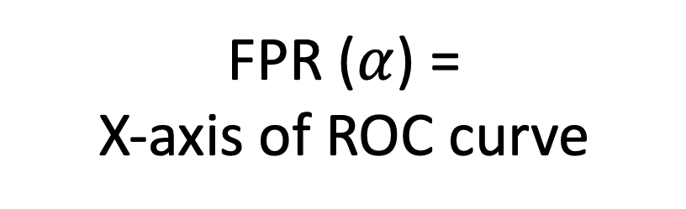
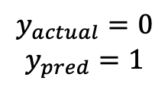
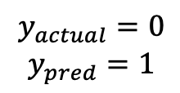
$$y_{actual}=0$$
$$y_{pred}=1$$
FPR ($α$) = X-axis of ROC curve
$$y_{actual}=0, y_{pred}=0$$
$$y_{actual}=0$$
$$y_{pred}=1$$
it is independent of p(y_{actual}=1), and insensitive to unbalanced class

Slide 9
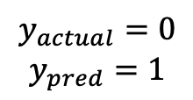


$$y_{actual}=0, y_{pred}=0$$
Specificity =
$$y_{actual}=0, y_{pred}=0$$
$$y_{actual}=0$$
$$y_{pred}=1$$
it is independent of p(y_{actual}=1), and insensitive to unbalanced class

Slide 10

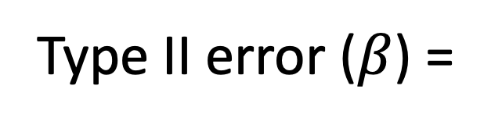

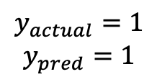
$$y_{actual}=1, y_{pred}=0$$
Type II error ($β$) =
$$y_{actual}=1, y_{pred}=0$$
$$y_{actual}=1$$
$$y_{pred}=1$$
it is independent of p(y_{actual}=1), and insensitive to unbalanced class

Slide 11



Decision threshold moving to the right equals to a smaller y_{pred}=1
Decision threshold
$$y_{actual}=1$$
$$y_{actual}=0$$
$$y_{pred}=1$$
The set of all samples = 1

Slide 12
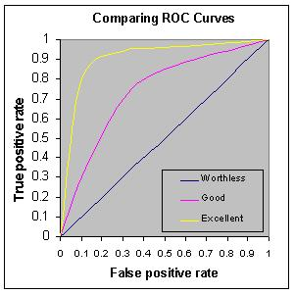





$$y_{actual}=1$$
$$y_{actual}=0$$
A better classifier equals to shifting the y_{pred}=1 to the left
$$y_{pred}=1$$
$$y_{pred}=1$$
$$y_{pred}=1$$

Slide 14
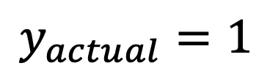
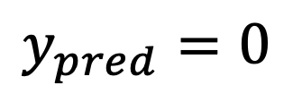
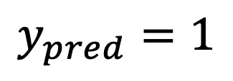
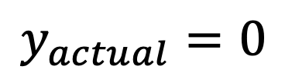
$$y_{pred}=0$$
$$y_{actual}=0$$
$$y_{pred}=1$$
$$y_{actual}=1$$
Notes:
Daniel Yang @ 2020

Slide 15
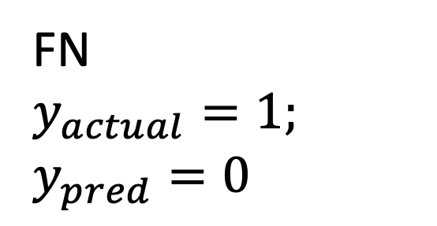
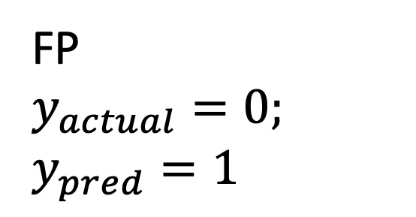
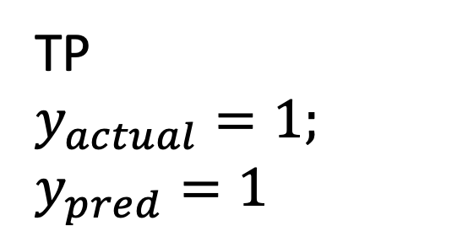
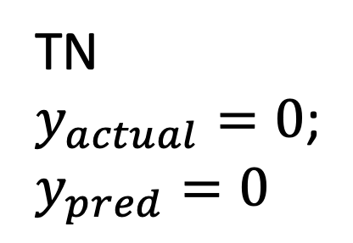
TN
$y_{actual}=0$;
$$y_{pred}=0$$
FP
$$y_{actual}=0;$$
$$y_{pred}=1$$
$$y_{pred}=1$$
TP
$$y_{actual}=1;$$
$$y_{pred}=1$$
FN
$$y_{actual}=1;$$
$$y_{pred}=0$$
Notes:
Daniel Yang @ 2020

Slide 16
Recall / TPR
Notes:
Daniel Yang @ 2020

Slide 17
0
FPR
Notes:
Daniel Yang @ 2020

Slide 18
Notes:
Daniel Yang @ 2020

Slide 19
Notes:
Daniel Yang @ 2020

Slide 20
Notes:
Daniel Yang @ 2020

Slide 21
Precision =

