Slide 1


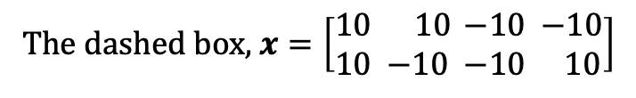


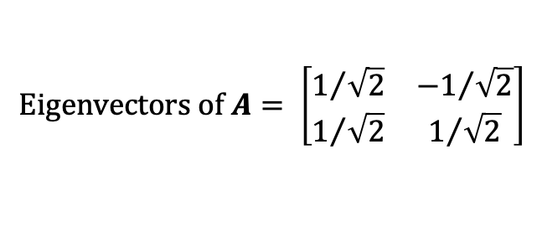

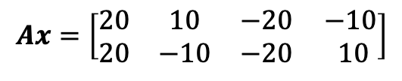

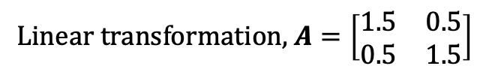

Eigenvectors and eigenvalues are characteristics of a linear transformation
(20, 20)
$$\text{The} \text{dashed} \text{box}\text{, }x=\left[\begin{matrix}10 \\ 10\end{matrix} \begin{matrix} 10 \\ −10 \end{matrix}\begin{matrix}−10 \\ −10 \end{matrix}\begin{matrix}−10 \\ 10\end{matrix}\right]$$
$$λ_{1}v_{1}$$
(-10, 10)
(10, 10)
$$\text{Linear} \text{transformation}\text{, }A=\left[\begin{matrix}1.5 & 0.5 \\ 0.5 & 1.5\end{matrix}\right]$$
$$λ_{2}v_{2}$$
$$Ax=\left[\begin{matrix}20 & 10 & −20 \\ 20 & −10 & −20\end{matrix}\begin{matrix} −10 \\ 10\end{matrix}\right]$$
$$v_{1}$$
$$v_{2}$$
$$\text{Eigenvectors} \text{of} A= \left[\begin{matrix}1/{\sqrt{2}} & {−1}/{\sqrt{2}} \\ 1/{\sqrt{2}} & 1/{\sqrt{2}}\end{matrix}\right]$$
(-10, -10)
(10, -10)
$$λ_{1}$$
$$λ_{2}$$
$$\text{Eigenvalues} \text{of} A= \left[\begin{matrix}2 & 1\end{matrix}\right]$$
(-20, -20)
Notes:
Daniel Yang @ 2020

