Slide 1
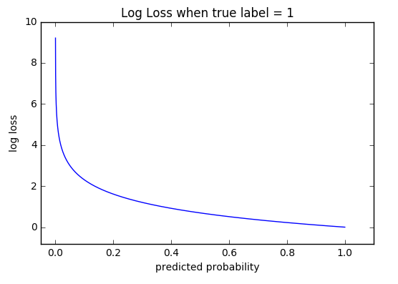

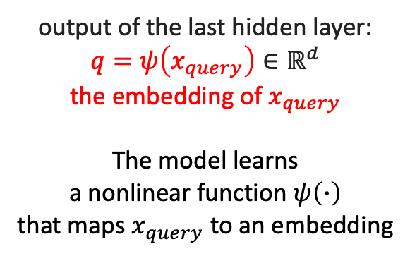
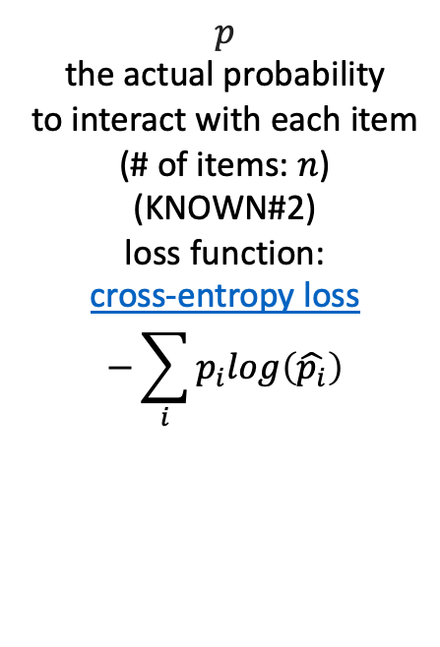
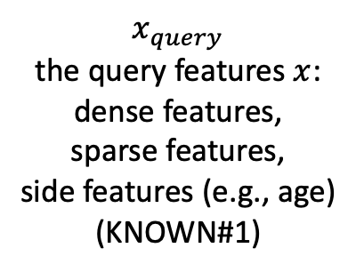
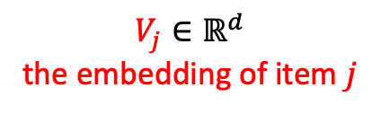
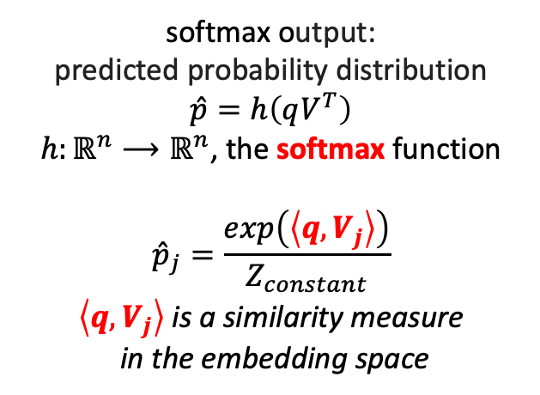
.30
minimize
difference
.40
matrix of weights
$$V∈ℝ^{n×d}$$
The item embedding matrix
in matrix factorization
.50
.55
...
...
...
...
...
...
$$V_{j}∈ℝ^{d}$$
the embedding of item $j$
.80
.75
input layer
hidden layers
softmax readout layer
ground truth
$$x_{query}$$
the query features $x$:
dense features, sparse features, side features (e.g., age)
(KNOWN#1)
output of the last hidden layer:
$$q=ψ\left(x_{query}\right)∈ℝ^{d}$$
the embedding of $x_{query}$
The model learns a nonlinear function $ψ\left(∙\right)$ that maps $x_{query}$ to an embedding
softmax output:
predicted probability distribution
$$\hat{p}=h\left(qV^{T}\right)$$
$h:ℝ^{n}⟶ℝ^{n}$, the softmax function
$${\hat{p}}_{j}=\frac{exp\left(\left\langle q,V_{j}\right\rangle \right)}{Z_{constant}}$$
$\left\langle q,V_{j}\right\rangle$ is a similarity measure in the embedding space
$$p$$
the actual probability
to interact with each item
(# of items: $n$)
(KNOWN#2)
loss function: cross-entropy loss $$−\sum_{i}{p_{i}log\left(\hat{p_{i}}\right)}$$

