Slide 1
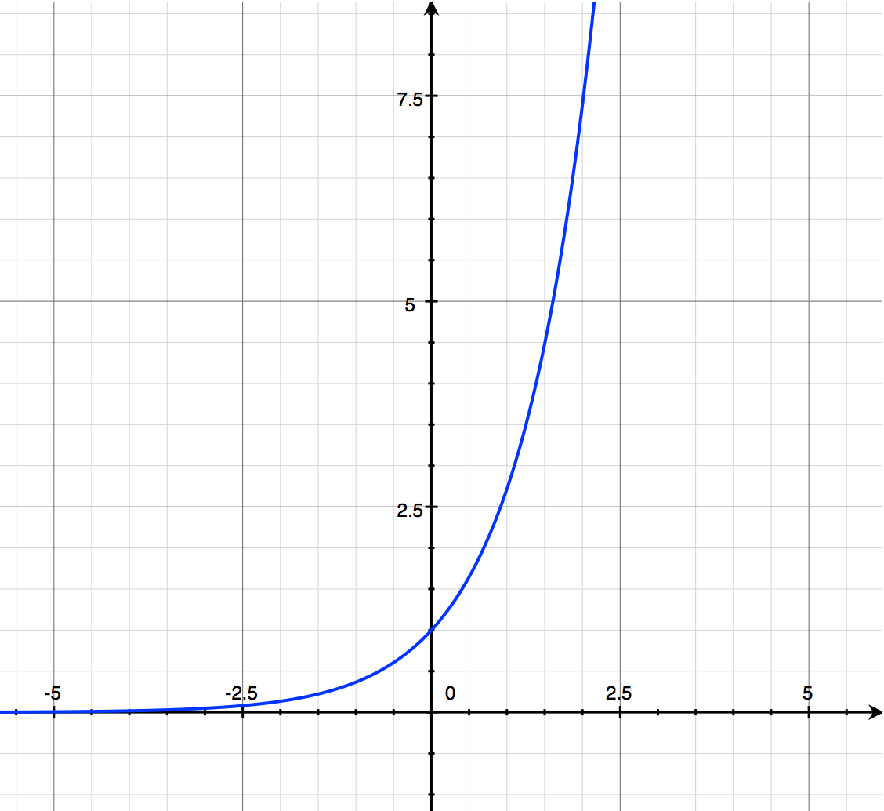


$odds=\frac{p}{q}=e^{z}$
or $odds ratio=e^{β_{1}}$
Let f(z) = e^{z}
The derivative:
f’(z) = e^{z}
f’(0) = e⁰=1, the critical slope
f’(z<0) < 1
f’(z>0) > 1
(1,e)
(-1,1/e)
(0,1)
$$z or β_{1}$$

Slide 2
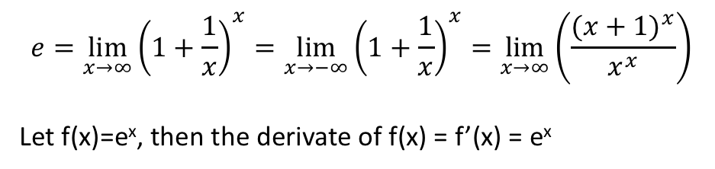
$$e=\lim_{x→∞}{{\left(1+\frac{1}{x}\right)}^{x}}=\lim_{x→−∞}{{\left(1+\frac{1}{x}\right)}^{x}}=\lim_{x→∞}\left(\frac{{(x+1)}^{x}}{x^{x}}\right)$$
Let f(x)=e^{x}, then the derivate of f(x) = f’(x) = e^{x}

Slide 3
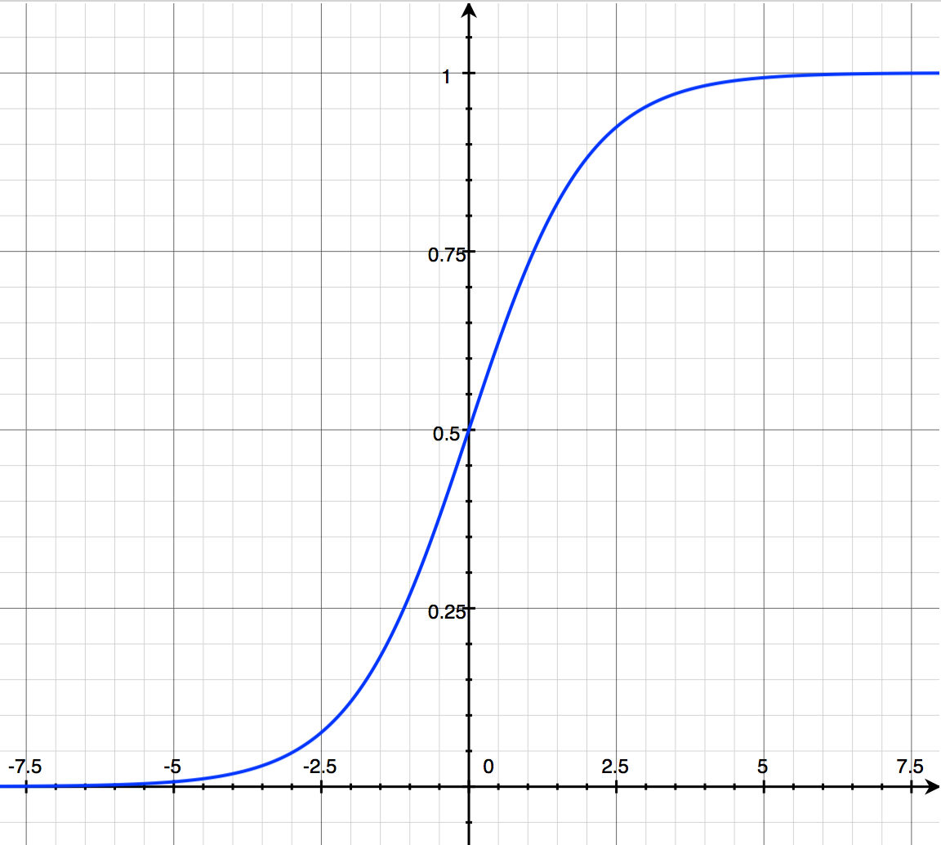

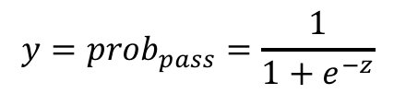
$$y={prob}_{pass}=\frac{1}{1+e^{−z}}$$
(0,0.5)
z = log odds = $β_{0}+β_{1}x$

Slide 4
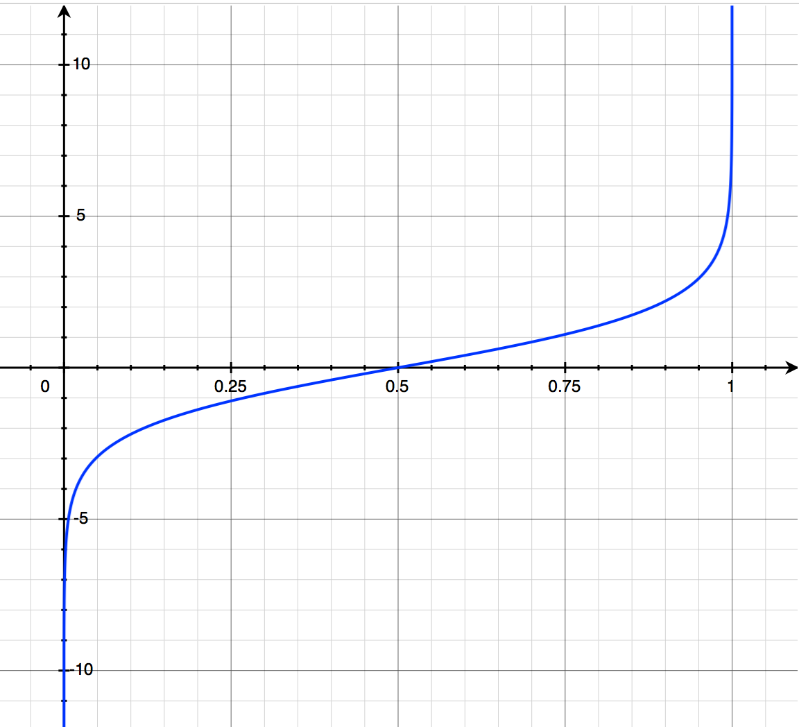


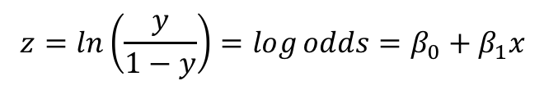
$$z=ln\left(\frac{y}{1−y}\right)=\log{odds=β_{0}+β_{1}x}$$
$$y={prob}_{pass}$$
Note: $odds=\frac{p}{q}$ thus log odds is simply taking the natural log of the odds

