Slide 1
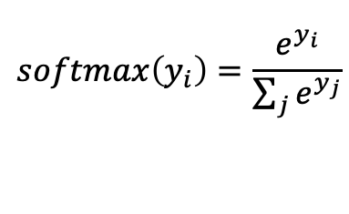
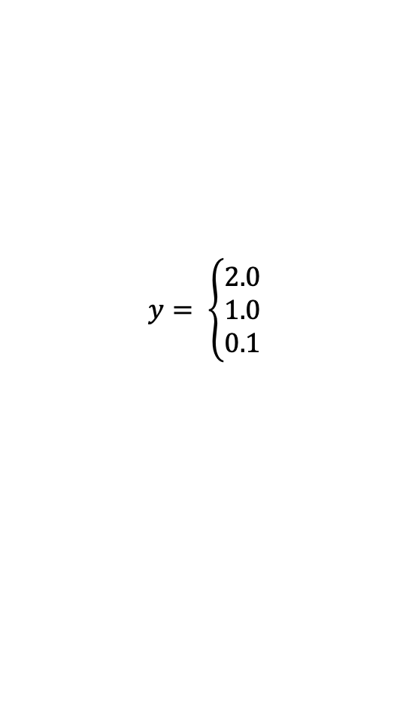
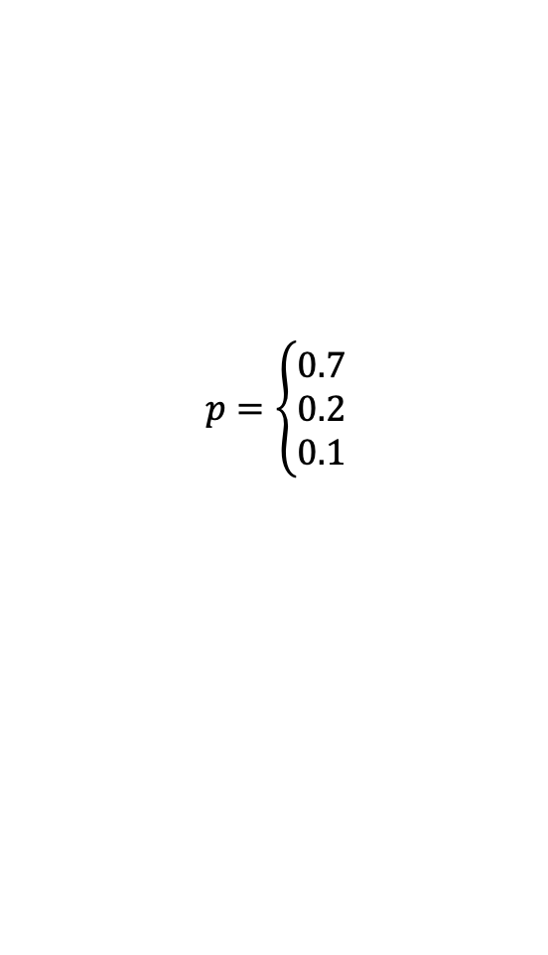
logit
scores
softmax
probabilities
$$y= \left\{\begin{aligned}2.0 \\ 1.0 \\ 0.1\end{aligned}\right.$$
$$softmax\left(y_{i}\right)=\frac{e^{y_{i}}}{\sum_{j}{e^{y_{j}}}}$$
$$p=\left\{\begin{aligned}0.7 \\ 0.2 \\ 0.1\end{aligned}\right.$$

