Slide 1
Topic: Comparison of stock market performance among the US and Chinese tech companies, with respect to the Impact of the Covid-19 Pandemic
Student Name: Wong Chuen Lik Daniel
Student Number: 210763720
Supervisor Name: William Marsh
Programme of Study: MSc in Computing and Information System (Conversion)

Slide 2
Problem Statement
Analyze the impact of Covid-19 on stock markets in the US and China based on the total number of new cases
Evaluate and compare different classical models incorporating macroeconomic factors against the baseline model (ARIMA)

Slide 3
Outline of content
Background research
Literature Review
Data Source
Exploratory Analysis
Time Series Modelling
Classical Learning Modelling
Conclusion
Session 1
Session 2
Session 3
Notes:
Our project is integrated with 3 parts: Background research, Exploratory Analysis, and Data Modelling

Slide 4
1
Background research & Literature Review

Slide 5

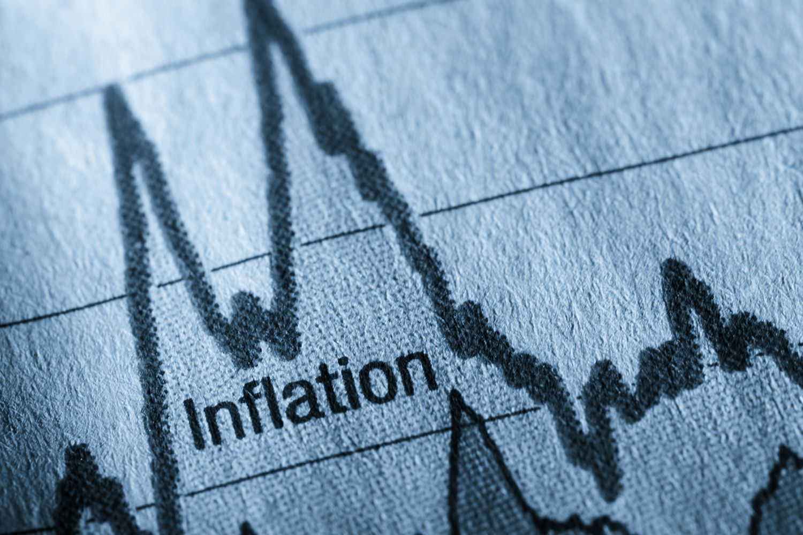
Background
A brief of the current macroeconomic situation across the world
2019 – current
2021-2022
The inflation Environment
Ongoing increase of CPI in the US
Tapering and rising interest rate
The Covid-19 Pandemic
Different public policies against Covid-19 (US vs China)
Social Distance -> WFH policy / Shutdown
Emerging technology in the pandemic (e.g., “click and Mortar” and “live commerce”)
Thrive of Zoom and Netflix
Notes:
Therefore, while we are exploring the relationship between the covid-19 pandemic and stock market, we might also need to consider the effect of macroeconomic environment
4 Primary markets: commodities, bond prices, stocks, and currencies.
Inverse relationship between interest rate and bond prices
stock head down eventually if bond down
New Legislations against anti-monopoly / ongoing War between Russia and Ukraine
taper = reducing securities purchases

Slide 6
Literature Review
4 Literature Articles
Stock Returns based on social media content (knowledge-based)
2nd Classical Learning Model: SVR model
Predicting attributes:
Exponential moving average of stock prices (EMA_10)
Covid-19 new cases
Composite index of government response
CPI
Unemployment rate
Highlighted that individual investors tend to rely on stock information (i.e., News)
Highlighted Support Vector Regression (SVR) is the most effective model in stock price prediction
2
4
1
3
1st Classical Learning Model: Linear Regression model
Time Series Model:
ARIMA model (baseline model)
Univariate input attribute: Actual stock prices
Used one of the popular technical indicators – exponential moving average (EMA) as the input feature
Highlighted that ARIMA models are robust and efficient in financial time series forecasting
Good at short-term prediction
Notes:
1. Solid foundational knowledge about the behaviour of individual investor’s decision
2. About linear regression model, It inspired us the alternative to use ...
3. Included different applications in regression and SVR models, and it highlighted that SVR is the most effective model in stock price prediction. Strengthen our confidence to choose SVR for our data modelling.
4. About ARIMA model (aka Autoregressive Integrated Moving Average model). As it is good at short-term prediction, we used it as a baseline model to compare the performance for our classical models.
In other words, we’re going to explore effectiveness of using classical learning models in stock price prediction and compare results with baseline model
As principle: we have 5 predicting attributes in classical models ; whereas ARIMA simply use previous actual value to predict future value

Slide 7
Data Source
5 Data sources
Covid-19 New Cases
New_cases
Downloaded from World Health Organization (2022)
NDX (US) / FXI (China)
Stock Price
Justification of chosen stocks
Downloaded from Yahoo Finance (2022)
OxCGRT
Time Series
Composite Index of Government
Responses against Covid-19
NDX = Nasdaq 100 Index
FXI = iShares China Large-Cap ETF
15 and 10 top tech companies in the US and China were chosen according to their market cap
Downloaded from Blavatnik School of Government (2022)
CPI
Consumer Price Index (CPI)
Downloaded from Office for National Statistics (2022) and Trading Economics (2022)
Unemployment Rate
Unemployment
Downloaded from Trading Economics (2022) and Federal Reserve Economic Data (2022)
Notes:
Chosen 15 and 10 largest tech companies in the US and China for exploratory analysis
23 indicators, such as travel restrictions, face covering, vaccination policy, etc.
CPI can be deemed equivalent to the inflation rate.

Slide 8
2
Exploratory Analysis
Macroeconomic factors
Comparison of stocks by groups
Covid-19 new cases vs stock prices
CPI & Unemployment rate Vs stock prices

Slide 9
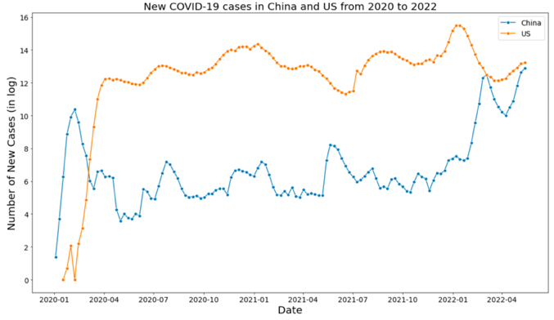
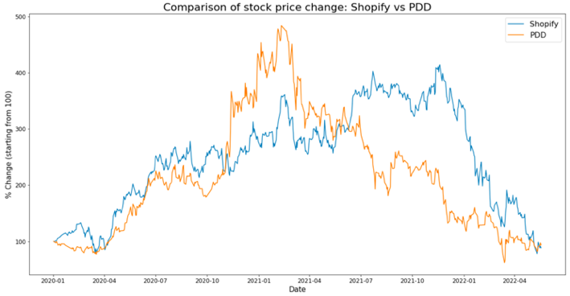
Exploratory Analysis
Comparison of macroeconomic factors
and specific stock prices by country
New Covid-19 Cases in China and the US from 2020 to 2022
China had more Covid-19 new cases than the US before Apr 2020 (aka the first wave),
The US overtook China after that (aka the second wave).
Comparison of stock price change: Shopify vs PDD
Solely focus on online shopping platforms
Extensively benefited from the Covid-19 pandemic
Reach approximately 450% and 350% growth in Mar 2021 respectively
Notes:
In the first two parts of our exploratory analysis, we visualize the difference between the US and China for each macroeconomic factor and stock price in some specific sectors (e.g., Tesla vs Zoom, Shopify vs PDD, Netflix vs Bilibili)
As an example for the first part, log transformation was taken for the no. of new covid-19 cases. We can see a significant difference between the US and China in different time period.
Imply different country may have different stock prices due to pandemic
As an example for the second part, we've chosen Shopify and PDD bcoz…

Slide 10
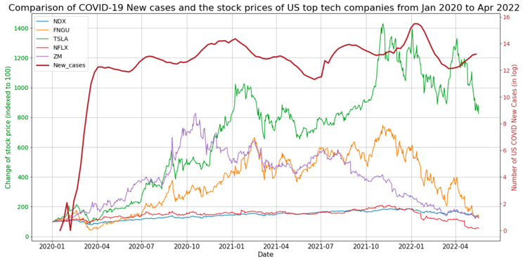
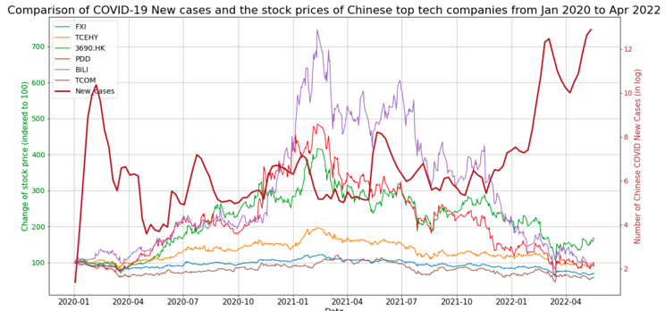
Exploratory Analysis
Covid-19 new cases
Vs Stock Prices in tech companies
Most of stocks in the US market started declining in Nov 2021
Performance of FNGU (covered the 10 biggest American tech companies) > NDX (Nasdaq 100 Index)
Revealed that the COVID-19 pandemic has posed a negative impact on the US stock market
A significant diversion occurred in the Chinese tech stock market
'Trip.com experienced a slump in the market due to the low demand for travelling
Bilibili, Meituan, and PDD were performing extraordinary (which are the prevailing Chinese video streaming service; Food and grocery delivery; Emerging online shopping platform)

Slide 11
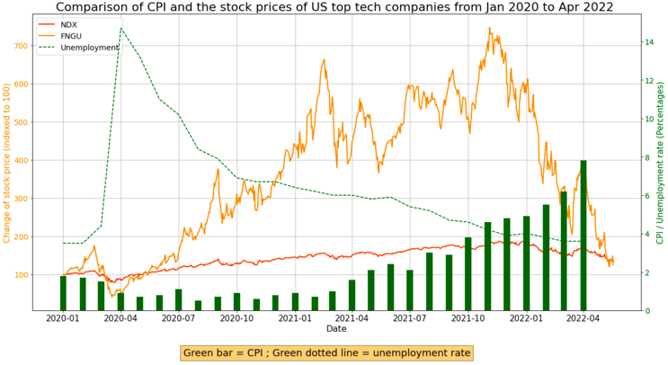
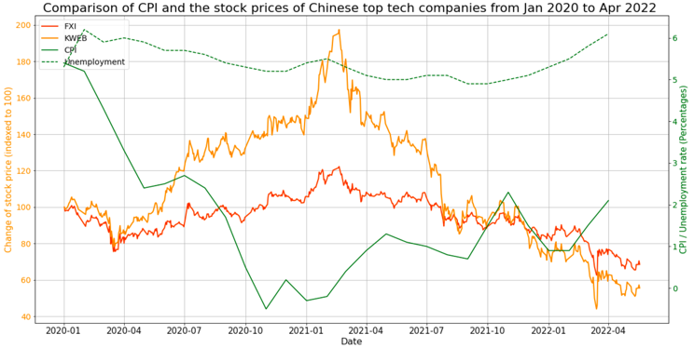
Exploratory Analysis
CPI & unemployment rate
vs Stock Prices in tech companies
In theory: Unemployment ⬇️ = Economic output ⬆️ (Okun's law, 1962)
In theory: small amount of inflation can help drive economic growth
Hence anticipated a growing economy in the US
Result: both Nasdaq 100 index and FNGU have been growing upward from Apr 2020 to Dec 2021, and then dropped dramatically due to the current “hard landing” policy (tapering and rising interest rates).
A relatively low inflation rate (CPI) and high unemployment rate
Negative CPI (-1%) implied a deflation environment for a short period
Result: both FXI and KWEB (mainly composed of China Internet companies), showed upward growing trend until Feb 2021
Implied a gap between the economic theory and actual stock price performance
Notes:
In theory, there is an inverse relationship between Unemployment rate and economic output
And we believed that small amount of inflation can help drive economic growth
In the first graph, although Nasdaq 100 index and FNGU have been growing upward until Dec 2021, they dropped dramatically due to the hard landing policy after that
For comparison, there is a relatively low inflation rate (CPI) and high unemployment rate in China. There had been a nagative CPI in Nov 2020 implying a deflation environment during the pandemic. But still, the majority of tech companies still show an upward trend.
Therefore, it seems there is a gap between the economic factors and the actual stock price performance

Slide 12
3.1
Time Series Model (baseline model)
ARIMA Model

Slide 13
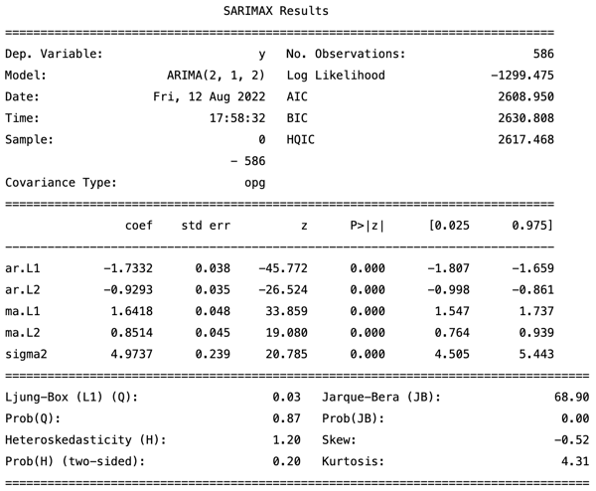
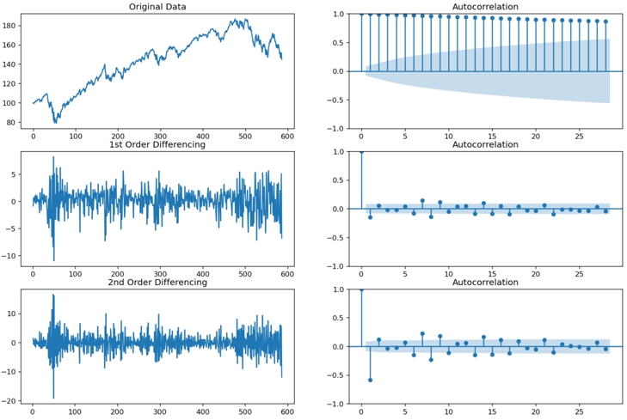

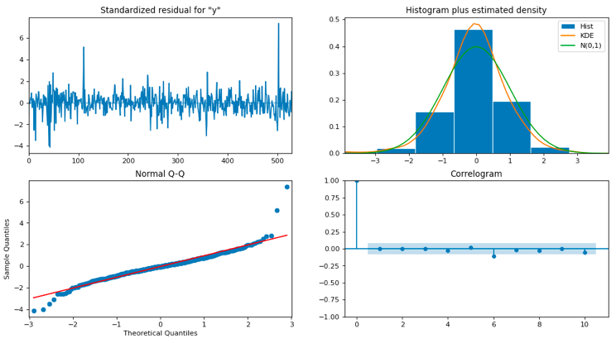
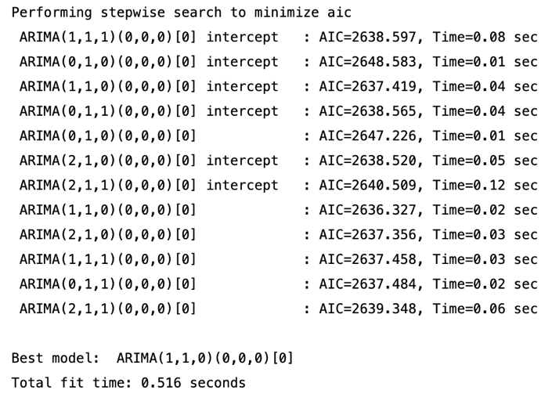
1. Differencing
Visualization of Autocorrelation function (ACF) to identify trend and autocorrelation
Determine the degree of differencing (d)
Time Series modelling
Set up of parameters (p,d,q) in ARIMA
2. Observe values in statistical summary
Compare the scores in Akaike Information Criteria (AIC) and p-value
p-value<0.05 and a lower AIC is preferred
Determine the number of lag (p) and the size of moving average window (q)
Alternative: use auto_arima() to search the best parameters
3. Review of Residual plots
Left top: Residual error, should be close to mean 0
Right top: suggests normal distribution with mean zero
Left bottom: all dots should fall in line with the red line
Right bottom: ACF plot, shows the residual errors are not autocorrelated
Notes:
We used a manual approach to find out the optimal parameters in this project
Visualize the ACF plots to identify the trend and autocorrelation in data so that we can determine the degree of differencing (d).
Determine number of lag (p) and size of moving average window (q) by observe the values in a statistics summary.
Review residual plot to validate the model performance… (e.g. identify whether there is any abnormal residual error or did it suggest a normal distribution)
Alternative: call the function auto_arima to search the best parameter automatically, however this function may have error and bias as it take into account the runtime of each hypermeters

Slide 14
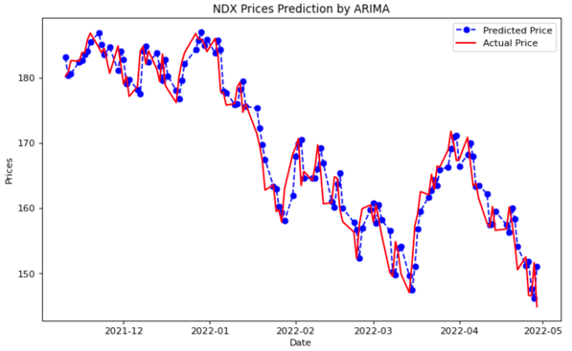

Time Series modelling
Result of baseline model
An example result of NDX Prices Prediction using ARIMA model
Shows an excellent result with a very low RMSE (3.1) and a high correlation coefficient (0.965).
BEAT our proposed models

Slide 15
3.2
Classical Learning Models
Simple Linear Regression
Polynomial Regression
SVR with linear kernel
SVR with ‘RBF’ kernel
Notes:
RBF = radial basis function, default kernel used in SVM classification

Slide 16
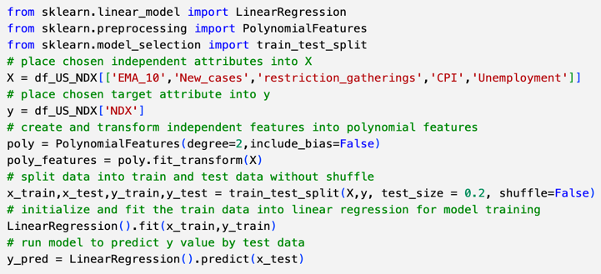
Classical learning modelling
Aims and Set up
Aims: evaluate the effectiveness of classical models by utilizing the macroeconomic factors as input attributes.
The models include Linear Regression, Polynomial Regression, and Support Vector Regression (SVR).
Place exponential moving average (EMA_10) and macroeconomic factors as predicting attributes
Determined the degree of polynomial features as 2
Split into training and test data in a proportion of 8:2

Slide 17
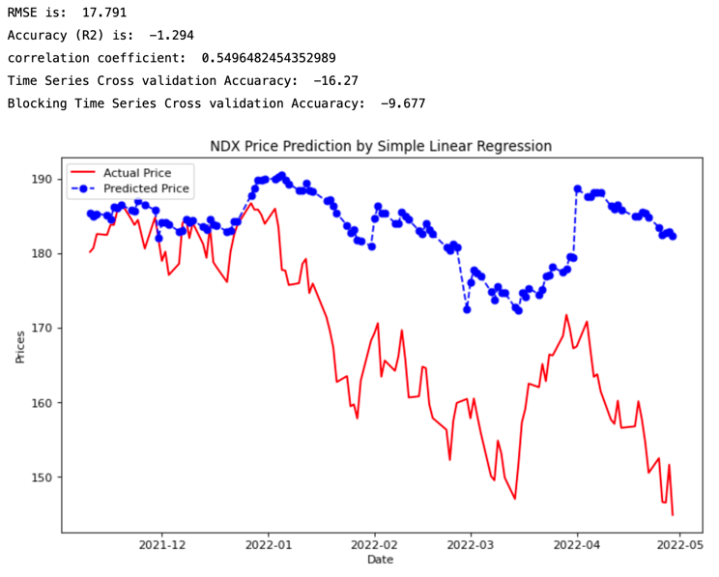
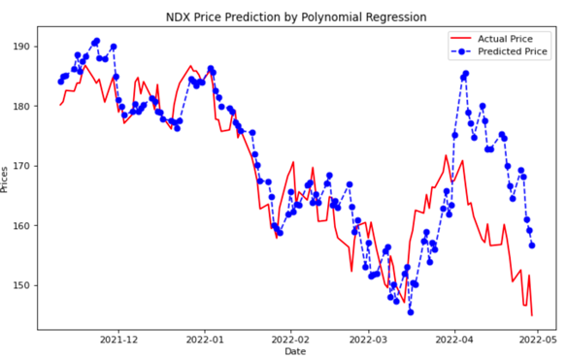
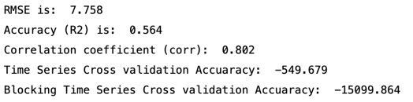
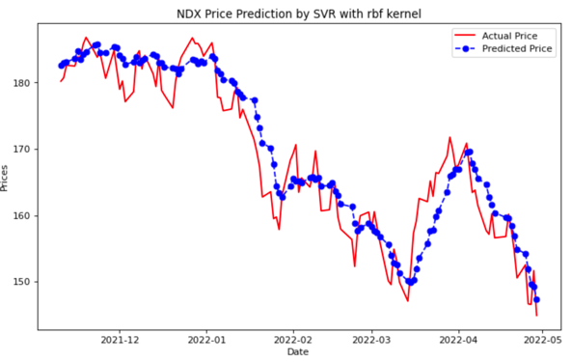
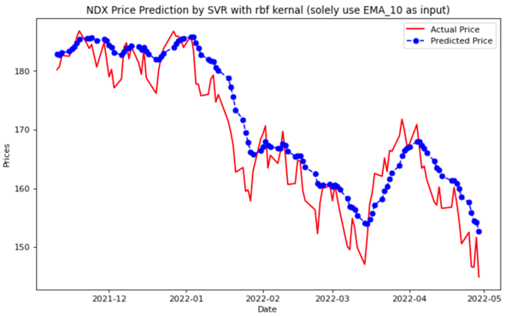
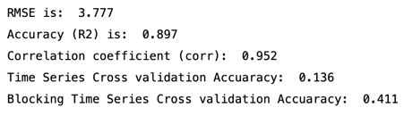
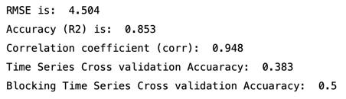
Classical learning modelling
Results
1. Simple Linear Regression:
the poorest performance
2. Polynomial Regression: better but not good enough
3. SVR (with rbf kernel):
The Best result
4. Solely use EMA_10 as input in SVR: even worse than previous one
Insight: the effectiveness of stock price prediction can be improved if we integrated the macroeconomics factors as our input attributes

Slide 18
Conclusion
Key Findings:
SVR with ‘RBF’ kernel had an outstanding performance in stock price prediction
Incorporating macroeconomics factors can explicitly enhance Stock forecasting performance in classical learning models
Limitations and Future work:
Challenging to establish a robust model in actual market (psychological factors)
Power of the ARIMA model could be potentially leveraged by including seasonality and exogenous factors (i.e., SARIMAX model)
More advanced techniques could be adopted (e.g., neural network, deep learning, XGBoost)
Notes:
Reviewed sophisticated relationships behind the stock market particularly in this uncertain environment.
Real-life financial forecasting is often more complicated than the relationships described in the exploratory analysis section, but these depict a full picture of how the various actors play in the process of economic decision-making.
As the key findings, first, we've found that
SVR with ‘RBF’ kernel had an outstanding performance among all classical learning models in stock price prediction
Stock forecasting performance can be explicitly enhanced by placing macroeconomics factors as predicting attributes in classical learning models (polynomial regression and SVR with the ‘RBF’ kernel)
Limitations and Future work:
1. Challenging to predict the future in actual market, as machine learning model is difficult to predict the psychological factors of humans
2. use more advanced models (SARIMAX) or advanced techniques

Slide 19
It’s the END
Thank you
Acknowledgement: Prof William Marsh

