Slide 1

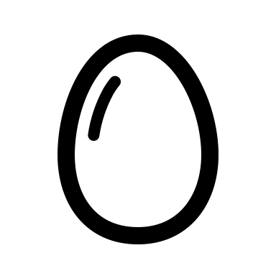
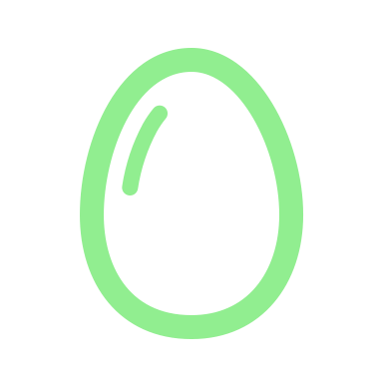



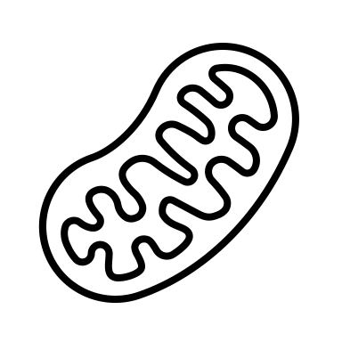
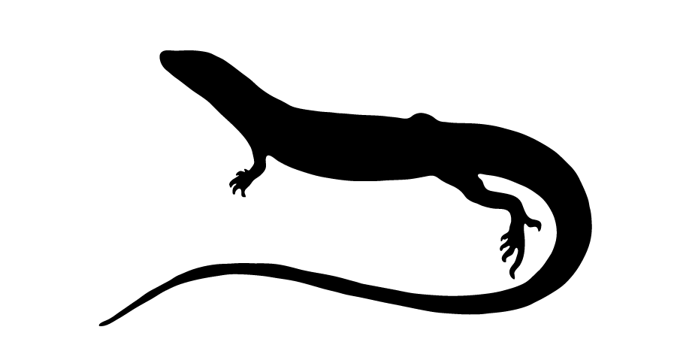

CORT & Incubation
Treatments
Hatchling
Measurements
Juvenile
Measurements
Adult
Measurements
0d
105.7 ± 10.8d
466.1 ± 12.4d
23°C
48.3 ± 8.4d
30.9 ± 4.8d
28°C

Slide 2
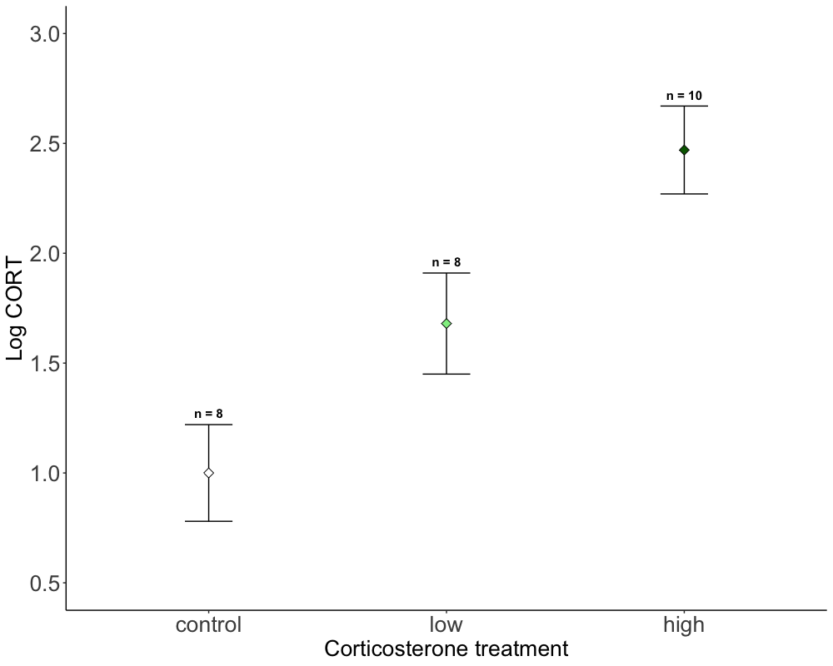
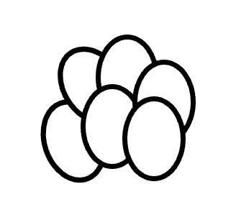
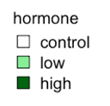
B
B
A,B
A,B
A
A

Slide 3
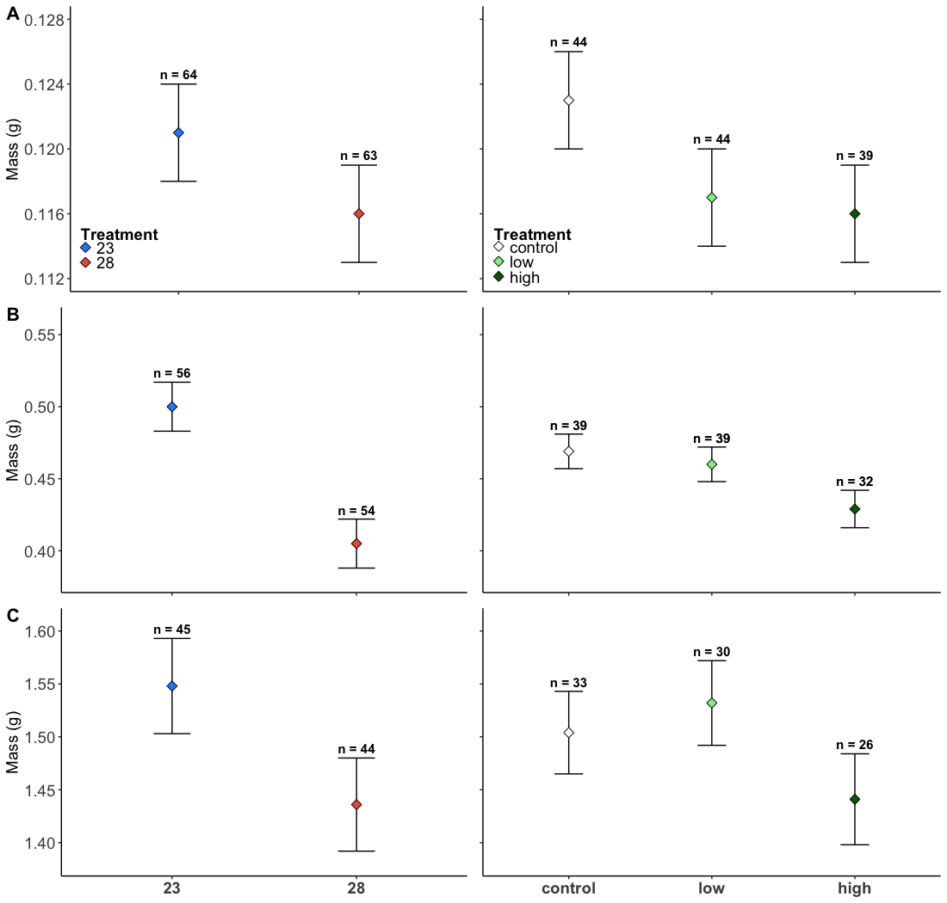
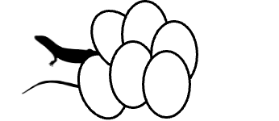
A
A
B
A,B
B
A
A
A,B
B
B
A
A
A
A
A
Notes:
1000*800

Slide 4
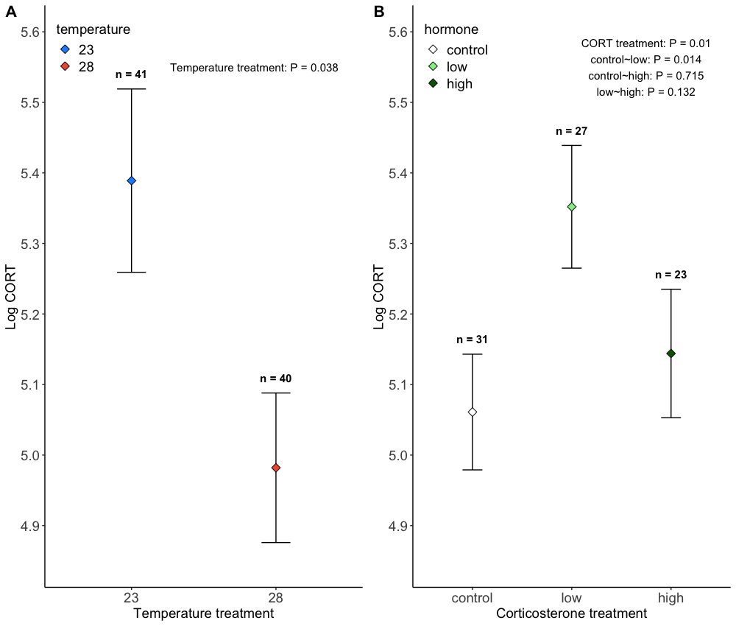

Slide 5
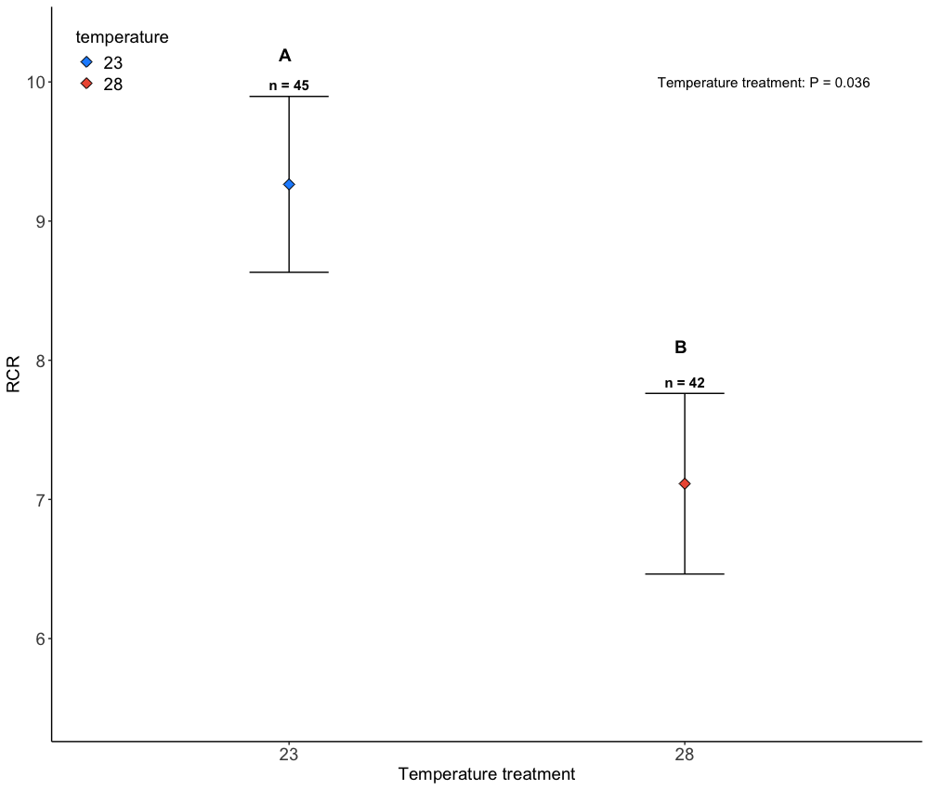

Slide 6
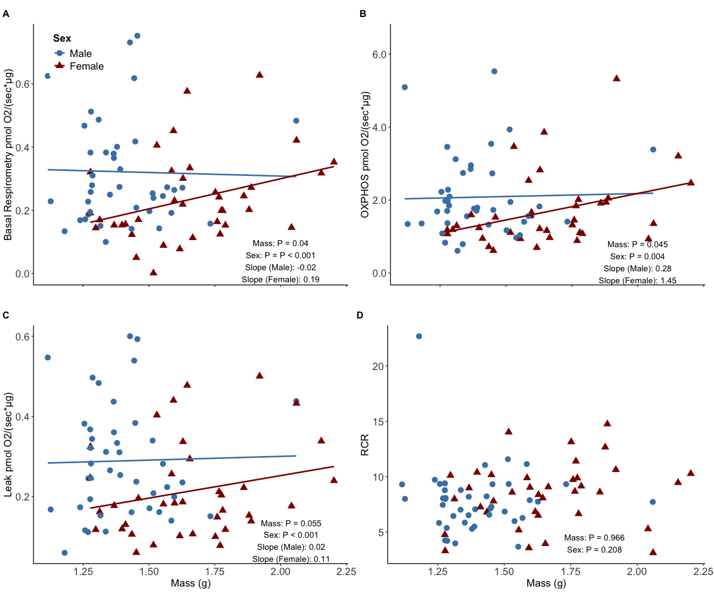

Slide 7
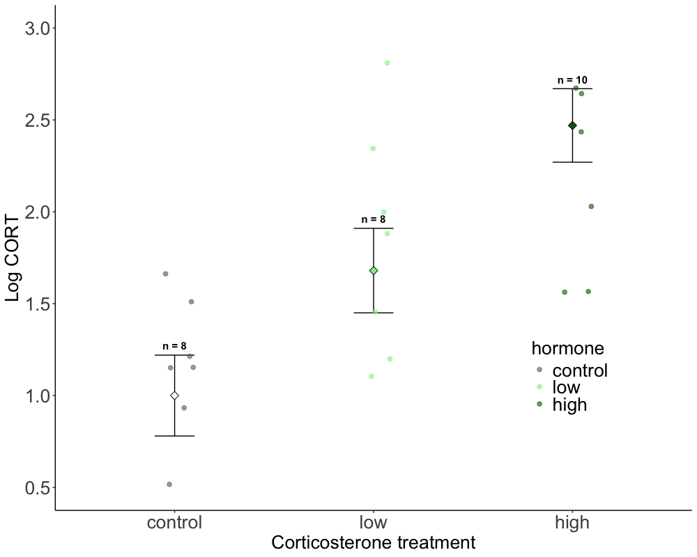
B
A,B
A
Notes:
S1

Slide 8
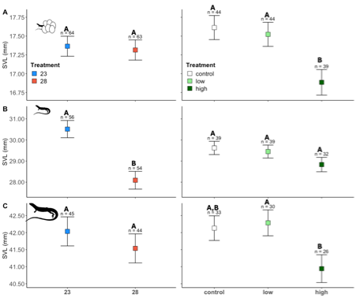

Slide 9
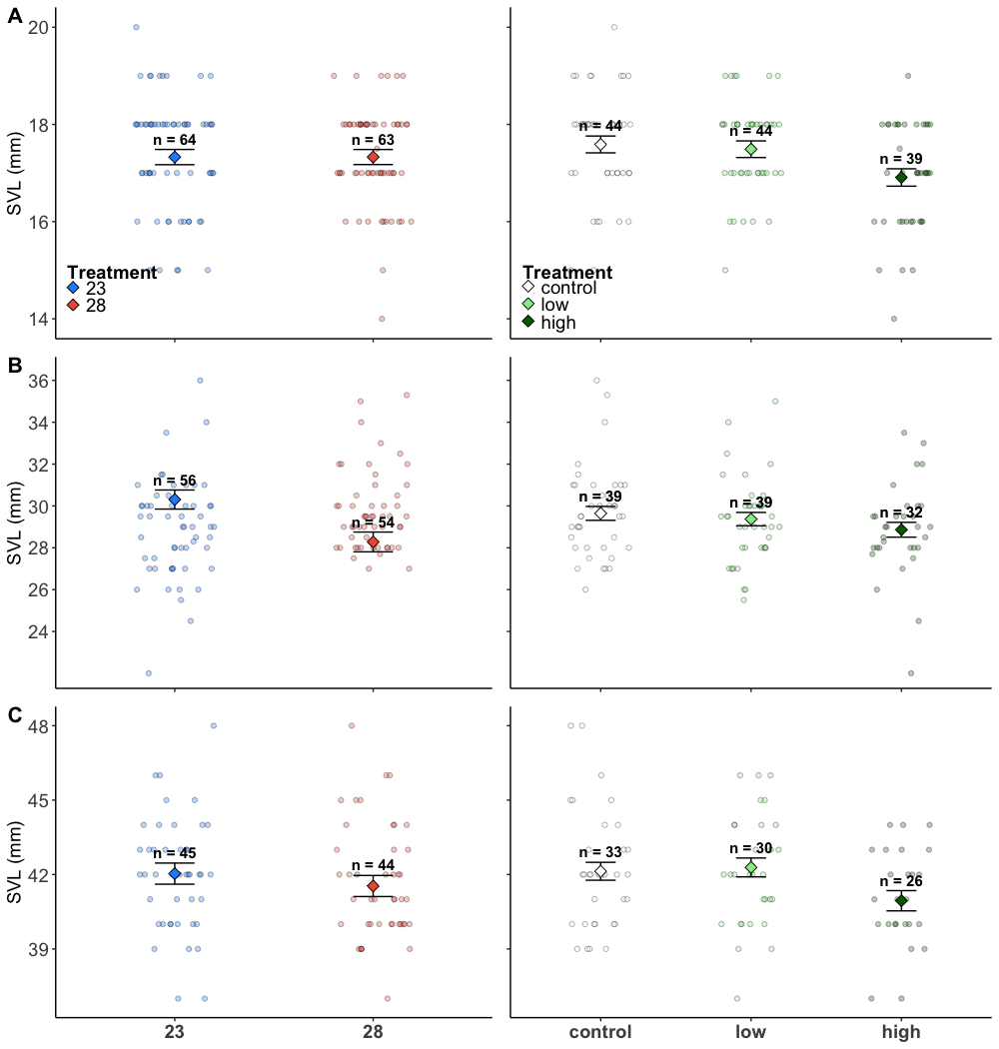
A
A
A
A
B
A
A
B
A
A
A
A
A,B
A
B
Notes:
S3

Slide 10
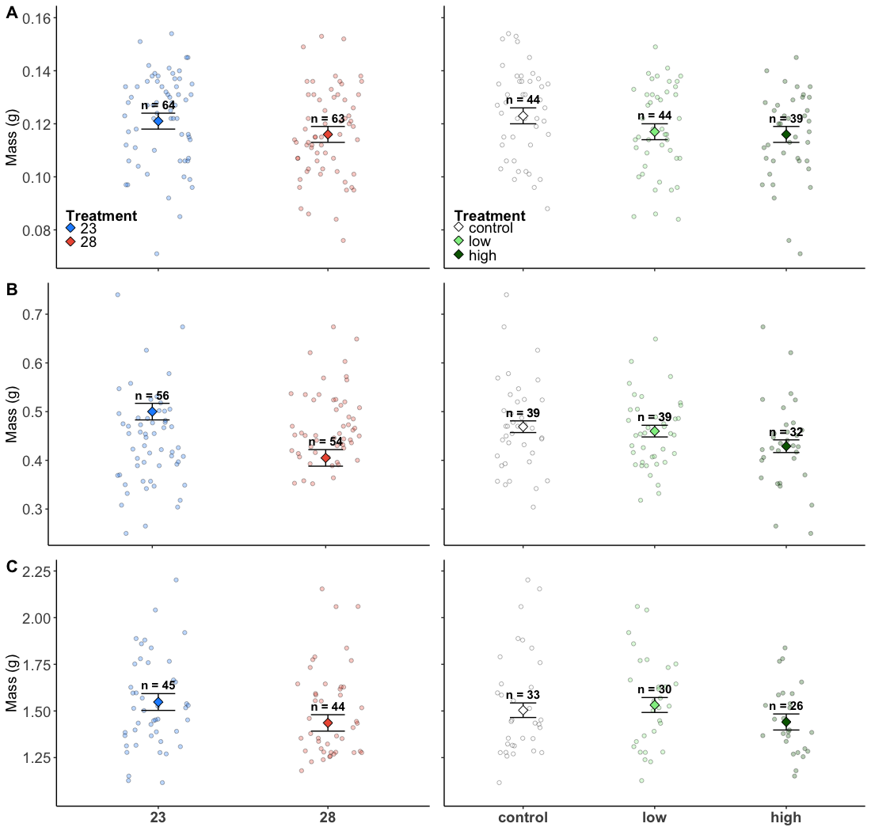
A
A
A,B
B
B
A
A
A,B
B
B
A
A
A
A
A
Notes:
Figure S4

Slide 11
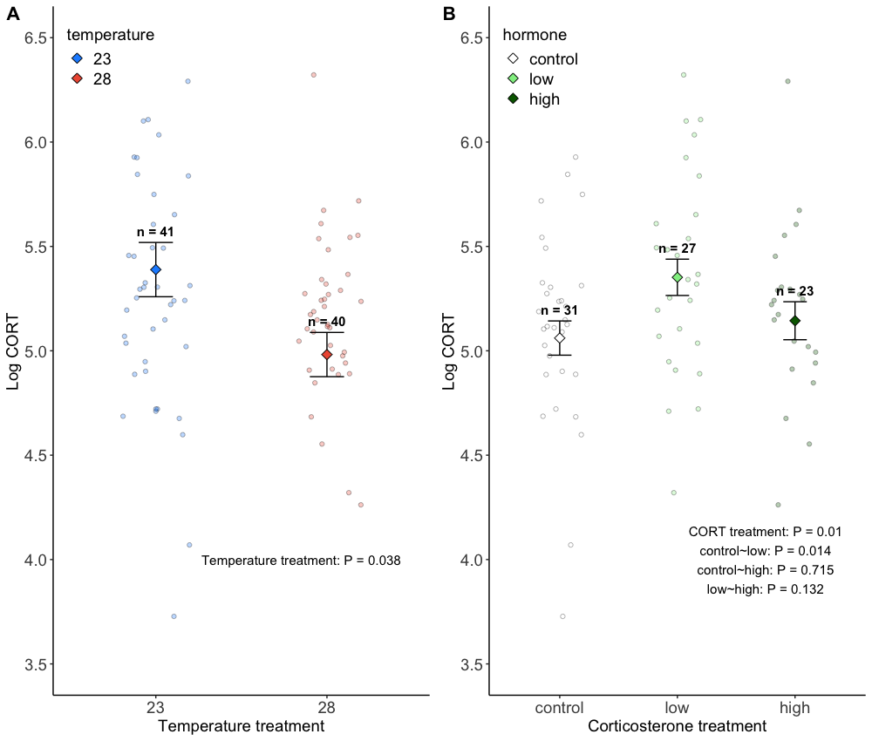

Slide 12
