Slide 1
Notes:
Fig XX. Timeline of experimental design when animal traits and physiological parameters were measured (d). Errors are SD of mean for each time (d) of measurement.

Slide 6
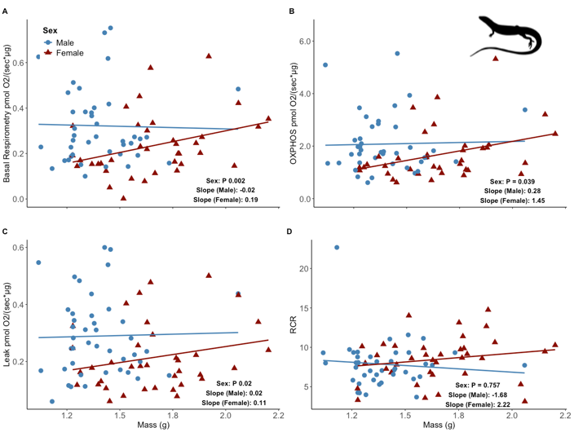

Slide 7
