Slide 1






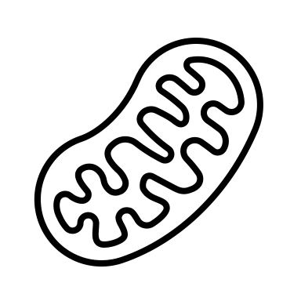


CORT & Incubation
Treatments
Hatchling
Measurements
Juvenile
Measurements
Adult
Measurements
0d
105.7 ± 10.8d
466.1 ± 12.4d
23°C
48.3 ± 8.4d
30.9 ± 4.8d
28°C

Slide 2
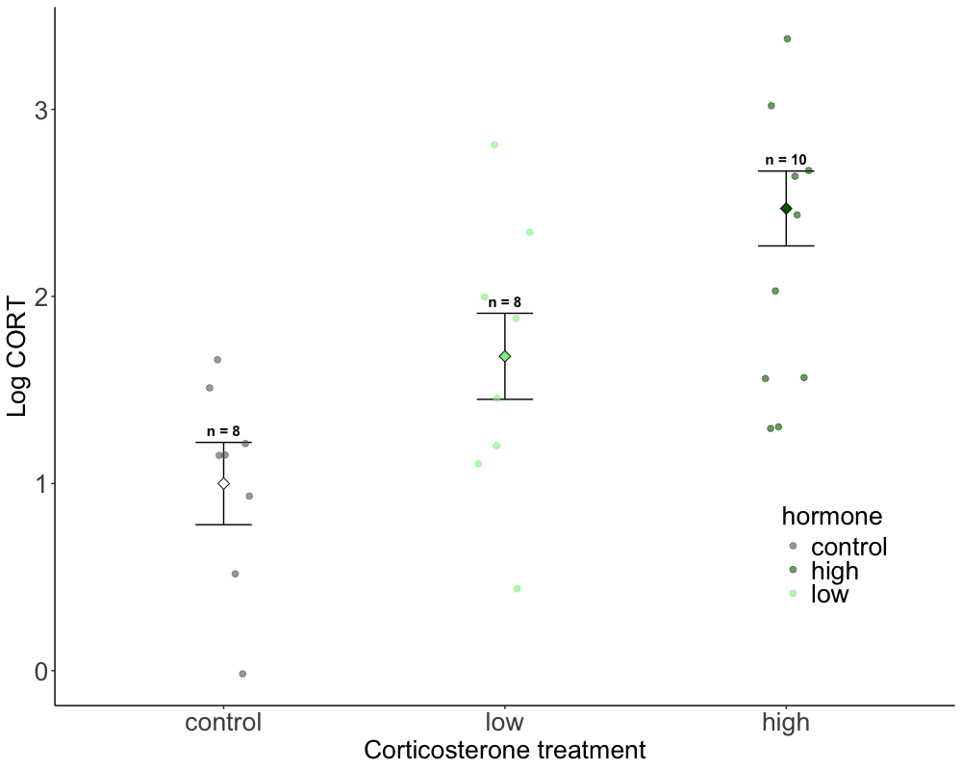
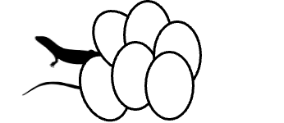
B
A,B
A
Notes:
Figure 1. Corticosterone treatment (x-axis) and its effect on log-transformed yolk corticosterone levels (y-axis). Data are from model results from emmean model, with mean and SE. Significant differences from posthoc test are indicated by asterisk (*) and sample sizes (n) for each treatment are indicated above.

Slide 3
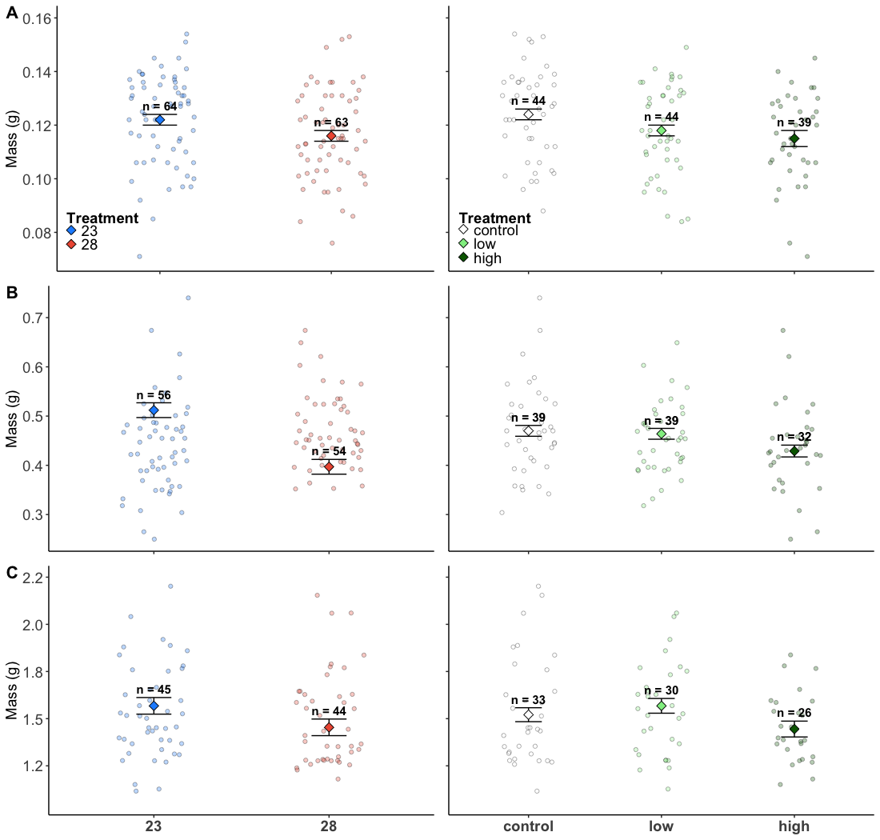
A
A
A,B
B
B
A
A
A,B
B
B
A
A
A
A
A
Notes:
1000*800

Slide 4
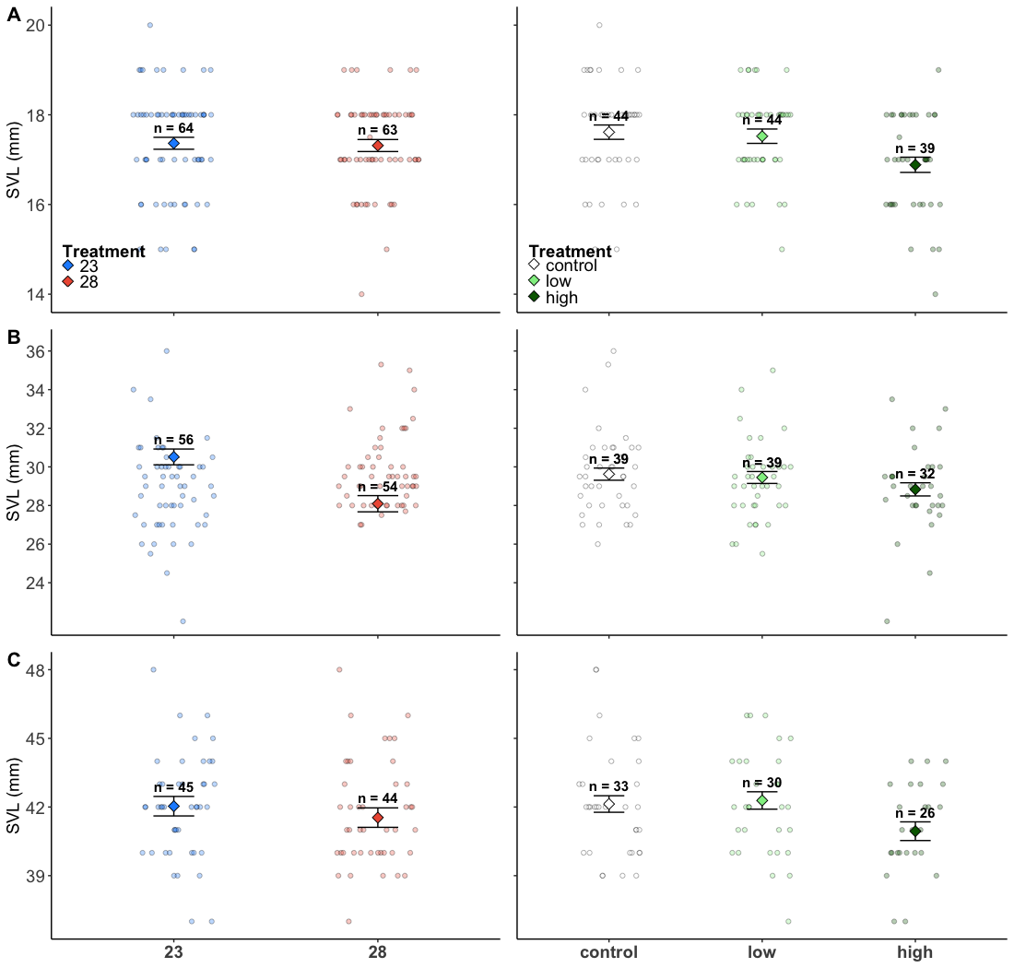
A
A
A
A
B
A
A
A
A
B
A
A
A,B
A
B
Notes:
1000*800

Slide 5
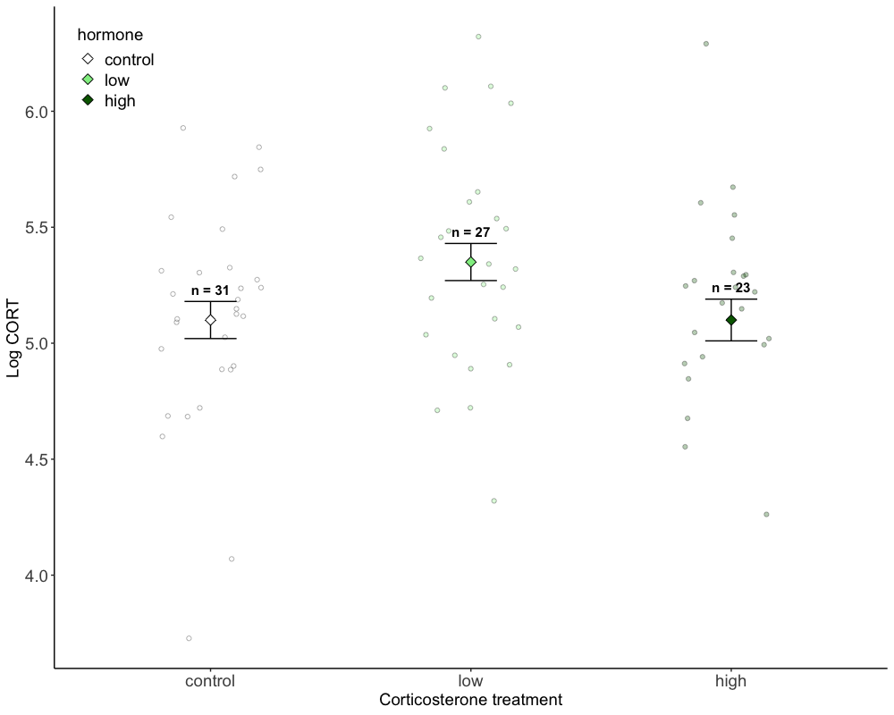

Slide 6
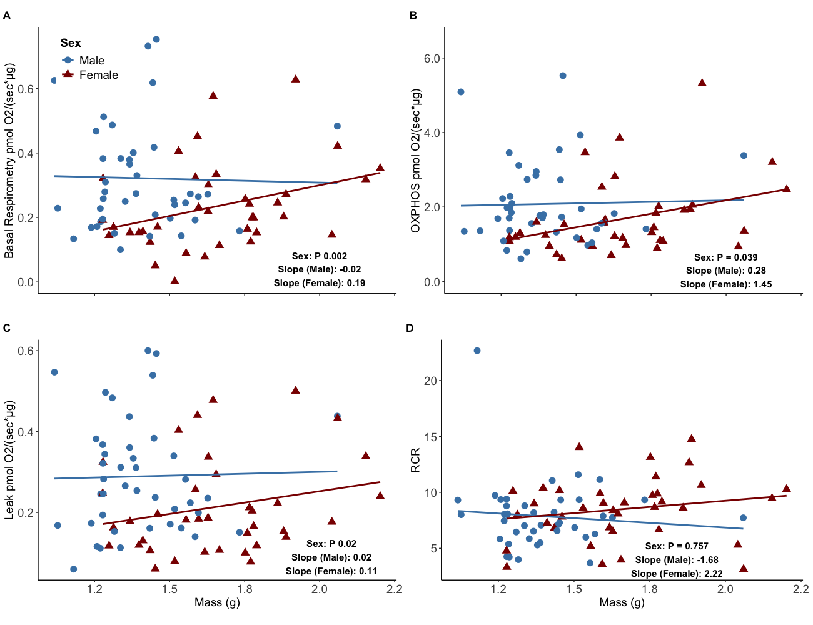

Slide 7
