Slide 1
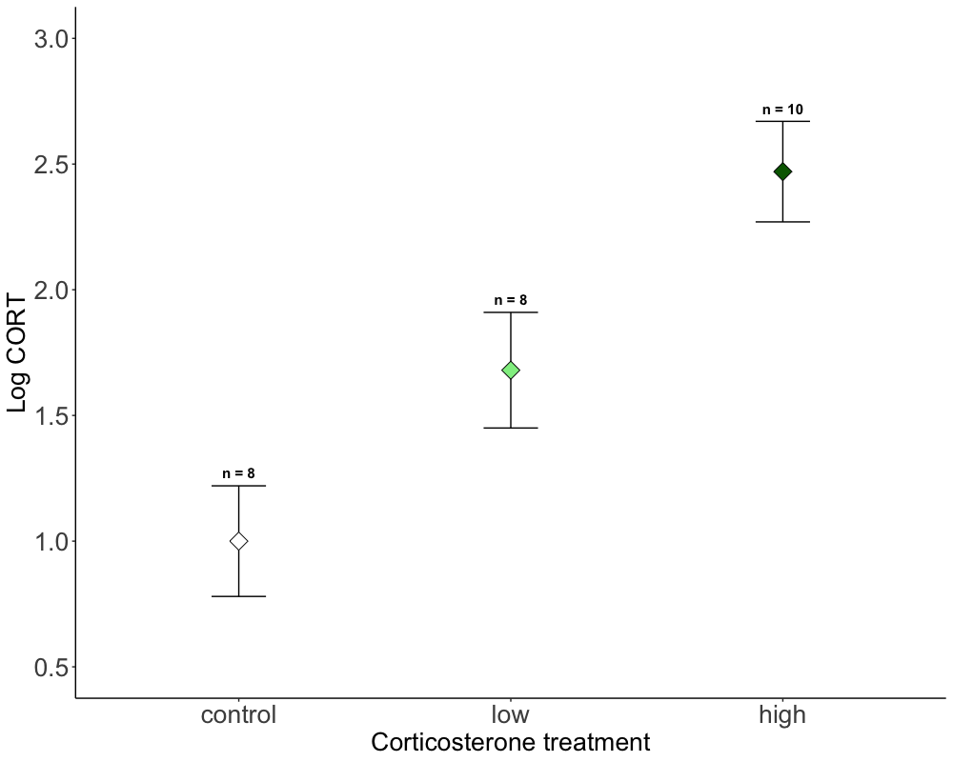

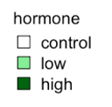
B
A,B
A
Notes:
Figure 1. Corticosterone treatment (x-axis) and its effect on log-transformed yolk corticosterone levels (y-axis). Data are from model results from emmean model, with mean and SE. Significant differences from posthoc test are indicated by asterisk (*) and sample sizes (n) for each treatment are indicated above.

Slide 2
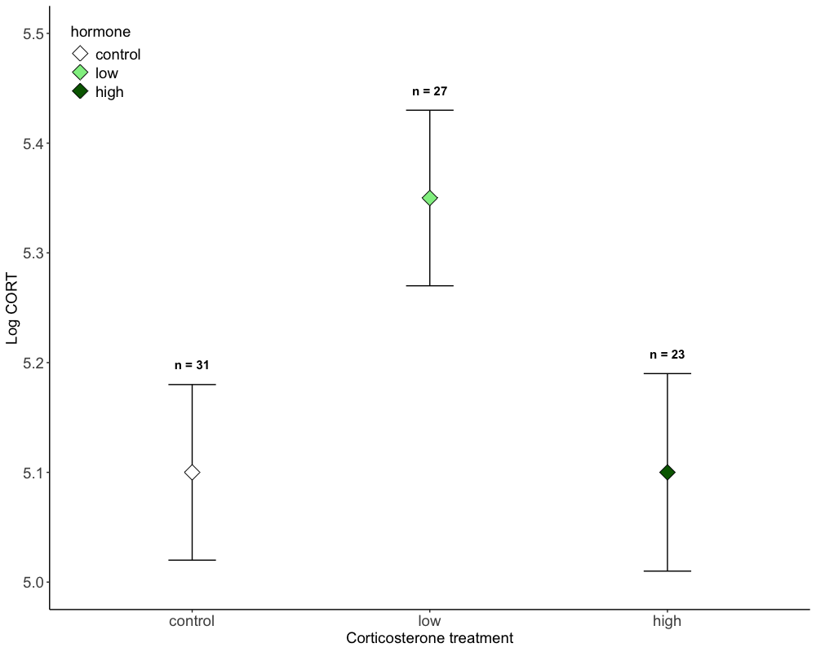

CORT treatment: P = 0.045
control ~ low: P =0.06
control ~ high: P =0.99
control ~ low: P =0.10

Slide 3
