Slide 1

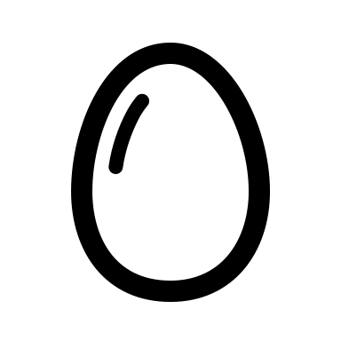
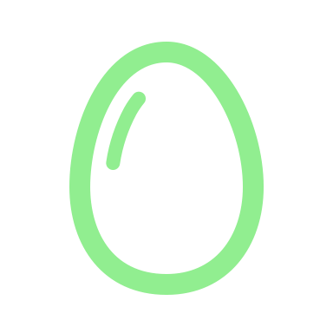


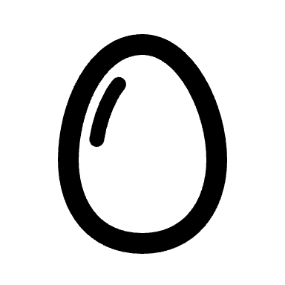
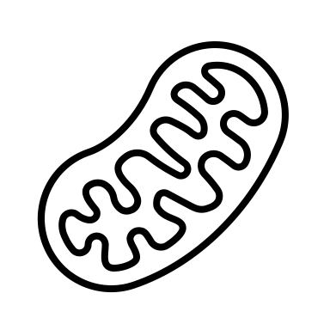
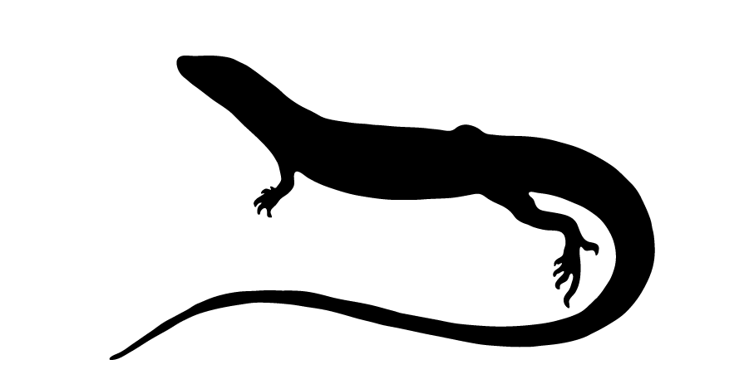
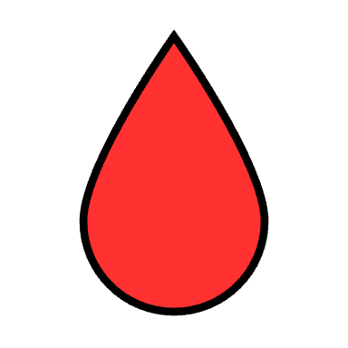
CORT & Incubation
Treatments
Hatchling
Measurements
Juvenile
Measurements
Adult
Measurements
0d
105.7 ± 10.8d
466.1 ± 12.4d
23°C
48.3 ± 8.4d
30.9 ± 4.8d
28°C

Slide 2
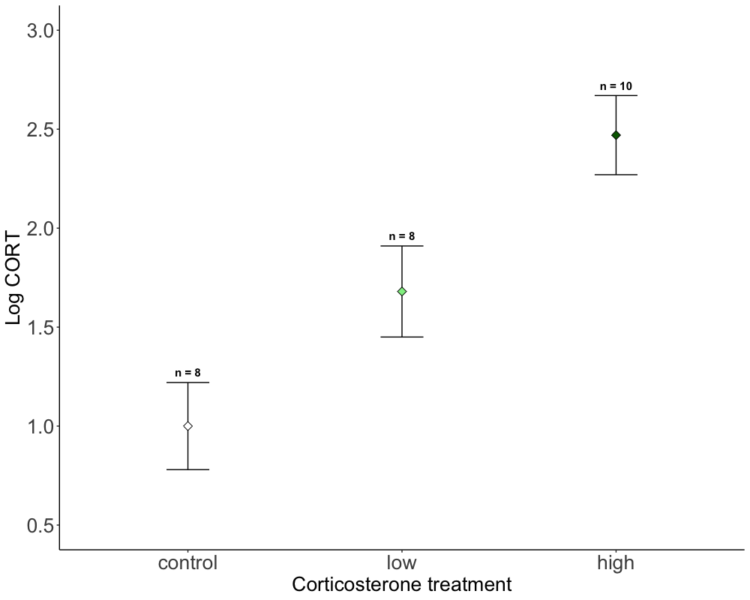
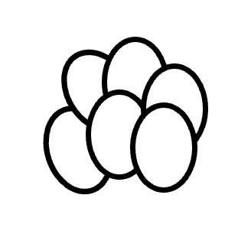
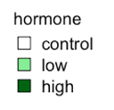
B
A,B
A

Slide 3
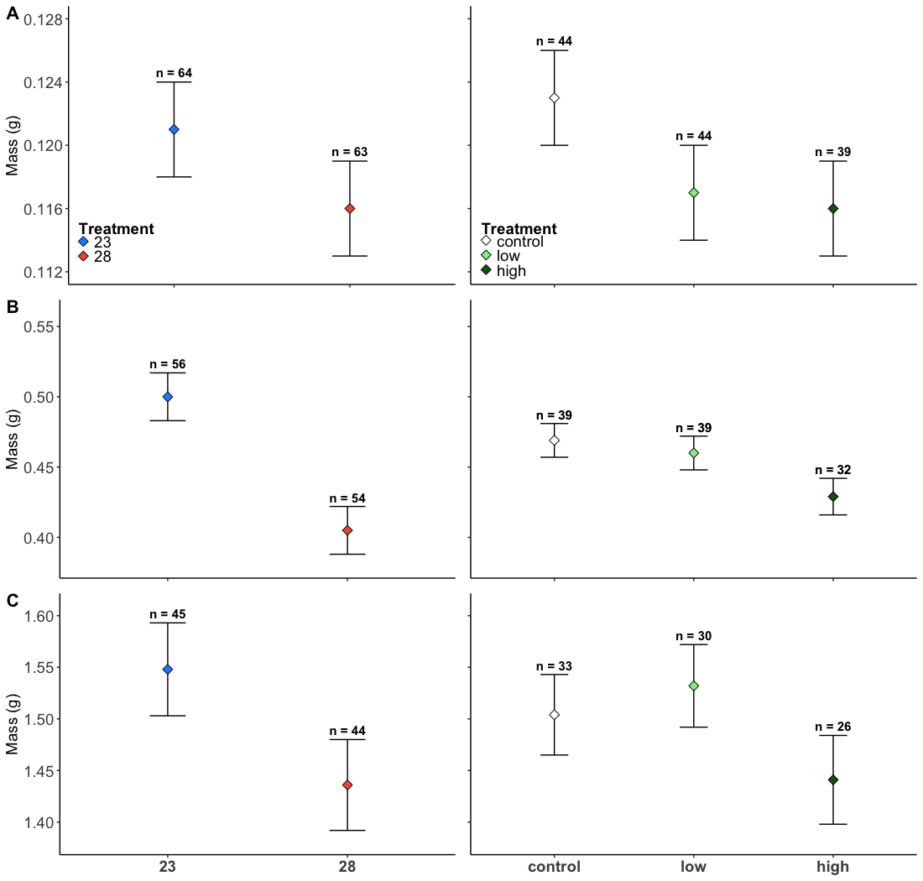
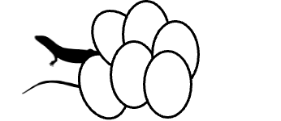
A
A
B
A,B
B
A
A
A,B
B
B
A
A
A
A
A
Notes:
1000*800

Slide 4
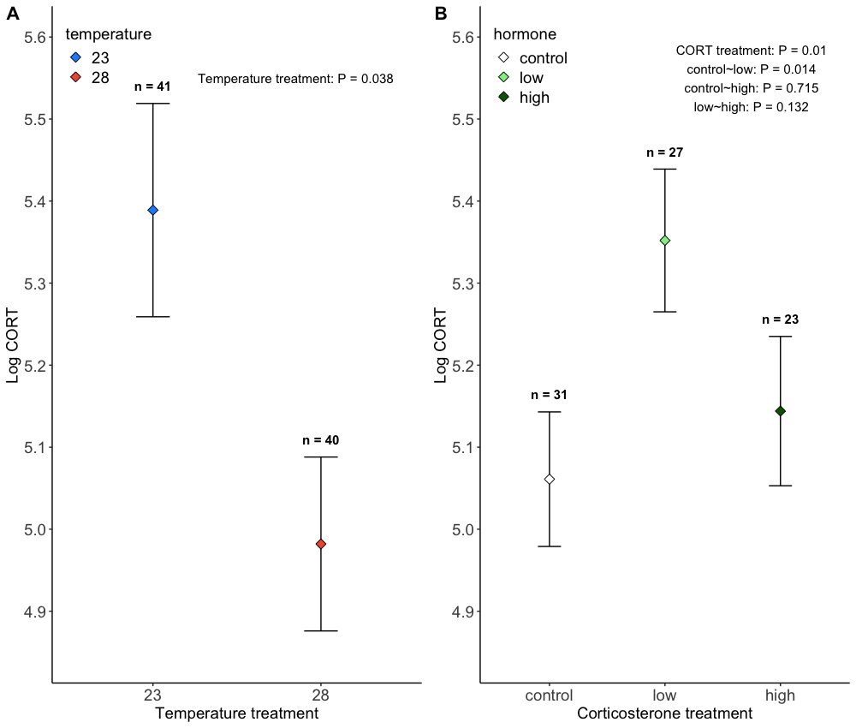

Slide 5
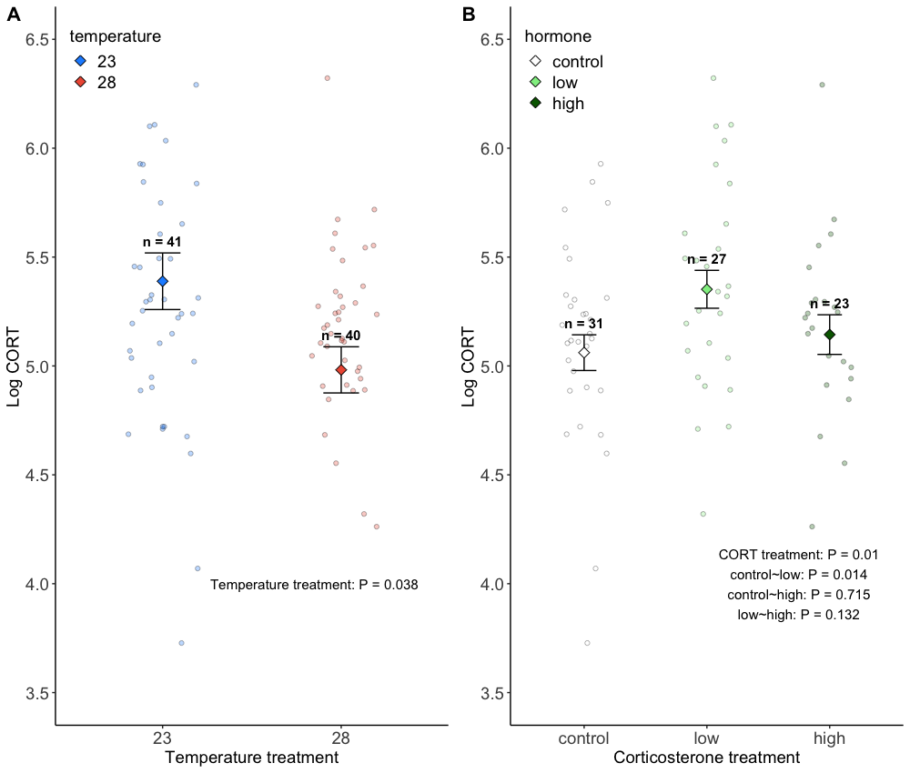

Slide 6
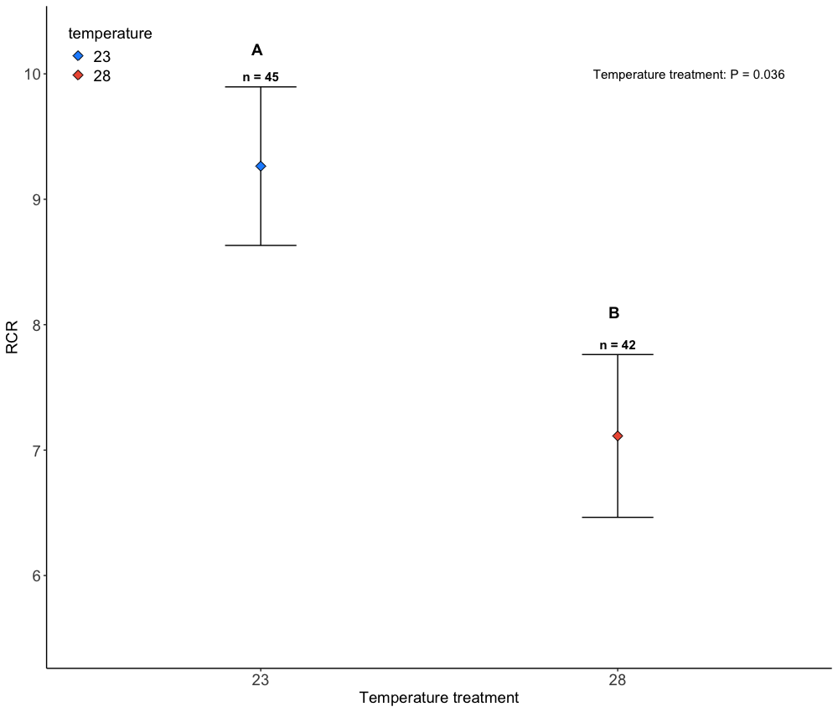

Slide 7
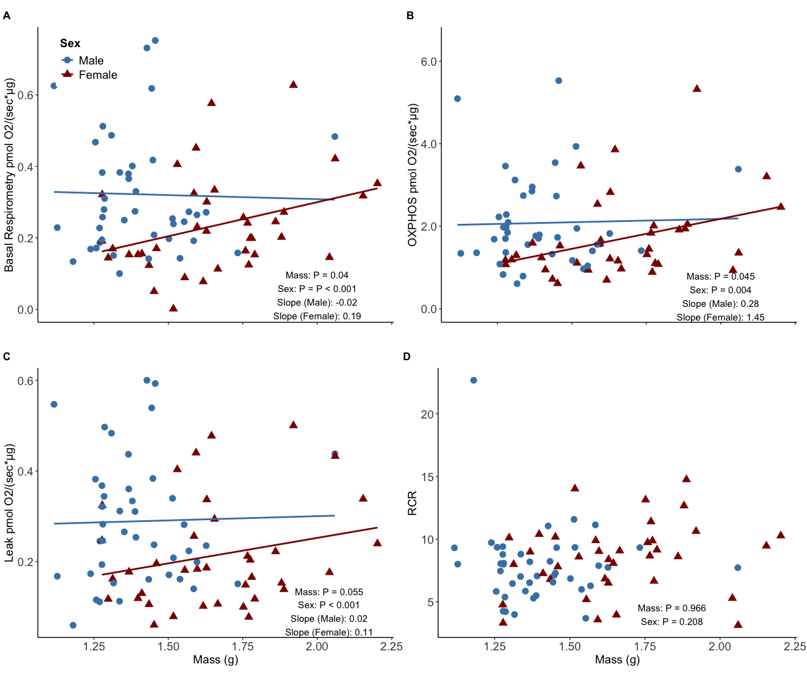

Slide 8
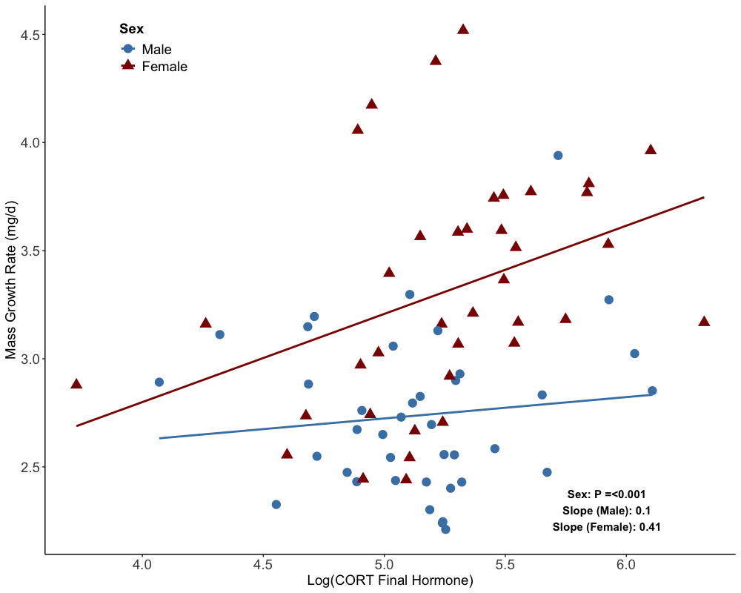

Slide 9
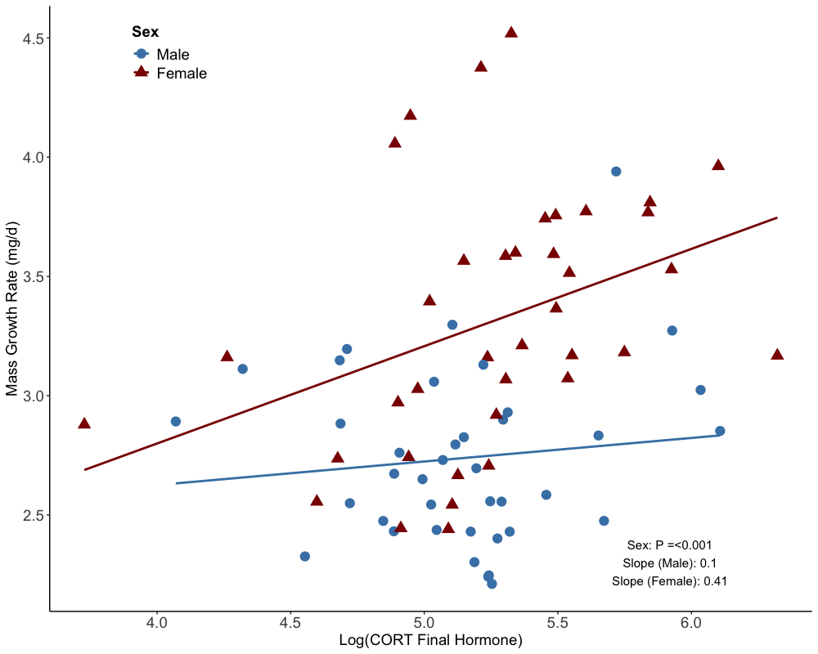

Slide 10
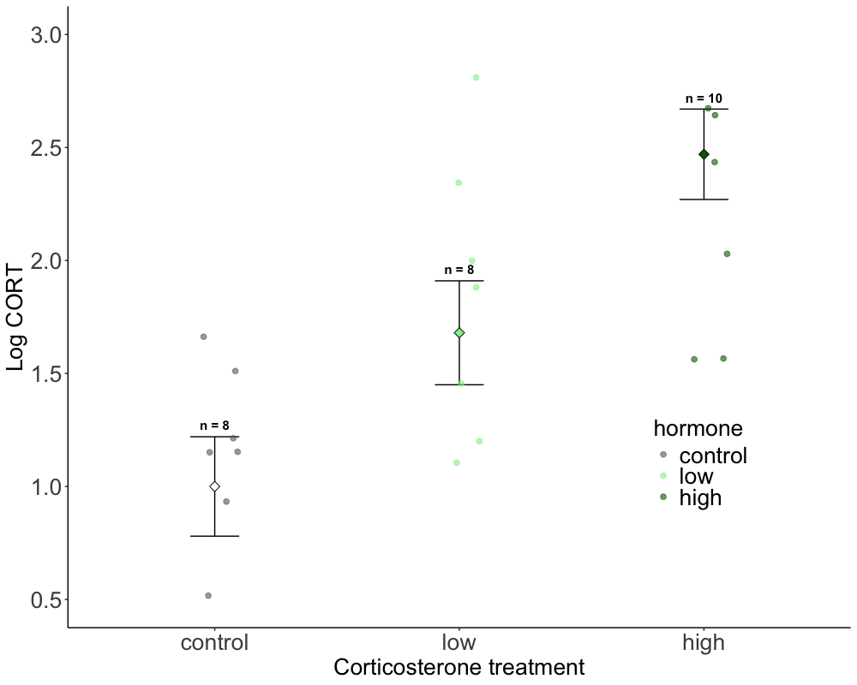
B
A,B
A

Slide 11
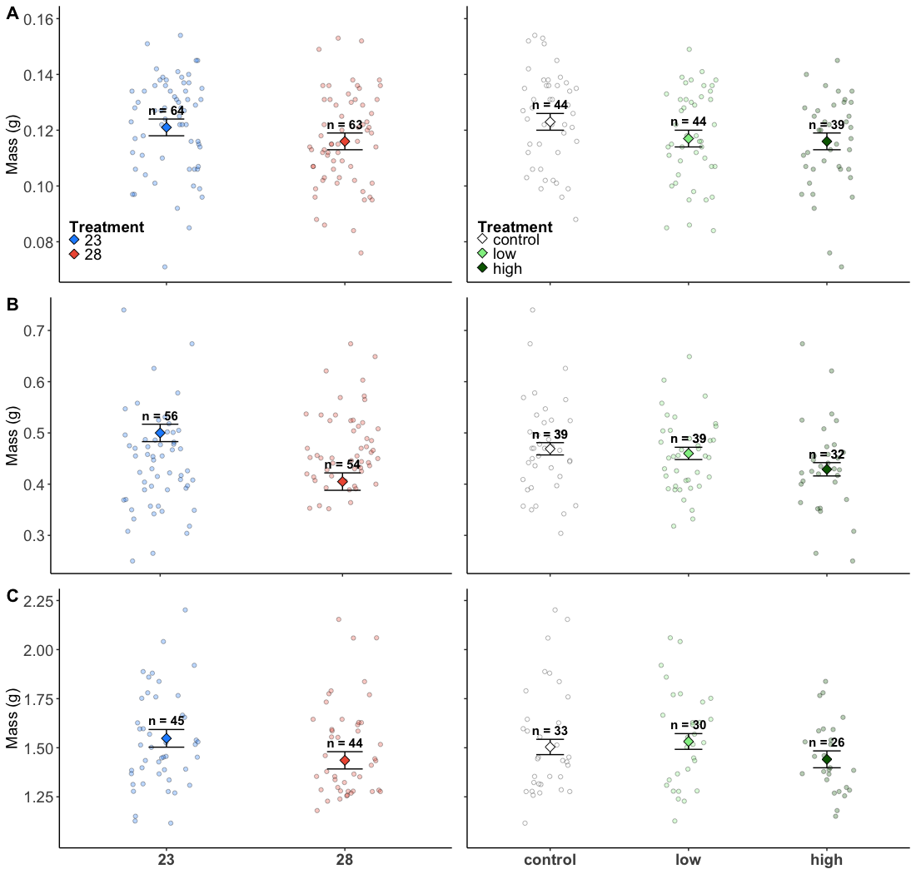
A
A
A,B
B
B
A
A
A,B
B
B
A
A
A
A
A
Notes:
1000*800

Slide 12
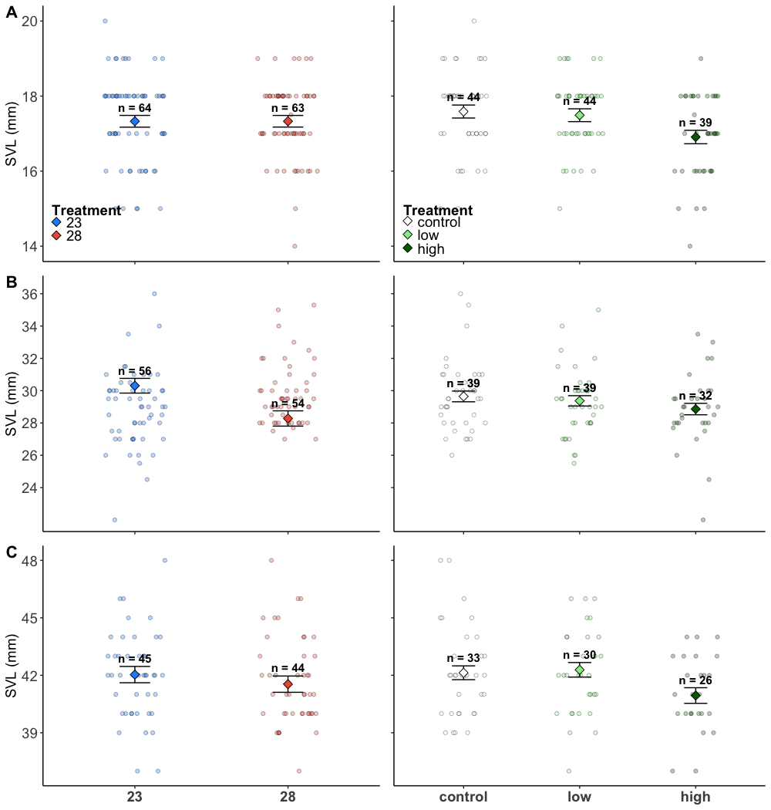
A
A
A
A
B
A
A
B
A
A
A
A
A,B
A
B
Notes:
1000*800

