Slide 1
Meta-analysis in Comparative Physiology: A brief introduction to effect sizes and meta-analytic modelling
Daniel W.A Noble, Nicholis Wu, Essie Rodgers, Patrice Pottier

Slide 2
Slide with Bullets
Bullet 1
Bullet 2
Bullet 3
$$y_{i}=x^{2}$$
Eat eggs
Drink coffee

Slide 3
Slide with R Output
# LDH activity in 8 C treatment trt_8C <- rnorm(10, 0.4, 0.5) # LDH activity in 26 C treatment trt_26C <- rnorm(10, 0.6, 0.2) # What's the difference, i.e., effect size, between treatments? mean(trt_26C - trt_8C)
## [1] 0.1183659
t.test(trt_26C, trt_8C)
## ## Welch Two Sample t-test ## ## data: trt_26C and trt_8C ## t = 0.56516, df = 10.942, p-value = 0.5834 ## alternative hypothesis: true difference in means is not equal to 0 ## 95 percent confidence interval: ## -0.3429047 0.5796364 ## sample estimates: ## mean of x mean of y ## 0.5161426 0.3977768

Slide 4
Do 1000s of experiments
experiment <- function(times) { dat <- data.frame(matrix(nrow = times, ncol = 2)) for (i in 1:times) { # LDH activity in 8 C treatment trt_8C <- rnorm(10, 0.4, 0.5) # LDH activity in 26 C treatment trt_26C <- rnorm(10, 0.6, 0.2) # What's the difference, i.e., effect size, between treatments? dat[i, 1] <- mean(trt_26C - trt_8C) dat[i, 2] <- t.test(trt_26C, trt_8C)$p.value } names(dat) <- c("effect", "p") return(dat) } expts <- experiment(10000)

Slide 5
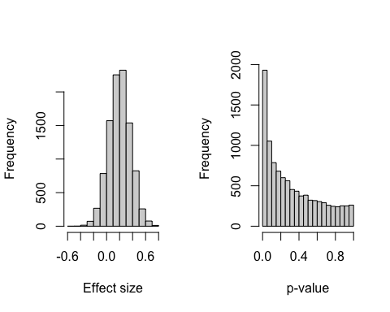
Figure

Slide 6
errors
$$SE=SD/\sqrt{N}$$
sd(expts$effect)
## [1] 0.1670892

Slide 7
se
means <- c() for (i in 1:1e+06) { mass <- rnorm(n = 18, mean = 10.8, sd = 0.988) means <- c(means, mean(mass)) } # The mean of the means mean(means) # The standard deviation of the means or standard error sd(means)

Slide 8
Our analytical calculaton
se <- sd(mass)/sqrt(length(mass)) se

Slide 9
Plots
ggplot() + geom_histogram(aes(x = means))

Slide 10
Zr
zr_data <- read.csv("https://raw.githubusercontent.com/daniel1noble/meta-workshop/gh-pages/data/ind_disp_raw_data.csv") %>% dplyr::select(study_ID, taxa, species, trait, response, response_unit, disp_trait, disp_unit, corr_coeff, sample_size) %>% # remove irrelevant columns for this tutorial dplyr::top_n(10) # select first 10 effect sizes to illustrate escalc function
## Selecting by sample_size

Slide 11
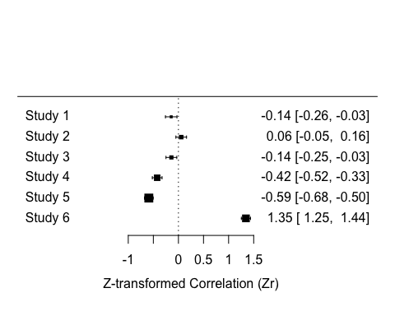
Effect calculation
# Calculate Fisher's r-to-z transformed correlation coefficient (ZCOR) as yi = effect size and vi = sampling variances, where ri = raw correlation coefficients, and ni = sample size. zr_data <- metafor::escalc(measure = "ZCOR", ri = corr_coeff, ni = sample_size, data = zr_data, var.names=c("Zr","v_Zr")) zr_data
## ## study_ID taxa species trait response ## 1 5 Mammalia Tamias_striatus Metabolism Resting MR ## 2 13 Aves Parus_major Metabolism Basal MR ## 3 13 Aves Parus_major Metabolism Basal MR ## 4 45 Mammalia Syncerus_caffer Condition Body condition ## 5 45 Mammalia Syncerus_caffer Condition Body condition ## 6 55 Aves Phoenicopterus_ruber Condition Body condition ## 7 87 Aves Cyanistes caeruleus Immunity WBC ## 8 87 Aves Cyanistes caeruleus Cardiovascular Haematocrit ## 9 87 Aves Cyanistes caeruleus Immunity WBC ## 10 87 Aves Cyanistes caeruleus Cardiovascular Haematocrit ## response_unit disp_trait disp_unit corr_coeff sample_size Zr ## 1 residual mW Exploration residual -0.14300000 296 -0.1440 ## 2 mass-corrected W Exploration 0.05547002 345 0.0555 ## 3 mass-corrected W Exploration -0.13969969 335 -0.1406 ## 4 index Dispersal % -0.40000000 415 -0.4236 ## 5 index Dispersal % -0.53000000 508 -0.5901 ## 6 Dispersal 0.87300000 462 1.3456 ## 7 n Activity n 0.06500000 485 0.0651 ## 8 % Activity n 0.01500000 485 0.0150 ## 9 n Activity n 0.17000000 485 0.1717 ## 10 % Activity n -0.13000000 485 -0.1307 ## v_Zr ## 1 0.0034 ## 2 0.0029 ## 3 0.0030 ## 4 0.0024 ## 5 0.0020 ## 6 0.0022 ## 7 0.0021 ## 8 0.0021 ## 9 0.0021 ## 10 0.0021
metafor::forest(x = zr_data$Zr[1:6], vi = zr_data$v_Zr[1:6], xlab = "Z-transformed Correlation (Zr)")

Slide 12
Back transofrmation
# We can easily convert back to r as follows zr_data$r <- tanh(zr_data$Zr) zr_data %>% select(corr_coeff, r)
## ## corr_coeff r ## 1 -0.14300000 -0.14300000 ## 2 0.05547002 0.05547002 ## 3 -0.13969969 -0.13969969 ## 4 -0.40000000 -0.40000000 ## 5 -0.53000000 -0.53000000 ## 6 0.87300000 0.87300000 ## 7 0.06500000 0.06500000 ## 8 0.01500000 0.01500000 ## 9 0.17000000 0.17000000 ## 10 -0.13000000 -0.13000000

Slide 13
Hedges
contrast_data <- read.csv("https://raw.githubusercontent.com/daniel1noble/meta-workshop/gh-pages/data/pop_disp_raw_data.csv") %>% dplyr::select(study_ID, taxa, species, trait, response, response_unit, mean_core, sd_core, n_core, mean_front, sd_front, n_front) %>% # remove irrelevant columns for this tutorial dplyr::top_n(10) # select first 10 effect sizes to illustrate escalc function
## Selecting by n_front

Slide 14
Hedgesg
# Calculate Hedges' g as g = effect size and v_g = sampling variances, where m1i = mean of edge population, n1i = sample size of edge population, sd1i = standard deviation of edge population, m2i = mean of core population, n2i = sample size of core population, sd2i = standard deviation of core population. contrast_data <- metafor::escalc(measure = "SMD", m1i = mean_front, n1i = n_front, sd1i = sd_front, m2i = mean_core, n2i = n_core, sd2i = sd_core, data = contrast_data, var.names=c("g","v_g")) contrast_data %>% select(study_ID, mean_core, sd_core, n_core, mean_front, sd_front, n_front, g, v_g)
## ## study_ID mean_core sd_core n_core mean_front sd_front n_front ## 1 9 0.8264591 0.41322957 98 0.9525292 0.58132296 161 ## 2 24 0.4333333 0.02804233 116 0.5116402 0.02698413 117 ## 3 34 2491.3240000 619.79470000 94 2528.9950000 603.98380000 96 ## 4 34 2491.3240000 619.79470000 94 2850.9130000 749.38730000 96 ## 5 37 1.3800000 0.18000000 2757 1.4400000 0.18000000 306 ## 6 37 1.3600000 0.17000000 2478 1.4100000 0.16000000 215 ## 7 38 1.3900000 0.13000000 228 1.4600000 0.20000000 238 ## 8 38 1.3700000 0.16000000 200 1.4300000 0.19000000 137 ## 9 38 1.2200000 0.59000000 86 1.1900000 0.42000000 130 ## 10 39 0.0320000 0.00300000 188 0.0350000 0.00300000 188 ## 11 39 0.0290000 0.00200000 251 0.0320000 0.00200000 251 ## g v_g ## 1 0.2398 0.0165 ## 2 2.8366 0.0344 ## 3 0.0613 0.0211 ## 4 0.5203 0.0218 ## 5 0.3333 0.0036 ## 6 0.2954 0.0051 ## 7 0.4125 0.0088 ## 8 0.3464 0.0125 ## 9 -0.0604 0.0193 ## 10 0.9980 0.0120 ## 11 1.4977 0.0102

Slide 15
lnRR
# Calculate log response ratio, lnRR = effect size and v_lnRR = sampling variances, where m1i = mean of edge population, n1i = sample size of edge population, sd1i = standard deviation of edge population, m2i = mean of core population, n2i = sample size of core population, sd2i = standard deviation of core population. contrast_data <- metafor::escalc(measure = "ROM", m1i = mean_front, n1i = n_front, sd1i = sd_front, m2i = mean_core, n2i = n_core, sd2i = sd_core, data = contrast_data, var.names=c("lnRR","v_lnRR")) contrast_data %>% select(study_ID, mean_core, sd_core, n_core, mean_front, sd_front, n_front, lnRR, v_lnRR) #contrast_data$cluster <- c(1,1,1,2,2,3,4,5,6,7,8) contrast_data$obs <- 1:nrow(contrast_data) data <- contrast_data covariance_funtions <- function(data, m, sd, n, cov_type){ if(cov_type == "ROM"){ # Covariance for shared control when using log response ratio. From Jageunesse 2011. Ecology cov <- data[, sd]^2 / (data[, n] * data[, m]^2) } if(cov_type == "LOR"){ #formula for odds ratio (1/x + 1/(m-x)) cov <- (1/data[, m] + 1) / (data[, n] - data[, m]) } return(cov) } # Step 1: split on cluster splt <- split(data, data$cluster) # Step 2: calculate the covariance. Because cluster will have repeated values these will be the same within a study data$cov <- unlist(lapply(splt, function(x) if(dim(x)[1] > 1) { covariance_funtions(x, m = "mean_core",sd = "sd_core", n = "n_core", cov_type = "ROM") } else { 0})) # Step 3: build matrix m <- diag(data$v_lnRR) m <- lapply(splt, function(x) matrix(x$v_lnRR)) m_splt <- split(m, data$cluster) bdiag(m) m[which(duplicated(data[,cluster])==TRUE), which(duplicated(data[,cluster])==TRUE)] <- data$cov[which(duplicated(data[,cluster])==TRUE)] m[upper.tri(m)] <- t(m[lower.tri(m)]) mat_splt <- lapply(splt, function(x) diag(x$v_lnRR)) mat_splt[[2]][lower.tri(mat_splt[[2]])] <- data$cov[1:3] ### Testing out new make_VCV with contrast_data as example contrast_data$cluster <- c(1,1,2,2,3,3,3,0,0,0,0) contrast_data$cluster <- paste0(contrast_data$cluster,".", contrast_data$study_ID) metaAidR::make_VCV_matrix(data = contrast_data, V = "v_lnRR", obs = "obs", cluster = "cluster", type = "cor") make_VCV_matrix(contrast_data, V = "v_lnRR", obs = "obs", cluster = "cluster", m = "mean_core", sd = "sd_core", n = "n_core", cov_type = "ROM")

Slide 16
COnverting back to understand lnRR
### Let's back calculate effects to make sure we understand why they are interpreted as percentage differences # Make sure we understand how it's calculated with(contrast_data, log(mean_front[1] / mean_core[1]))
## [1] 0.1419703
# Alternatively.... with(contrast_data, log(mean_front[1]) - log(mean_core[1]))
## [1] 0.1419703
# Now lets back-transform to odds. with(contrast_data, exp(log(mean_front[1]) - log(mean_core[1])))
## [1] 1.152542
# Interpretation: What this tells us is that the numerator is 1.15 times the denominator, or, that the marginal (front) mean is 15% larger compared to the core mean. We can see that this is true as follows: with(contrast_data, exp(log(mean_front[1]) - log(mean_core[1])) * mean_core[1])
## [1] 0.9525292
# This value should now match the marginal mean value, which it does with(contrast_data, mean_front[1])
## [1] 0.9525292

Slide 17
Latency
$$ln\overset{‾}{X}=log\left(\overset{‾}{X}\right)−log\sqrt{\left(1+\frac{SD^{2}}{{\overset{‾}{X}}^{2}}\right)}$$
$$lnSD=\sqrt{log\left(1+\frac{SD^{2}}{{\overset{‾}{X}}^{2}}\right)}$$

Slide 18
Proportions
$$\overset{‾}{X_{p}}=log\left(\frac{p}{1−p}\right)$$
$$SD_{p}=\sqrt{SD^{2}\left(\frac{1}{p}\right)+\left(\frac{p}{1−p^{2}}\right)}$$

Slide 19
Arcsine transformation
$$\overset{‾}{X_{t}}=arcsine\left(\sqrt{\overset{‾}{X}}\right)$$
$$SD_{t}=\sqrt{\frac{SD^{2}}{4\overset{‾}{X}\left(1−\overset{‾}{X}\right)}}$$
## Geary test - Counts
$$\frac{\overset{‾}{X}}{SD}\left(\frac{4N^{3/2}}{1+4N}\right)≥3$$

Slide 20
Q10
$$lnRR_{Q_{10}}=ln\left(\frac{R_{2}}{R_{1}}\right)\left( \frac{{10}^{∘}C}{T_{2}−T_{1}}\right)\left(\#eq:lnq10\right)$$
$$s_{lnRR_{Q_{10}}}^{2}=\left(\frac{SD_{2}^{2}}{R_{2}^{2}N_{2}}+\frac{SD_{1}^{2}}{R_{1}^{2}N_{1}}\right){\left( \frac{{10}^{∘}C}{T_{2}−T_{1}}\right)}^{2}\left(\#eq:Vlnq10\right)$$

Slide 21
Fixed effect
# Generate some simulated effect size data with known sampling variance # assumed to come from a common underlying distribution set.seed(86) # Set see so that we all get the same simulated results # We will have 5 studies stdy <- 1:5 # We know the variance for each effect Ves <- c(0.05, 0.10, 0.02, 0.10, 0.09) # We'll need this later but these are weights W <- 1 / Ves # We assume they are sampled from a normal distribution with a mean effect size of 2 es <- rnorm(length(Ves), 2, sqrt(Ves)) # Data for our fixed effect meta-analysis dataFE <- data.frame(stdy = stdy, es, Ves)

Slide 22
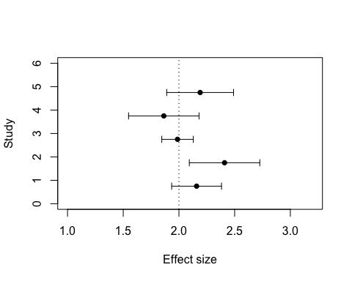
Fixed effects

Slide 23
Fixed effect model
# Run a fixed effect meta-analysis using the FE dataset. metafor::rma(yi = es, vi = Ves, method = "FE", data = dataFE)
## ## Fixed-Effects Model (k = 5) ## ## I^2 (total heterogeneity / total variability): 0.00% ## H^2 (total variability / sampling variability): 0.56 ## ## Test for Heterogeneity: ## Q(df = 4) = 2.2340, p-val = 0.6928 ## ## Model Results: ## ## estimate se zval pval ci.lb ci.ub ## 2.0731 0.0994 20.8459 <.0001 1.8782 2.2680 *** ## ## --- ## Signif. codes: 0 '***' 0.001 '**' 0.01 '*' 0.05 '.' 0.1 ' ' 1

Slide 24
Now by hand FE
We can even do all the seemingly fancy stuff metafor is doing ourselves if we want….we just need to know the equations:
$$\overset{‾}{ES}=∑\left(W*ES\right)/∑W$$
$$σ_{\overset{‾}{ES}}^{2}=\frac{1}{∑W}$$
# Calculate pooled effect size EsP.FE <- sum(W*dataFE$es) / sum(W) EsP.FE
## [1] 2.073105
# Calculate the pooled variance around estimate VarEsP.FE <- 1 / sum(W) VarEsP.FE
## [1] 0.00989011
# Calculate the standard error around estimate SE.EsP.FE <- sqrt(VarEsP.FE) SE.EsP.FE
## [1] 0.09944903

Slide 25
Q10
$$Q_{10}={\left(\frac{R_{2}}{R_{1}}\right)}^{\left( \frac{{10}^{∘}C}{T_{2}−T_{1}}\right)}$$
## lnq10
$$lnRR_{Q_{10}}=ln\left(\frac{R_{2}}{R_{1}}\right)\left( \frac{{10}^{∘}C}{T_{2}−T_{1}}\right)$$
$$s_{lnRR_{Q_{10}}}=\left(\frac{SD_{2}^{2}}{R_{2}^{2}N_{2}}+\frac{SD_{1}^{2}}{R_{1}^{2}N_{1}}\right){\left( \frac{{10}^{∘}C}{T_{2}−T_{1}}\right)}^{2}$$

Slide 26
lnvrq10
$$lnVR_{Q_{10}}=ln\left(\frac{SD_{2}}{SD_{1}}\right)\left( \frac{{10}^{∘}C}{T_{2}−T_{1}}\right)$$
$$s_{lnVR_{Q_{10}}}=\left(\frac{1}{2\left(N_{2}−1\right)}+\frac{1}{2\left(N_{1}−1\right)}\right){\left( \frac{{10}^{∘}C}{T_{2}−T_{1}}\right)}^{2}$$

Slide 27
lncvrq10
$$lnCVR_{Q_{10}}=ln\left(\frac{{\text{CV}}_{2}}{{\text{CV}}_{1}}\right)\left( \frac{{10}^{∘}C}{T_{2}−T_{1}}\right)$$
$$s_{lnCVR_{Q_{10}}}=\left[\frac{{\left({\text{SD}}_{1}\right)}^{2}}{N_{1}{\left(R_{1}\right)}^{2}}+\frac{{\left({\text{SD}}_{2}\right)}^{2}}{N_{2}{\left(R_{2}\right)}^{2}}+\frac{1}{2\left(N_{1}−1\right)}+\frac{1}{2\left(N_{2}−1\right)}\right]{\left( \frac{{10}^{∘}C}{T_{2}−T_{1}}\right)}^{2}$$

Slide 28
Random effect in code
# Here adding 0.8 says we want to add 0.8 as the between study variability. In other words, each effect size is sampled from a larger distribution of effect sizes that itself comes from a distribution with a variance of 0.8. esRE <- rnorm(length(Ves), 2, sqrt(Ves + 0.8)) # Data for our random effect meta-analysis dataRE <- data.frame(stdy = stdy, esRE, Ves)

Slide 29
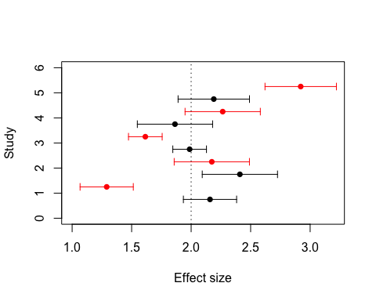
Random effect plot
Mean (arrows are sampling standard deviation) effect size for each study. Data simulated under a fixed effect model in black and data simulated under a random effect model in red.

Slide 30
random effect model
metafor::rma(yi = esRE, vi = Ves, method="DL", data = dataRE)
## ## Random-Effects Model (k = 5; tau^2 estimator: DL) ## ## tau^2 (estimated amount of total heterogeneity): 0.2947 (SE = 0.2731) ## tau (square root of estimated tau^2 value): 0.5429 ## I^2 (total heterogeneity / total variability): 83.61% ## H^2 (total variability / sampling variability): 6.10 ## ## Test for Heterogeneity: ## Q(df = 4) = 24.4015, p-val < .0001 ## ## Model Results: ## ## estimate se zval pval ci.lb ci.ub ## 2.0163 0.2697 7.4753 <.0001 1.4876 2.5449 *** ## ## --- ## Signif. codes: 0 '***' 0.001 '**' 0.01 '*' 0.05 '.' 0.1 ' ' 1

Slide 31
Random by hand
We first need to estimate $τ^{2}$ or the between-study variance which can be calculated from these equations:
$$τ^{2}=\frac{Q−df}{C}$$
where
$$Q=\sum_{i=1}^{k}{W_{i}ES_{i}^{2}}−\frac{{\left(\sum_{i=1}^{k}{W_{i}ES_{i}}\right)}^{2}}{\sum_{i=1}^{k}{W_{i}}}$$
$$C=∑W_{i}−\frac{∑W_{i}^{2}}{∑W_{i}}$$

Slide 32
Random effect by hand 2
# Calculate our Q statistic again Q <- sum(W*(dataRE$es^2) ) - (sum(W*dataRE$es)^2 / sum(W)) Q
## [1] 24.40149
# Calculate tau2 C <- sum(W) - ((sum(W^2))/sum(W)) C
## [1] 69.23077
# Calculate df df <- nrow(dataRE) - 1 T2 <- (Q - df) / C T2
## [1] 0.2946883

Slide 33
Now that we have tau2 lets do the meta-analysis
Remember, things are the same but the weighting is different now.
# RE weights W.re <- 1 / (T2 + dataRE$Ves) #Pooled effect size for random effect meta-analysis esPoolRE <- sum(W.re*dataRE$es) / sum(W.re) esPoolRE
## [1] 2.016261
# Calculate the pooled variance around estimate VarES <- 1 / sum(W.re) # Calculate the standard error around estimate SE.ES.RE <- sqrt(VarES) SE.ES.RE
## [1] 0.2697219

Slide 34
Q10 write our functioon
#' @title lnRR_Q10 #' @description Calculates the log Q10 response ratio. Note that temperature 2 is placed in the numerator and temperature 1 is in the denominator #' @param t1 Lowest of the two treatment temperatures #' @param t2 Highest of the two treatment temperatures #' @param r1 Mean physiological rate for temperature 1 #' @param r2 Mean physiological rate for temperature 2 #' @param sd1 Standard deviation for physiological rates at temperature 1 #' @param sd2 Standard deviation for physiological rates at temperature 2 #' @param n1 Sample size at temperature 1 #' @param n2 Sample size at temperature 2 #' @param name Character string for column name #' @example #' lnRR_Q10(20, 30, 10, 5, 1, 1, 30, 30) #' lnRR_Q10(20, 30, 10, 5, 1, 1, 30, 30, name = "acclim") #' @export lnRR_Q10 <- function(t1, t2, r1, r2, sd1, sd2, n1, n2, name ="acute"){ lnRR_Q10 <- (10 / (t2 - t1)) * log(r2 / r1) V_lnRR_Q10 <- (10 / (t2 - t1))^2 * ((sd1^2 / (n1*r1^2)) + (sd2^2 / (n2*r2^2))) dat <- data.frame(lnRR_Q10, V_lnRR_Q10) colnames(dat) <- c(paste0("lnRR_Q10", name), paste0("V_lnRR_Q10", name)) return(dat) }

Slide 35
Q10
q10_dat <- read.csv("https://osf.io/download/fb3ht/") # Calculate lnRRQ10 and it's associated sampling variance q10_dat <- cbind(q10_dat, with(q10_dat, lnRR_Q10(t1 = t1, t2 = t2, r1 = mean_t1, r2 = mean_t2, sd1 = sd_t1, sd2 = sd_t2, n1 = n_t1, n2 = n_t2, name = ""))) head(q10_dat)
## study_ID study_name year species order life_stage ## 1 119 119_Udyawer_etal_2016 2016 Hydrophis curtus serpentes unspecified ## 2 119 119_Udyawer_etal_2016 2016 Hydrophis curtus serpentes unspecified ## 3 119 119_Udyawer_etal_2016 2016 Hydrophis curtus serpentes unspecified ## 4 119 119_Udyawer_etal_2016 2016 Hydrophis elegans serpentes unspecified ## 5 119 119_Udyawer_etal_2016 2016 Hydrophis elegans serpentes unspecified ## 6 119 119_Udyawer_etal_2016 2016 Hydrophis elegans serpentes unspecified ## animal_source body_mass respiration_mode replication_level dive.type ## 1 wild 160 bimodal individual voluntary ## 2 wild 160 bimodal individual voluntary ## 3 wild 160 bimodal individual voluntary ## 4 wild 1035 bimodal individual voluntary ## 5 wild 1035 bimodal individual voluntary ## 6 wild 1035 bimodal individual voluntary ## summary_stat acclimation_temp t1 t2 mean_t delta_t t_magnitude mean_t1 ## 1 mean 27 21 24 22.5 3 plus3 39.78947 ## 2 mean 27 24 27 25.5 3 plus3 28.42105 ## 3 mean 27 27 30 28.5 3 plus3 15.78947 ## 4 mean 27 21 24 22.5 3 plus3 27.36842 ## 5 mean 27 24 27 25.5 3 plus3 21.68421 ## 6 mean 27 27 30 28.5 3 plus3 14.10526 ## sd_t1 n_t1 se_t1 mean_t2 sd_t2 n_t2 se_t2 shared_control ## 1 16.059446 11 4.842105 28.42105 15.361210 11 4.6315789 1 ## 2 15.361210 11 4.631579 15.78947 4.887658 11 1.4736842 2 ## 3 4.887658 11 1.473684 11.15789 3.491184 11 1.0526316 3 ## 4 13.314853 10 4.210526 21.68421 9.986140 10 3.1578947 1 ## 5 9.986140 10 3.157895 14.10526 4.660199 10 1.4736842 2 ## 6 4.660199 10 1.473684 10.94737 1.997228 10 0.6315789 3 ## Q10 source lnRR_Q10 V_lnRR_Q10 ## 1 0.3257666 Fig1B -1.1215741 0.4596238 ## 2 0.1409586 Fig1B -1.9592889 0.3918671 ## 3 0.3143272 Fig1B -1.1573207 0.1956786 ## 4 0.4602349 Fig1B -0.7760182 0.4986339 ## 5 0.2384836 Fig1B -1.4334546 0.3569331 ## 6 0.4296305 Fig1B -0.8448297 0.1582664

Slide 36
Q10 Interpretation
# Now we can back-calculate to put on the original Q10 scale. We can than check that this matches the Q10 already in the data head(q10_dat %>% mutate(exp_lnRR_Q10 = exp(lnRR_Q10)) %>% select(exp_lnRR_Q10, Q10))
## exp_lnRR_Q10 Q10 ## 1 0.3257666 0.3257666 ## 2 0.1409586 0.1409586 ## 3 0.3143272 0.3143272 ## 4 0.4602349 0.4602349 ## 5 0.2384836 0.2384836 ## 6 0.4296305 0.4296305
For the first row of our data we can see that dive duration when temperatures increase by 10$​^{∘}$C is expected to decrease by ~67% (1-0.33).

Slide 37
MLMA
# install.packages("pacman") ; uncomment this line if you haven't already installed 'pacman' pacman::p_load(metafor, tidyverse) asr_dat <- read.csv("https://osf.io/qn2af/download")
We’ll also need our function for calculating ARR and its sampling variance because these don’t exist in any current packages.
#' @title arr #' @description Calculates the acclimation response ratio (ARR). #' @param t2_l Lowest of the two treatment temperatures #' @param t1_h Highest of the two treatment temperatures #' @param x1_h Mean trait value at high temperature #' @param x2_l Mean trait value at low temperature #' @param sd1_h Standard deviation of mean trait value at high temperature #' @param sd2_l Standard deviation of mean trait value at low temperature #' @param n1_h Sample size at high temperature #' @param n2_l Sample size at low temperature arr <- function(x1_h, x2_l, sd1_h, sd2_l, n1_h, n2_l, t1_h, t2_l){ ARR <- (x1_h - x2_l)/(t1_h - t2_l) V_ARR <- ((1/(t1_h - t2_l))^2*(sd2_l^2/n2_l + sd1_h^2/n1_h)) return(data.frame(ARR, V_ARR)) }

Slide 38
Caluclate ARR
# Calculate the effect sizes asr_dat <- asr_dat %>% mutate(ARR = arr(x1_h = mean_high, x2_l = mean_low, t1_h = acc_temp_high, t2_l = acc_temp_low, sd1_h = sd_high, sd2_l = sd_low, n1_h = n_high_adj, n2_l = n_low_adj)[, 1], V_ARR = arr(x1_h = mean_high, x2_l = mean_low, t1_h = acc_temp_high, t2_l = acc_temp_low, sd1_h = sd_high, sd2_l = sd_low, n1_h = n_high_adj, n2_l = n_low_adj)[, 2]) %>% filter(sex == "female")

Slide 39
Fit model
# Multi-level meta-analytic model MLMA <- metafor::rma.mv(yi= ARR~ 1, V = V_ARR, method="REML", random=list(~1|species_ID, ~1|authors, ~1|es_ID), dfs = "contain", test="t", data=asr_dat) print(MLMA)
## ## Multivariate Meta-Analysis Model (k = 123; method: REML) ## ## Variance Components: ## ## estim sqrt nlvls fixed factor ## sigma^2.1 0.0008 0.0280 29 no species_ID ## sigma^2.2 0.0154 0.1241 21 no authors ## sigma^2.3 0.0097 0.0987 123 no es_ID ## ## Test for Heterogeneity: ## Q(df = 122) = 3941.0055, p-val < .0001 ## ## Model Results: ## ## estimate se tval df pval ci.lb ci.ub ## 0.1668 0.0316 5.2857 20 <.0001 0.1010 0.2327 *** ## ## --- ## Signif. codes: 0 '***' 0.001 '**' 0.01 '*' 0.05 '.' 0.1 ' ' 1

Slide 40
Phylogeny1
## [1] search_string unique_name approximate_match ott_id ## [5] is_synonym flags number_matches ## <0 rows> (or 0-length row.names)
## Progress [---------------------------------] 0/984 ( 0) ?sProgress [==============================] 984/984 (100) 0s
## Warning in collapse_singles(tr, show_progress): Dropping singleton ## nodes with labels: Deuterostomia, Chordata, mrcaott42ott658, Craniata ## (subphylum in Deuterostomia), Vertebrata (subphylum in Deuterostomia), ## Gnathostomata (superclass in phylum Chordata), Teleostomi, Sarcopterygii, ## Dipnotetrapodomorpha, Mammalia, Eutheria (in Deuterostomia), mrcaott42ott30082, ## Glires, mrcaott42ott29157, Rodentia, mrcaott42ott48903, mrcaott42ott254702, ## Myomorpha, Muroidea, mrcaott42ott45197, mrcaott42ott55942, mrcaott42ott102, ## mrcaott102ott283439, mrcaott102ott38119, mrcaott102ott125766, ## mrcaott102ott456651, mrcaott102ott1729, mrcaott102ott23039, mrcaott102ott289304, ## mrcaott102ott185328, mrcaott102ott542525, mrcaott102ott348560, ## mrcaott102ott542521, mrcaott102ott321218, Mus musculus, mrcaott8118ott211375, ## mrcaott8118ott606407, mrcaott8118ott993024, mrcaott8118ott106790, ## mrcaott8118ott366063, mrcaott8118ott167547, mrcaott8118ott106786, ## mrcaott8118ott92106, mrcaott92106ott577539, mrcaott92106ott182319, ## mrcaott19510ott565388, mrcaott19510ott154782, mrcaott19510ott981023, ## mrcaott19510ott79088, mrcaott79088ott404792, mrcaott79088ott89162, ## mrcaott79088ott89262, mrcaott89262ott89265, mrcaott89262ott838823, ## mrcaott89262ott197974, mrcaott197974ott764841, mrcaott739ott15637, Neotominae, ## mrcaott18770ott5266794, mrcaott18770ott39171, mrcaott18770ott39181, ## mrcaott18770ott76407, mrcaott76407ott1024550, mrcaott76407ott138845, ## mrcaott76407ott319357, mrcaott76407ott373073, mrcaott76407ott576106, ## mrcaott76407ott259483, mrcaott259483ott1026151, mrcaott259483ott259485, ## Peromyscus maniculatus, mrcaott9032ott42889, Arvicolinae, mrcaott42889ott176437, ## mrcaott42889ott48249, mrcaott48249ott270179, mrcaott48249ott90548, ## mrcaott48249ott496185, mrcaott48249ott131164, mrcaott131164ott427965, ## mrcaott131164ott404170, mrcaott131164ott163267, mrcaott163267ott177476, ## mrcaott163267ott509531, mrcaott163267ott803141, mrcaott163267ott7067213, ## mrcaott163267ott449577, Hystricomorpha, mrcaott38834ott173065, ## mrcaott38834ott45520, mrcaott38834ott44975, mrcaott44975ott67355, ## mrcaott67355ott88915, mrcaott88915ott236057, mrcaott236057ott744018, Caviidae, ## mrcaott236057ott264229, mrcaott236057ott484314, Cavia, mrcaott236059ott744000, ## mrcaott236059ott810517, Sciuromorpha, mrcaott10477ott829369, Sciuridae, ## mrcaott10477ott43435, mrcaott10477ott97818, mrcaott10477ott259084, ## mrcaott10477ott152097, Marmotini, Tamias, mrcaott428070ott429973, ## mrcaott429973ott501354, mrcaott429973ott501356, mrcaott501356ott599867, ## mrcaott599867ott599879, mrcaott786ott112387, Primates, Haplorrhini, Simiiformes, ## Catarrhini, mrcaott786ott3607729, mrcaott786ott83926, Cercopithecoidea, ## Cercopithecidae, mrcaott786ott5512, Cercopithecinae, mrcaott33609ott111862, ## mrcaott33609ott436611, mrcaott436611ott741053, mrcaott436611ott554544, ## mrcaott436611ott665522, Papio, mrcaott485691ott741051, mrcaott485691ott554291, ## mrcaott485691ott1013353, Papio cynocephalus, Strepsirrhini, mrcaott3428ott50727, ## Lemuriformes, mrcaott3428ott22554, mrcaott3428ott132960, mrcaott3428ott5146, ## Cheirogaleidae, mrcaott5146ott311696, mrcaott5146ott516007, mrcaott5146ott16910, ## Microcebus, mrcaott311211ott765339, mrcaott1548ott6790, mrcaott1548ott3607484, ## mrcaott1548ott4942380, mrcaott1548ott4942547, mrcaott1548ott3021, Artiodactyla, ## mrcaott1548ott21987, mrcaott1548ott5256, Ruminantia, Pecora, Cervidae, ## mrcaott15447ott54038, mrcaott54038ott256566, mrcaott256566ott1008240, ## Capreolus, Capreolus capreolus, mrcaott20474ott233507, mrcaott20474ott561127, ## mrcaott20474ott21273, mrcaott20474ott23046, mrcaott20474ott98208, ## mrcaott20474ott938450, Caprinae, mrcaott20474ott768699, mrcaott20474ott274550, ## mrcaott20474ott346628, mrcaott20474ott88864, mrcaott88864ott143624, ## mrcaott88864ott698614, mrcaott88864ott556488, mrcaott556488ott862859, Capra ## pyrenaica, mrcaott132224ott185299, Ovis, Bovinae, mrcaott24247ott73074, ## mrcaott73074ott1054629, mrcaott73074ott354607, mrcaott73074ott116346, ## Syncerus, Syncerus caffer, mrcaott4697ott263949, Carnivora, mrcaott4697ott6940, ## Caniformia, mrcaott4697ott10732, mrcaott4697ott231602, mrcaott4697ott638813, ## mrcaott4697ott203417, Mustelidae, mrcaott4697ott901933, mrcaott4697ott4709, ## mrcaott4697ott135341, Melinae, Meles, Meles meles, Eulipotyphla, ## mrcaott3285ott17250, mrcaott3285ott60434, Soricidae, Crocidurinae, ## Crocidura, Metatheria, mrcaott6735ott29033, mrcaott6735ott905267, ## mrcaott6735ott70811, Diprotodontia, mrcaott6735ott44497, mrcaott6735ott34417, ## mrcaott34417ott262996, mrcaott34417ott42481, Macropodidae, mrcaott42481ott46393, ## mrcaott42481ott42818, mrcaott42481ott65579, mrcaott42481ott317154, ## mrcaott42481ott733444, mrcaott42481ott234941, mrcaott42481ott836770, ## mrcaott42481ott42493, mrcaott42481ott398453, mrcaott42481ott901181, Sauropsida, ## Sauria, mrcaott246ott4128455, mrcaott246ott4127082, mrcaott246ott4129629, ## mrcaott246ott4142716, mrcaott246ott4126667, mrcaott246ott2982, ## mrcaott246ott31216, mrcaott246ott4947920, mrcaott246ott4127428, ## mrcaott246ott4126230, mrcaott246ott4127421, mrcaott246ott664349, ## mrcaott246ott4126505, mrcaott246ott4127015, mrcaott246ott4129653, ## mrcaott246ott4127541, mrcaott246ott4946623, mrcaott246ott4126482, ## mrcaott246ott4128105, mrcaott246ott4127288, mrcaott246ott4132146, ## mrcaott246ott3602822, mrcaott246ott4143599, mrcaott246ott3600976, ## mrcaott246ott4132107, Aves, Neognathae, mrcaott246ott5481, mrcaott246ott5021, ## mrcaott246ott7145, mrcaott246ott928360, mrcaott246ott3600042, ## mrcaott246ott47588, mrcaott246ott7113, Passeriformes, mrcaott246ott3212, ## mrcaott246ott428578, mrcaott246ott44866, mrcaott246ott5929, mrcaott246ott32658, ## mrcaott246ott4820, mrcaott246ott22325, mrcaott246ott176461, mrcaott246ott10351, ## mrcaott246ott3364, mrcaott3364ott73828, mrcaott3364ott4083, mrcaott4083ott35042, ## mrcaott4083ott370807, mrcaott4083ott469177, mrcaott4083ott11712, ## mrcaott4083ott52094, mrcaott4083ott24017, mrcaott24017ott105913, ## mrcaott105913ott311555, mrcaott311555ott1082386, mrcaott311555ott445491, ## Taeniopygia, mrcaott4088ott95302, mrcaott4088ott8371, mrcaott4088ott6366, ## mrcaott4088ott5616, mrcaott5616ott5620, mrcaott5616ott28339, ## mrcaott5616ott6023, mrcaott6023ott243614, mrcaott6023ott101225, ## mrcaott6023ott125079, mrcaott125079ott463026, Zonotrichia (genus in domain ## Eukaryota), Junco, mrcaott765405ott4947621, mrcaott765405ott7068418, ## Junco hyemalis, mrcaott9416ott840030, mrcaott9416ott96147, ## mrcaott9416ott7068473, Passer, mrcaott9416ott407769, mrcaott9416ott25628, ## mrcaott9416ott407764, mrcaott9416ott68955, mrcaott9416ott73636, Passer ## domesticus, mrcaott1488ott72472, mrcaott1488ott2375, mrcaott2375ott73144, ## mrcaott2375ott71358, mrcaott2375ott814750, mrcaott2375ott61147, Cyanistes, ## mrcaott123763ott258794, mrcaott84656ott5925750, mrcaott84656ott325811, ## mrcaott84656ott325806, mrcaott84656ott875992, Parus, mrcaott84656ott492911, ## mrcaott2907ott6895, Strigiformes, Strigidae, mrcaott98069ott254541, ## mrcaott98069ott176475, mrcaott98069ott178693, Athene, mrcaott98069ott649945, ## mrcaott98069ott526159, Accipitriformes, mrcaott1858ott1036186, ## mrcaott1858ott806938, Accipitridae, Accipitrinae, mrcaott1858ott103122, ## mrcaott1858ott8285, mrcaott1858ott238260, mrcaott1858ott317639, ## mrcaott1858ott1866, mrcaott1858ott806935, mrcaott1858ott14661, ## mrcaott1858ott1864, mrcaott1867ott14657, mrcaott14657ott901447, ## mrcaott14657ott479314, mrcaott14657ott624767, mrcaott14657ott283156, Hieraaetus ## fasciatus, mrcaott47576ott103132, mrcaott47576ott677096, mrcaott47576ott677101, ## mrcaott47576ott317001, Neophron, Neophron percnopterus, mrcaott5272ott9830, ## mrcaott5272ott92263, mrcaott92263ott472423, Phoenicopteriformes, ## Phoenicopteridae, Phoenicopterus, mrcaott472423ott595567, Phoenicopterus ## ruber, mrcaott1662ott4947157, Lepidosauria, Squamata (order in Deuterostomia), ## Bifurcata, Unidentata, mrcaott1662ott4126044, Serpentes, mrcaott1662ott20148, ## mrcaott1662ott4126085, mrcaott1662ott35603, mrcaott1662ott16254, ## mrcaott1662ott106872, mrcaott1662ott215727, mrcaott1662ott6519, ## mrcaott1662ott49551, mrcaott1662ott4565, mrcaott1662ott120972, ## mrcaott1662ott106866, mrcaott1662ott69228, mrcaott1662ott69220, ## mrcaott1662ott334726, mrcaott1662ott430823, mrcaott1662ott7069534, ## mrcaott1662ott334719, mrcaott1662ott1669, mrcaott1669ott28505, ## mrcaott28505ott331713, mrcaott28505ott234912, mrcaott28505ott49758, ## mrcaott28505ott405892, Pantherophis
## character(0)

Slide 41
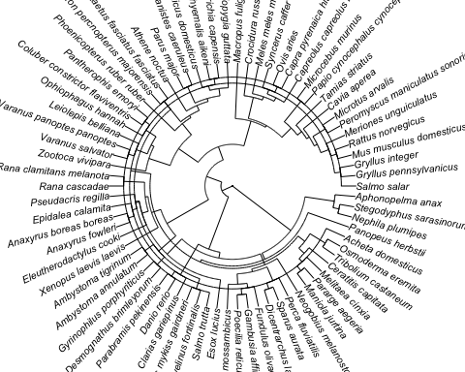
Phylegeny2

Slide 42
Phylegeny3
overall_model <- metafor::rma.mv(yi = Zr, V = V_Zr, mod = ~1, random = list(~1 | study_ID, ~1 | es_ID, ~1 | species, ~1 | species_OTL), R = list(species_OTL = phylo_cor), method = "REML", test = "t", dfs = "contain", data = zr_data %>% dplyr::mutate(species_OTL = stringr::str_replace_all(species_OTL, " ", "_"))) summary(overall_model)
## ## Multivariate Meta-Analysis Model (k = 272; method: REML) ## ## logLik Deviance AIC BIC AICc ## -160.5426 321.0852 331.0852 349.0958 331.3116 ## ## Variance Components: ## ## estim sqrt nlvls fixed factor R ## sigma^2.1 0.0016 0.0398 88 no study_ID no ## sigma^2.2 0.1155 0.3399 272 no es_ID no ## sigma^2.3 0.0260 0.1614 79 no species no ## sigma^2.4 0.0000 0.0000 74 no species_OTL yes ## ## Test for Heterogeneity: ## Q(df = 271) = 2508.8317, p-val < .0001 ## ## Model Results: ## ## estimate se tval df pval ci.lb ci.ub ## 0.0979 0.0347 2.8202 73 0.0062 0.0287 0.1671 ** ## ## --- ## Signif. codes: 0 '***' 0.001 '**' 0.01 '*' 0.05 '.' 0.1 ' ' 1

Slide 43
Shared Control
# Load packages # install.packages('devtools') # We need this package to download from GitHub. # Un-comment if you don't already have it installed. devtools::install_github("daniel1noble/metaAidR") # We've created a useful function for creating matrices here
## Skipping install of 'metaAidR' from a github remote, the SHA1 (bc8ae816) has not changed since last install. ## Use `force = TRUE` to force installation
pacman::p_load(metaAidR, metafor, corrplot) # Load the data mass_data <- read.csv("https://raw.githubusercontent.com/daniel1noble/meta-workshop/gh-pages/data/Mass.data.csv")

Slide 44
Shared Control2
## Calculate the log response ratio mass_data <- escalc(measure = "ROM", n1i = treat_N, n2i = control_N, m1i = treat_mean, m2i = control_mean, sd1i = treat_error, sd2i = control_error, data = mass_data) mass_data$obs <- 1:dim(mass_data)[1]

Slide 45
Shared Control2
## Calculate the M matrix M <- make_VCV_matrix(data = mass_data, V = "vi", cluster = "comparison_ID", m = "control_mean", sd = "control_error", n = "control_N", type = "vcv", vcal = "ROM", obs = "obs")

Slide 46
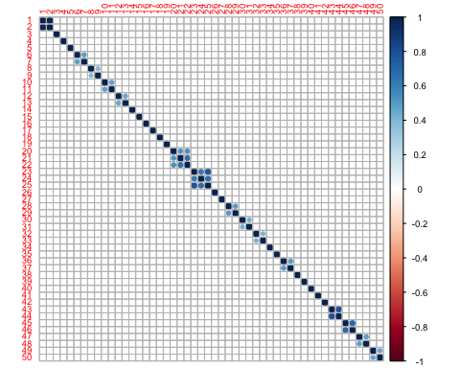
shared2
## Plot the M matrix as a correlation matrix corrplot::corrplot(cov2cor(M), tl.cex = 0.6, cl.cex = 0.6)

Slide 47
Share4
# full model including all random effects and moderators to do AICc model # selection on mlma <- rma.mv(yi = yi, V = M, mod = ~1, random = list(~1 | paper_no, ~1 | Genus_species, ~1 | data_ID), data = mass_data, method = "REML", test = "t", dfs = "contain") summary(mlma)
## ## Multivariate Meta-Analysis Model (k = 50; method: REML) ## ## logLik Deviance AIC BIC AICc ## 60.1528 -120.3057 -112.3057 -104.7384 -111.3966 ## ## Variance Components: ## ## estim sqrt nlvls fixed factor ## sigma^2.1 0.0000 0.0000 19 no paper_no ## sigma^2.2 0.0029 0.0540 16 no Genus_species ## sigma^2.3 0.0022 0.0465 50 no data_ID ## ## Test for Heterogeneity: ## Q(df = 49) = 954.2505, p-val < .0001 ## ## Model Results: ## ## estimate se tval df pval ci.lb ci.ub ## -0.0151 0.0169 -0.8916 15 0.3867 -0.0512 0.0210 ## ## --- ## Signif. codes: 0 '***' 0.001 '**' 0.01 '*' 0.05 '.' 0.1 ' ' 1

Slide 48
Het 1

Slide 49
Het2
$$I_{total}^{2}=\frac{σ_{study}^{2}+σ_{phylogeny}^{2}+σ_{species}^{2}+σ_{residual}^{2}}{σ_{study}^{2}+σ_{phylogeny}^{2}+σ_{species}^{2}+σ_{residual}^{2}+σ_{m}^{2}} \left(\#eq:itot\right)$$
# The orchaRd package has some convenient functions for calculating various I2 estimates including total. We'll load and install that package #install.packages("pacman") pacman::p_load(devtools, tidyverse, metafor, patchwork, R.rsp, emmeans, flextable) #devtools::install_github("daniel1noble/orchaRd", force = TRUE, build_vignettes = TRUE) library(orchaRd) orchaRd::i2_ml(MLMA, data = asr_dat)
## I2_Total I2_species_ID I2_study_ID I2_es_ID ## 98.418961 2.982312 58.480574 36.956076

Slide 50
PIs
$$PI∼\overset{‾}{u}±1.96\sqrt{SE^{2}+σ_{study}^{2}+σ_{species}^{2}+σ_{residual}^{2}}\left(\#eq:pi\right)$$
# Calculate the prediction intervals predict(MLMA)
## ## pred se ci.lb ci.ub pi.lb pi.ub ## 0.1668 0.0316 0.1010 0.2327 -0.1755 0.5091

Slide 51
2
l.pi.z = 0.1668 - 1.96*sqrt(MLMA$se^2 + sum(MLMA$sigma2)) u.pi.z = 0.1668 + 1.96*sqrt(MLMA$se^2 + sum(MLMA$sigma2)) c(l.pi.z, u.pi.z)
## [1] -0.1548412 0.4884412
l.pi.t = 0.1668 - qt(0.975, df = 20)*sqrt(MLMA$se^2 + sum(MLMA$sigma2)) u.pi.t = 0.1668 + qt(0.975, df = 20)*sqrt(MLMA$se^2 + sum(MLMA$sigma2)) c(l.pi.t, u.pi.t)
## [1] -0.1755121 0.5091121

Slide 52
MetaReg
meta_reg <- metafor::rma.mv(yi= ARR ~ 1 + method + class, V = V_ARR, method="REML", random=list(~1|species_ID, ~1|study_ID, ~1|es_ID), dfs = "contain", test="t", data=asr_dat) meta_reg
## ## Multivariate Meta-Analysis Model (k = 123; method: REML) ## ## Variance Components: ## ## estim sqrt nlvls fixed factor ## sigma^2.1 0.0009 0.0305 29 no species_ID ## sigma^2.2 0.0037 0.0605 21 no study_ID ## sigma^2.3 0.0105 0.1024 123 no es_ID ## ## Test for Residual Heterogeneity: ## QE(df = 115) = 898.2185, p-val < .0001 ## ## Test of Moderators (coefficients 2:8): ## F(df1 = 7, df2 = 13) = 4.0631, p-val = 0.0142 ## ## Model Results: ## ## estimate se tval df pval ci.lb ci.ub ## intrcpt 0.2953 0.0381 7.7505 13 <.0001 0.2130 0.3776 ## methodLTmax -0.0541 0.0569 -0.9507 115 0.3438 -0.1667 0.0586 ## classAmphibia -0.0312 0.1029 -0.3035 13 0.7663 -0.2534 0.1910 ## classArachnida -0.3432 0.1347 -2.5477 13 0.0243 -0.6341 -0.0522 ## classChondrichthyes 0.0453 0.1113 0.4072 13 0.6905 -0.1951 0.2857 ## classInsecta -0.2331 0.0517 -4.5114 13 0.0006 -0.3447 -0.1215 ## classMalacostraca -0.1331 0.0598 -2.2271 13 0.0442 -0.2623 -0.0040 ## classReptilia -0.2291 0.1071 -2.1393 13 0.0520 -0.4605 0.0023 ## ## intrcpt *** ## methodLTmax ## classAmphibia ## classArachnida * ## classChondrichthyes ## classInsecta *** ## classMalacostraca * ## classReptilia . ## ## --- ## Signif. codes: 0 '***' 0.001 '**' 0.01 '*' 0.05 '.' 0.1 ' ' 1

Slide 53
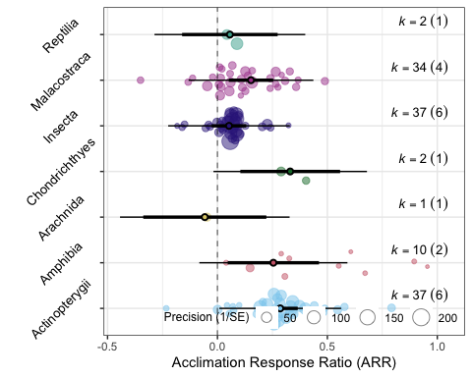
Orchard
orchaRd::orchard_plot(meta_reg, data = asr_dat, mod = "class", group = "study_ID", xlab = "Acclimation Response Ratio (ARR)", angle = 45)

Slide 54
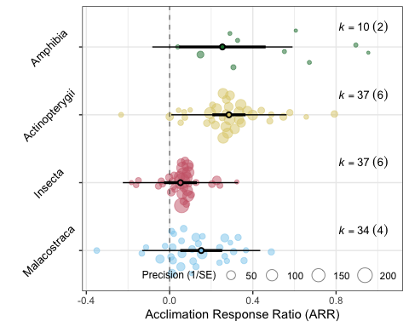
Orchard2
mod_table <- orchaRd::mod_results(meta_reg, data = asr_dat, mod = "class", group = "study_ID", at = list(class = c("Malacostraca", "Insecta", "Actinopterygii", "Amphibia")), subset = TRUE) orchaRd::orchard_plot(mod_table, xlab = "Acclimation Response Ratio (ARR)", angle = 45)

Slide 55
Pub bias
## Warning: Some 'yi' and/or 'vi' values equal to +-Inf. Recoded to NAs.

Slide 56
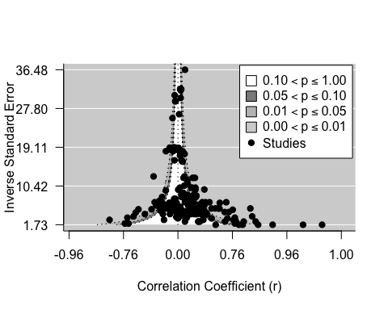
Pub bias 2
par(mfrow=c(1,1)) metafor::funnel(x = arnold_data_endo$Zr, vi = arnold_data_endo$Zr_v, yaxis = "seinv", digits = 2, level = c(0.1, 0.05, 0.01), shade = c("white", "gray55", "gray 75"), las = 1, xlab = "Correlation Coefficient (r)", atransf = tanh, legend = TRUE)

Slide 57
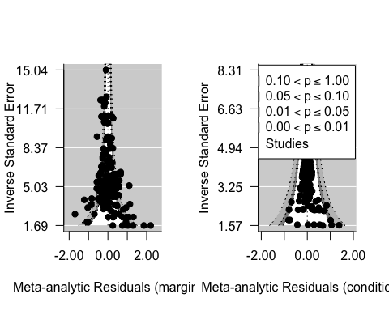
Pub bias 3

Slide 58
Pub bias 4
$$y_{i}=μ+β_{se}se+s_{j\left[i\right]}+spp_{k\left[i\right]}+e_{i}+m_{i}$$

Slide 59
Pub bias 4.3
$$y_{i}=μ+\sum_{i=1}^{N_{m}}{β_{m}}x_{m}+β_{se}se+β_{y}Year+s_{j\left[i\right]}+spp_{k\left[i\right]}+e_{i}+m_{i}$$

Slide 60
Pub bias 5
# Including sampling standard error as moderator metareg_se <- rma.mv(yi = Zr, V = Zr_v, mods = ~ sqrt(Zr_v), test = "t", dfs = "contain", data = arnold_data_endo, random = list(~1|Ref, ~1|obs)) summary(metareg_se)
## ## Multivariate Meta-Analysis Model (k = 209; method: REML) ## ## logLik Deviance AIC BIC AICc ## -77.9464 155.8928 163.8928 177.2237 164.0908 ## ## Variance Components: ## ## estim sqrt nlvls fixed factor ## sigma^2.1 0.0626 0.2503 62 no Ref ## sigma^2.2 0.0380 0.1951 209 no obs ## ## Test for Residual Heterogeneity: ## QE(df = 207) = 844.4496, p-val < .0001 ## ## Test of Moderators (coefficient 2): ## F(df1 = 1, df2 = 207) = 14.3314, p-val = 0.0002 ## ## Model Results: ## ## estimate se tval df pval ci.lb ci.ub ## intrcpt -0.0668 0.0727 -0.9184 60 0.3621 -0.2122 0.0787 ## sqrt(Zr_v) 1.3908 0.3674 3.7857 207 0.0002 0.6665 2.1151 *** ## ## --- ## Signif. codes: 0 '***' 0.001 '**' 0.01 '*' 0.05 '.' 0.1 ' ' 1

Slide 61
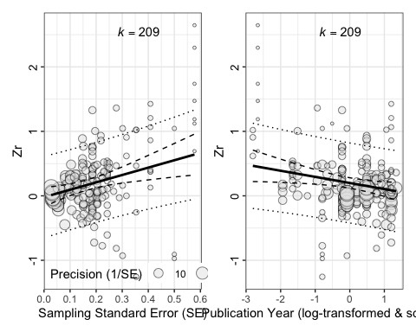
Pub bias 6
# Including sampling standard error as moderator and year arnold_data_endo$se <- sqrt(arnold_data_endo$Zr_v) arnold_data_endo$c_log_year <- scale(log(arnold_data_endo$Year)) # Fit model metareg_se_time <- rma.mv(yi = Zr, V = Zr_v, mods = ~ se + c_log_year, test = "t", dfs = "contain", data = arnold_data_endo, random = list(~1|Ref, ~1|obs)) summary(metareg_se_time)
## ## Multivariate Meta-Analysis Model (k = 209; method: REML) ## ## logLik Deviance AIC BIC AICc ## -74.9818 149.9636 159.9636 176.6030 160.2636 ## ## Variance Components: ## ## estim sqrt nlvls fixed factor ## sigma^2.1 0.0569 0.2385 62 no Ref ## sigma^2.2 0.0376 0.1940 209 no obs ## ## Test for Residual Heterogeneity: ## QE(df = 206) = 835.6677, p-val < .0001 ## ## Test of Moderators (coefficients 2:3): ## F(df1 = 2, df2 = 59) = 10.2748, p-val = 0.0001 ## ## Model Results: ## ## estimate se tval df pval ci.lb ci.ub ## intrcpt -0.0202 0.0733 -0.2757 59 0.7837 -0.1669 0.1265 ## se 1.1444 0.3734 3.0644 206 0.0025 0.4081 1.8806 ** ## c_log_year -0.0949 0.0408 -2.3251 59 0.0235 -0.1765 -0.0132 * ## ## --- ## Signif. codes: 0 '***' 0.001 '**' 0.01 '*' 0.05 '.' 0.1 ' ' 1
# Bubble plots! p1 <- orchaRd::bubble_plot(metareg_se_time, mod = "se", group = "Ref", data = arnold_data_endo, xlab = "Sampling Standard Error (SE)", ylab = "Zr", legend.pos = "bottom.left") p2 <- orchaRd::bubble_plot(metareg_se_time, mod = "c_log_year", group = "Ref", data = arnold_data_endo, xlab = "Publication Year (log-transformed & scaled)", ylab = "Zr", legend.pos = "none") p1 | p2

