Slide 1
Meta-analysis in Comparative Physiology: A brief introduction to effect sizes and meta-analytic modelling
Daniel W.A Noble, Nicholis Wu, Essie Rodgers, Patrice Pottier

Slide 2
Slide with Bullets
Bullet 1
Bullet 2
Bullet 3
$$y_{i}=x^{2}$$
Eat eggs
Drink coffee

Slide 3
Slide with R Output
# LDH activity in 8 C treatment trt_8C <- rnorm(10, 0.4, 0.5) # LDH activity in 26 C treatment trt_26C <- rnorm(10, 0.6, 0.2) # What's the difference, i.e., effect size, between treatments? mean(trt_26C - trt_8C)
## [1] 0.2015051
t.test(trt_26C, trt_8C)
## ## Welch Two Sample t-test ## ## data: trt_26C and trt_8C ## t = 0.8405, df = 10.991, p-value = 0.4185 ## alternative hypothesis: true difference in means is not equal to 0 ## 95 percent confidence interval: ## -0.3262227 0.7292329 ## sample estimates: ## mean of x mean of y ## 0.7293553 0.5278502

Slide 4
Do 1000s of experiments
experiment <- function(times) { dat <- data.frame(matrix(nrow = times, ncol = 2)) for (i in 1:times) { # LDH activity in 8 C treatment trt_8C <- rnorm(10, 0.4, 0.5) # LDH activity in 26 C treatment trt_26C <- rnorm(10, 0.6, 0.2) # What's the difference, i.e., effect size, between treatments? dat[i, 1] <- mean(trt_26C - trt_8C) dat[i, 2] <- t.test(trt_26C, trt_8C)$p.value } names(dat) <- c("effect", "p") return(dat) } expts <- experiment(10000)

Slide 5
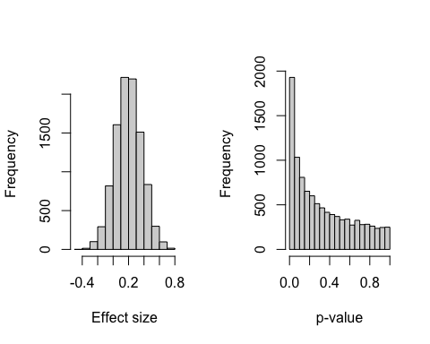
Figure

Slide 6
errors
$$SE=SD/\sqrt{N}$$
sd(expts$effect)
## [1] 0.1728306

