Slide 1



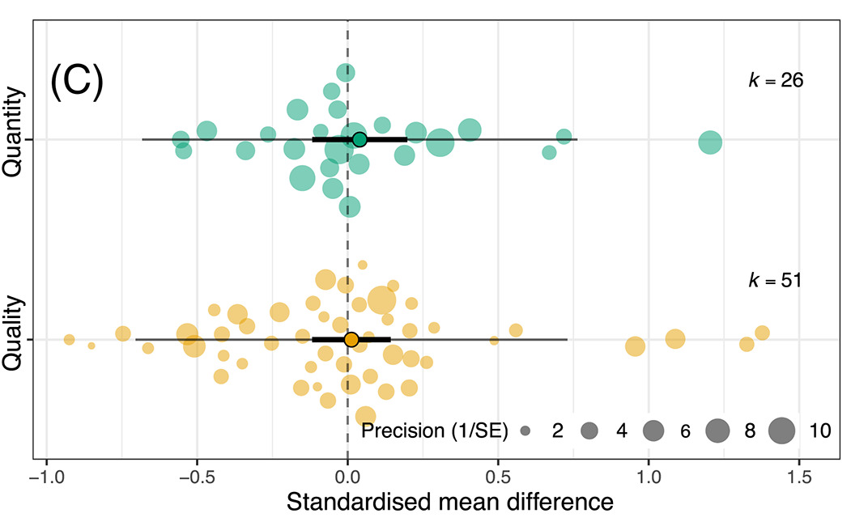
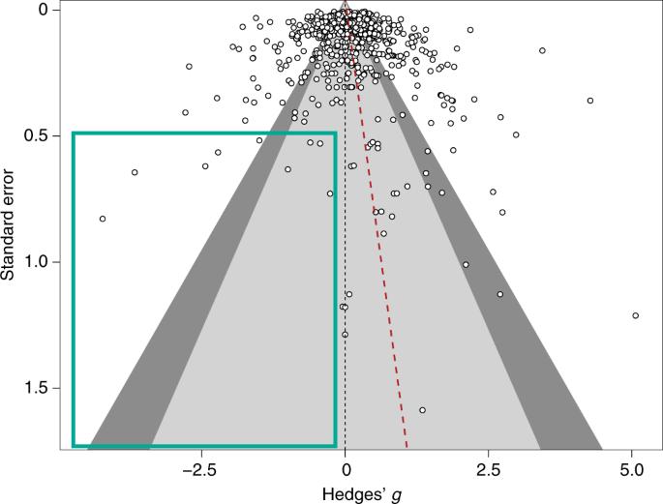




#SEBmeta
Meta-analysis in Comparative Physiology PART 2: Introduction to meta-analytic modelling: common challenges and advanced concepts
Nakagawa et al. 2021
De Boer et al. 2021
Daniel Noble, Nicholas Wu, Essie Rodgers, Patrice Pottier

Slide 2
Workshop Overview
Part 1: 9:00 – 10:30
What is meta-analysis and why should we use it?
Effect size and sampling variance: the key data for meta-analysis
What are effect sizes?
What types are out there and when to use?
Standardizing effect estimates – nuisance heterogeneity
Interpreting effect sizes and transformations
Assumptions, limitations, and common challenges
Part 2: 11:00 – 12:30
Meta-analytic modelling
Fixed and random effect meta-analyses
Multi-level meta-analytic models (MLMA): The main types in comparative physiology
Non-independence – phylogeny, study, species, shared controls
Robust variance estimation
Sensitivity analyses
Meta-regression and heterogeneity
Interpreting and reporting meta-analytic model output
Publication bias
Time-lag, reporting bias
Detecting and correcting
Part 3: 14:45 – 16:00
Help (advice) with your own meta-analysis! (if you need it)

Slide 3
Two main aims of meta-analysis
Finding generality across studies on the same (similar) topics
Meta-analysis
Finding consistency (inconsistency) among studies – just looking at means may not be useful
Heterogeneity analysis
Meta-regression
Publication-bias tests

Slide 4
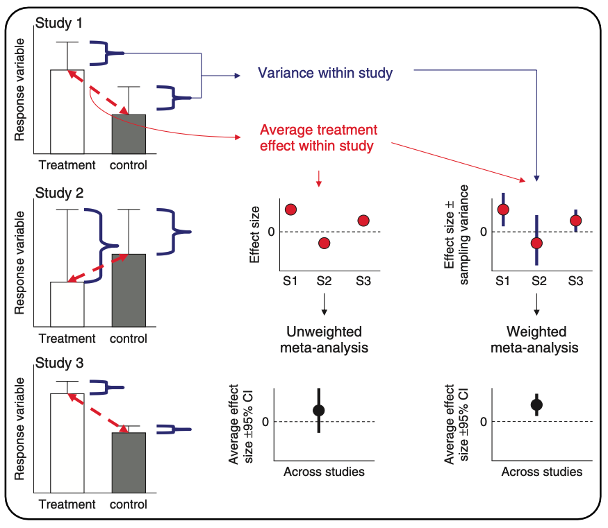
What meta-analysis is doing…
Hillebrand & Gurevitch (2016). eLS

Slide 5
Meta-analysis
Fixed-effect (common-effect) and random-effects meta-analyses
Heterogeneity tests
Meta-regression (mixed-effects meta-analysis)
Publication bias
Are studies with significant results more likely to be published?

Slide 6
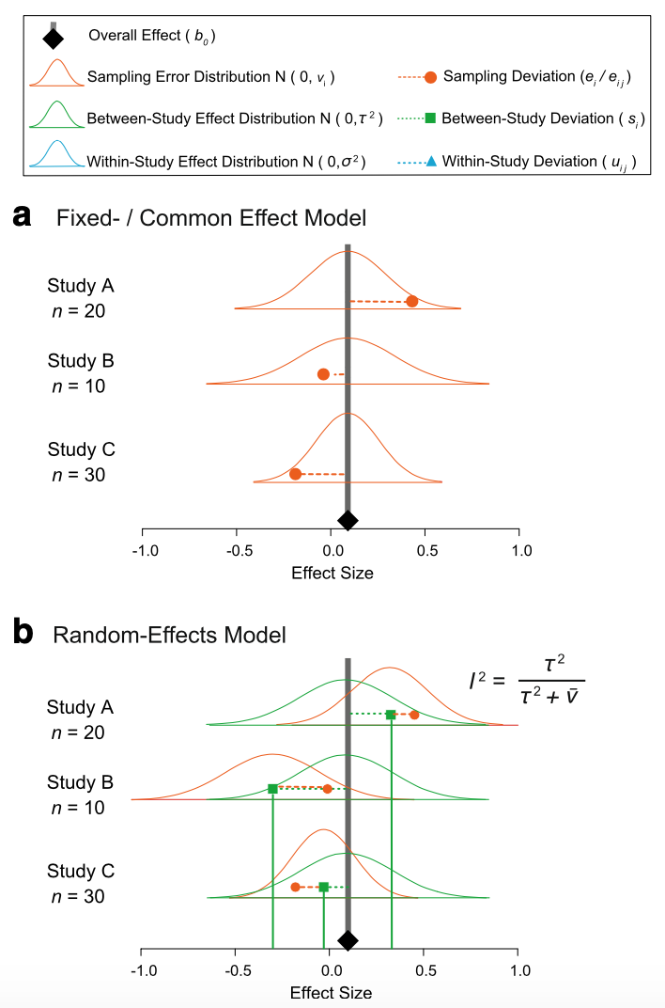

Fixed and random model assumptions
Fixed (common) effect
All studies are estimating the same (common) “true” underlying effect
Variability between studies is due to random variation (chance) only

Slide 7
Fixed and random model assumptions
Random effects
Each study has different “true” underlying effects
Variability between studies is due to random variation (chance) and actual differences

Slide 8


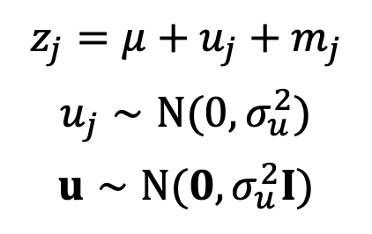
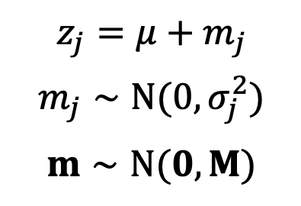

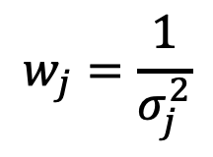
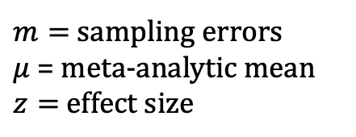
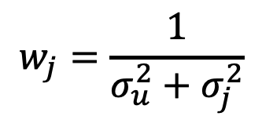
Fixed (common) and random: it’s just another linear model
Fixed-effect meta-analysis
(common-effect meta-analysis)
Random-effects meta-analysis
$$z_{j}=μ+m_{j}$$
$$m_{j}∼N(0,σ_{j}^{2})$$
$$m∼N(0,M)$$
$$z_{j}=μ+u_{j}+m_{j}$$
$$u_{j}∼N(0,σ_{u}^{2})$$
$$u∼N(0,σ_{u}^{2}I)$$
$$w_{j}=\frac{1}{σ_{j}^{2}}$$
$$w_{j}=\frac{1}{σ_{u}^{2}+σ_{j}^{2}}$$
$$j=1,…,N_{study}$$
$u=$ study-specific effect
$m=$ sampling errors
$μ$ = meta-analytic mean
$z=$ effect size
$σ_{u}^{2}$ is often referred to as $τ^{2}$
Nakagawa & Santos (2012, Evol Ecol)
Notes:
Need to add more

Slide 9
Fixed (common) effect in code…
# Generate some simulated effect size data with known sampling variance # assumed to come from a common underlying distribution set.seed(86) # Set see so that we all get the same simulated results
# We will have 5 studies stdy <- 1:5
# We know the variance for each effect Ves <- c(0.05, 0.10, 0.02, 0.10, 0.09)
# We'll need this later but these are weights W <- 1 / Ves
# We assume they are sampled from a normal distribution with a mean effect size of 2 es <- rnorm(length(Ves), 2, sqrt(Ves))
# Data for our fixed effect meta-analysis dataFE <- data.frame(stdy = stdy, es, Ves)

Slide 10
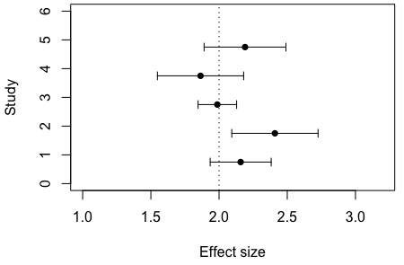
Fixed effects model data…

Slide 11
Fixed effect model meta-analysis..
# Run a fixed effect meta-analysis using the FE dataset. metafor::rma(yi = es, vi = Ves, method = "FE", data = dataFE)
## ## Fixed-Effects Model (k = 5) ## ## I^2 (total heterogeneity / total variability): 0.00% ## H^2 (total variability / sampling variability): 0.56 ## ## Test for Heterogeneity: ## Q(df = 4) = 2.2340, p-val = 0.6928 ## ## Model Results: ## ## estimate se zval pval ci.lb ci.ub ​ ## 2.0731 0.0994 20.8459 <.0001 1.8782 2.2680 *** ## ## --- ## Signif. codes: 0 '***' 0.001 '**' 0.01 '*' 0.05 '.' 0.1 ' ' 1

Slide 12

Now a fixed effect analysis by hand…
We can even do all the seemingly fancy stuff metafor is doing ourselves if we want….we just need to know the equations:
$$\overset{‾}{ES}=∑\left(W∗ES\right)/∑W$$
$$σ_{\overset{‾}{ES}}^{2}=\frac{1}{∑W}$$
# Calculate pooled effect size EsP.FE <- sum(W*dataFE$es) / sum(W) EsP.FE
## [1] 2.073105
# Calculate the pooled variance around estimate VarEsP.FE <- 1 / sum(W) VarEsP.FE
## [1] 0.00989011
# Calculate the standard error around estimate SE.EsP.FE <- sqrt(VarEsP.FE) SE.EsP.FE
## [1] 0.09944903
# We'll need this later but these are weights W <- 1 / Ves
## estimate se zval pval ci.lb ci.ub ​ ## 2.0731 0.0994 20.8459 <.0001 1.8782 2.2680 ***

Slide 13
Now a fixed effect analysis by hand…
We can even do all the seemingly fancy stuff metafor is doing ourselves if we want….we just need to know the equations:
$$\overset{‾}{ES}=∑\left(W∗ES\right)/∑W$$
$$σ_{\overset{‾}{ES}}^{2}=\frac{1}{∑W}$$
# Calculate pooled effect size EsP.FE <- sum(W*dataFE$es) / sum(W) EsP.FE
## [1] 2.073105
# Calculate the pooled variance around estimate VarEsP.FE <- 1 / sum(W) VarEsP.FE
## [1] 0.00989011
# Calculate the standard error around estimate SE.EsP.FE <- sqrt(VarEsP.FE) SE.EsP.FE
## [1] 0.09944903
# We'll need this later but these are weights W <- 1 / Ves
## estimate se zval pval ci.lb ci.ub ​ ## 2.0731 0.0994 20.8459 <.0001 1.8782 2.2680 ***

Slide 14
Now a fixed effect analysis by hand…
We can even do all the seemingly fancy stuff metafor is doing ourselves if we want….we just need to know the equations:
$$\overset{‾}{ES}=∑\left(W∗ES\right)/∑W$$
$$σ_{\overset{‾}{ES}}^{2}=\frac{1}{∑W}$$
# Calculate pooled effect size EsP.FE <- sum(W*dataFE$es) / sum(W) EsP.FE
## [1] 2.073105
# Calculate the pooled variance around estimate VarEsP.FE <- 1 / sum(W) VarEsP.FE
## [1] 0.00989011
# Calculate the standard error around estimate SE.EsP.FE <- sqrt(VarEsP.FE) SE.EsP.FE
## [1] 0.09944903
## estimate se zval pval ci.lb ci.ub ​ ## 2.0731 0.0994 20.8459 <.0001 1.8782 2.2680 ***

Slide 15

Now a fixed effect analysis by hand…
We can even do all the seemingly fancy stuff metafor is doing ourselves if we want….we just need to know the equations:
$$\overset{‾}{ES}=∑\left(W∗ES\right)/∑W$$
$$σ_{\overset{‾}{ES}}^{2}=\frac{1}{∑W}$$
# Calculate pooled effect size EsP.FE <- sum(W*dataFE$es) / sum(W) EsP.FE
## [1] 2.073105
# Calculate the pooled variance around estimate VarEsP.FE <- 1 / sum(W) VarEsP.FE
## [1] 0.00989011
# Calculate the standard error around estimate SE.EsP.FE <- sqrt(VarEsP.FE) SE.EsP.FE
## [1] 0.09944903
## estimate se zval pval ci.lb ci.ub ​ ## 2.0731 0.0994 20.8459 <.0001 1.8782 2.2680 ***
Notes:
2.073105 / 0.09944903 gets you the zval
2*pnorm(20.8459, lower.tail = FALSE) gets you the p-value for this

Slide 16
Random effect model in code….
# Here adding 0.8 says we want to add 0.8 as the between study variability. In other words, each effect size is sampled from a larger distribution of effect sizes that itself comes from a distribution with a variance of 0.8.
esRE <- rnorm(length(Ves), 2, sqrt(Ves + 0.8))
# Data for our random effect meta-analysis dataRE <- data.frame(stdy = stdy, esRE, Ves)

Slide 17
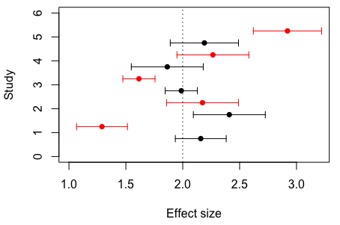
Random effect model data…
Mean (arrows are sampling standard deviation) effect size for each study. Data simulated under a fixed effect model in black and data simulated under a random effect model in red.

Slide 18
Random effects model meta-analysis..
# Random effect meta-analysis
metafor::rma(yi = esRE, vi = Ves, method="DL", data = dataRE)
## ## Random-Effects Model (k = 5; tau^2 estimator: DL) ## ## tau^2 (estimated amount of total heterogeneity): 0.2947 (SE = 0.2731) ## tau (square root of estimated tau^2 value): 0.5429 ## I^2 (total heterogeneity / total variability): 83.61% ## H^2 (total variability / sampling variability): 6.10 ## ## Test for Heterogeneity: ## Q(df = 4) = 24.4015, p-val < .0001 ## ## Model Results: ## ## estimate se zval pval ci.lb ci.ub ​ ## 2.0163 0.2697 7.4753 <.0001 1.4876 2.5449 *** ## ## --- ## Signif. codes: 0 '***' 0.001 '**' 0.01 '*' 0.05 '.' 0.1 ' ' 1

Slide 19
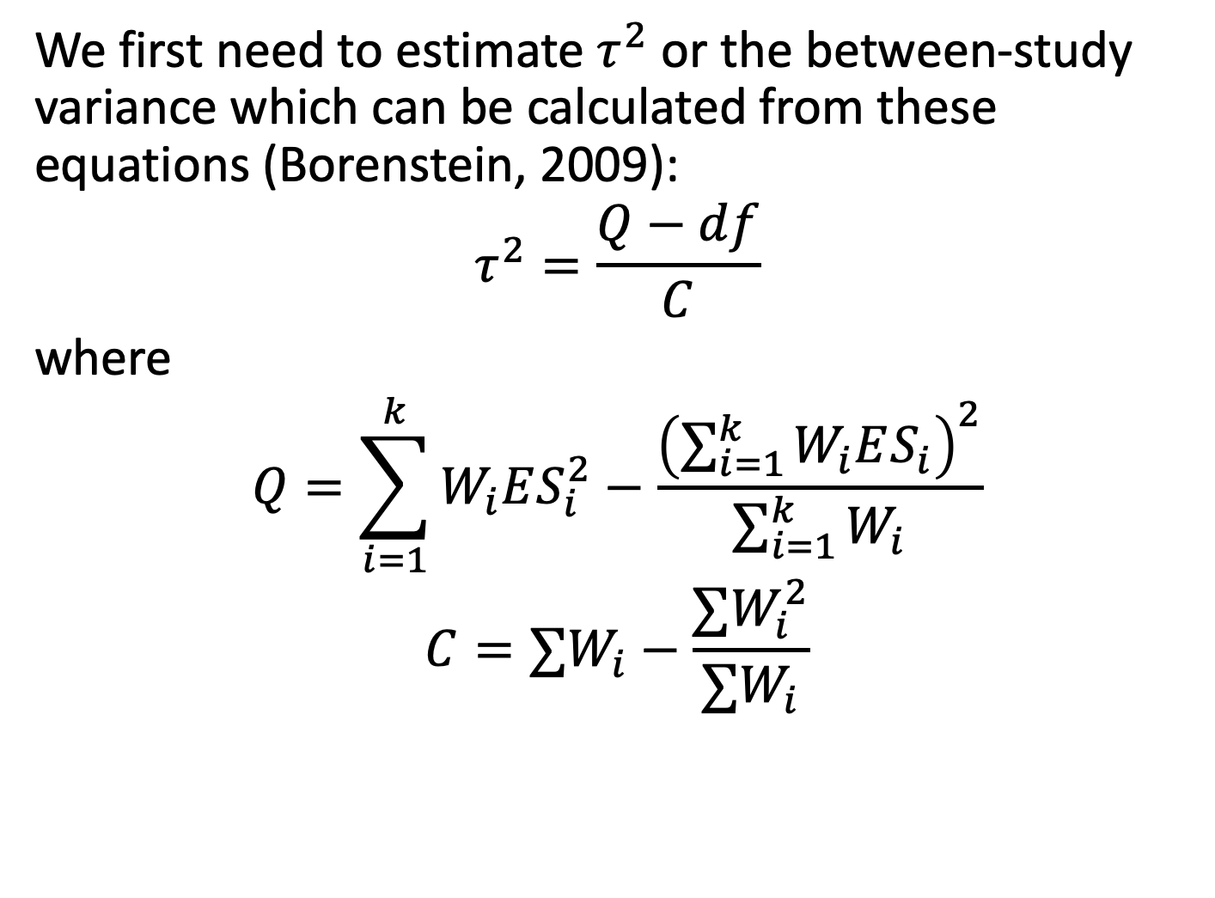
Now a random effect analysis by hand…
We first need to estimate $τ^{2}$ or the between-study variance which can be calculated from these equations (Borenstein, 2009):
$$τ^{2}=\frac{Q−df}{C}$$
where
$$Q=\sum_{i=1}^{k}{W_{i}ES_{i}^{2}}−\frac{{\left(\sum_{i=1}^{k}{W_{i}ES_{i}}\right)}^{2}}{\sum_{i=1}^{k}{W_{i}}}$$
$$C=∑W_{i}−\frac{∑W_{i}^{2}}{∑W_{i}}$$

Slide 20
Now a random effect analysis by hand…
# Calculate our Q statistic again Q <- sum(W*(dataRE$es^2) ) - (sum(W*dataRE$es)^2 / sum(W)) Q
## [1] 24.40149
# Calculate tau2 C <- sum(W) - ((sum(W^2))/sum(W)) C
## [1] 69.23077
# Calculate df df <- nrow(dataRE) - 1 T2 <- (Q - df) / C T2
## [1] 0.2946883
## Test for Heterogeneity: ## Q(df = 4) = 24.4015, p-val < .0001
## tau^2 (estimated amount of total heterogeneity): 0.2947 (SE = 0.2731)

Slide 21
Now a random effect analysis by hand…
Remember, things are the same but the weighting is different now.
# RE weights W.re <- 1 / (T2 + dataRE$Ves) #Pooled effect size for random effect meta-analysis esPoolRE <- sum(W.re*dataRE$es) / sum(W.re) esPoolRE
## [1] 2.016261
# Calculate the pooled variance around estimate VarES <- 1 / sum(W.re) # Calculate the standard error around estimate SE.ES.RE <- sqrt(VarES) SE.ES.RE
## [1] 0.2697219
## estimate se zval pval ci.lb ci.ub ​ ## 2.0163 0.2697 7.4753 <.0001 1.4876 2.5449 ***

Slide 22

More non-independence
Pick one or averaging or modeling?
What would you do?

