Slide 1
Meta-analysis in Comparative Physiology: A brief introduction to effect sizes and meta-analytic modelling
Daniel W.A Noble, Nicholis Wu, Essie Rodgers, Patrice Pottier

Slide 2
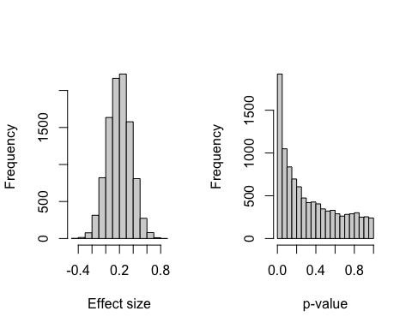
Slide with Bullets
Bullet 1
Bullet 2
Bullet 3
$$y_{i}=x^{2}$$
Eat eggs
Drink coffee
Slide with R Output
# LDH activity in 8 C treatment trt_8C <- rnorm(10, 0.4, 0.5) # LDH activity in 26 C treatment trt_26C <- rnorm(10, 0.6, 0.2) # What's the difference, i.e., effect size, between treatments? mean(trt_26C - trt_8C)
## [1] 0.1689233
t.test(trt_26C, trt_8C)
## ## Welch Two Sample t-test ## ## data: trt_26C and trt_8C ## t = 0.90505, df = 12.249, p-value = 0.3829 ## alternative hypothesis: true difference in means is not equal to 0 ## 95 percent confidence interval: ## -0.2368285 0.5746752 ## sample estimates: ## mean of x mean of y ## 0.6241681 0.4552448
Do 1000s of experiments
experiment <- function(times) { dat <- data.frame(matrix(nrow = times, ncol = 2)) for (i in 1:times) { # LDH activity in 8 C treatment trt_8C <- rnorm(10, 0.4, 0.5) # LDH activity in 26 C treatment trt_26C <- rnorm(10, 0.6, 0.2) # What's the difference, i.e., effect size, between treatments? dat[i, 1] <- mean(trt_26C - trt_8C) dat[i, 2] <- t.test(trt_26C, trt_8C)$p.value } names(dat) <- c("effect", "p") return(dat) } expts <- experiment(10000)
Figure

Slide 3
errors
$$SE=SD/\sqrt{N}$$
sd(expts$effect)
## [1] 0.1706722
se
means <- c() for (i in 1:1e+06) { mass <- rnorm(n = 18, mean = 10.8, sd = 0.988) means <- c(means, mean(mass)) } # The mean of the means mean(means) # The standard deviation of the means or standard error sd(means)
Our analytical calculaton
se <- sd(mass)/sqrt(length(mass)) se
Plots
ggplot() + geom_histogram(aes(x = means))
Zr
zr_data <- read.csv("https://raw.githubusercontent.com/daniel1noble/meta-workshop/gh-pages/data/ind_disp_raw_data.csv") %>% dplyr::select(study_ID, taxa, species, trait, response, response_unit, disp_trait, disp_unit, corr_coeff, sample_size) %>% # remove irrelevant columns for this tutorial dplyr::top_n(10) # select first 10 effect sizes to illustrate escalc function
## Selecting by sample_size

Slide 4
Effect calculation
# Calculate Fisher's r-to-z transformed correlation coefficient (ZCOR) as yi = effect size and vi = sampling variances, where ri = raw correlation coefficients, and ni = sample size. zr_data <- metafor::escalc(measure = "ZCOR", ri = corr_coeff, ni = sample_size, data = zr_data, var.names=c("Zr","v_Zr")) zr_data
## ## study_ID taxa species trait response ## 1 5 Mammalia Tamias_striatus Metabolism Resting MR ## 2 13 Aves Parus_major Metabolism Basal MR ## 3 13 Aves Parus_major Metabolism Basal MR ## 4 45 Mammalia Syncerus_caffer Condition Body condition ## 5 45 Mammalia Syncerus_caffer Condition Body condition ## 6 55 Aves Phoenicopterus_ruber Condition Body condition ## 7 87 Aves Cyanistes caeruleus Immunity WBC ## 8 87 Aves Cyanistes caeruleus Cardiovascular Haematocrit ## 9 87 Aves Cyanistes caeruleus Immunity WBC ## 10 87 Aves Cyanistes caeruleus Cardiovascular Haematocrit ## response_unit disp_trait disp_unit corr_coeff sample_size Zr ## 1 residual mW Exploration residual -0.14300000 296 -0.1440 ## 2 mass-corrected W Exploration 0.05547002 345 0.0555 ## 3 mass-corrected W Exploration -0.13969969 335 -0.1406 ## 4 index Dispersal % -0.40000000 415 -0.4236 ## 5 index Dispersal % -0.53000000 508 -0.5901 ## 6 Dispersal 0.87300000 462 1.3456 ## 7 n Activity n 0.06500000 485 0.0651 ## 8 % Activity n 0.01500000 485 0.0150 ## 9 n Activity n 0.17000000 485 0.1717 ## 10 % Activity n -0.13000000 485 -0.1307 ## v_Zr ## 1 0.0034 ## 2 0.0029 ## 3 0.0030 ## 4 0.0024 ## 5 0.0020 ## 6 0.0022 ## 7 0.0021 ## 8 0.0021 ## 9 0.0021 ## 10 0.0021

Slide 5
Back transofrmation
# We can easily convert back to r as follows zr_data$r <- tanh(zr_data$Zr) zr_data %>% select(corr_coeff, r)
## ## corr_coeff r ## 1 -0.14300000 -0.14300000 ## 2 0.05547002 0.05547002 ## 3 -0.13969969 -0.13969969 ## 4 -0.40000000 -0.40000000 ## 5 -0.53000000 -0.53000000 ## 6 0.87300000 0.87300000 ## 7 0.06500000 0.06500000 ## 8 0.01500000 0.01500000 ## 9 0.17000000 0.17000000 ## 10 -0.13000000 -0.13000000

