Slide 1



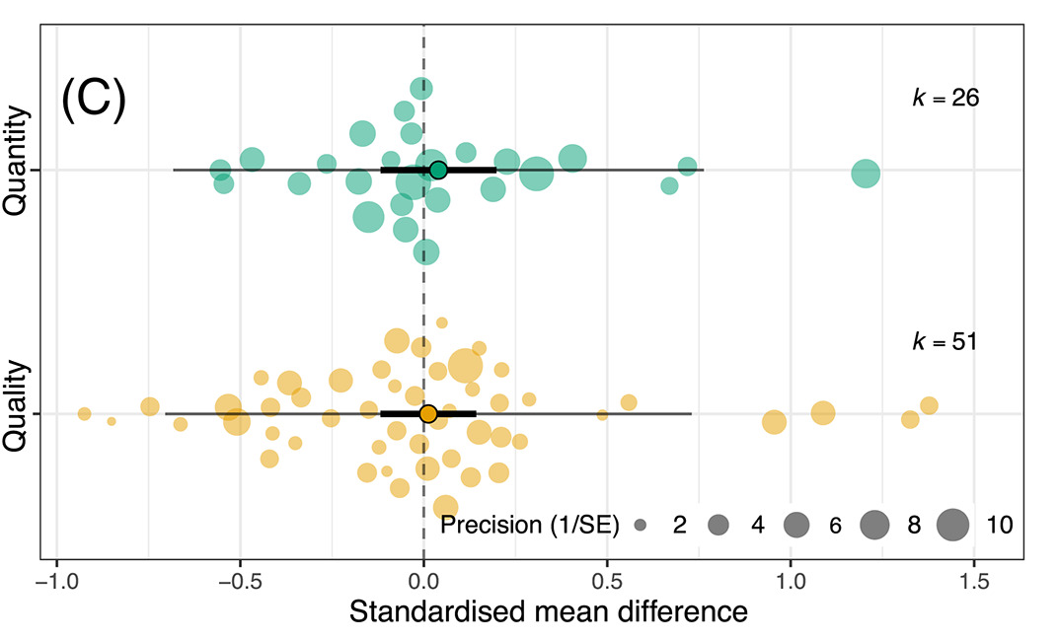
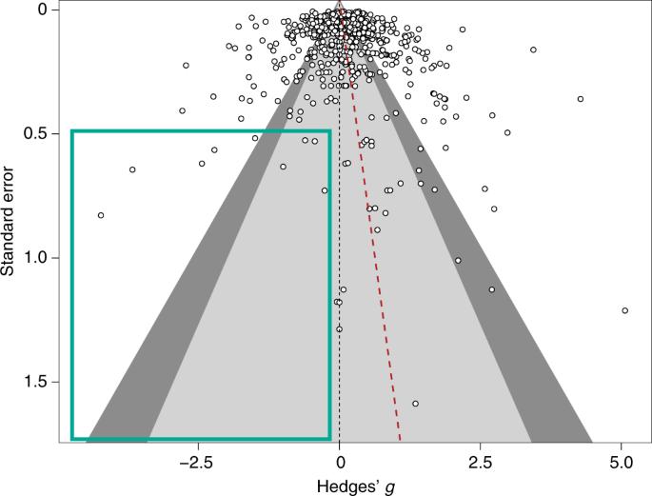




#SEBmeta
Meta-analysis in Comparative Physiology PART 2: Introduction to meta-analytic modelling: common challenges and advanced concepts
Nakagawa et al. 2021
De Boer et al. 2021
Daniel Noble, Nicholas Wu, Essie Rodgers, Patrice Pottier

Slide 2
Workshop Overview
Part 1: 9:00 – 10:30
What is meta-analysis and why should we use it?
Effect size and sampling variance: the key data for meta-analysis
What are effect sizes?
What types are out there and when to use?
Standardizing effect estimates – nuisance heterogeneity
Interpreting effect sizes and transformations
Assumptions, limitations, and common challenges
Part 2: 11:00 – 12:30
Meta-analytic modelling
Fixed and random effect meta-analyses
Multi-level meta-analytic models (MLMA): The main types in comparative physiology
Non-independence – phylogeny, study, species, shared controls
Robust variance estimation
Sensitivity analyses
Meta-regression and heterogeneity
Interpreting and reporting meta-analytic model output
Publication bias
Time-lag, reporting bias
Detecting and correcting
Part 3: 14:45 – 16:00
Help (advice) with your own meta-analysis! (if you need it)

Slide 3
Two main aims of meta-analysis
Finding generality across studies on the same (similar) topics
Meta-analysis
Finding consistency (inconsistency) among studies – just looking at means may not be useful
Heterogeneity analysis
Meta-regression
Publication-bias tests

Slide 4
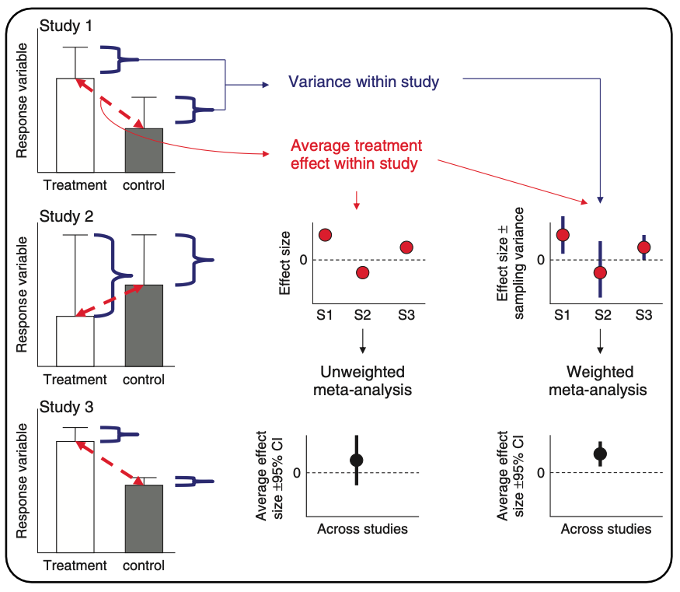
What meta-analysis is doing…
Hillebrand & Gurevitch (2016). eLS

Slide 5
Meta-analysis
Fixed-effect (common-effect) and random-effects meta-analyses
Heterogeneity tests
Meta-regression (mixed-effects meta-analysis)
Publication bias
Are studies with significant results more likely to be published?

Slide 6
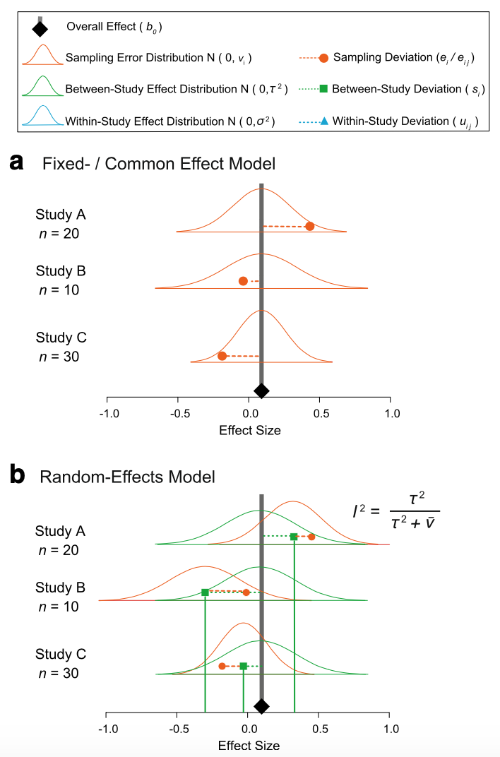

Fixed and random model assumptions
Fixed (common) effect
All studies are estimating the same (common) “true” underlying effect
Variability between studies is due to random variation (chance) only

Slide 7
Fixed and random model assumptions
Random effects
Each study has different “true” underlying effects
Variability between studies is due to random variation (chance) and actual differences

Slide 8


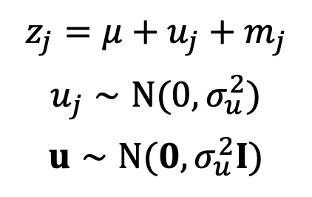
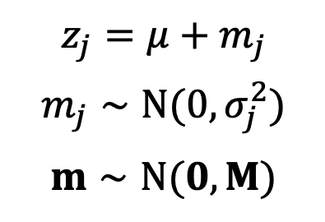

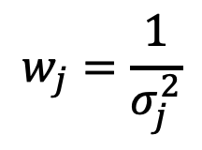
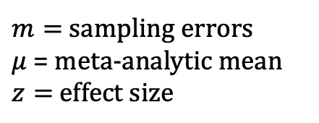
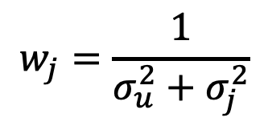
Fixed (common) and random: it’s just another linear model
Fixed-effect meta-analysis
(common-effect meta-analysis)
Random-effects meta-analysis
$$z_{j}=μ+m_{j}$$
$$m_{j}∼N(0,σ_{j}^{2})$$
$$m∼N(0,M)$$
$$z_{j}=μ+u_{j}+m_{j}$$
$$u_{j}∼N(0,σ_{u}^{2})$$
$$u∼N(0,σ_{u}^{2}I)$$
$$w_{j}=\frac{1}{σ_{j}^{2}}$$
$$w_{j}=\frac{1}{σ_{u}^{2}+σ_{j}^{2}}$$
$$j=1,…,N_{study}$$
$u=$ study-specific effect
$m=$ sampling errors
$μ$ = meta-analytic mean
$z=$ effect size
$σ_{u}^{2}$ is often referred to as $τ^{2}$
Nakagawa & Santos (2012, Evol Ecol)
Notes:
Need to add more

Slide 9
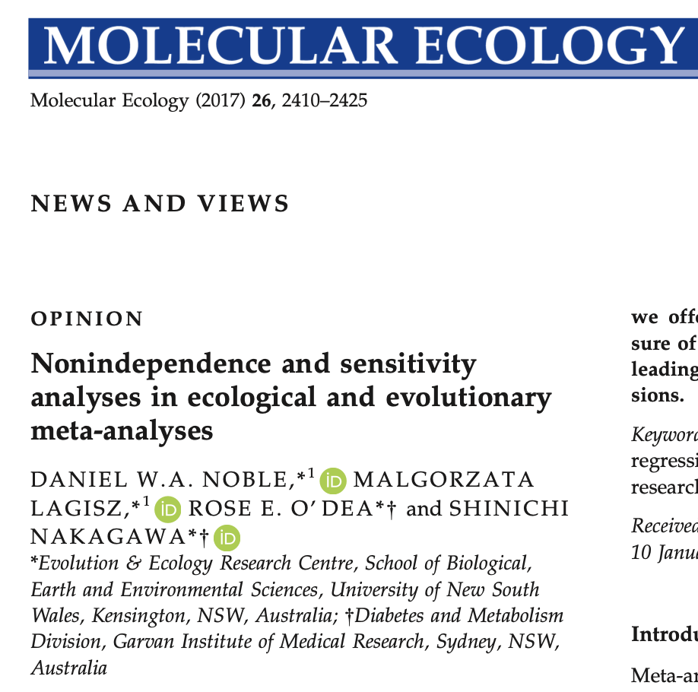
More non-independence
Pick one or averaging or modeling?
What would you do?

