Slide 1
Meta-analysis in Comparative Physiology: A brief introduction to effect sizes and meta-analytic modelling
Daniel W.A Noble, Nicholis Wu, Essie Rodgers, Patrice Pottier

Slide 2
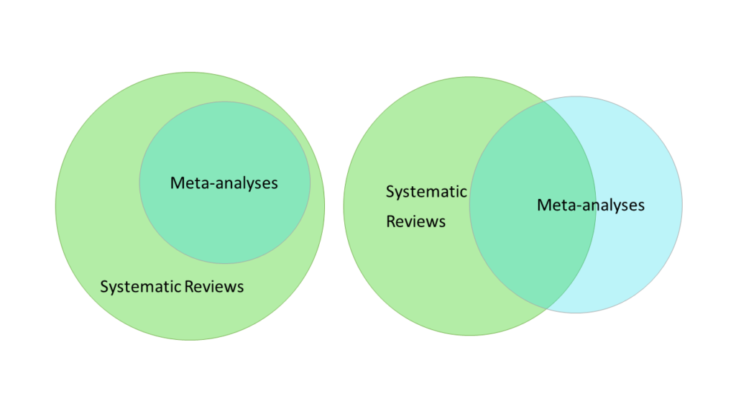
What is meta-analysis?
Statistical procedure for synthesising effect size results from different studies
Part of a systematic review
Transparent and reproducible literature searches
Reproducible inclusion and exclusion criteria

Slide 3
Identifies gaps and biases in existing research
Explore why effects vary across studies
Can test specific hypotheses

Slide 4
Slide with Bullets
Bullet 1
Bullet 2
Bullet 3
$$y_{i}=x^{2}$$
Eat eggs
Drink coffee

Slide 5
Slide with R Output
x <- rnorm(100, 0, 1) summary(cars)
## speed dist ## Min. : 4.0 Min. : 2.00 ## 1st Qu.:12.0 1st Qu.: 26.00 ## Median :15.0 Median : 36.00 ## Mean :15.4 Mean : 42.98 ## 3rd Qu.:19.0 3rd Qu.: 56.00 ## Max. :25.0 Max. :120.00

Slide 6
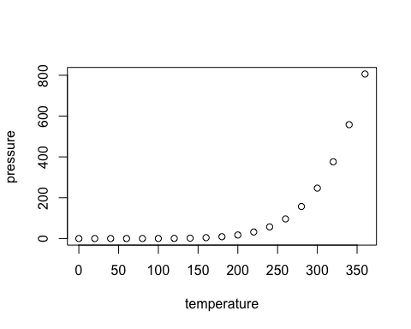
Slide with Plot

