Slide 1

PDb
PARAMETER DATABASE
July 2012
Notes:
2011-10-19

Slide 2
AGENDA
What is PDB?
Main functionality
Main benefits
Configuration ‘actors’ involved
Inputs and outputs of PDB
Q&A

Slide 3
WHAT IS PDB?
Parameter handling database
Hosts both reference and real configurations, revision control, detailed info of parameters
Configuration workspace
Allows working with configurations, customize, browse, compare, audit, merge, create deltas
Node configuration tool
Configures real nodes via LDAP and NETCONF

Slide 4
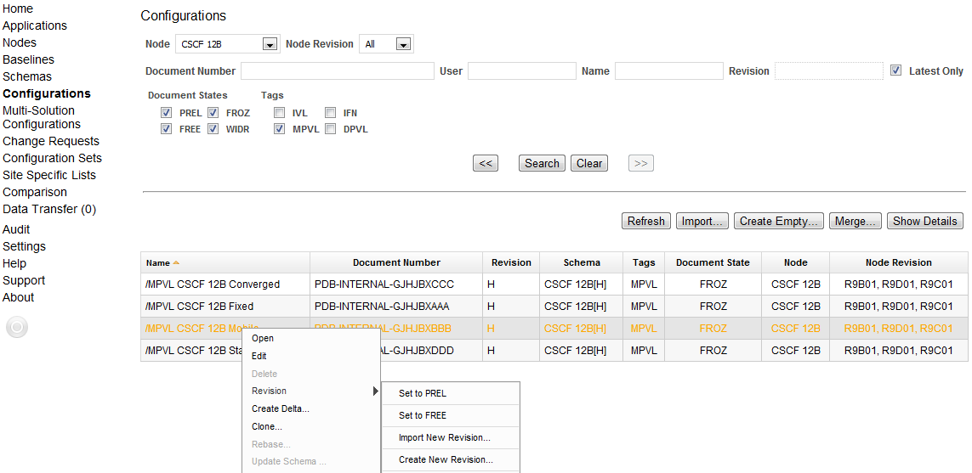
Configuration workspace
This is how the configurations page looks like. It allows you to find configurations based on different criteria. This is the starting point for working with configurations
Generate node configuration
from reference configuration
Customize reference configs
via delta configurations
Parameter history
Revision control
Notes:
This is how the configurations page looks like. It allows you to find configurations based on different criteria. This is the starting point for working with configurations

Slide 5
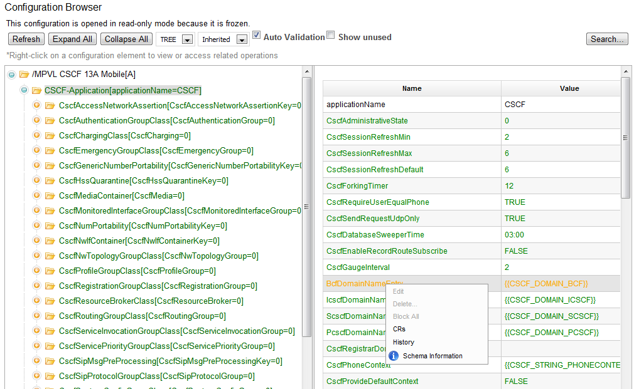
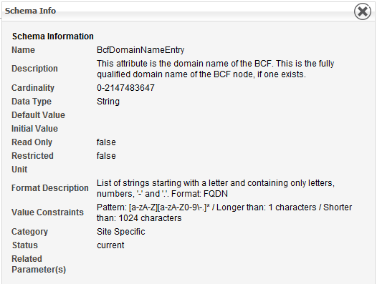
Configuration Browser
The configuration browser allows you to perform all the changes you would normally need to apply to a configuration. Parameter information is also available
Navigate parameters
Contextual info
for parameters
Add, delete, modify
Visualize the whole
configuration
Notes:
The configuration browser allows you to perform all the changes you would normally need to apply to a configuration. Parameter information is also available

Slide 6
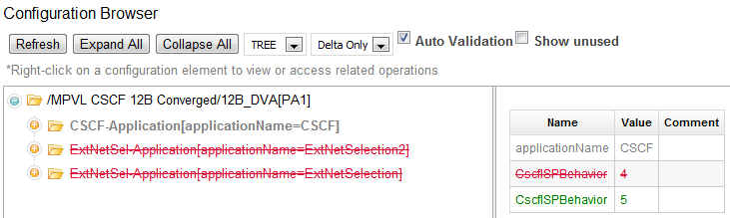
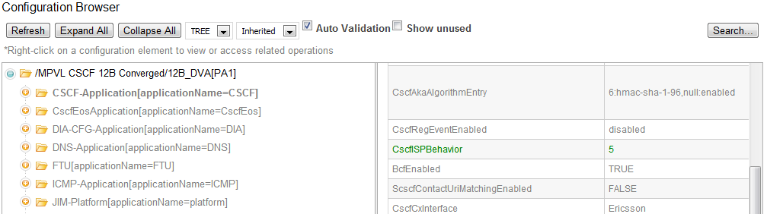
DELTA CONFIGURATIONS
Delta configurations allow you to customize reference configurations, without affecting the reference configuration. Different view modes give you full control of the modifications applied
Parameter inheritance
Modify the delta
without changing the parent
Customize
reference configs
ExtNetSel
is not present
Save time and
work efficiently
Notes:
Delta configurations allow you to customize reference configurations, without affecting the reference configuration. Different view modes give you full control of the modifications applied

Slide 7
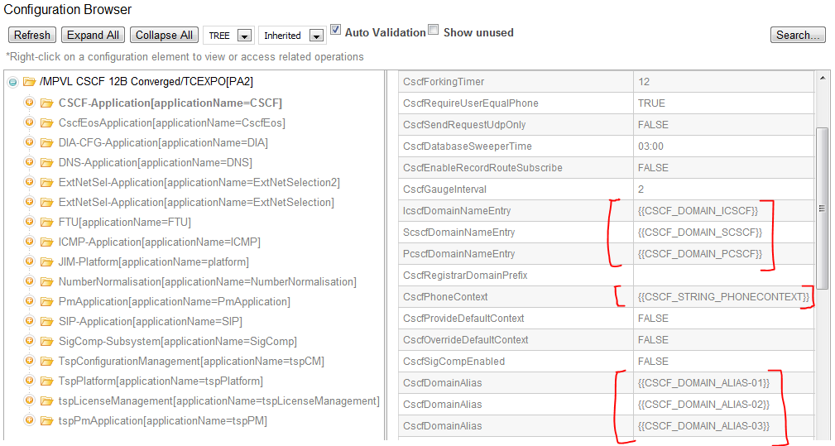
SITE SPECIFIC VARIABLES
Reference configurations have variables instead of site specific values. This way, the same reference configuration can be used as a template for different real configurations
Reference configurations
contain variables
Variables are mapped
to site specific values
One reference config generates
different configurations
Re-usability,
enhanced efficiency
Notes:
Reference configurations have variables instead of site specific values. This way, the same reference configuration can be used as a template for different real configurations

Slide 8
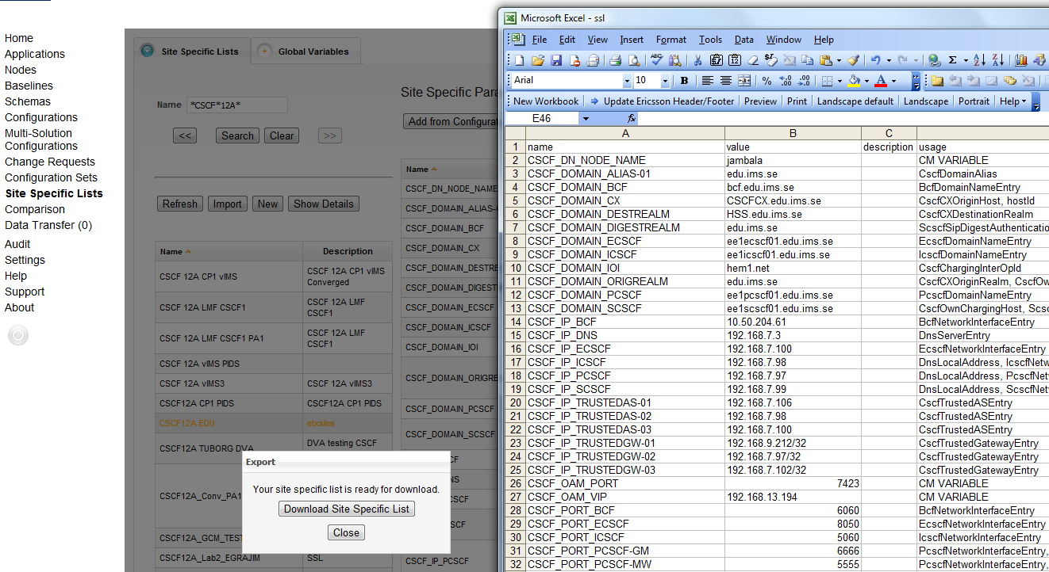
SITE SPECIFIC LISTS
Site Specific Lists (SSL) allows you to export a generic configuration using specific values. For your convenience, you can work and edit SSLs inside or outside PDB
SSL can be manipulated
in PDB or externally
SSL can be exported
in Excel-friendly format (CSV)
There could be many SSLs
for the same configuration
Re-usability,
enhanced efficiency
Notes:
Site Specific Lists (SSL) allows you to export a generic configuration using specific values. For your convenience, you can work and edit SSLs inside or outside PDB

Slide 9
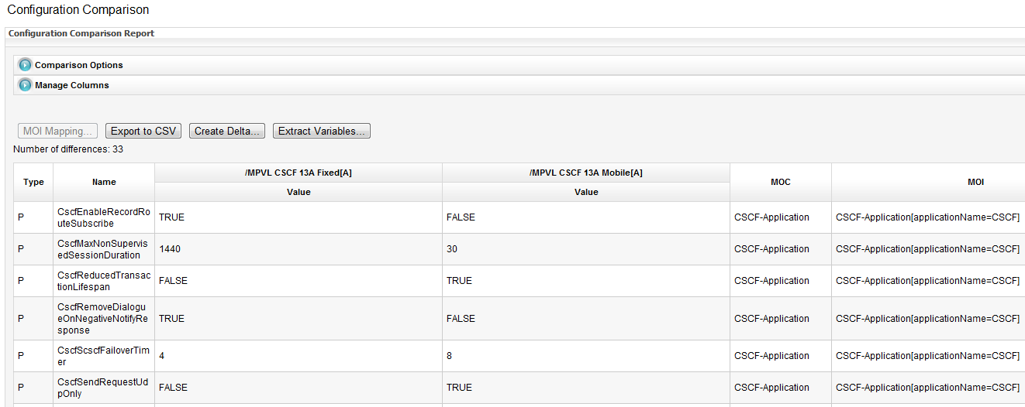
comparison & AUDIT
Use “comparison” functionality to find out how a real node differs from a reference configuration, to compare any two configurations or to audit the same configuration
at different points in time
Compare configurations
from real nodes
Spot differences
and identify patterns
Powerfull
comparison options
Save time and
work efficiently
Notes:
Use “comparison” functionality to find out how a real node differs from a reference configuration, to compare any two configurations or to audit the same configuration
at different points in time

Slide 10
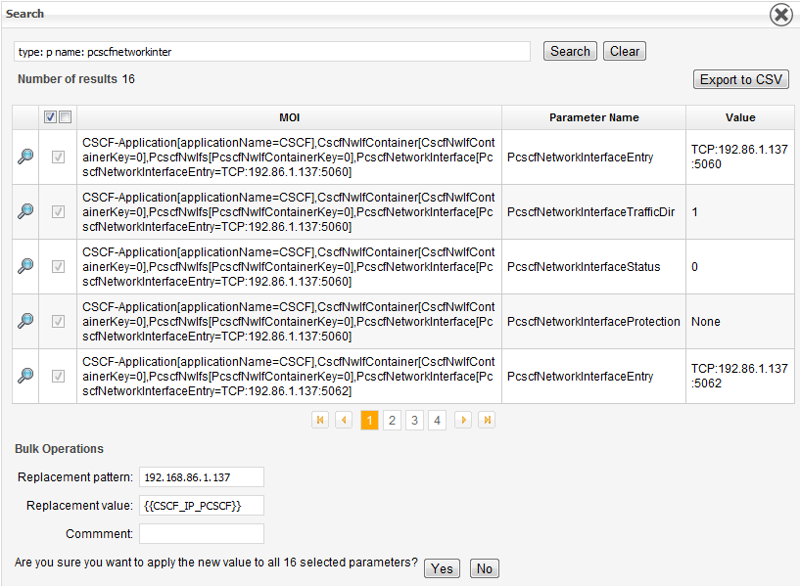
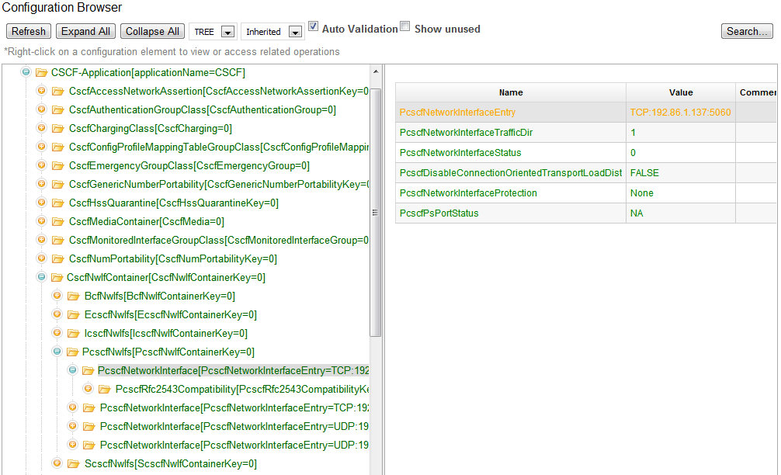
REPLACE VALUES BY VARIABLES
Reference configurations have variables instead of site specific values. This way, the same reference configuration can be used as a template for different real configurations
Create re-usable
configurations
Convert specific values
into variables
Bulk operation
searc & replace
Save time and
work efficiently
Notes:
Reference configurations have variables instead of site specific values. This way, the same reference configuration can be used as a template for different real configurations

Slide 11
Configuration Actors involved
PDB
Applied on…
recommended
config
site specific
values 1
NODE
test lab
The node produces a reference configuration and verifies it in a lab prior to release it
IMS NODE
(development)
I&V takes the reference configuration and customize it for testing different aspects (network integration, characteristics, solutions). PIDS participates in DVA activities and gets acquainted with the installation procedure
custom config
(delta)
site specific
values 2
I&V
test lab
IMS I&V
System Tester
PIDS
Support
custom config
(delta)
site specific
values 3
REGION
test lab
The SA takes the reference configuration and customizes it for a specific operator. Both SA and SI work together to verify in a lab the configuration to be applied on site
REGION
System Integrator
REGION
Solution Architect
site specific
values 4
Once on site, the SI simply configures the node by using the same custom configuration with another set of site specific values
ON SITE!
CUSTOMER
network
REGION
System Integrator
Notes:
1- The node produces a reference configuration and verifies it in a lab prior to release it
2- I&V takes the reference configuration and customize it for testing different aspects (network integration, characteristics, solutions). PIDS participates in DVA activities and gets acquainted with the installation procedure
3- The SA takes the reference configuration and customizes it for a specific operator. Both SA and SI work together to verify in a lab the configuration to be applied on site
4- Once on site, the SI simply configures the node by using the same custom configuration with another set of site specific values

Slide 12
PDB inputs and outputs
The diagram below shows the different formats that are imported and exported by PDB. A schema is the definition of all possible parameters within a configuration. The configuration itself is a set of parameter instances with values. The site specific list contains the mapping of variables and values
Schema definitions
(MIM, MP, others)
Node configurations
(LDIF, NETCONF)
Configuration values
(PVL, CPP_CSV,
LDIF, NETCONF)
SA
PDB
Reports
(CSV, PVL)
Site specific values
(CSV proprietary)
user
Notes:
The diagram below shows the different formats that are imported and exported by PDB. A schema is the definition of all possible parameters within a configuration. The configuration itself is a set of parameter instances with values. The site specific list contains the mapping of variables and values

Slide 13
Architecture and technologies
IceFaces
PDB
PDB
SOAP
EJB
JSF
Java
Application Server
Glassfish
Glassfish
JavaEE
Java
MySQL
JPA
Hibernate
JAXB
Linux/Windows
Linux/Windows
Linux/Windows
Linux / Windows
MySQL
JAX-WS

Slide 14
BENEFITS
One tool and one source for parameter handling
  From development to customer site → same tool and procedure in all phases
  Consistency, traceability
Facilitates deployment of IMS networks
  Based on reference configurations
  Same configuration procedure for all nodes
  Less training, less gurus
Facilitates troubleshooting of IMS networks
  Comparison
  Auditing
Less time, less error prone
  Automated procedure
  Errors are mainly systematic ones
  Configurations can be prepared offsite
Can be used in non-IMS solutions

Slide 15
PDB servers
PDB production server (official)
http://pdb-ims.lab.tn.sw.ericsson.se:8080/pdb
PDB sandbox
http://pdb-sandbox.lab.tn.sw.ericsson.se:8080/pdb

Slide 16
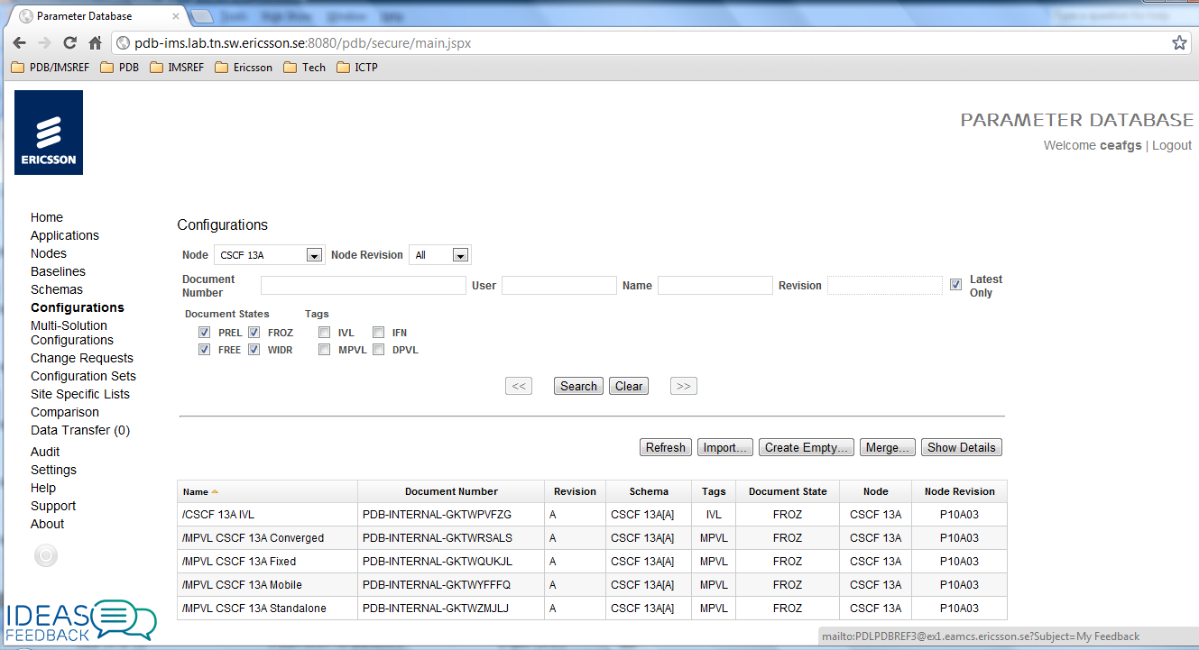
CONTACT US + INFO
Send us an email
Visit our EriCOLL page (docs, deliveries, support)
Click on the “Ideas & Feedback” on the PDB GUI
IMS Ericsson Academy video tutorials

Slide 17


