Slide 1


SIM & RELATED SOFTWARE
OFFER
SIM Cards - Software Tools & Services

Slide 2





Cards - For All Operators’ Needs
Native 2G SIM 8K E²PROM
Java USIM/SIM
64K to 128K E²PROM
with co-processor PK option
Native 2G+ STK SIM 16K, 32K or 64K E²PROM
Native/Java CDMA 32K to 64K E²PROM
Java 2G+ 32K to 128K E²PROM with co-processor PK option
Notes:
Large Offer.
What going on today : most of poeple have native cards
Java is growing
3G cards are ready and CDMA too..
Let’s focus on GemXplore Xpresso cards with 64 K in EEPROM to load your application

Slide 3
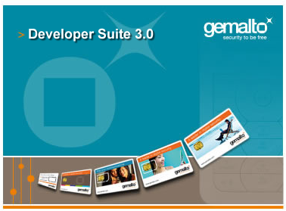


Software – ADMIN, SIMu & DEV Tools

Slide 4
Software - Card Administration Tools Offer
Manage the basics of all 2G & 3G SIM cards
(Native AND Java)
Option: Manage the basics of all CDMA cards
Option: Mobile and OTA platform simulation

Slide 5
Software - Card Administration Tools: This Training Course
Manage the basic of all the 2G SIM cards
(Native AND Java)
Option: Mobile and OTA platform simulation

Slide 6
Other Software Solutions…
Integrated solutions ==>
  OTA Platform (Open solution - VAS delivery)
  Dynamic STK Cards & Gateway (Dynamic STK “browsing”)
Notes:
Sol@: STK applications browsed OTA by SIM
WML server VASs => STK optimized
=> Less SMSs
only Browser in SIM (1st step to WAP)
(WAP needs fast 3GPP-GPRS +
compatible handsets)
GemCast: Extension of GMRM for Applet downloading + Mobile commerce management
SUITE: platform for development, deployment, operation & management of mobile VAS's
Framework to host & add products ("Manager" modules: Card, Channel, Applet… gateway connection or integration of WAP, PKI, Payment modules… email, location server gateways...

Slide 7


How to send data/applications to SIM ?
SMS
Text Messages
Server
Base
Transceiver
Station
"Over The Air"
Data/applications
for SIM
SMSC:
Short Message
Service Center

Slide 8
Value Added Services Platform
To manage card
Service
Providers
OTA Platform
Consumers
To manage application
download OTA, TCP/IP
To manage browsing
applications
DSTK Gateway
Notes:
The 4 modules are connected to a base system defined by the framework. Each module communicates with the others using the same protocol and are centrally administered. They can be selected and added as required. And they can be installed on different sites or different hardware.
Remember: GemXplore Suite is the new generation of platform to replace the GMRM range. GemCast was the old name of the combination of the card manager, channel manager and applet manager.
GemXplore Online, also known as Sol@, is now integrated into the GemXplore Suite offer. Sol@ is the ‘techno’ name (protocol)
GemXplore Online is the killer element of this architecture. By adding the module, Gemplus presents the most complete solution.

Slide 9



How Does DSTK “SIM Browsing” Work ?
Service request
Service response
Content/service
provider
Gateway/platform
SIM card
containing a browser application
SSL
Notes:
SSL : A protocol designed by Netscape Communications to enable encrypted, authenticated communications across the Internet

Slide 10


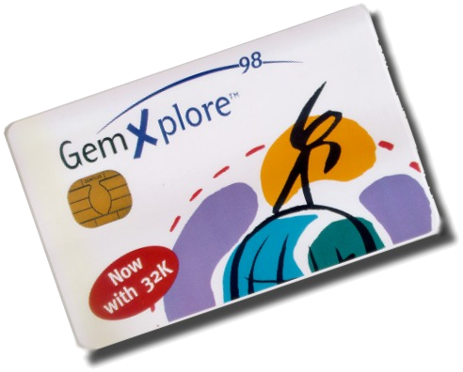
DSTK : Manager/Browser
Internet
content
WML
DSTK Gateway
Platform
S@T
STK Card Browser
Intranet content
WML/STKML
GSM network
OTA platform
S@T protocol
Multitude of Services browsed from a Server, not stored on-Card
SIM Alliance => S@T protocol, dynamic mobile services
Notes:
WML subset in fact, not 100% WML

Slide 11










Global Offer
SIM « Browsing »
DSTK Gateway
OTA download
Internet
OTA Platform
POS
Solution
Card Management
Perso Services
VAS deployment platform
VAS development
Consulting
Project mngt
Applets
portfolio
Partners
Operator
GGS
Application development
Tools

Slide 12
Services Offer
Services Offer
Project Management
Turn-key Project
On-site integration
User Acceptance Test...
Support
Training
Hotline
Consulting
Feasibility Study
Specifications
System
Security schemes
Worldwide support of Smart-card-based Mobile Services
Notes:
Gemplus also offers a wide range of services to support your Java Card project:
- Consultancy,
- Specific developments.
Cf. PSO presentations.

Slide 13
Training Offer
Other Training Courses
  SIM, STK, OTA Basics – SIM / Card ADMIN & SIMu Tool
  Java SIM Card Administration – Java SIM / ADMIN & SIMu Tools
  Java STK Applet Development – Java SIM / ADMIN, SIMu & Dev Tools
  USIM in 3G Networks – USIM /Card ADMIN & SIMu
  Java 3G Card Administration – Java USIM / Admin & SIMu Tools
  OTA Usage, Administration & Development - OTA & DSTK Platform
  DSTK Services Administration & Development - DSTK SDK
  Other Smart-card courses (PKI, Security & Crypto, EMV Payment…)

