Slide 1

UNDERSTANDING
SIM CARDS
Notes:
Now let’us begin by an overview of the SIM card

Slide 2
Summary
Introduction to SIM Cards & Standards
GSM 11.11
Definition
Card architecture
Card life phases
Memory organization
File management
Security features
Special features
Command set
Application file examples
Card configuration
SIM ADMIN Tool - “GemXplorer”
Exercises
Notes:
Regarding the planning of this first part.
First we begin by an introduction of the SIM and its standard.
The name of the standard is GSM 11.11
We are going to detail it and we finish this first part by doing some praticals using the tool developped by Gemplus called GemXplore ADMIN.

Slide 3

INTRODUCTION
TO SIM CARDS
& STANDARDS

Slide 4







The SIM card
 SIM : Subscriber Identity Module
Identity
Security
Services
    User ID
    Phone number
    Location..
    PIN
    Keys
    Phonebook
Basic GSM requirement
    VAS *
  (*Value Added Services)
Notes:
Id
LOCI file contents the temporary IMSI
The coordinate (set of cells) of the network attached by the mobile and used by the mobile to manage the user mobility
Th

Slide 5





GSM Standards
For coherent Communication between
“GSM 11.11”
“GSM 11.14”
Using STK
GSM
“GSM 03.48”
“GSM 03.40”

Slide 6

ETSI: GSM /3GPP
Merge of 2G/3G standards groups
New name for :
  GSM 11.11 standard became
    3GPP TS 51.011
      release 4 for SIM
  GSM 11.14 standard became
    firstly 3GPP TS 51.014
      release 4 for SIM
    now 3GPP TS 31.111
      from release 5 for SIM/USIM
  GSM 03.48 standard becomes
    3GPP TS 23.048
      release 5
Notes:
Just some words about the naming of the standard.
Indeed, ETSI organisation is in charge of the 2G standard maintenance
In fact the names have changed because before it was the ETSI organisation that it was involved of the standard. But with the 3G card apparition, the 3GPP,
11.14 (SAT) applies to GSM only
31.111 (UniversalSAT) applies to 3G only

Slide 7
Evolving GSM standards
Phase 1 to Phase 2: debug to deployment
  GSM 11.11, Basic GSM requirements
Phase 2 to Phase 2+ : enhancement of existing Standards
  GSM 11.14 added, SIM Toolkit for Value Added Services
GSM
phase2 +
X
SIM toolkit
X
O.T.A (ESMS)
GSM phase2
X
GSM phase1
X
88
89
90
91
92
93
94
95
96
97
1998
Notes:
phase 2: GSM 11.11 (final version 4.20.0)
phase 2+: GSM 11.11 and GSM 11.14 (SIM TOOLKIT)
release 96: GSM 11.11 (v 5.x.x) - 11.14 (v 5.y.y)
release 97: (v 6.x.x) (v 6.x.x)
release 98: (v 7.x.x) (v 7.x.x)

Slide 8




Cards - For All Operators’ Needs
Java USIM/SIM 64-256K E²PROM
Phase 2+
Java 2G+ 32 to 128K E²PROM with co-processor PK option
Phase 2
Native 2G+ STK SIM 16K, 32K or 64K E²PROM
Native 2G SIM 8K E²PROM
Notes:
Large Offer.
What going on today : most of poeple have native cards
Java is growing
3G cards are ready and CDMA too..
Let’s focus on GemXplore Xpresso cards with 64 K in EEPROM to load your application
OLD COMMENTS
GX98: In 97: 70 to 80% of the market
phase 2+ introduced with phase 2+ mobile phones also. Can’t run SIM toolkit with phase 2 card.
GXXpresso: phase 2+ compliant
Xplore Xpresso V1 = 23 kB No Garbage Collector
- JCAPI2.1: Source code OK (first SIM card on market)
- VM2.0: Byte code NOK (proprietary compiler...)
- STKAPI1.0:
- No GSM OP loader: wont support OTA, proprietary applet download
Xplore Xpresso V2 = 32 kB Q2 2000 (Q1 protos)
- JCAPI2.1: Source code OK
- VM2.0 ?: Byte code NOK (proprietary compiler...)
- STKAPI2.0: more STK functions (dual subscription…)
- GSM OP loader (Oct99): will support OTA, std applet download
(Xplore Xpresso V3 = 32 - 64 kB) 2001
- JCAPI2.1: Source code OK
- VM2.1: Byte code OK ?
- STKAPI: latest
- GSM OP loader: will support OTA, std applet download

Slide 9
3GPP TS 51.011
(GSM 11.11)
Notes:
VAS & STK

Slide 10

1. DEFINITION
3GPP TS 51.011

Slide 11

51.011 : Basic GSM Requirements
SIM - ME Interface
Physical characteristics of the card
Electrical Communication interface
Card / Mobile Equipment
Logical Data structure
and access
Notes:
Card Formats
ISO 7816-1 format
Plug-in (GSM specific defined in GSM11.11)
Mechanical tolerance
Defined in ISO 7816-1 and 7816-2
Thermal tolerance
Fully operational at -25°C to +70°C
Supports occasional peaks up to +85°C
Operational Interface defined in GSM 11.11
Electrical characteristics defined in ISO 7816-3
Communication protocol: T=0 (ISO 7816-3 compatible)
GSM operational instruction set (ETSI/TE9 compatible)

Slide 12
Data Structure/Access Specifications
Data management
  File types
  File selection
  Accessing data in a file
  File contents
Security features
  Algorithms and processes
  File access conditions
File management and the security features are defined in GSM 11.11

Slide 13

2 - CARD
ARCHITECTURE

Slide 14
Focus on the User's Memory
Data Bus
micro
ROM
(O.S.)
Vcc
Ground
processor
EEPROM
RAM
Reset
NC
Clock
I/O
Address Bus
Master
File
64-128 kBytes
of EEPROM
DF
DF
Data
file
Data
file
gsm
Telecom
Data
file
Data
file
Data
file
Data
file
...
...
...
Notes:
ROM RAM E2PROM
Phase1 6 KB 256 B 2/3K
Phase2 16 KB 256 B 8/16K
Phase2+ 32 KB 1 KB 16/32K
µProcessor (Xpl98) = 8 bit

Slide 15
Focus on the Operating System
micro
ROM
(O.S.)
Vcc
Ground
processor
EEPROM
RAM
Reset
NC
Clock
I/O
Remote access APDU
commands
Patches
STK
applications
Filters
Native Code
Java Code
GSM files
STK code and data
OTA Layer
Interpreter
Local access
APDU
Operating System
Notes:
Filter: OS modif written in Native 'C' code
Patch: OS modif written in Java code
(Parts of OS developed in Java, parts in 'C')
Patch method Ex: APDU command
Filter custom algo
STK bytecode: java compiled for javacard
OS proprietary G+
VM proprietary following SUN specs

Slide 16
File Definition
The card is divided into files
  MF (Master File): the root of the file structure.
  Serving the function of a root directory
  DF (Dedicated File): a file containing other data files Serving the function of a directory
  Each DF will behave like a separate application
  EF (Elementary File) : a file containing data
  Serving the function of a file
EF's are "Children" of their "Parent" Directory

Slide 17
Typical SIM Card Organization
MF
MF
Level 0
DF
EF
DF
DF
DF
EF
EF
EF
Level 1
EF
gsm
Telecom
EF
EF
EF
EF
EF
EF
EF
EF

Slide 18
Multi-level Structure
MF
Level 0
GSM
application
DFs
DF
EF
EF
EF
Level 1
DF
EF
EF
EF
gsm
Telecom
Chv1
Chv1
Chv2
Chv2
EF
EF
EF
EF
EF
DF
EF
EF
EF
EF
EF
Level 2
...
...
Ex: Satellite or PCS
application DF
EF
DF
Level 3
EF
Up to 3 DF levels are allowed under the MF
Notes:
Under DF gsm : DF pcs(1900) Level2
DF satellite(Irridium,globalstar…)
Defined in GSM11.11
Level 3 Rare

Slide 19
File Identification
File identifiers: 2 bytes long
GSM 11.11 imposes :
  MF 3F00
    EF's underneath = 2Fxx
    DF 7Fxx
      EF's underneath= 6Fxx
      DF 5Fxx
        EF's under. = 4Fxx
        DF xxyy
        EF's under. = xxyy
ETSI - TE9 standard allows xxyy
Example:
  Secret code CHV1
    Id = 0000
  Secret code CHV2
    Id = 0100
Codes and key file identifiers follow TE9
0
1
2
3
TE9 = Administrative Commands & Management around GSM
Notes:
Identification conflicts are avoided

Slide 20
File Identifiers
Level 0
MF
3F 00
GSM
application
DFs
Level 1
DF
DF
EF
EF
EF
7F20
7F10
00 00
0100
2Fxx
Chv1
Chv1
Chv2
Chv2
Level 2
DF
EF
EF
EF
EF
EF
...
5Fxx
6Fxx
6Fxx
6Fxx
6Fxx
6Fxx
...
Ex: Satellite or PCS
application DF
Level 3
EF
DF
4Fxx
xxyy
EF
GSM / TE9 file identification
xxyy

Slide 21

3. CARD LIFE PHASES

Slide 22

SIM Card Life Phases
Chip Manufacturing
OS, chip n°
Initialization
Patches, Filters
Personalization
Files & applications
Application phase
User Data
Post personalization phase
Files, applications

Slide 23
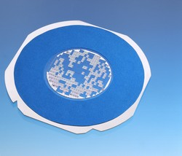




Data Loading
Chip
manufacturing
Card
manufacturing
Memory
initialization
Personalization
Application
Silicon wafer
Root directory
GSM files
Specific files
Operator Data:
IMSI, Ki ...
OS coded
in ROM
Chip number
Card serial number
Filters/Patches
Subscriber data:
phone numbers.
Post Perso OTA
Chip data
Card data
Network data
Subscriber data

Slide 24

4. MEMORY
ORGANIZATION

Slide 25

Elementary File Structures
Transparent ("binary") files
Record-oriented files:
  Linear Fixed-Length Records
  Cyclic
Notes:
Set of data units or records which share the same file identifier. An EF cannot be the parent of another file. There are four types of EFs:
-Transparent EFs (previously called a binary data field), where data can be manipulated in strings of bytes of variable length (maximum length is 256 bytes long), located anywhere within the EF.
-Linear Fixed EFs (previously called a formatted data field), where the data is stored in series of strings of fixed length called records. Linear fixed EFs offer more extensive data addressing possibilities than transparent EFs.
-Cyclic EFs are composed of fixed-length records The length is determined when the file is created and is stored in the file descriptor. Records are referenced in the inverse order of creation so that the last record to be written is always record number 1. When the file is full, the oldest record is replaced by the new record.
-Script files are similar to transparent EFs except that they contain executable code

Slide 26
File Implementation
EF Descriptor :
  EF features
  (structure, attributes)
DF Descriptor :
  DF and child EF features
  (structure, attributes)
EF DESCRIPTOR
(20 Bytes : Transparent)
DF DESCRIPTOR (20 Bytes)
(20 Bytes : Linear Fixed)
(20 Bytes : Cyclic)
(4 Bytes : Extensions to files)
BODY
[stored data] mod4
BODY : Cyclic
[stored data + 1] mod4
Descriptor :
all information that can be used during file management
Body :
block of application data
The DF descriptor contains attributes of its EF children
and the EF descriptor contains its own attributes

Slide 27
Mapping
System area
The chronological order of file creation starts from the beginning of the memory
MF
EF1 Descriptor (MF child)
EF1 Body
DF1
EF2 Descriptor (DF1 child)
EF2 Body
EEPROM
32/64 kBytes
EF3 Descriptor (MF child)
Files can be deleted anywhere in the memory
Freed space can be re-allocated by the Operating System with
fragmentation management
EF3 Body
DF2
EF4 Descriptor (DF2 child)
EF4 Body
Backup area

Slide 28
System Area
System area
MF
Operating system information
  Chip serial number
  Manufacturer transport key
  LOCK information
  Internal filter addresses
  Configuration of backup area
  No access after personalization
EF1 Descriptor (MF child)
EF1 Body
DF1
EF2 Descriptor (DF1 child)
EF2 Body
EF3 Descriptor (MF child)
EF3 Body
DF2
EF4 Descriptor (DF1 child)
EF4 Body
Backup area
Notes:
~ 100 bytes of EEPROM
Flag used by the operating system. This flag is required when the personalization process includes a pre-personalization step.Pre-personalization is an intermediate personalization step used when the final part of the personalization process is performed by the customer. In this case two flags are used: bissuer and bappli (bissuer being set after pre-personalization and bappli after final personalization).When bappli is set, the system memory is definitively locked (that is, cannot be accessed by either physical or logical memory management commands).When their is no pre-personalization step (that is, when the whole personalization process is performed by Gemplus) the bappli flag is set at the same time as the bissuer flag.

Slide 29
Backup Area
System area
MF
Managed by OS
  Backup all sensitive data
    Descriptors, secret codes...
    Fields updated via ESMS
  Data restore after a power failure
EF1 Descriptor (MF child)
EF1 Body
DF1
EF2 Descriptor (DF1 child)
EF2 Body
EF3 Descriptor (MF child)
EF3 Body
DF2
EF4 Descriptor (DF1 child)
EF4 Body
Backup mechanism automatically managed by OS
Backup area
Notes:
~ 250 bytes of EEPROM
depending on Chip Type

Slide 30

5. FILE
MANAGEMENT

Slide 31
File selection
MF
MF
DF1
DF2
EF1
MF is selected by default
File selection using the SELECT command
  using 2-Byte File Identifier (GSM 11.11)
  Selecting the MF or a DF sets the "current" directory (no current EF)
  Selecting an EF sets the "current" EF (must be a "child" of the current directory)
  Following access rules
DF3
EF
EF3
EF
EF2
EF4
EF5
Last selected file
Valid selections
MF (no EF)
DF1, DF2, EF1
DF1 (no EF)
MF, DF2, DF3, EF2
DF2 (no EF)
MF, DF1, EF3, EF4
DF3 (no EF)
MF, DF1, EF5
(MF) EF1
MF, DF1, DF2
  ------>
(DF1) EF2
MF, DF1, DF3, DF2
(DF2) EF3
MF, DF1, DF2, EF4
(DF2) EF4
MF, DF1, DF2, EF3
(DF3) EF5
MF, DF3, DF1
Notes:
Child number Select mode also possible

Slide 32
File information
GET RESPONSE & GET FILE INFO
Get Response
  GSM 11.11 related information on an EF or DF
    access conditions, record length...
Get File Info
  GSM application & additional administrative information on an EF or DF
    specific secret code, secret key info...
Commands which can be issued after a SELECT

Slide 33

Transparent EF File
Binary files containing data
Example in GSM configuration :
  EFicc-id with 2FE2 identifier
  Contains unique value
  of SIM Serial Number
This file type allows data storage with no specific formatting

Slide 34
Creation of transparent EF
The length (nbr. of bytes) of the body is defined at creation. This information is then stored in the file descriptor
  CREATE FILE command File type is defined at creation (Transparent, cyclic...)
  Default contents = 00…00
Descriptor
EF data structure
Body
Block of bytes
File body size is coded on 2 Bytes for
Transparent EFs

Slide 35
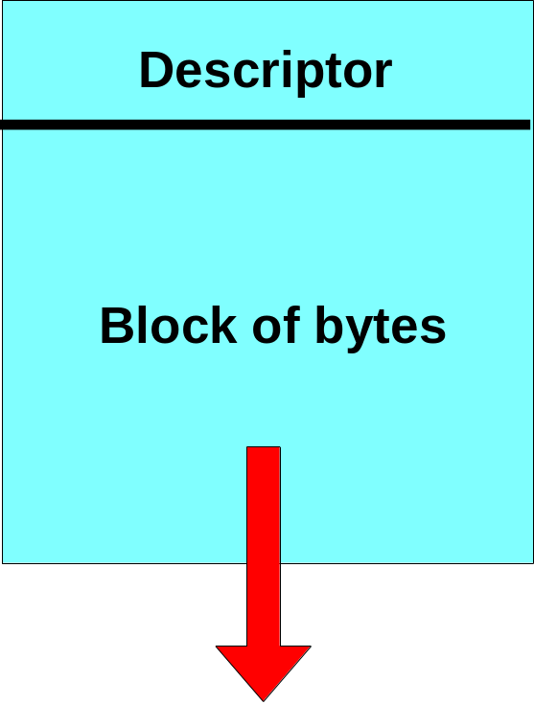
Extending transparent EF
Extend the length of the body using EXTEND command
The extension will have the same attributes as those in the descriptor
EXTEND command can be carried out more than once with different sizes.
Up to 255 bytes can be added during each extension

Slide 36
Accessing Transparent
File Data
Access Commands :
  READ BINARY
  UPDATE BINARY
Indication of the relative address
  Offset in bytes (start position)
  Number of bytes to be read
  or updated
00 00
00 12
9 bytes
The offset and length parameters
are sent with each access command

Slide 37
Linear Fixed File
The file is divided into
several equal-length records
Ex: in a GSM configuration
  EFadn with 6F3A identifier under DFtelecom
  Series of stored phone numbers accessible by the subscriber
Record file
Up to
255 records
Up to 255 bytes
This file type allows repetitive data to be stored

Slide 38
Creation of Linear Fixed File
File creation:
  CREATE FILE command:
    File type (linear fixed)
    Attributes stored in the descriptor
    Records are created with
    default value FF…FF
Descriptor
EF data structure
Record#1
Record#2
Record#3
Body
255 records max
Record#P
extensions included
Last record
A linear fixed file contains a series of fixed-length records

Slide 39
Extending Linear Fixed EF
Extending the body to create new
fixed-length records
EXTEND command
  Extension with the same conditions
  as those defined in the descriptor
  Extension size = number of records
  Default value FF… is loaded in each record
Extension limited up to 254 records
EF descriptor
Record#
1
Record#
2
Record#
3
Record#
P
Last record

Slide 40
Accessing Data
Access commands :
  READ RECORD
  UPDATE RECORD
With absolute addressing :
  Record number
  Current record pointer is not modified
With relative addressing :
  First, last, previous, current or next mode.Current record pointer is updated
#1
first record
previous record
current record
next record
#n
last record
Updating/Reading the entire record with no offset

Slide 41
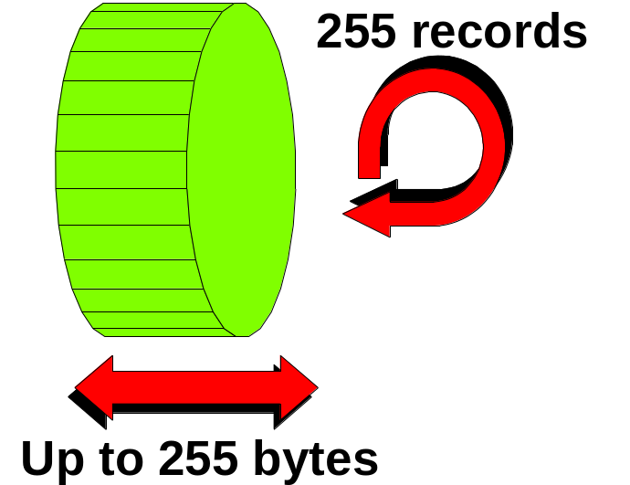
Cyclic File EF
Cyclic file is used to keep track of data in chronological order
Ex: in GSM application
  EFlnd with the 6F44 identifier
  under the DFtelecom
  Last 5 telephone numbers dialled
  are stored in chronological order
Data is stored in equal-length records

Slide 42
Creating Cyclic EFs
CREATE FILE command:
  Type of file (cyclic), attributes stored
  in descriptor (No. of records)
  Records are created inside the file with
  default value FF…FF
A cyclic EF can contain up to 255 records
No record may be longer than 255 bytes
The last created record is contiguous with the first record created
Descriptor
EF data structure
Last record
First record
Body
created
created
A cyclic file cannot be extended

Slide 43
Accessing Data
Descriptor
EF data structure
READ RECORD Command
Addressing mode:
  Absolute addressing
    Record number
  Relative mode:
    First, last, previous,
    next, current
Body
Oldest record
Last written record
= record #N
= record #1
Current record
= record #1
When a Cyclic EF is selected, the current record
is record #1 and is the last written record

Slide 44
Accessing Data
UPDATE RECORD command
Addressing mode:
  Relative mode / previous
The INCREASE command :
  The increase value is added to
  last written record value and
  result overwrites oldest written record => becomes #1
  Ex: EF acm, call time is added to
  current accumulated call value,
  new value becomes current record
EF data structure
Oldest record
= record #N
Last written record
Previous
Current record
now = #2
= record #1
Current record
= record #1
Notes:
#1 current value
#1 previous value
#1 ...

Slide 45
Accessing Data in a Linear fixed or cyclic EF (SEEK)
SEEK command:
  Search for a character string pattern (up to 255 bytes long)
  This string is stored at the beginning of a record
  Current record pointer is updated if the Seek command is successful

Slide 46
Memory management (DELETE)
Files can be deleted anywhere in the SIM
  regardless of their creation order
  deleting a DF will delete all files belonging to this DF
Free memory can be used again
  for creating new DFs or EFs
  fragmentation is managed...
  ...automatically by OS

Slide 47

6. Security
Features

Slide 48


Secret Codes and Keys
Secret Code: Presented to the card to access a file
  access right is granted upon successful presentation
Secret Key:
  Used by a cryptographic algorithm for Certificate computation or Ciphering of data
  Used by the card and the network to perform the Authentication process

Slide 49
Security Elements
Secret codes are stored in the card
  CHV1 and CHV2 (also called PIN)
  4 administrative secret codes: ADM0 ... ADM3
Secret key is stored and protected in the card to perform:
  Internal authentication
Algorithm
Chv1
Chv2
ADM...

Slide 50


Authentication Concepts
Hello I’m IMSI N°XXX give me a GSM access !
Identity
IMSI = France/Operator/David
Hello Card Please show me that you know the secret key to connect
Authentication
PIN CODE & KEY
Here you are !
Enter PIN code :
----
Hello User show me that you know the secret code to access GSM
Notes:
Run GSM Algo = Internal Authenticate command with key number in command fixed to #0

Slide 51

Internal
Authentication
Network

Slide 52
Internal Authentication Parameters
The network verifies that the card belongs to a GSM application
A unique IMSI/Ki per subscriber
Ki is stored in the AUC
The network generates Rnd
MSC
HLR
AUC
Network protection
against conterfeited cards
HOME PLMN
IMSI
Rnd
Ki
SIM
Notes:
International Mobile Subscriber Identity. GSM subscribers are identified by a unique IMSI code which is an individual number permanently assigned to the subscriber. The IMSI code allows the system to identify the country and home PLMN of the user

Slide 53

Authentication Mechanism
HLR
AUC
SIM
IMSI
IMSI
PIN
Network
Rnd
KI
KI
Rnd
Rnd
A3
A3
SIM Result
Network
Result
=?
Result
A3 usually coupled with A8 in one single Algorithm
Notes:
Run GSM Algo = Internal Authenticate command with key number in command fixed to #0

Slide 54

Communication Ciphering
Ki
Rnd
Ki
Rnd
A8
A8
Encrypted Voice
Kc
Channel
Kc
A5
A5
A5 is supplied by the mobile handset

Slide 55
Data Inside the SIM Card
128-bit random number is sent by the network
Ki key referenced by Run GSM Algo command
A3 / A8 algorithm gives :
  a 32-bit authentication value SRES, used by the network to authenticate the SIM
  A 64-bit session key Kc, used by the mobile equipment to cipher the communication
A3 / A8 = Result compatible with Comp128 algorithm defined by the MOU (Memorandum Of Understanding)
Notes:
Run GSM Algo command = Int Auth cmd with
key number fixed to # 0
Signed RESponse. The Signed Response is a four-byte signature computed by the authentication algorithm (A3) using a random number (RAND) and the secret key (Ki) as inputs. The SRES is computed in the Mobile Station's SIM, and returned the originator of the random number for comparison with a value computed locally.

Slide 56
Internal Authentication Algorithms
XOR / Comp 128-v1 / Comp 128-v2 / Comp 128-v3 (v4 – AES option)
  Comp 128 issued by GSM MoU
Custom Algorithms possible
  Filter implementation
Authentication counter mechanism available
to increase security
Notes:
DPA = Differential Power Analysis
COMP128-1 and 2 on card.
DES/3DES reserved for OTA purposes. In key sets
G+ look towards future: Proprietary algos are Stronger
(Algos = GSM 03.20)

Slide 57
Protection of Data
Inside the Card

Slide 58

Definitions
Each DF and EF supports several commands divided into 6 groups
Command execution is protected by access conditions
There are 8 different access conditions
Each command for a given file is protected
by a given access conditions

Slide 59
File Security Management
DF
EF
Group 1
RFU
Read / Seek
Group 2
RFU
Update
Group 3
Delete
Increase (Cyclic)
Group 4
Create / Extend
RFU
Group 5
RFU
Rehabilitate
Group 6
RFU
Invalidate
Groups 3 and 4 of a DF govern the management of its child EFs

Slide 60
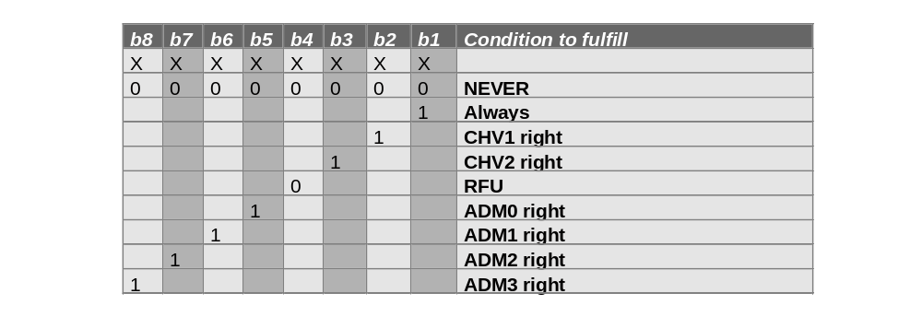
Access Conditions
Condition(s) which must be fulfilled to grant the right to perform an action on a file
The rights granted during a session are valid until the end of the session
GSM 11.11
Proprietary
Each command group can be protected
by a specific secret code
Notes:
0x12 = CHV1 ou ADM0
Create File => APDU data field
contains 6 bytes, 1 for each
command group

Slide 61
Organization of Command Protection
Example of protection
  Deletion of EF under DF protected by ADM1
  Read of EF protected by CHV1
Access
command
conditions
groups
__
RFU
__
RFU
20h ADM1
Delete
DF
20h ADM1
Create/Extend
__
RFU
__
RFU
Access
command
conditions
groups
12h CHV1 or ADM0
Read/Seek
20h ADM1
Update
00h never
Increase
EF
00h never
RFU
20h ADM1
Rehabilitate
20h ADM1
Invalidate

Slide 62
Secret Code EFs
Secret codes may be stored in a Transparent EF
with identifiers:
...PIN codes...
...Administrative codes...
EF
CHV1
EF
CHV2
EF
ADM0
EF
ADM1
EF
ADM2
EF
ADM3
0000
0100
1000
1001
1002
1003
Identifiers are defined in the TE9 standard

Slide 63
Secret Code EF Data Structure
Byte Nb
Description
Length
1
Activation byte
1
2
Presentation type
1
3
RFU (CHV) / AC0 (ADM)
1
4 - 11
Secret Code value
8
12
Maximum ratification number
1
13
Ratification counter (SC)
1
14 - 21
Unblock Secret Code value
8
22
Ratification counter (USC)
1
23
Unblock mechanism counter
1
Notes:
Byte in descriptor at file creation, specifies if the Enable / Disable function is allowed
(only for CHV1, GSM 11.11)

Slide 64
Description of EF Secret Codes
Activation byte
Code enabled / disabled
Presentation type
BCD (Binary Coded Decimal)
or Alphanumeric
Secret code value
8-byte length
Max. ratification number
Defines the maximum number
of incorrect code presentations
Ratification counter
Remaining number of incorrect
code presentations
Unblocking secret code value
8-byte length to unblock a code
Ratification counter
Remaining number of incorrect
presentations of unblocking code
Unblock mechanism counter
Decremented each time the
unblocking procedure is used
Notes:
Activation byte for CHV1 only (GSM11.11)
Ratif counter PUK = 10 at perso,
can be set to other value

Slide 65
Secret Code Commands
Commands attached to secret codes :
  Verify CHV / ADM
  Change CHV / ADM
  Disable CHV / ADM
  Enable CHV / ADM
  Unblock CHV / ADM
Secret code number and secret code value must be specified with the command
    Commands available for CHV and ADM codes

Slide 66
Dedicated Rights
An ADM code can be used to grant other rights than its own (ADM0 to ADM3, CHV1 and CHV2)
Features of a EF ADM file:
  Configuration of rights in the AC0 byte
  One AC0 byte per ADM file
Storage of these parameters in the EF ADM body
Granted rights:
8
7
6
5
4
3
2
ADM3
ADM2
ADM1
ADM0
RFU
CHV2
CHV1
AC0 byte
This byte indicates the rights that are granted
when the ADM is correctly verified.

Slide 67
Secret Key Files
A Key file is a Transparent EF with a specific structure
  one key file which stores 1 Internal Authentication key (Ki)
  "Ki", used by the network to authenticate a card
Within a key file, only 3 commands are available:
  Update
  Invalidate
  Rehabilitate
Ki is stored in an EF key file under the MF

Slide 68
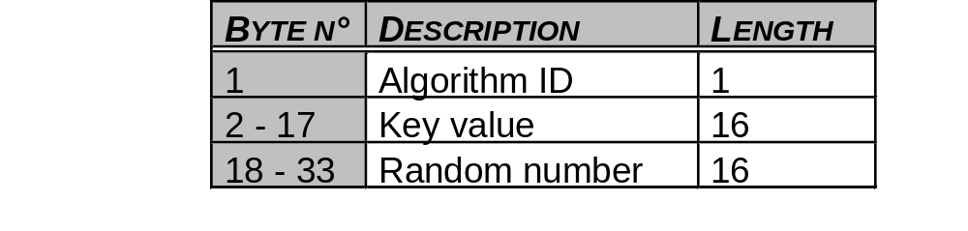
Secret Key EF Structure
Algorithms
  XOR (41h)
  COMP128-1 (40h)
  COMP128-2 (F8h)
  COMP128-3 (44h)
  COMP128-4 option
Random Number
  COMP128-2 algorithm
  random number used to
  encrypt key (XOR).
  Others cases this field is RFU
Secret key EF structure
Notes:
The key value is encrypted by performing a byte by byte XOR with the following random number value only in comp128-2 algorithm case. In the others cases (comp128-1 and xor algorithm) the key is NOT encrypted

Slide 69

7. SPECIAL
FEATURES

Slide 70
Changing Protocol Speed
PPS: Protocol Parameter Selection mechanism:
  procedure described in GSM 11.11 for enhancing speed (9 600 to 230 400 Baud) between mobile handset and SIM after ATR
High-speed exchanges between a card and a terminal
Notes:
PTS: negociation between ME & SIM after ATR (indicates if SIM supports PTS)
Sw Pro: Command usuable at any time (Perso)

Slide 71
Security of Keys
It is possible to set a counter to limit the number of Internal Authentication commands performed during the life of the SIM card
This 3 Bytes counter is stored in the EFauthcount file (6F1F) stored under the MF
It is decreased upon each internal authentication command
When Counter reaches 0 ,
Internal Authentication is no longer allowed

Slide 72
FDN Mechanism
FDN : Fixed Dialling Number
ADN : Abbreviated Dialling Number
At power on, if FDN enabled
(ADN invalidated),
OS automatically invalidates
EFimsi and EFloci files
Two commands
  Invalidate
  Rehabilitate
Invalidated ADN =
Card in FDN mode
ADN or other phone n°
FDN phone n°
Mechanism forbids use of a GemXplore card in FDN mode
with Phase 1 mobiles
Notes:
Phase 1 mobiles don’t support rehab/invald cmds

Slide 73
8. COMMAND SET

Slide 74

GSM COMMANDS

Slide 75
GSM Command Set
FILE MANAGEMENT
SECURITY MANAGEMENT
Verify CHV/ADM
Change CHV/ADM
Disable CHV/ADM
Enable CHV/ADM
Unblock CHV/ADM
Run GSM Algorithm
(Internal Authentication)
Invalidate
Rehabilitate
Select
Status
Get Response
Sleep (phase 1 ME)
Read Binary
Update Binary
Read Record
Update Record (Enhanced)
Seek
Increase
SPECIFIC MECHANISM
MANAGEMENT
Commands defined by GSM11.11 standard

Slide 76
9. APPLICATION FILE
Examples

Slide 77
EF IMSI
Function
Description
DFgsm
Identifier
6F07
7F20
Type
Transparent EF
File size
9 bytes
EF
Number of records
----
6F07
6F07
. . . . .
Valid command (cyclic EF)
----
imsi
Access conditions
Read
CHV1
Update
ADM1
Subscriber
RFU
-
number
RFU
-
Rehabilitate
CHV1
Invalidate
ADM1
. . . . . .
Value
Given by the operator

Slide 78
EF CHV1
Function
Description
Identifier
0000
Type
Transparent EF
MF
File size
23 bytes
3F 00
:
Access conditions
Read
ADM1
EF
Update
ADM1
0000
RFU
-
CHV 1
RFU
-
Rehabilitate
ADM1
Invalidate
ADM1
Pin codes
Disable function
Allowed
Change function
Allowed
Level granted
----
PIN code, PUK code values, Ratification counter...

Slide 79
EF ADN
Function
Description
Identifier
6F3A
DF Telecom
Type
Linear fixed EF
7F10
Record length
28 bytes
Number of records
50
EF
Valid command (cyclic EF)
----
6F3A
Access conditions
ADN
Read
CHV1
Update
CHV1
RFU
-
RFU
-
Phone
Rehabilitate
CHV2
number list
Invalidate
CHV2
Readable when invalidated
No
Invalidated when created
No
Value
«
FFF....FFF
»
Notes:
Length of ADN record = 28:
Tag <= 14 (X)
Length of Number = 1 (TON_NPI + Num)
TON_NPI = 1
Number <= 10 (BCD=20 digits)
(EXT1 file ID) =1 (FF)
(CCP config) =1 (FF)
GSM 11.11 => Tag length variable (Get Response enables mobile to get Record length)

Slide 80

10. CARD
CONFIGURATION

Slide 81
Standard Structure
MF
3F 00
EF
Files
. . . .
DF
. . . .
GSM
7F20
DF
. . . .
Telecom
7F10
Structure fully compliant with the standard

Slide 82
File Description
(Extract)
MF
MF
3F 00
3F 00
EF
EF
EF
EF
EF
EF
0000
0100
1001
1004
2FE2
0001
. . . . . .
CHV1
CHV2
ADM1
ADM3
Icc-id
Ki
PIN codes
Administrative
code
Manufacturer
code
Key file
Operator
Serial number

Slide 83
GSM DF Description (I)
(Extract)
DFgsm
DFgsm
7F20
7F20
EF
EF
EF
EF
EF
EF
EF
EF
EF
. . .
6F05
6F07
6F20
6F30
6F31
6F37
6F38
6F39
6F41
lp
hplmn
lp
imsi
hplmn
acmm
acm
imsi
kc
plmn
acmm
sst
acm
puct
kc
plmn
sst
puct
Language list
Subscriber
number
Ciphered key
Price per
Unit and
Currency
Table
Network choice
Used units
Connection delay
before initial network connection
Active services
. . . . . .
. . . . . .
Balance (units)
DF GSM contains network data

Slide 84
GSM DF Description (II)
(Extract)
DFgsm
DFgsm
7F20
7F20
EF
EF
EF
EF
EF
EF
EF
EF
. . .
6F45
6F74
6F78
6F7B
6F7E
6FAD
6FAE
6FAE
cbmi
loci
cbmi
bcch
loci
ad
bcch
acc
fplmn
ad
phase
acc
fplmn
phase
Network
messages
Frequency
recording
Network access
class
Network choice
Subscriber
Card version
location
phase 1/2/2+
Information about
card operation
mode
Notes:
EF phase 00 = Phase 1
02 = Phase 2
03 = Phase 2 + Profile Download
> 03 = Min " "

Slide 85
TELECOM DF Description
(Extract)
DFtelecom
DFtelecom
7F10
7F10
EF
EF
EF
EF
EF
EF
EF
EF
EF
EF
. . .
6F3A
6F3B
6F3C
6F3D
6F40
6F42
6F43
6F44
6F4A
6F4B
adn
sms
ccp
adn
msisdn
fdn
msisdn
smsp
fdn
smsp
smss
ext1
ext2
smss
lnd
ext1
ext2
Abbreviated
dialling number
Fixed dialling
Phone number
number
Fax
list extension
Fax
Last dialling
Short messages to
configuration
configuration
Message
number
exchange from a
mobile to an other
number
Subscriber's mobile
phone number
phone number
Recording
parameters
Telecom DF contains subscriber services
Notes:
CCP:This string defines the parameters of the bearer capabilities required and the mobile equipment settings for calls established using an abbreviated dialing number, a fixed dialing number, an MSISDN, a last number dialed, a service dialing number or a barred dialing number.The purpose of the bearer capability information element is to request a particular bearer service to be provided by the network. This indication is carried by certain connection control messages (that is, basically messages used during the call set-up phase and those used during the established connection). The contents of the bearer capability information element field is described in detail in GSM 07.01 and examples of bearer capability information element coding are given in Annex D of GSM 04.08.

Slide 86

Manage the basic of all 2G SIM cards
(Native AND Java)
11. Card
ADMIN
Tool
“GemXplorer”

Slide 87
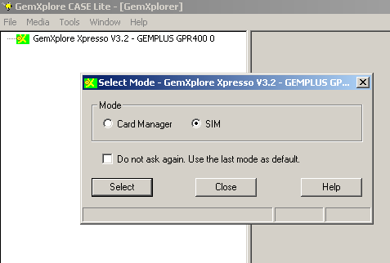
SIM Card
Content Management Modes
Card ADMIN enables you to:
    Manage GSM files => SIM Mode
    Manage STK applets => Card Manager Mode

Slide 88
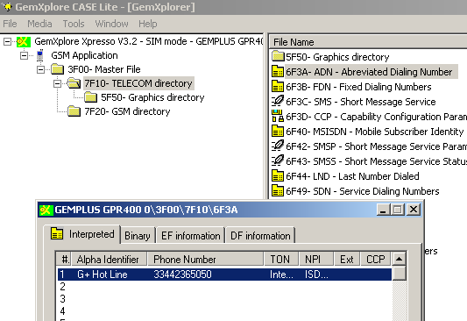
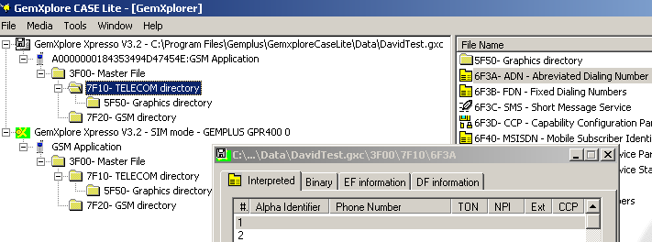
GemXplorer – SIM Mode
SIM File Explorer
    Explore real card
    content
    Manage GSM file system
Additional tools (1)
    Trace and replay options
    Copy card files
    to image file
Notes:
Classes in card (not accessible), can’t easily debug
(Exception management code, or DisplayTexts viewed using ADT)
Card simulator will allow break points etc, easier debug

Slide 89
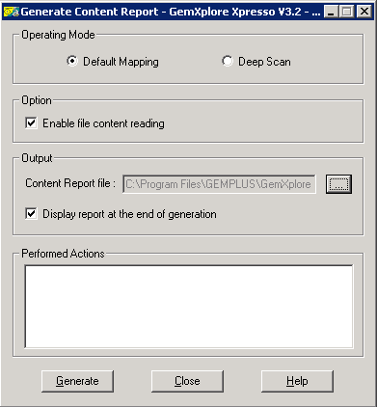
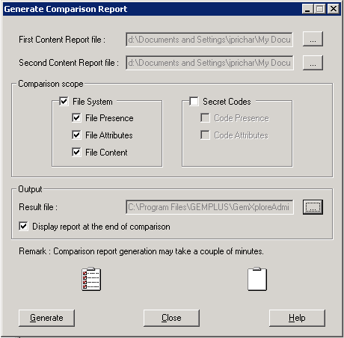
GemXplorer – SIM Mode
Additional tools (2)
    Card Content Report Generation
      HTML report format of
      SIM files & content
    Comparison of 2 Content Reports
Notes:
Classes in card (not accessible), can’t easily debug
(Exception management code, or DisplayTexts viewed using ADT)
Card simulator will allow break points etc, easier debug

Slide 90
GemXplorer – SIM Mode
Additional tools (3)
    “Card Typing” to scan non-Gemalto cards…
User enters other manufacturer cards specificities (Proprietary Files & Commands)
Each specificity parameterized is retrieved from one card insertion to the other
Each card parameterization is retrieved from one card generation to the other
Notes:
Classes in card (not accessible), can’t easily debug
(Exception management code, or DisplayTexts viewed using ADT)
Card simulator will allow break points etc, easier debug

Slide 91
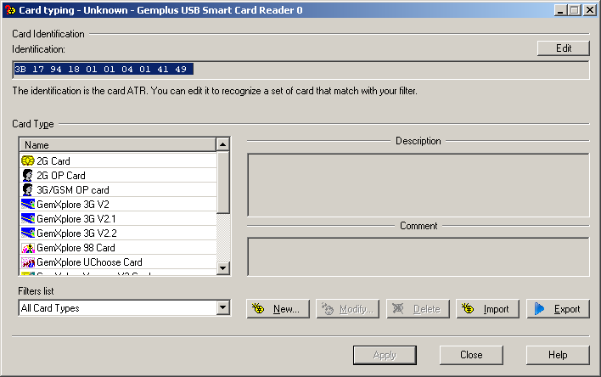
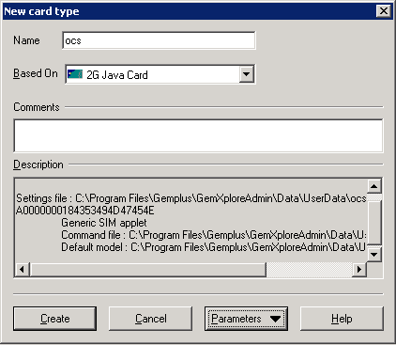

How To Define a New CARD TYPE
1. A given card is typed according to its ATR
With a Name
2 bis. Or the user has the possibility to define a custom type
Reusing an existing type
With a dedicated default mapping and a dedicated set of command
2. When a type is selected all the properties are associated to the card ATR

Slide 92
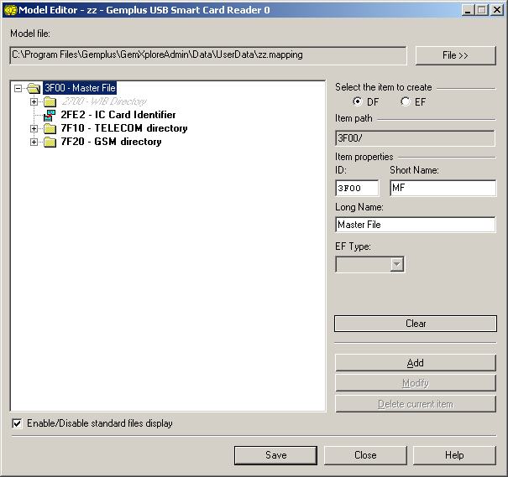
How To Access Proprietary FILES
PROPRIETARY FILES ARE SUPPORTED EDITING THE TYPE DEFAULT MAPPING
The user has the possibility to add either an EF or a DF in the default mapping
Once an EF/DF is added in the Default Mapping it appears in the GemXplorer only if it is present on the card
Specifying:
The ID
A short logical name
A long logical name
A Structure (for EF only)

Slide 93
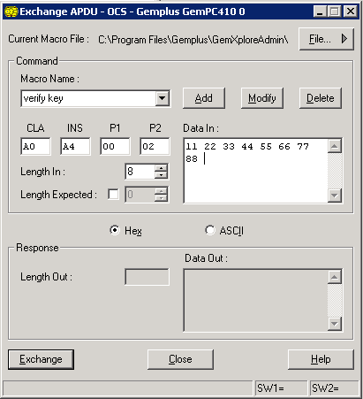
How To Run Proprietary APDU
3. And add it in the type command file
PROPRIETARY COMMANDS ARE SUPPORTED ADDING APDU IN THE TYPE COMMAND FILE
1. The user enters a new command name
2. Specifying the new command syntax

Slide 94
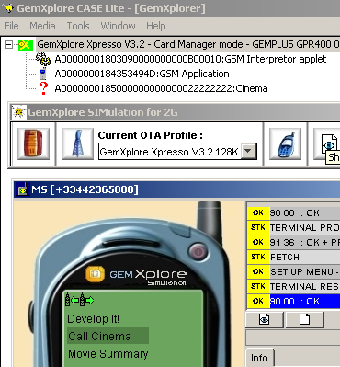
GemXplorer – Card Manager Mode
Java SIM Applet Explorer
    Explore card
    Application content
    Manage (STK) Applet
    Load/Install/Delete…
Additional tools
    Test STK services with
    GemXplore SIMulation for 2G option (Mobile Phone Simulator…)
Notes:
Classes in card (not accessible), can’t easily debug
(Exception management code, or DisplayTexts viewed using ADT)
Card simulator will allow break points etc, easier debug

Slide 95
12. “GemXplorer”
Demo & Practical Exercises

